Slide 1
Daily Market Report
Trade Date: 2026-06-11
JPX Derivative & Commodity Analytics
DataServer In-House

Slide 2
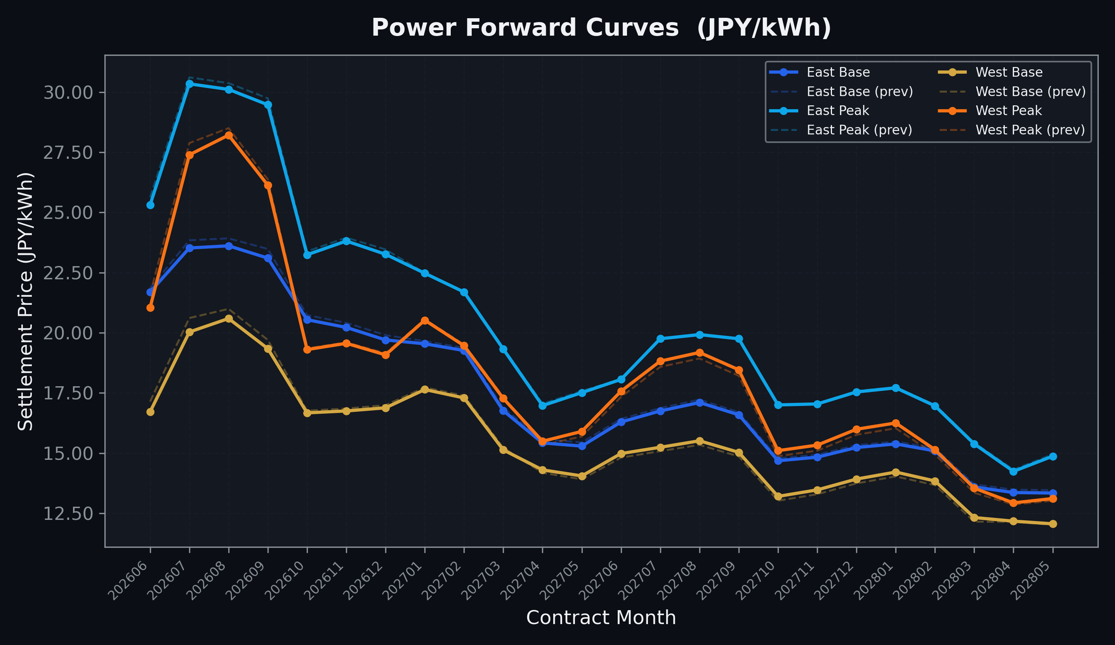
Power Forward Curves
East/West Base & Peak monthly contracts (2026-06-11)

Slide 3
Commodity Snapshot
Front-month settlement prices as of 2026-06-11
Category | Asset | Contract | Settlement | Unit | Change | % Chg
Energy | Barge Gas Oil | 202607 | 106,200.00 | JPY/kl | -300.00 | -0.28%
Energy | Barge Gasoline | 202607 | 100,000.00 | JPY/kl | +0.00 | +0.00%
Energy | Barge Kerosene | 202607 | 110,000.00 | JPY/kl | +0.00 | +0.00%
Energy | Chukyo Gasoline | 202607 | 95,000.00 | JPY/kl | +0.00 | +0.00%
Energy | Chukyo Kerosene | 202607 | 105,000.00 | JPY/kl | +0.00 | +0.00%
Energy | Dubai Crude Oil | 202606 | 90,920.00 | JPY/kl | +1040.00 | +1.16%
Energy | LNG (Platts JKM) | 202607 | 3,019.00 | USD/MMBtu | -1.00 | -0.03%
Metals | Gold | - | 21,030.00 | JPY/g | -566.00 | -2.62%
Metals | Palladium | 202606 | 6,400.00 | JPY/g | +100.00 | +1.59%
Metals | Platinum | - | 8,536.00 | JPY/g | -74.00 | -0.86%
Metals | Silver | 202606 | 330.00 | JPY/10g | -5.00 | -1.49%
Industrial | Rubber (RSS3) | 202606 | 415.10 | JPY/kg | +7.50 | +1.84%
Industrial | Rubber (TSR20) | 202607 | 360.00 | JPY/kg | +0.00 | +0.00%
Industrial | Shanghai Natural Rubber | 202609 | 17,565.00 | JPY/kg | +55.00 | +0.31%
Agriculture | Azuki Beans | 202606 | 12,300.00 | JPY/bag | +0.00 | +0.00%
Agriculture | Corn | 202607 | 39,000.00 | JPY/t | +0.00 | +0.00%
Agriculture | Soybeans | 202606 | 64,000.00 | JPY/t | +0.00 | +0.00%

Slide 4
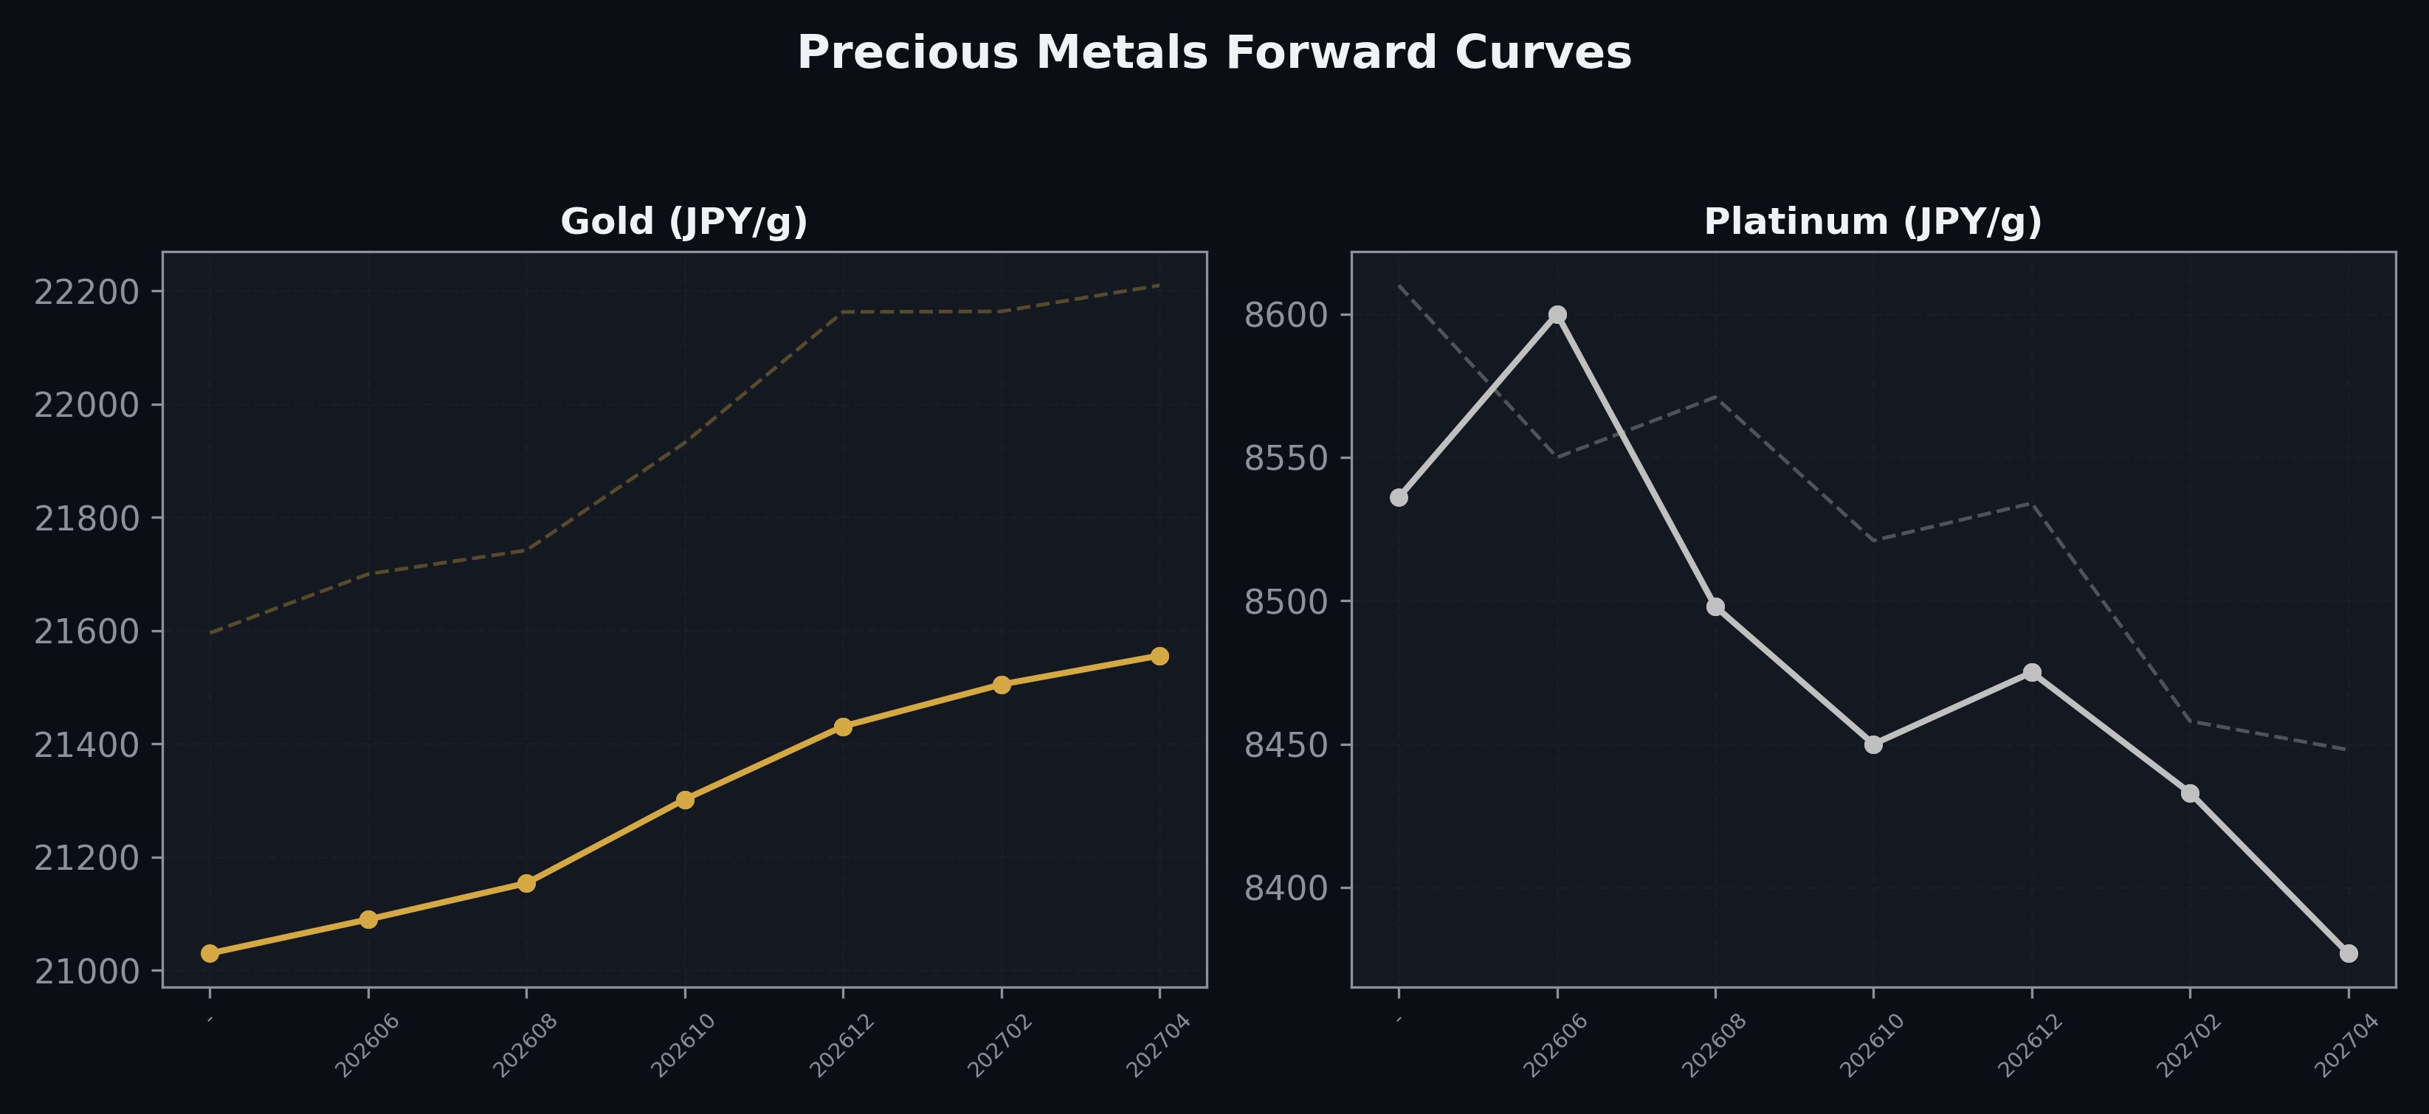
Precious Metals Forward Curves
Gold & Platinum (2026-06-11)

Slide 5
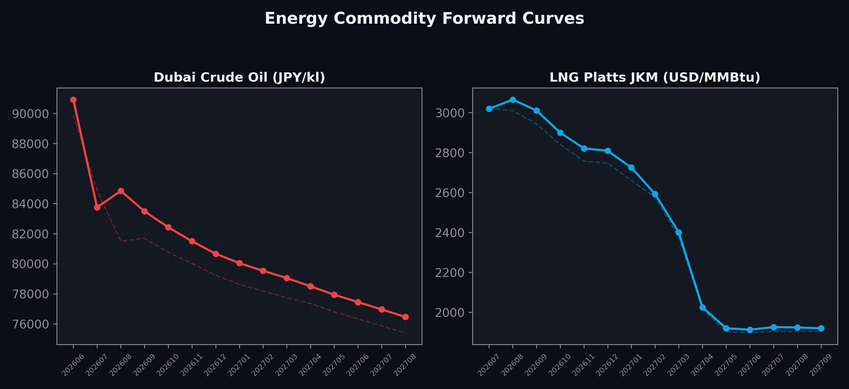
Energy Commodity Forward Curves
Dubai Crude Oil & LNG Platts JKM (2026-06-11)

Slide 6
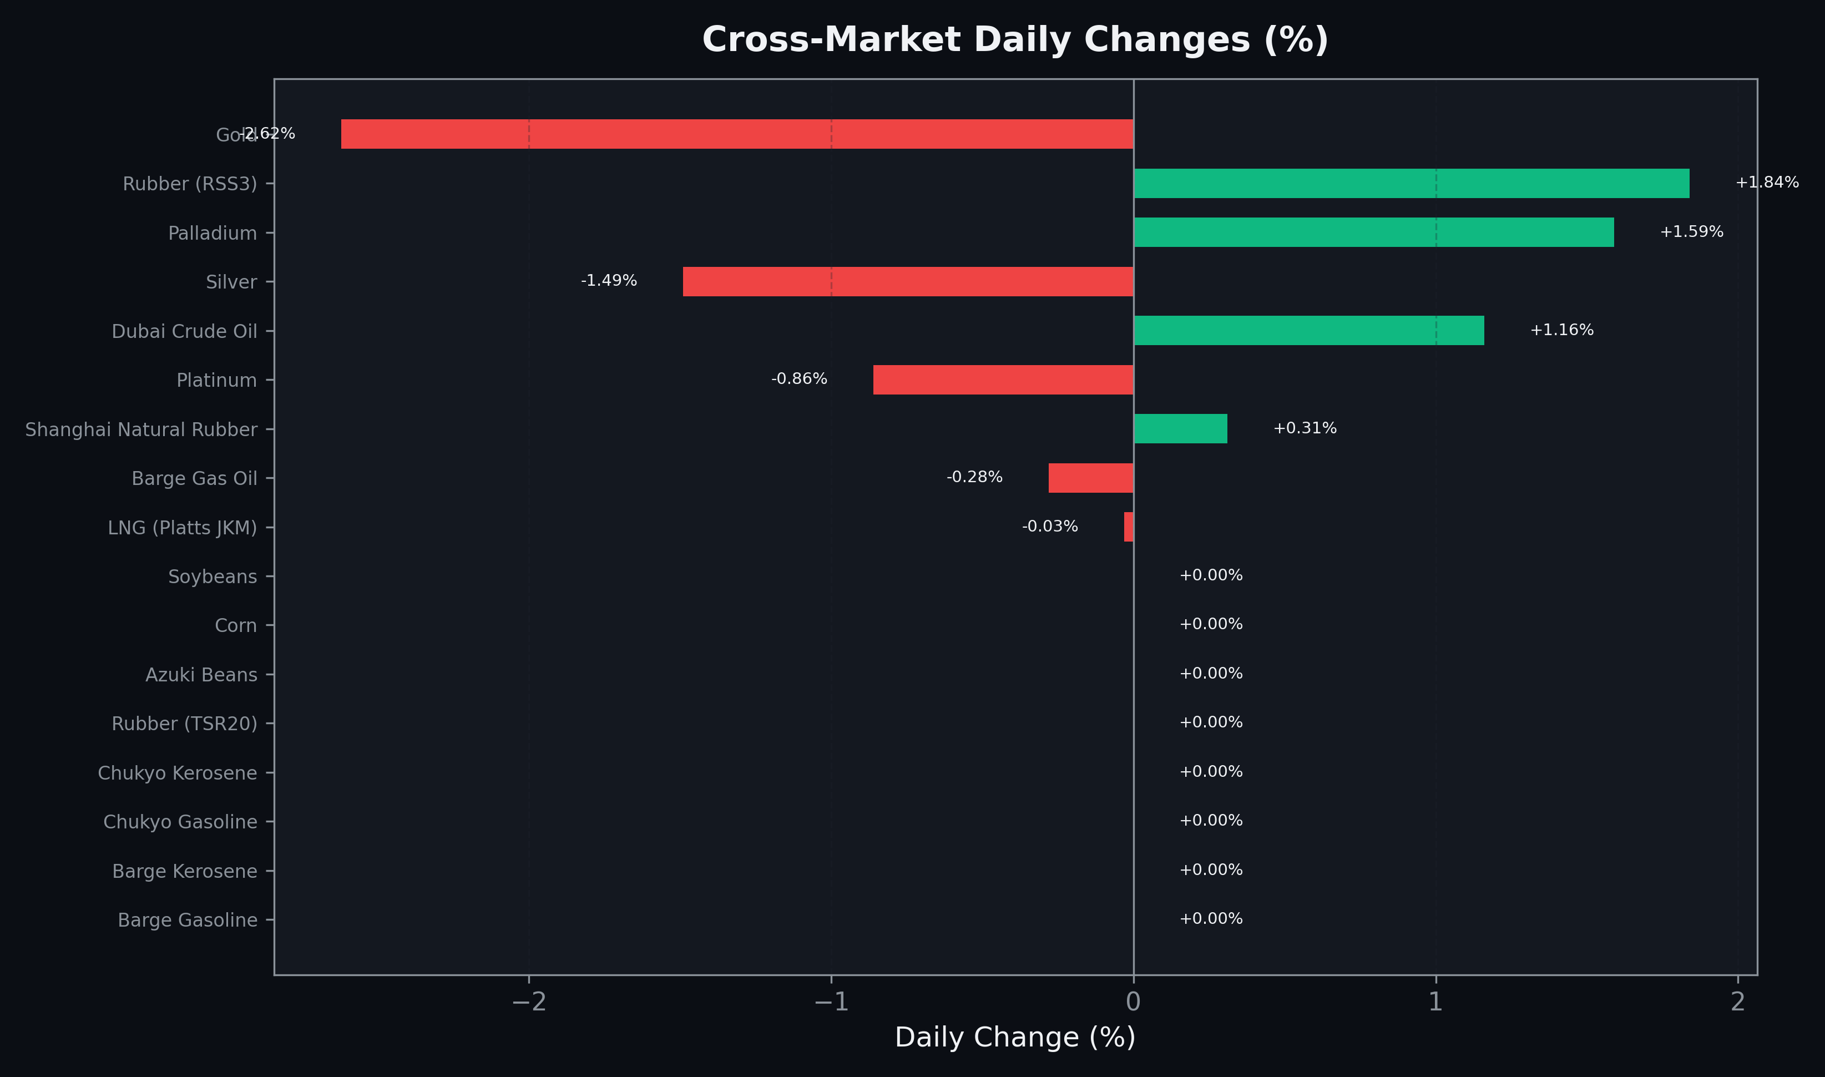
Cross-Market Daily Changes
All commodities sorted by absolute % change

Slide 7
Top Power Futures Movers
Largest absolute settlement price changes vs previous day (2026-06-11)
Instrument | Underlying | Month | Price | Prev | Change | % Chg
FUT_EWPW_260611 | Power West Peak (Weekly) | 20260612 | 16.33 | 17.59 | -1.26 | -7.16%
FUT_EEPW_260611 | Power East Peak (Weekly) | 20260612 | 23.24 | 23.90 | -0.66 | -2.76%
FUT_EWBW_260611 | Power West Base (Weekly) | 20260612 | 14.76 | 15.38 | -0.62 | -4.03%
FUT_EWPW_260709 | Power West Peak (Weekly) | 20260710 | 26.06 | 26.67 | -0.61 | -2.29%
FUT_EWB_260730 | Power West Base (Monthly) | 202607 | 20.03 | 20.61 | -0.58 | -2.81%
FUT_EWBW_260709 | Power West Base (Weekly) | 20260710 | 19.67 | 20.24 | -0.57 | -2.82%
FUT_EWP_260629 | Power West Peak (Monthly) | 202606 | 21.04 | 21.59 | -0.55 | -2.55%
FUT_EWPW_260618 | Power West Peak (Weekly) | 20260619 | 20.48 | 20.99 | -0.51 | -2.43%
FUT_EWP_260730 | Power West Peak (Monthly) | 202607 | 27.39 | 27.88 | -0.49 | -1.76%
FUT_EWBW_260618 | Power West Base (Weekly) | 20260619 | 16.81 | 17.29 | -0.48 | -2.78%
FUT_EWBW_260702 | Power West Base (Weekly) | 20260703 | 17.60 | 18.07 | -0.47 | -2.60%
FUT_EWPW_260702 | Power West Peak (Weekly) | 20260703 | 23.96 | 24.43 | -0.47 | -1.92%
FUT_EWB_260629 | Power West Base (Monthly) | 202606 | 16.71 | 17.14 | -0.43 | -2.51%
FUT_ECP_260629 | 電力(中部・日中) | 202606 | 23.27 | 23.68 | -0.41 | -1.73%
FUT_EWBW_260625 | Power West Base (Weekly) | 20260626 | 16.61 | 17.02 | -0.41 | -2.41%

