Slide 1
Daily Market Report
Trade Date: 2026-06-16
JPX Derivative & Commodity Analytics
DataServer In-House

Slide 2
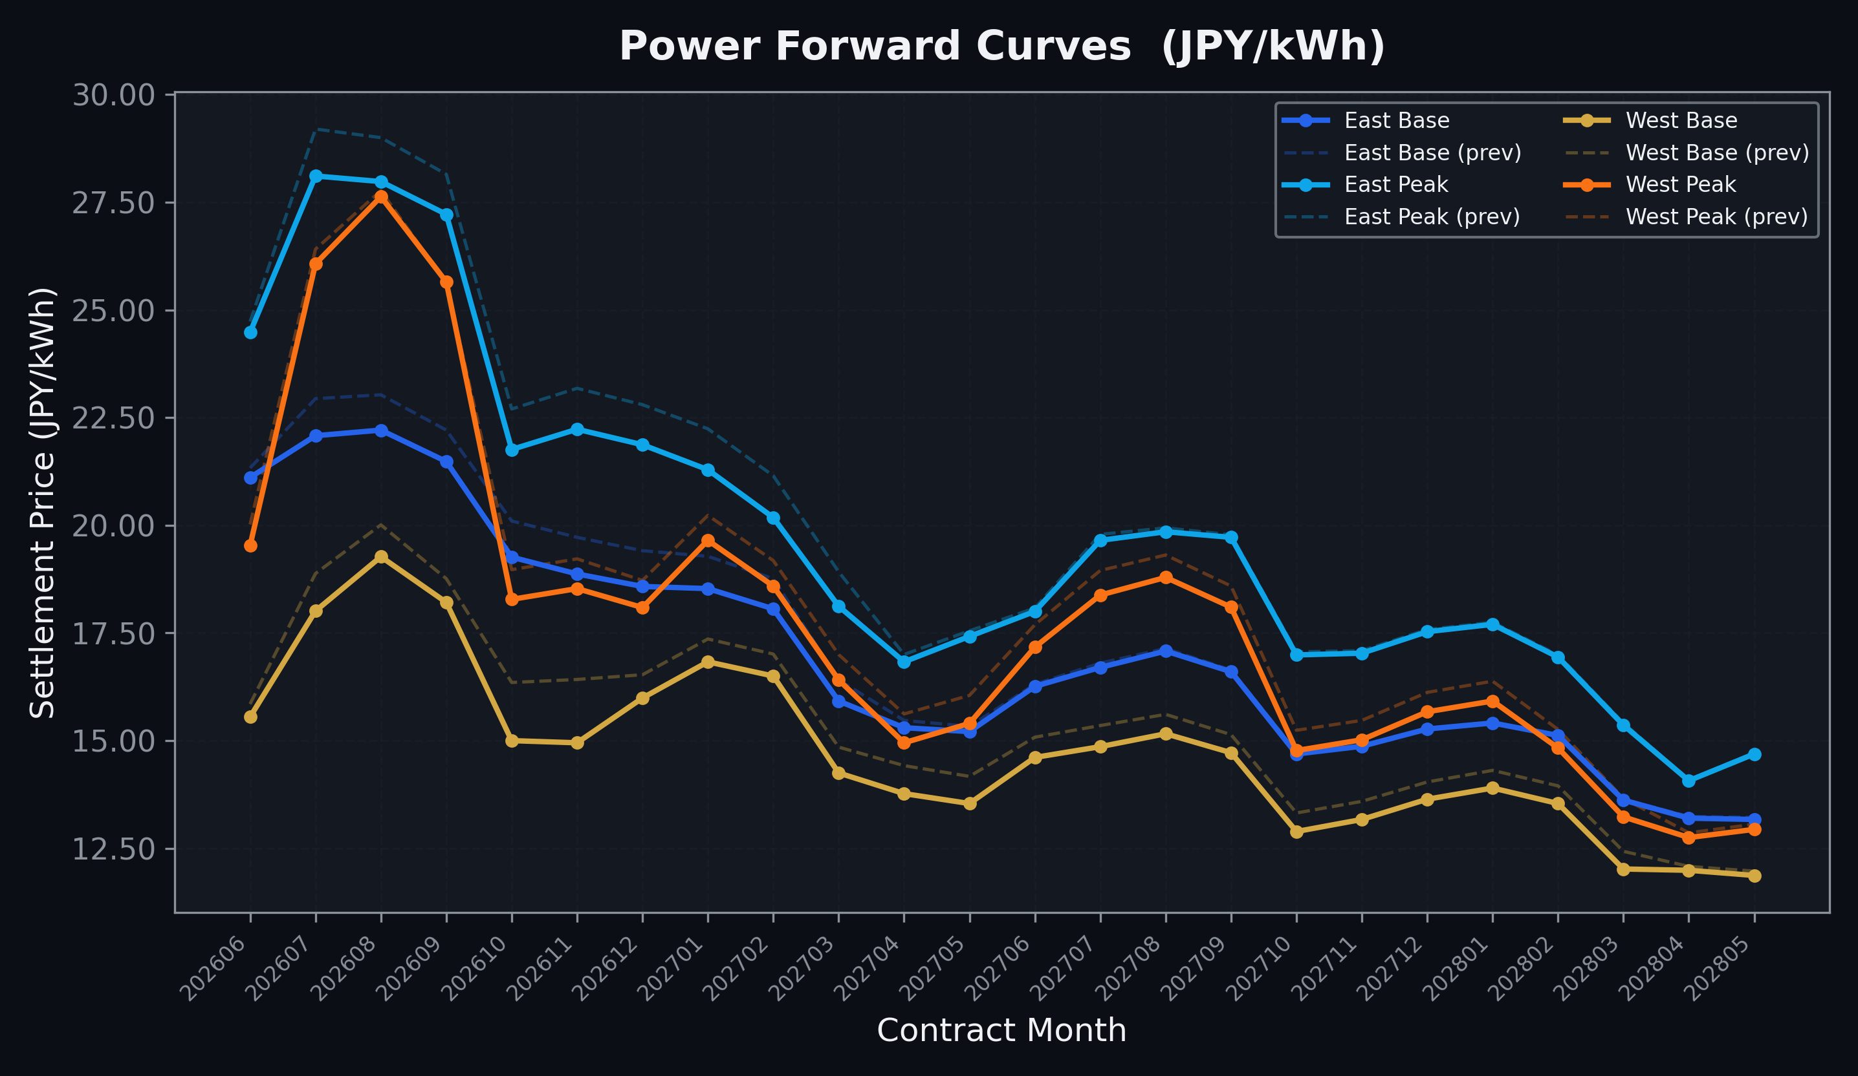
Power Forward Curves
East/West Base & Peak monthly contracts (2026-06-16)

Slide 3
Commodity Snapshot
Front-month settlement prices as of 2026-06-16
Category | Asset | Contract | Settlement | Unit | Change | % Chg
Energy | Barge Gas Oil | 202607 | 105,500.00 | JPY/kl | +0.00 | +0.00%
Energy | Barge Gasoline | 202607 | 98,000.00 | JPY/kl | -2000.00 | -2.00%
Energy | Barge Kerosene | 202607 | 110,000.00 | JPY/kl | +0.00 | +0.00%
Energy | Chukyo Gasoline | 202607 | 95,000.00 | JPY/kl | +0.00 | +0.00%
Energy | Chukyo Kerosene | 202607 | 105,000.00 | JPY/kl | +0.00 | +0.00%
Energy | Dubai Crude Oil | 202606 | 87,000.00 | JPY/kl | -220.00 | -0.25%
Energy | LNG (Platts JKM) | 202608 | 2,632.00 | USD/MMBtu | -388.00 | -12.85%
Metals | Gold | - | 22,240.00 | JPY/g | +49.00 | +0.22%
Metals | Palladium | 202606 | 6,800.00 | JPY/g | +0.00 | +0.00%
Metals | Platinum | - | 8,967.00 | JPY/g | -71.00 | -0.79%
Metals | Silver | 202606 | 345.00 | JPY/10g | +8.00 | +2.37%
Industrial | Rubber (RSS3) | 202606 | 433.60 | JPY/kg | +8.70 | +2.05%
Industrial | Rubber (TSR20) | 202607 | 362.00 | JPY/kg | +0.00 | +0.00%
Industrial | Shanghai Natural Rubber | 202609 | 18,200.00 | JPY/kg | +650.00 | +3.70%
Agriculture | Azuki Beans | 202606 | 12,300.00 | JPY/bag | +0.00 | +0.00%
Agriculture | Corn | 202609 | 39,000.00 | JPY/t | +0.00 | +0.00%
Agriculture | Soybeans | 202608 | 64,000.00 | JPY/t | +0.00 | +0.00%

Slide 4
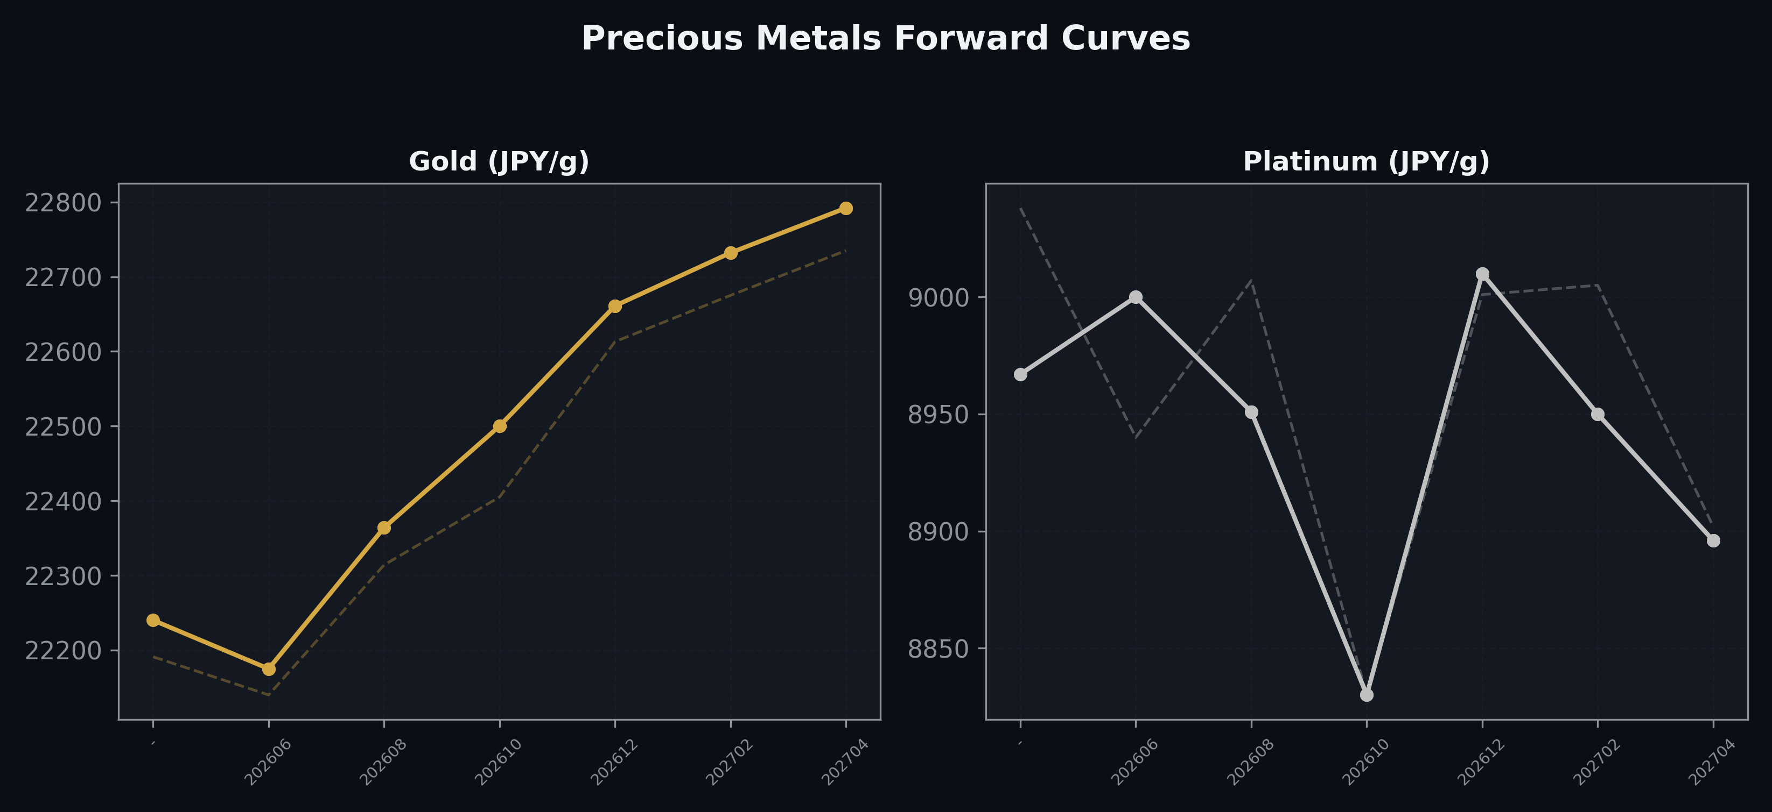
Precious Metals Forward Curves
Gold & Platinum (2026-06-16)

Slide 5
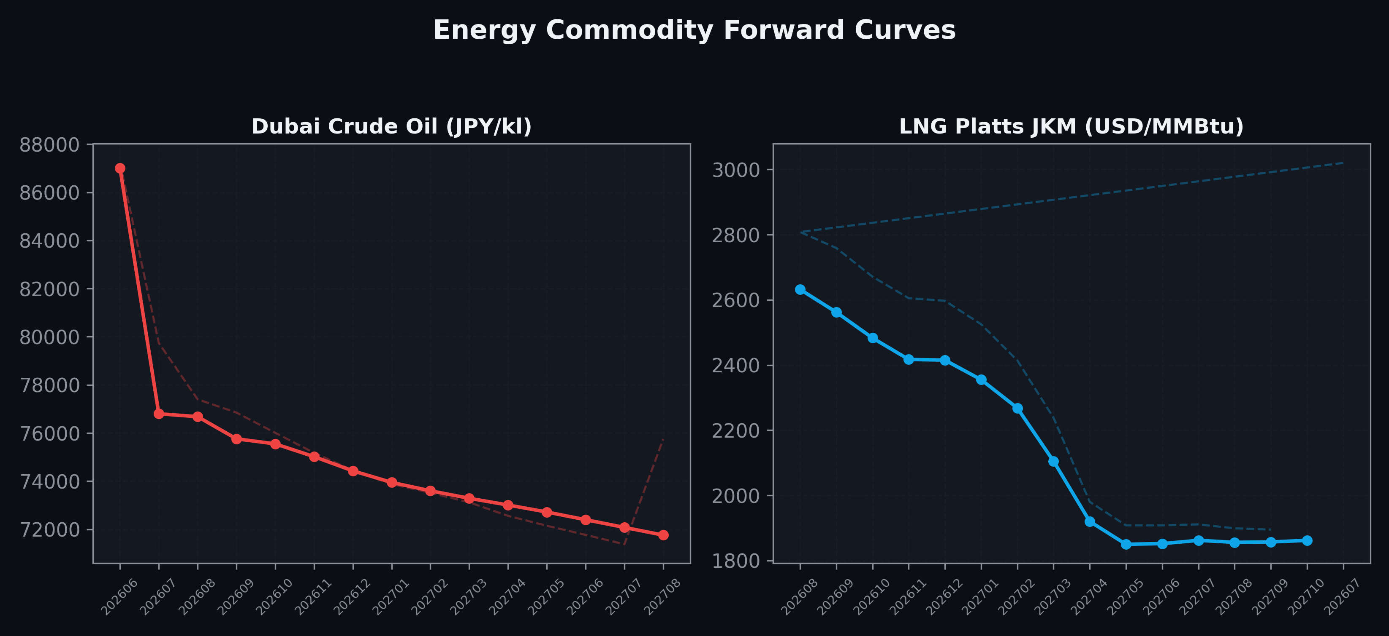
Energy Commodity Forward Curves
Dubai Crude Oil & LNG Platts JKM (2026-06-16)

Slide 6
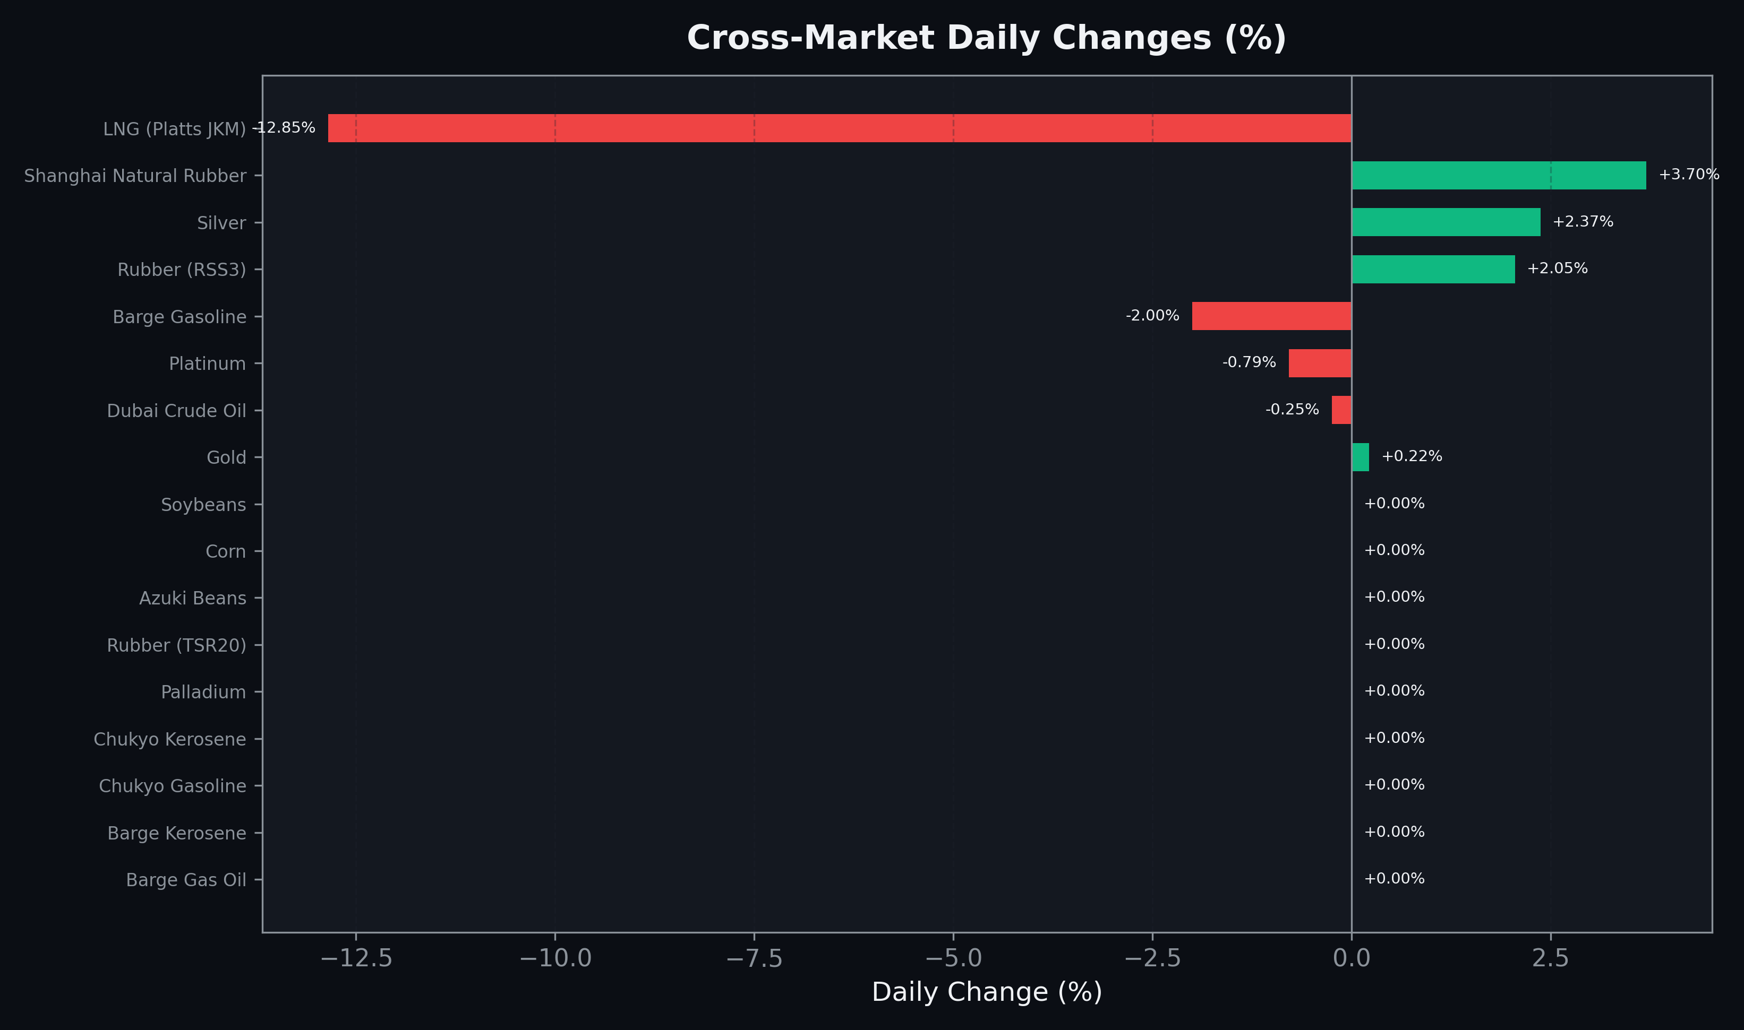
Cross-Market Daily Changes
All commodities sorted by absolute % change

Slide 7
Top Power Futures Movers
Largest absolute settlement price changes vs previous day (2026-06-16)
Instrument | Underlying | Month | Price | Prev | Change | % Chg
FUT_EWPW_260716 | Power West Peak (Weekly) | 20260717 | 23.71 | 25.20 | -1.49 | -5.91%
FUT_EWB_261127 | Power West Base (Monthly) | 202611 | 14.95 | 16.42 | -1.47 | -8.95%
FUT_EWB_261030 | Power West Base (Monthly) | 202610 | 15.00 | 16.35 | -1.35 | -8.26%
FUT_EWPW_260618 | Power West Peak (Weekly) | 20260619 | 16.35 | 17.64 | -1.29 | -7.31%
FUT_ECP_260828 | 電力(中部・日中) | 202608 | 27.25 | 28.43 | -1.18 | -4.15%
FUT_EEPW_260709 | Power East Peak (Weekly) | 20260710 | 27.26 | 28.36 | -1.10 | -3.88%
FUT_EEP_260730 | Power East Peak (Monthly) | 202607 | 28.11 | 29.20 | -1.09 | -3.73%
FUT_ECP_260730 | 電力(中部・日中) | 202607 | 26.84 | 27.92 | -1.08 | -3.87%
FUT_EEPW_260716 | Power East Peak (Weekly) | 20260717 | 27.68 | 28.74 | -1.06 | -3.69%
FUT_EWBW_260716 | Power West Base (Weekly) | 20260717 | 17.90 | 18.96 | -1.06 | -5.59%
FUT_ECP_260929 | 電力(中部・日中) | 202609 | 26.55 | 27.59 | -1.04 | -3.77%
FUT_EWPW_260625 | Power West Peak (Weekly) | 20260626 | 19.71 | 20.74 | -1.03 | -4.97%
FUT_EEP_260828 | Power East Peak (Monthly) | 202608 | 27.98 | 29.00 | -1.02 | -3.52%
FUT_EEP_270225 | Power East Peak (Monthly) | 202702 | 20.18 | 21.15 | -0.97 | -4.59%
FUT_EEP_261127 | Power East Peak (Monthly) | 202611 | 22.23 | 23.18 | -0.95 | -4.10%

