Slide 1
Daily Market Report
Trade Date: 2026-03-26
JPX Derivative & Commodity Analytics
DataServer In-House

Slide 2
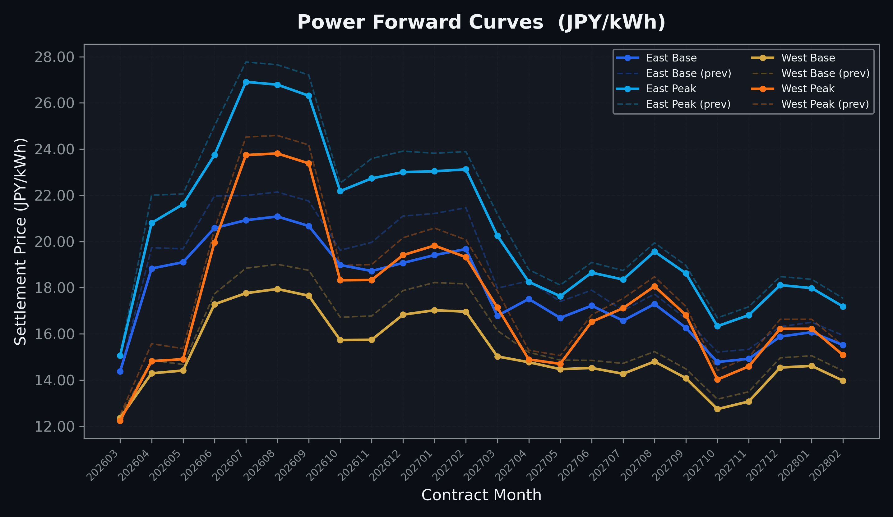
Power Forward Curves
East/West Base & Peak monthly contracts (2026-03-26)

Slide 3
Commodity Snapshot
Front-month settlement prices as of 2026-03-26
Category | Asset | Contract | Settlement | Unit | Change | % Chg
Energy | Barge Gas Oil | 202605 | 108,200.00 | JPY/kl | -4700.00 | -4.16%
Energy | Barge Gasoline | 202605 | 150,000.00 | JPY/kl | +0.00 | +0.00%
Energy | Barge Kerosene | 202605 | 140,000.00 | JPY/kl | +0.00 | +0.00%
Energy | Chukyo Gasoline | 202605 | 140,000.00 | JPY/kl | +0.00 | +0.00%
Energy | Chukyo Kerosene | 202605 | 130,000.00 | JPY/kl | +0.00 | +0.00%
Energy | Dubai Crude Oil | 202603 | 132,650.00 | JPY/kl | -2430.00 | -1.80%
Energy | LNG (Platts JKM) | 202605 | 3,102.00 | USD/MMBtu | -87.00 | -2.73%
Metals | Gold | - | 23,379.00 | JPY/g | +237.00 | +1.02%
Metals | Palladium | 202604 | 7,500.00 | JPY/g | +0.00 | +0.00%
Metals | Platinum | - | 9,368.00 | JPY/g | -449.00 | -4.57%
Metals | Silver | 202604 | 360.00 | JPY/10g | +0.00 | +0.00%
Industrial | Rubber (RSS3) | 202604 | 361.00 | JPY/kg | -3.80 | -1.04%
Industrial | Rubber (TSR20) | 202604 | 307.00 | JPY/kg | +0.00 | +0.00%
Industrial | Shanghai Natural Rubber | 202605 | 16,470.00 | JPY/kg | +10.00 | +0.06%
Agriculture | Azuki Beans | 202603 | 12,300.00 | JPY/bag | +0.00 | +0.00%
Agriculture | Corn | 202605 | 39,000.00 | JPY/t | +0.00 | +0.00%
Agriculture | Soybeans | 202604 | 64,000.00 | JPY/t | +0.00 | +0.00%

Slide 4
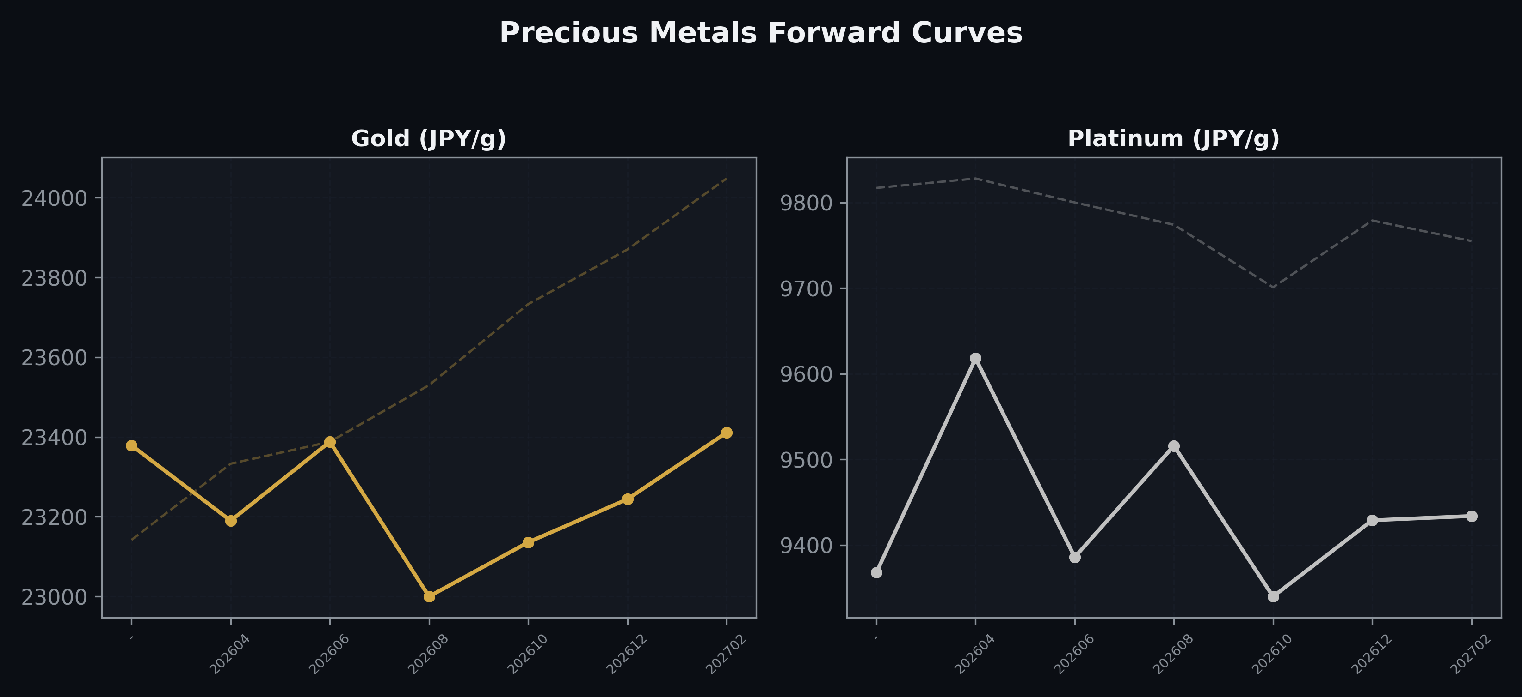
Precious Metals Forward Curves
Gold & Platinum (2026-03-26)

Slide 5
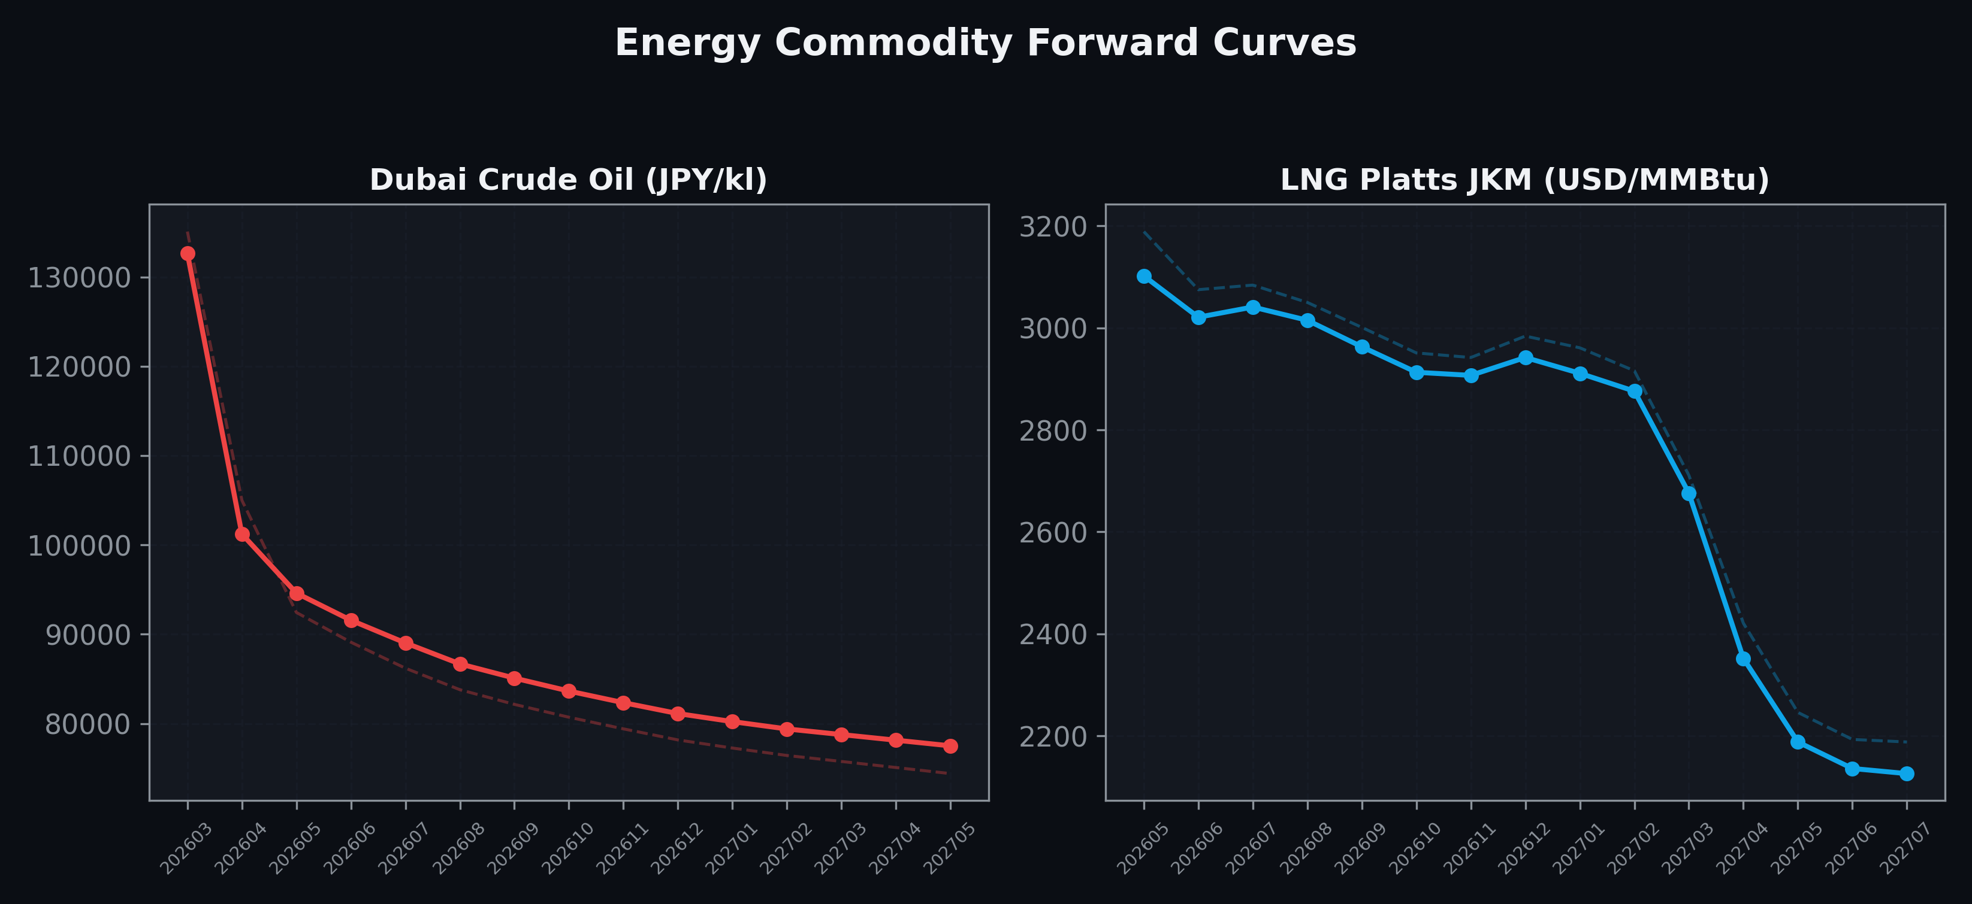
Energy Commodity Forward Curves
Dubai Crude Oil & LNG Platts JKM (2026-03-26)

Slide 6
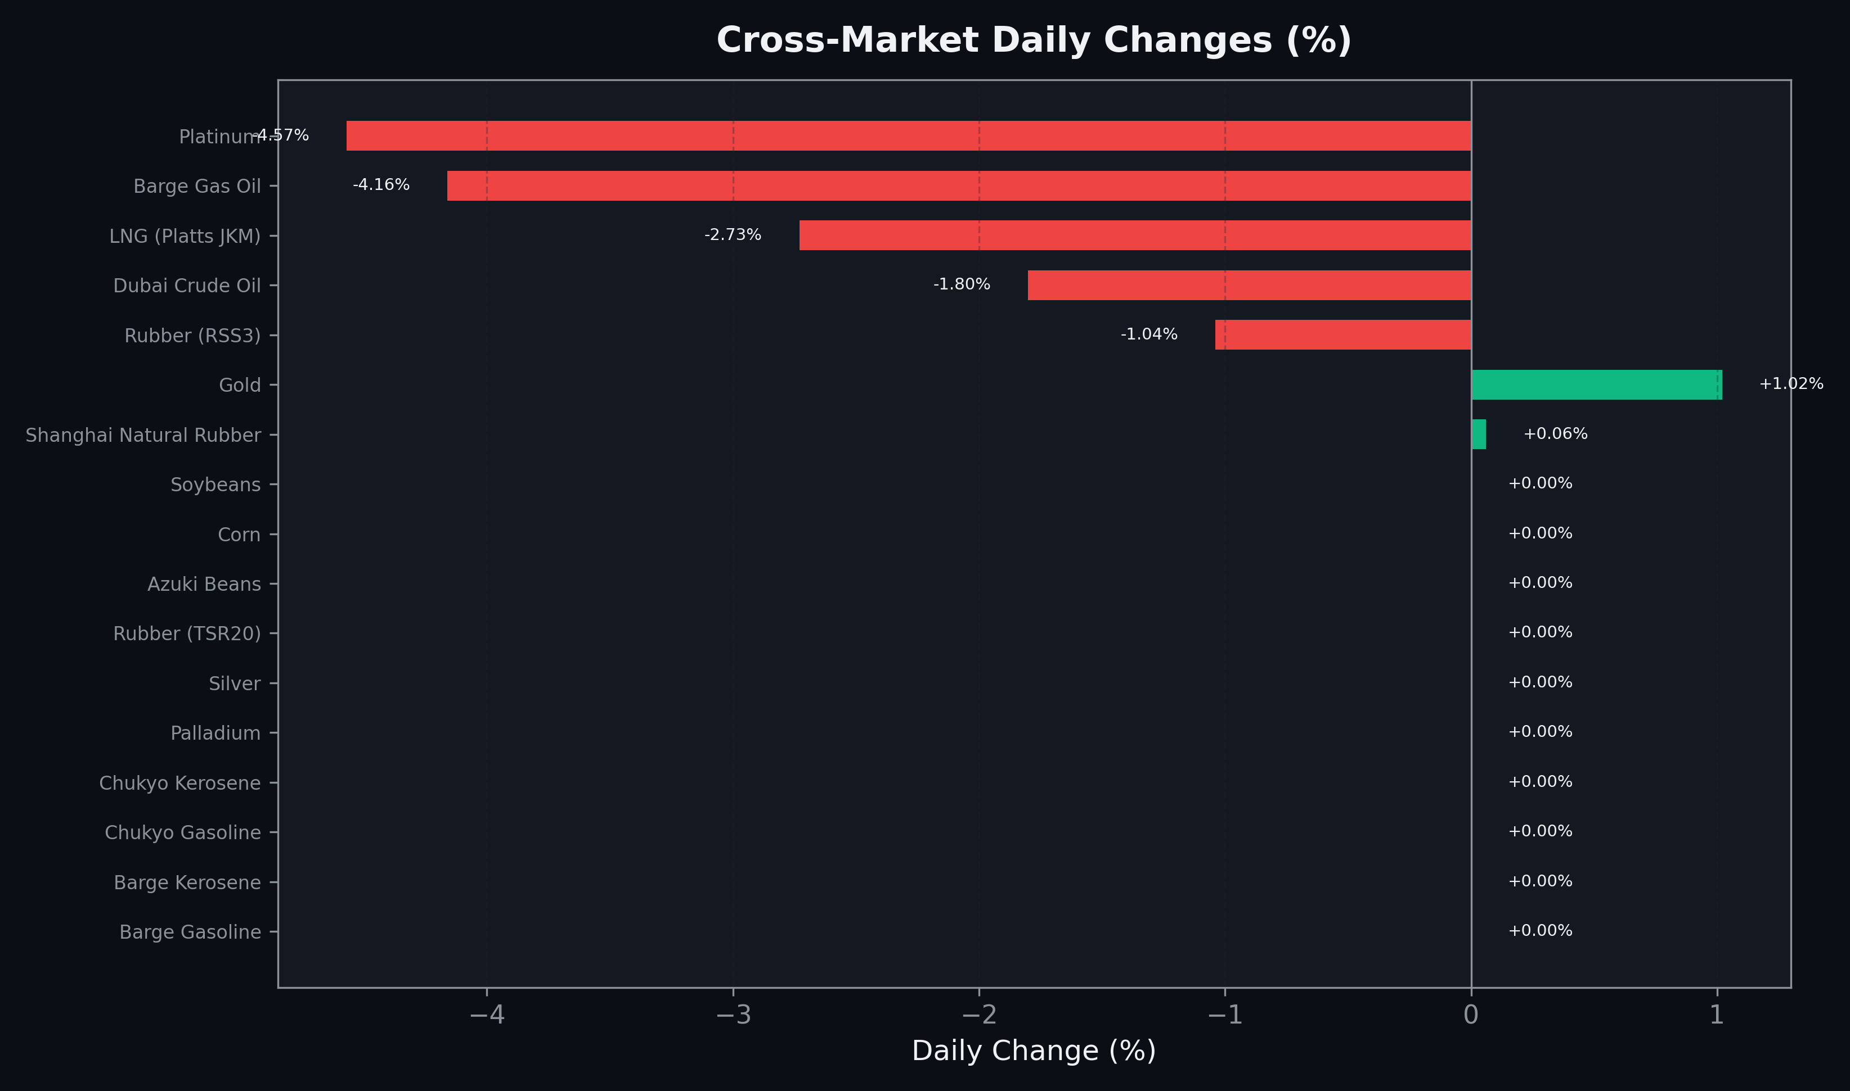
Cross-Market Daily Changes
All commodities sorted by absolute % change

Slide 7
Top Power Futures Movers
Largest absolute settlement price changes vs previous day (2026-03-26)
Instrument | Underlying | Month | Price | Prev | Change | % Chg
FUT_EEB_261230 | Power East Base (Monthly) | 202612 | 19.07 | 21.10 | -2.03 | -9.62%
FUT_EEB_270129 | Power East Base (Monthly) | 202701 | 19.41 | 21.21 | -1.80 | -8.49%
FUT_EEB_270226 | Power East Base (Monthly) | 202702 | 19.67 | 21.46 | -1.79 | -8.34%
FUT_EEB_260629 | Power East Base (Monthly) | 202606 | 20.58 | 21.97 | -1.39 | -6.33%
FUT_EWPW_260326 | Power West Peak (Weekly) | 20260327 | 13.74 | 15.01 | -1.27 | -8.46%
FUT_EEP_260629 | Power East Peak (Monthly) | 202606 | 23.74 | 25.00 | -1.26 | -5.04%
FUT_EEB_261127 | Power East Base (Monthly) | 202611 | 18.72 | 19.96 | -1.24 | -6.21%
FUT_EEBY_260326 | Power East Base (Yearly) | 202604 | 19.48 | 20.71 | -1.23 | -5.94%
FUT_EEB_270330 | Power East Base (Monthly) | 202703 | 16.78 | 17.98 | -1.20 | -6.67%
FUT_EEP_260428 | Power East Peak (Monthly) | 202604 | 20.80 | 22.00 | -1.20 | -5.45%
FUT_EWB_270129 | Power West Base (Monthly) | 202701 | 17.02 | 18.22 | -1.20 | -6.59%
FUT_EWB_270226 | Power West Base (Monthly) | 202702 | 16.96 | 18.16 | -1.20 | -6.61%
FUT_EWB_270330 | Power West Base (Monthly) | 202703 | 15.02 | 16.14 | -1.12 | -6.94%
FUT_EWB_260929 | Power West Base (Monthly) | 202609 | 17.65 | 18.75 | -1.10 | -5.87%
FUT_EEB_260929 | Power East Base (Monthly) | 202609 | 20.67 | 21.75 | -1.08 | -4.97%

