Slide 1
Daily Market Report
Trade Date: 2026-06-26
JPX Derivative & Commodity Analytics
DataServer In-House

Slide 2
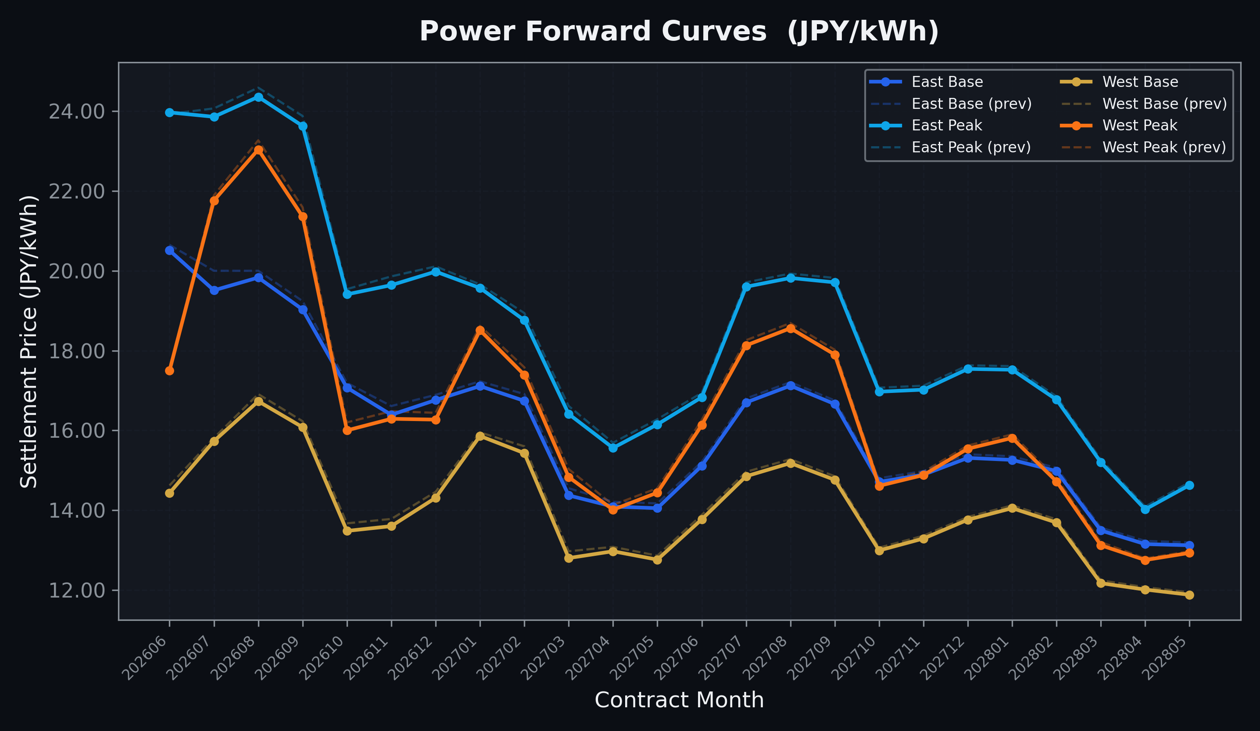
Power Forward Curves
East/West Base & Peak monthly contracts (2026-06-26)

Slide 3
Commodity Snapshot
Front-month settlement prices as of 2026-06-26
Category | Asset | Contract | Settlement | Unit | Change | % Chg
Energy | Barge Gas Oil | 202608 | 105,200.00 | JPY/kl | +0.00 | +0.00%
Energy | Barge Gasoline | 202608 | 97,000.00 | JPY/kl | +0.00 | +0.00%
Energy | Barge Kerosene | 202608 | 108,000.00 | JPY/kl | +0.00 | +0.00%
Energy | Chukyo Gasoline | 202608 | 95,000.00 | JPY/kl | +1000.00 | +1.06%
Energy | Chukyo Kerosene | 202608 | 105,000.00 | JPY/kl | -500.00 | -0.47%
Energy | Dubai Crude Oil | 202606 | 80,560.00 | JPY/kl | +260.00 | +0.32%
Energy | LNG (Platts JKM) | 202608 | 2,479.00 | USD/MMBtu | -6.00 | -0.24%
Metals | Gold | - | 20,867.00 | JPY/g | +238.00 | +1.15%
Metals | Palladium | 202608 | 6,400.00 | JPY/g | +0.00 | +0.00%
Metals | Platinum | - | 7,987.00 | JPY/g | -57.00 | -0.71%
Metals | Silver | 202608 | 325.00 | JPY/10g | +0.00 | +0.00%
Industrial | Rubber (RSS3) | 202607 | 402.30 | JPY/kg | -11.10 | -2.69%
Industrial | Rubber (TSR20) | 202607 | 340.00 | JPY/kg | -10.00 | -2.86%
Industrial | Shanghai Natural Rubber | 202609 | 16,610.00 | JPY/kg | -140.00 | -0.84%
Agriculture | Azuki Beans | 202607 | 12,300.00 | JPY/bag | +0.00 | +0.00%
Agriculture | Corn | 202609 | 39,000.00 | JPY/t | +0.00 | +0.00%
Agriculture | Soybeans | 202608 | 64,000.00 | JPY/t | +0.00 | +0.00%

Slide 4
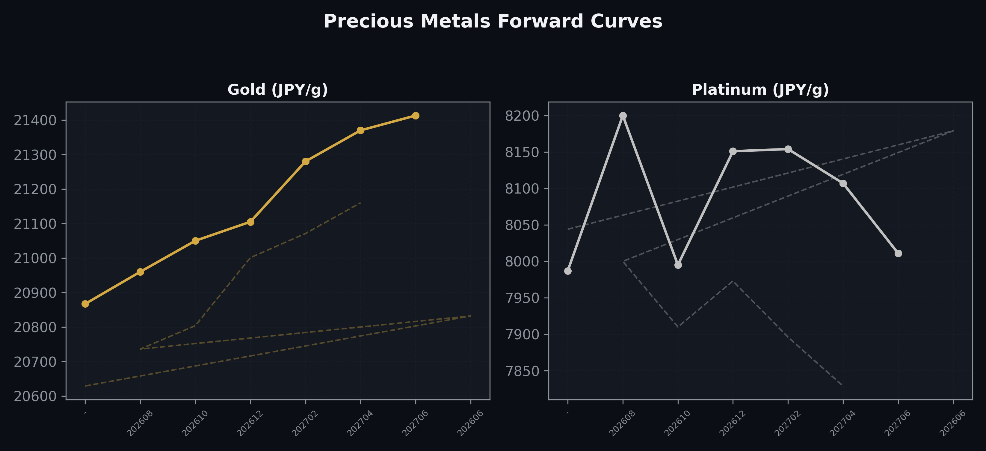
Precious Metals Forward Curves
Gold & Platinum (2026-06-26)

Slide 5
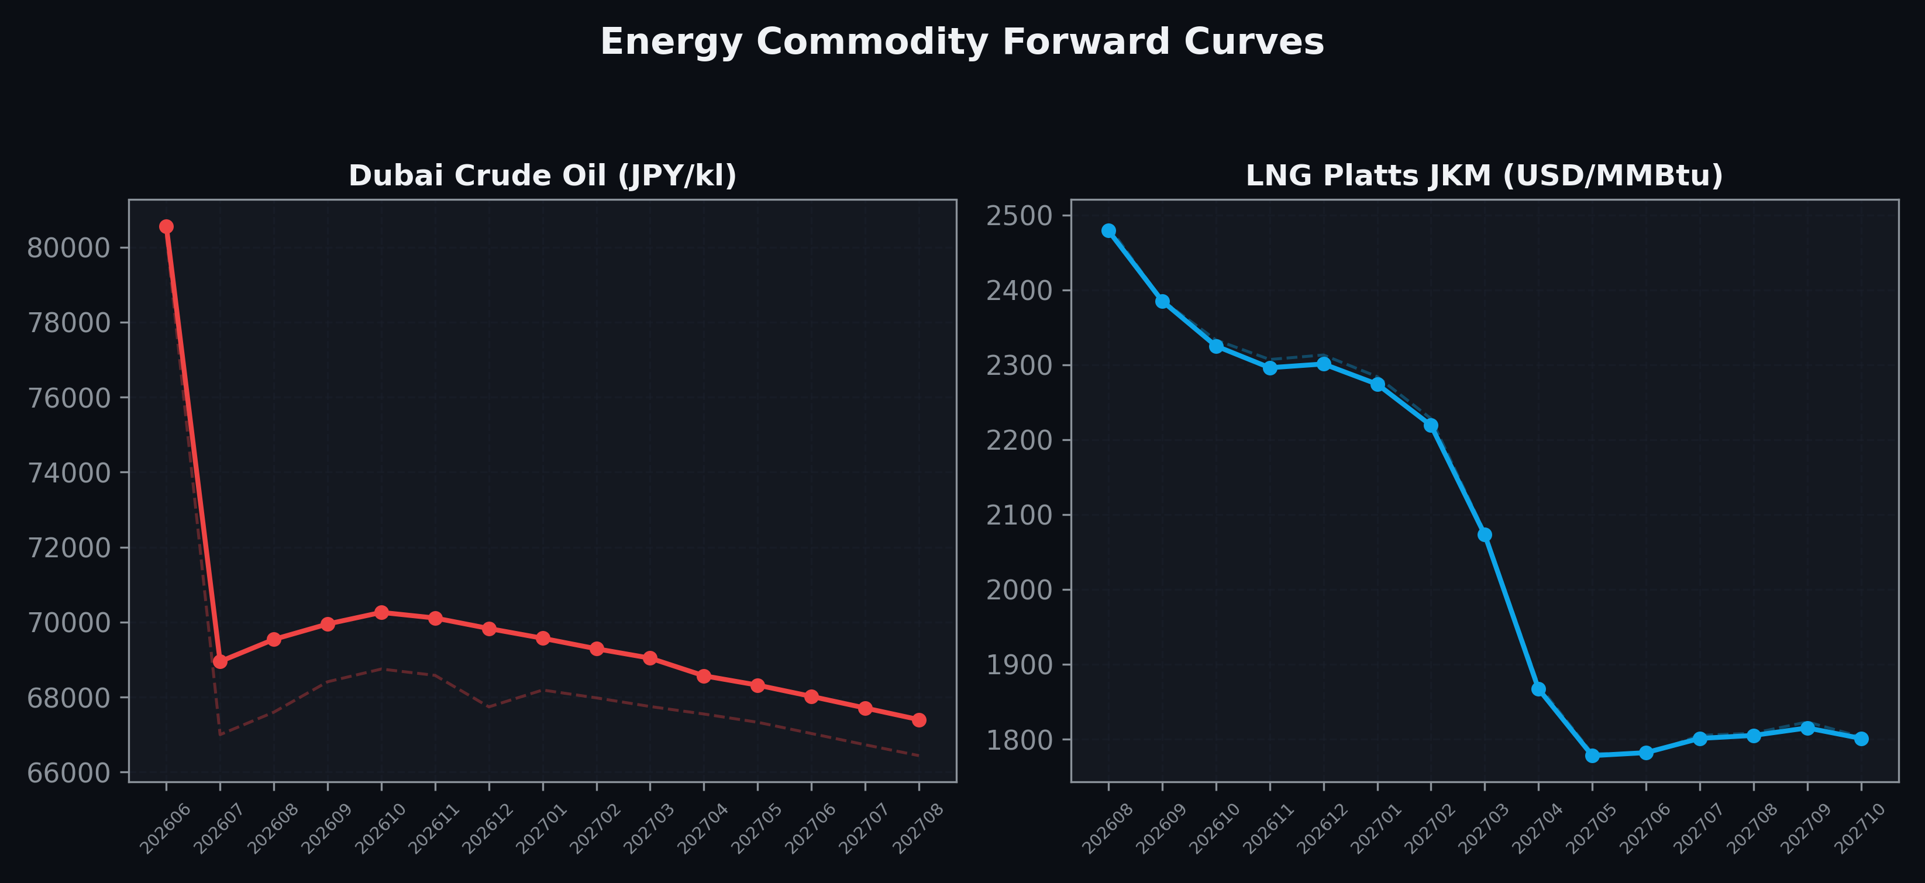
Energy Commodity Forward Curves
Dubai Crude Oil & LNG Platts JKM (2026-06-26)

Slide 6
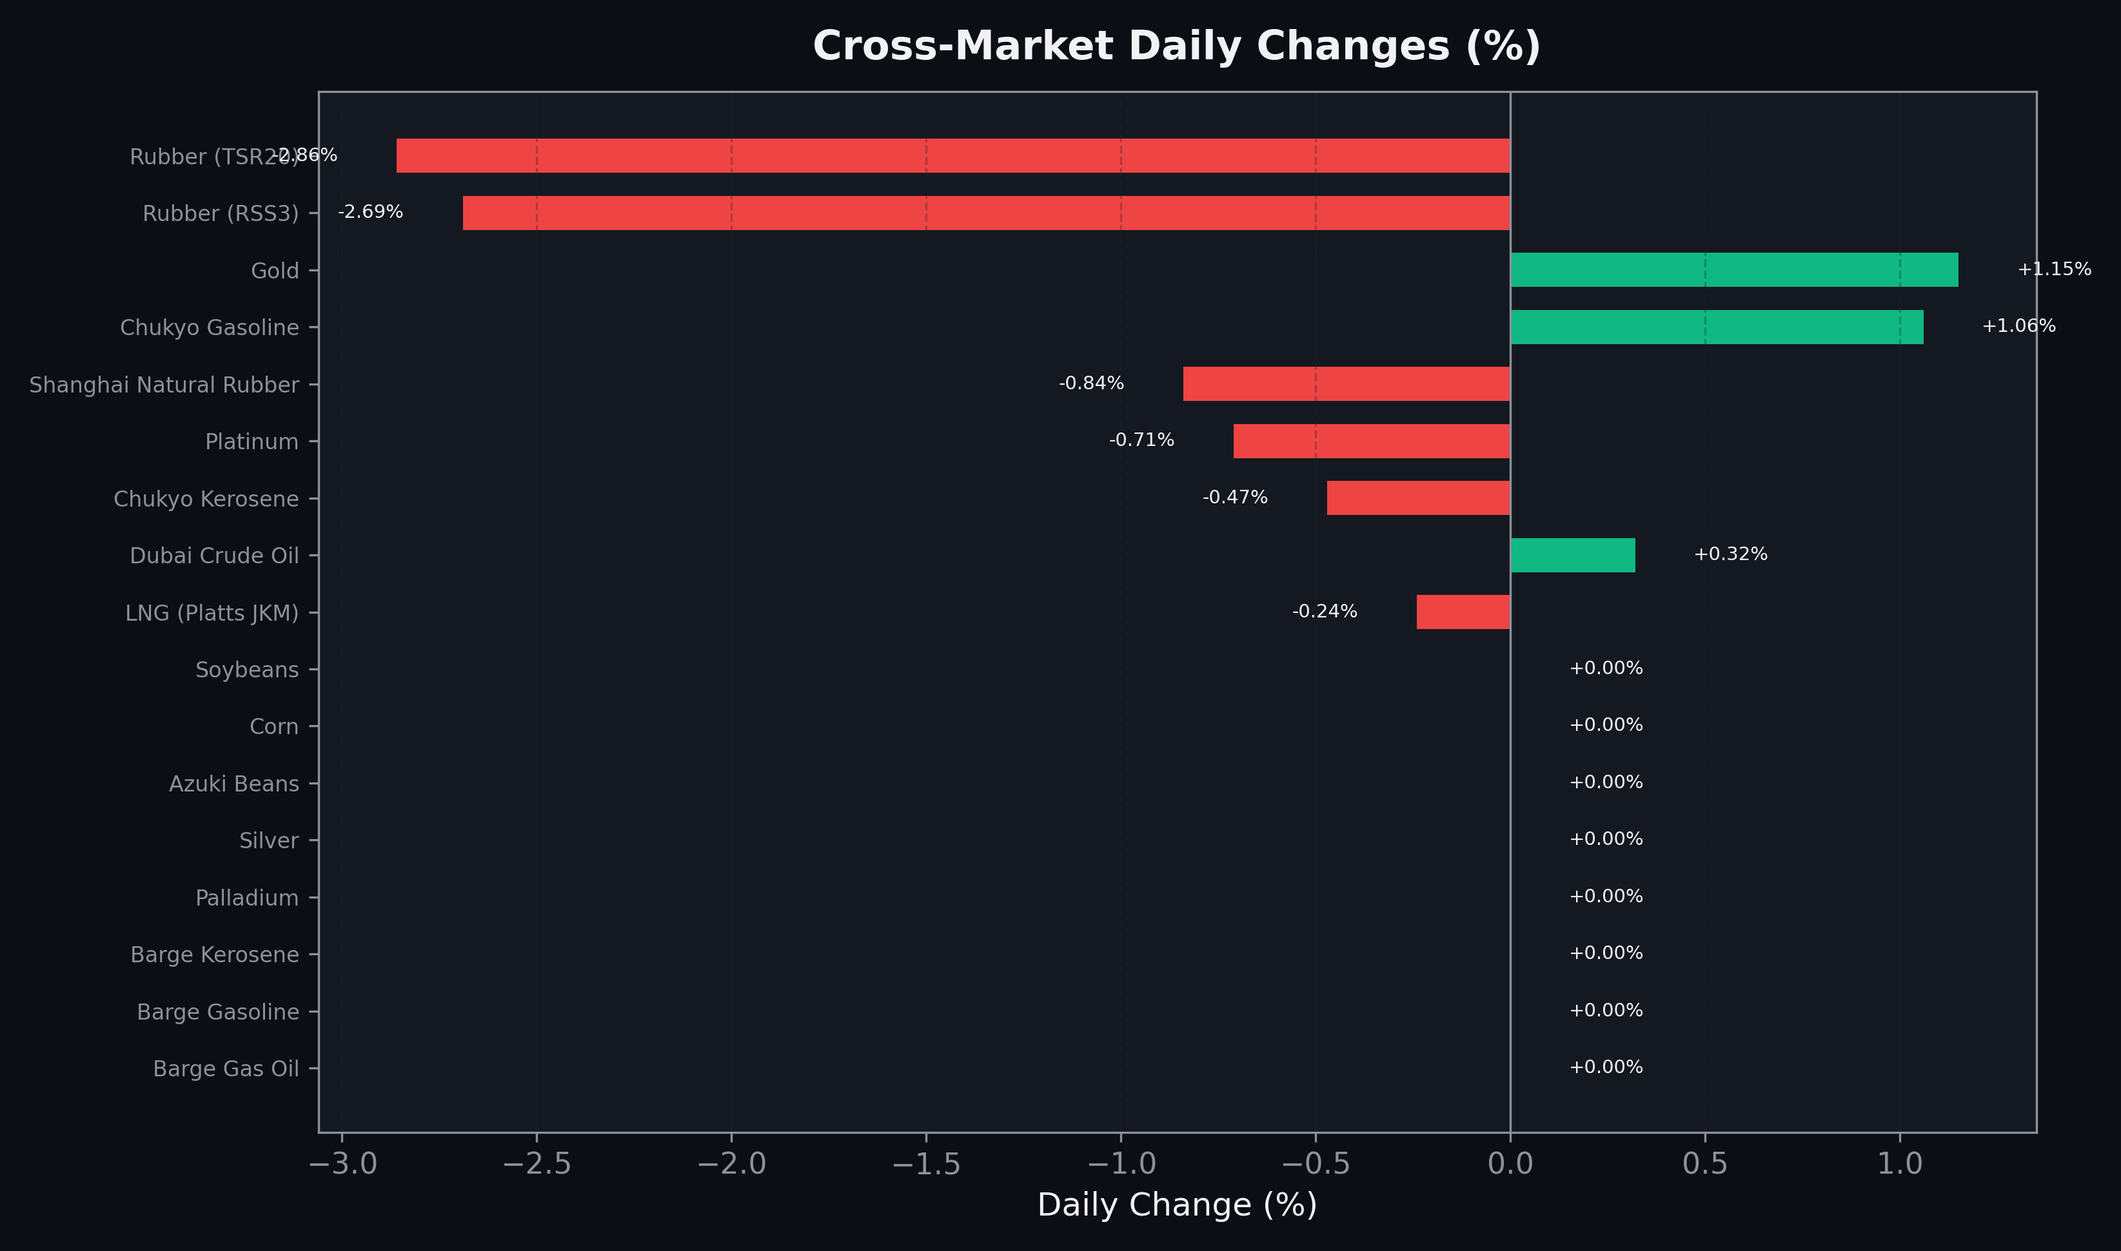
Cross-Market Daily Changes
All commodities sorted by absolute % change

Slide 7
Top Power Futures Movers
Largest absolute settlement price changes vs previous day (2026-06-26)
Instrument | Underlying | Month | Price | Prev | Change | % Chg
FUT_EEB_260730 | Power East Base (Monthly) | 202607 | 19.51 | 20.00 | -0.49 | -2.45%
FUT_EEBW_260709 | Power East Base (Weekly) | 20260710 | 19.53 | 20.02 | -0.49 | -2.45%
FUT_EEBW_260716 | Power East Base (Weekly) | 20260717 | 19.81 | 20.22 | -0.41 | -2.03%
FUT_EEBW_260723 | Power East Base (Weekly) | 20260724 | 19.21 | 19.52 | -0.31 | -1.59%
FUT_EEPW_260723 | Power East Peak (Weekly) | 20260724 | 24.49 | 24.75 | -0.26 | -1.05%
FUT_EEP_260929 | Power East Peak (Monthly) | 202609 | 23.63 | 23.88 | -0.25 | -1.05%
FUT_EEP_260828 | Power East Peak (Monthly) | 202608 | 24.36 | 24.59 | -0.23 | -0.94%
FUT_EWP_260828 | Power West Peak (Monthly) | 202608 | 23.04 | 23.27 | -0.23 | -0.99%
FUT_EWP_260929 | Power West Peak (Monthly) | 202609 | 21.36 | 21.59 | -0.23 | -1.07%
FUT_EEB_261127 | Power East Base (Monthly) | 202611 | 16.39 | 16.61 | -0.22 | -1.32%
FUT_EEP_261127 | Power East Peak (Monthly) | 202611 | 19.64 | 19.86 | -0.22 | -1.11%
FUT_EEB_260929 | Power East Base (Monthly) | 202609 | 19.03 | 19.24 | -0.21 | -1.09%
FUT_EEP_260730 | Power East Peak (Monthly) | 202607 | 23.86 | 24.07 | -0.21 | -0.87%
FUT_EEP_270330 | Power East Peak (Monthly) | 202703 | 16.41 | 16.61 | -0.20 | -1.20%
FUT_EEPW_260716 | Power East Peak (Weekly) | 20260717 | 24.24 | 24.44 | -0.20 | -0.82%

