Slide 1
Daily Market Report
Trade Date: 2026-06-22
JPX Derivative & Commodity Analytics
DataServer In-House

Slide 2
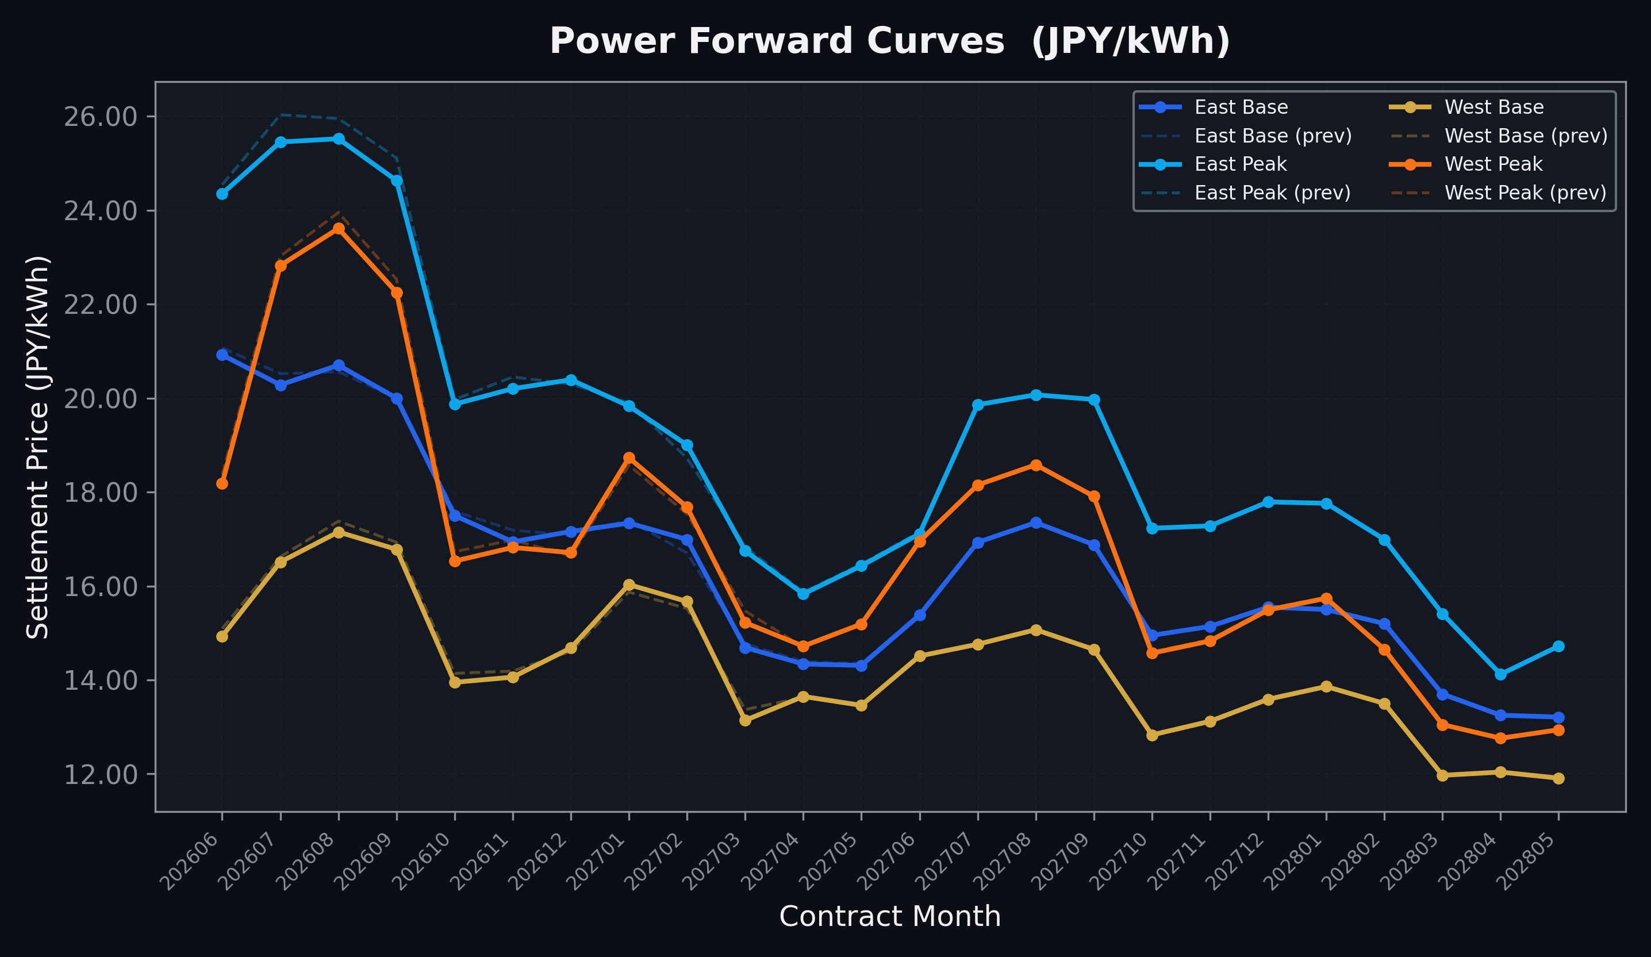
Power Forward Curves
East/West Base & Peak monthly contracts (2026-06-22)

Slide 3
Commodity Snapshot
Front-month settlement prices as of 2026-06-22
Category | Asset | Contract | Settlement | Unit | Change | % Chg
Energy | Barge Gas Oil | 202607 | 105,100.00 | JPY/kl | -100.00 | -0.10%
Energy | Barge Gasoline | 202607 | 98,000.00 | JPY/kl | +0.00 | +0.00%
Energy | Barge Kerosene | 202607 | 109,000.00 | JPY/kl | +0.00 | +0.00%
Energy | Chukyo Gasoline | 202607 | 95,000.00 | JPY/kl | +0.00 | +0.00%
Energy | Chukyo Kerosene | 202607 | 105,000.00 | JPY/kl | +0.00 | +0.00%
Energy | Dubai Crude Oil | 202606 | 81,400.00 | JPY/kl | -430.00 | -0.53%
Energy | LNG (Platts JKM) | 202608 | 2,528.00 | USD/MMBtu | +65.00 | +2.64%
Metals | Gold | - | 21,662.00 | JPY/g | -30.00 | -0.14%
Metals | Palladium | 202606 | 6,600.00 | JPY/g | +0.00 | +0.00%
Metals | Platinum | - | 8,484.00 | JPY/g | -30.00 | -0.35%
Metals | Silver | 202606 | 340.00 | JPY/10g | +0.00 | +0.00%
Industrial | Rubber (RSS3) | 202606 | 432.10 | JPY/kg | +2.20 | +0.51%
Industrial | Rubber (TSR20) | 202607 | 365.00 | JPY/kg | +0.00 | +0.00%
Industrial | Shanghai Natural Rubber | 202609 | 17,550.00 | JPY/kg | -300.00 | -1.68%
Agriculture | Azuki Beans | 202606 | 12,300.00 | JPY/bag | +0.00 | +0.00%
Agriculture | Corn | 202609 | 39,000.00 | JPY/t | +0.00 | +0.00%
Agriculture | Soybeans | 202608 | 64,000.00 | JPY/t | +0.00 | +0.00%

Slide 4
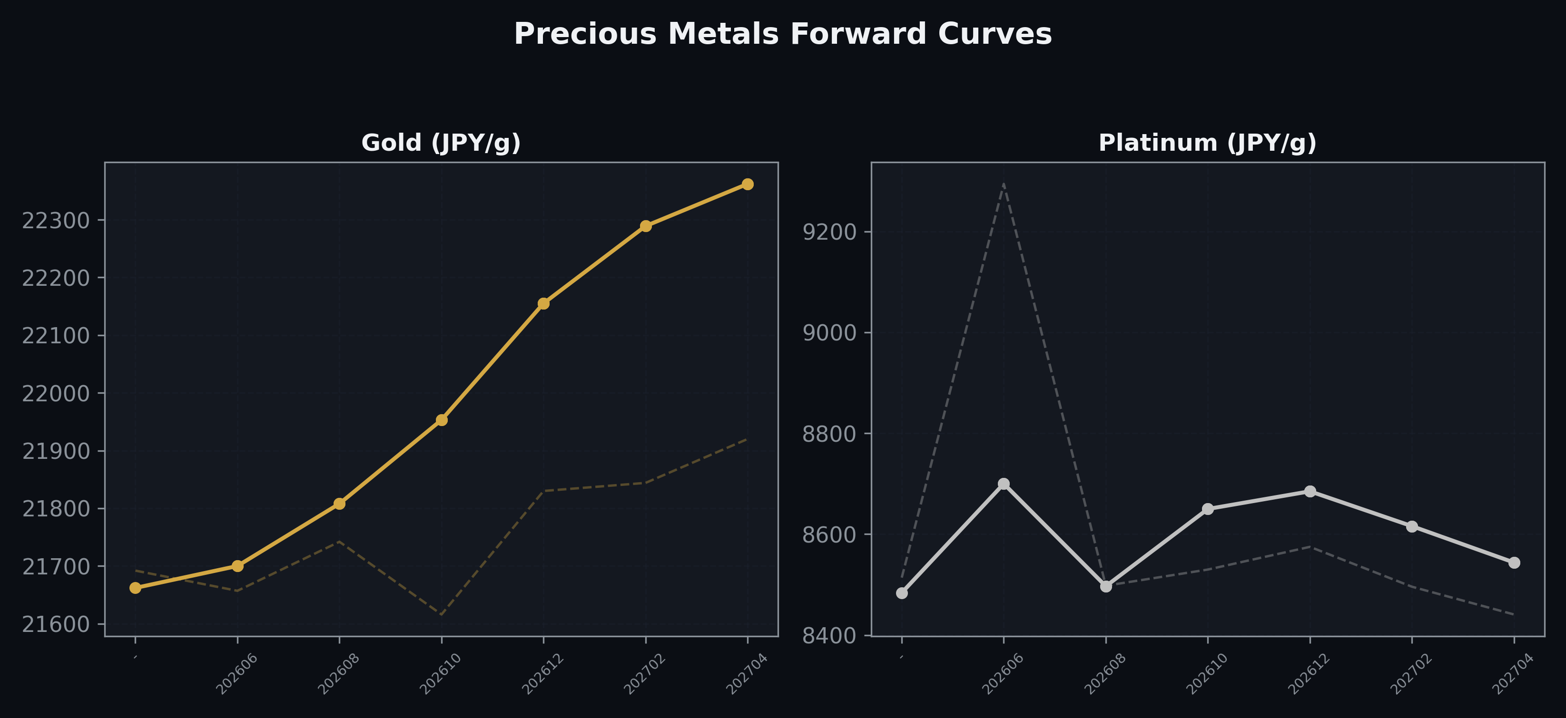
Precious Metals Forward Curves
Gold & Platinum (2026-06-22)

Slide 5
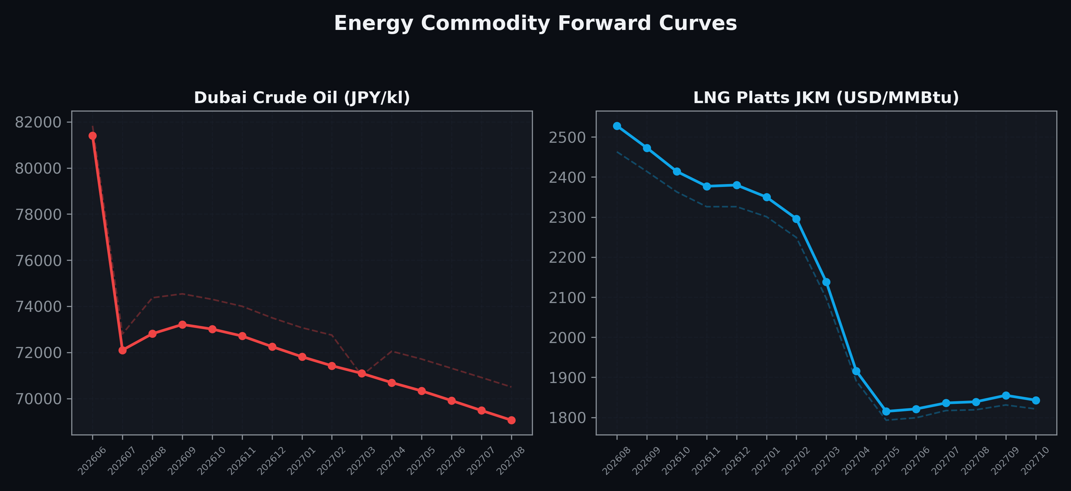
Energy Commodity Forward Curves
Dubai Crude Oil & LNG Platts JKM (2026-06-22)

Slide 6
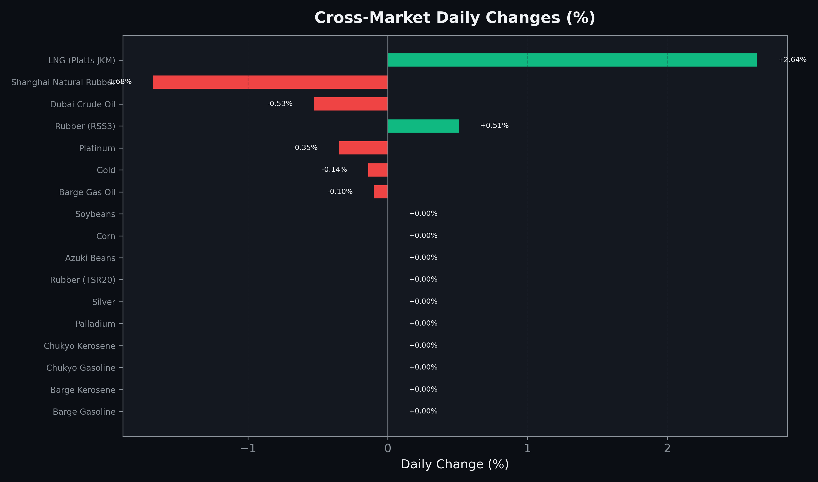
Cross-Market Daily Changes
All commodities sorted by absolute % change

Slide 7
Top Power Futures Movers
Largest absolute settlement price changes vs previous day (2026-06-22)
Instrument | Underlying | Month | Price | Prev | Change | % Chg
FUT_EEPW_260625 | Power East Peak (Weekly) | 20260626 | 21.83 | 23.31 | -1.48 | -6.35%
FUT_EWBW_260625 | Power West Base (Weekly) | 20260626 | 13.09 | 14.03 | -0.94 | -6.70%
FUT_EWPW_260625 | Power West Peak (Weekly) | 20260626 | 16.25 | 17.17 | -0.92 | -5.36%
FUT_EEBW_260625 | Power East Base (Weekly) | 20260626 | 19.52 | 20.40 | -0.88 | -4.31%
FUT_EEP_260730 | Power East Peak (Monthly) | 202607 | 25.45 | 26.03 | -0.58 | -2.23%
FUT_EEP_260929 | Power East Peak (Monthly) | 202609 | 24.63 | 25.11 | -0.48 | -1.91%
FUT_EEP_260828 | Power East Peak (Monthly) | 202608 | 25.52 | 25.95 | -0.43 | -1.66%
FUT_EEPW_260716 | Power East Peak (Weekly) | 20260717 | 25.25 | 25.68 | -0.43 | -1.67%
FUT_EEPW_260709 | Power East Peak (Weekly) | 20260710 | 24.86 | 25.27 | -0.41 | -1.62%
FUT_EWPW_260702 | Power West Peak (Weekly) | 20260703 | 19.99 | 20.38 | -0.39 | -1.91%
FUT_EEPW_260702 | Power East Peak (Weekly) | 20260703 | 23.48 | 23.85 | -0.37 | -1.55%
FUT_EEBW_260702 | Power East Base (Weekly) | 20260703 | 20.14 | 20.50 | -0.36 | -1.76%
FUT_EEPW_260723 | Power East Peak (Weekly) | 20260724 | 25.32 | 25.67 | -0.35 | -1.36%
FUT_ECB_270226 | 電力(中部・ベース) | 202702 | 16.52 | 16.18 | +0.34 | +2.10%
FUT_ECP_260929 | 電力(中部・日中) | 202609 | 24.01 | 24.35 | -0.34 | -1.40%

