Slide 1
Daily Market Report
Trade Date: 2026-06-30
JPX Derivative & Commodity Analytics
DataServer In-House

Slide 2
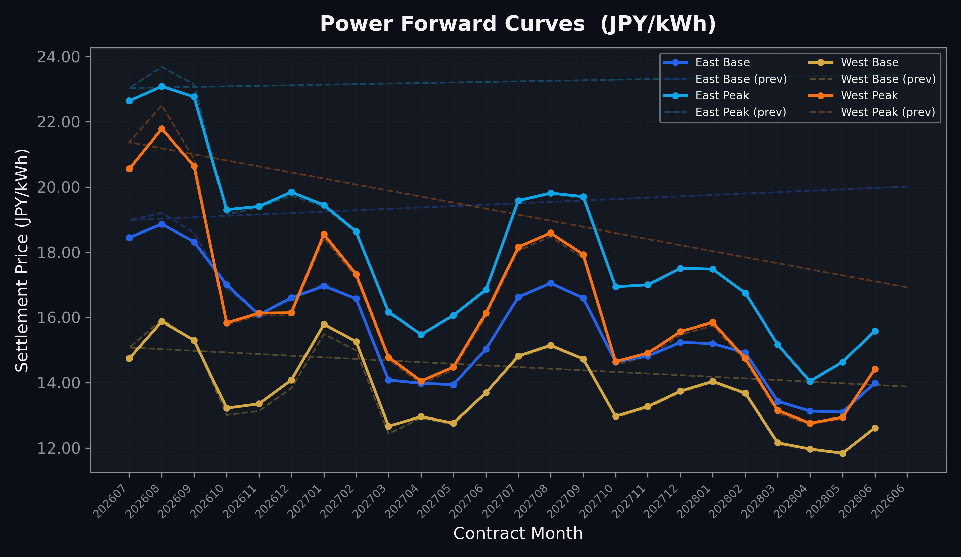
Power Forward Curves
East/West Base & Peak monthly contracts (2026-06-30)

Slide 3
Commodity Snapshot
Front-month settlement prices as of 2026-06-30
Category | Asset | Contract | Settlement | Unit | Change | % Chg
Energy | Barge Gas Oil | 202608 | 105,400.00 | JPY/kl | +300.00 | +0.29%
Energy | Barge Gasoline | 202608 | 97,000.00 | JPY/kl | +0.00 | +0.00%
Energy | Barge Kerosene | 202608 | 108,000.00 | JPY/kl | +0.00 | +0.00%
Energy | Chukyo Gasoline | 202608 | 95,000.00 | JPY/kl | +0.00 | +0.00%
Energy | Chukyo Kerosene | 202608 | 105,000.00 | JPY/kl | +0.00 | +0.00%
Energy | Dubai Crude Oil | 202606 | 80,150.00 | JPY/kl | +0.00 | +0.00%
Energy | LNG (Platts JKM) | 202608 | 2,580.00 | USD/MMBtu | +65.00 | +2.58%
Metals | Gold | - | 21,215.00 | JPY/g | +72.00 | +0.34%
Metals | Palladium | 202608 | 6,400.00 | JPY/g | +0.00 | +0.00%
Metals | Platinum | - | 8,225.00 | JPY/g | -160.00 | -1.91%
Metals | Silver | 202608 | 300.00 | JPY/10g | +0.00 | +0.00%
Industrial | Rubber (RSS3) | 202607 | 406.00 | JPY/kg | +6.00 | +1.50%
Industrial | Rubber (TSR20) | 202607 | 340.00 | JPY/kg | +0.00 | +0.00%
Industrial | Shanghai Natural Rubber | 202609 | 16,720.00 | JPY/kg | +20.00 | +0.12%
Agriculture | Azuki Beans | 202607 | 12,300.00 | JPY/bag | +0.00 | +0.00%
Agriculture | Corn | 202609 | 39,000.00 | JPY/t | +0.00 | +0.00%
Agriculture | Soybeans | 202608 | 64,000.00 | JPY/t | +0.00 | +0.00%

Slide 4
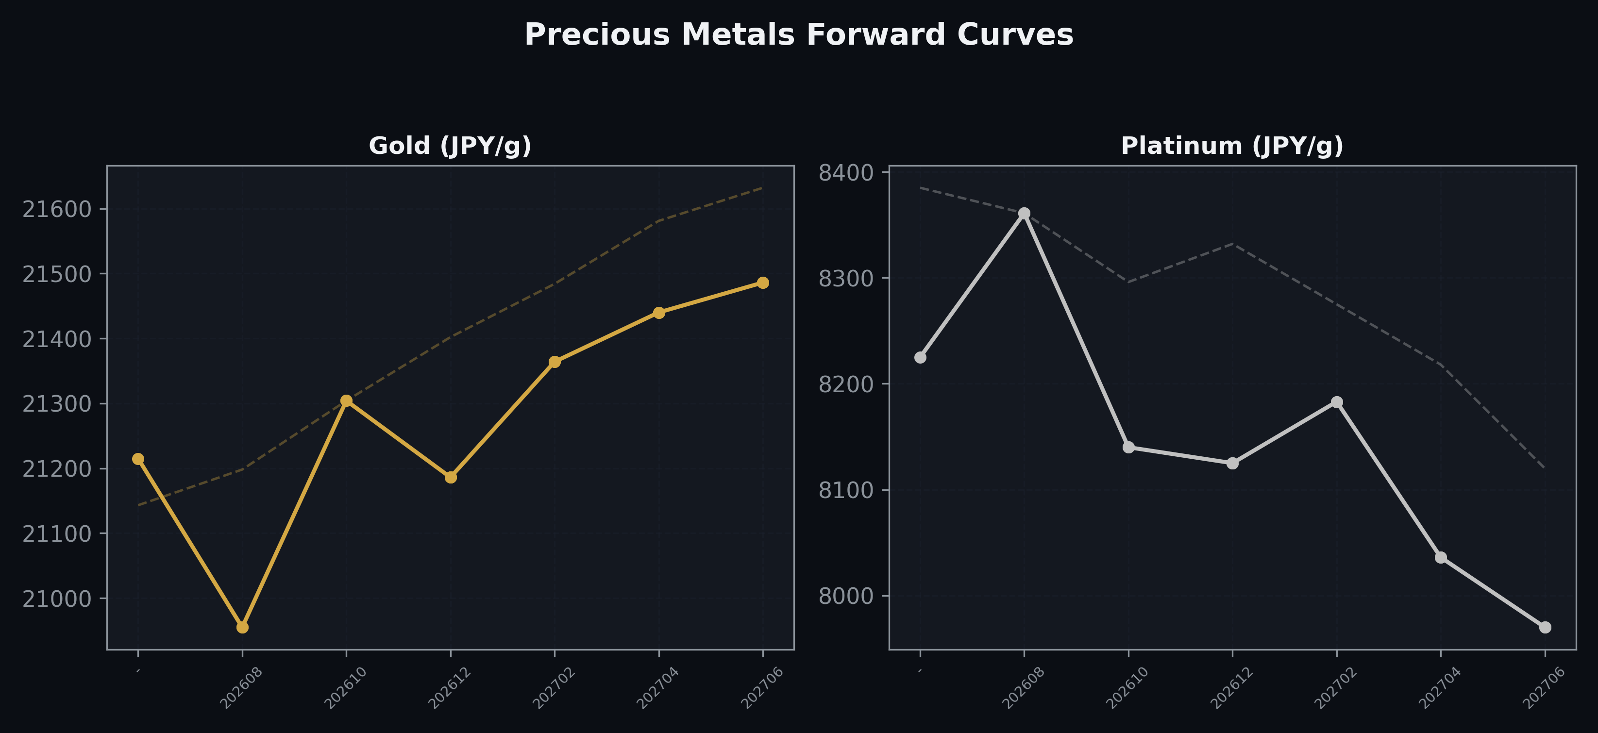
Precious Metals Forward Curves
Gold & Platinum (2026-06-30)

Slide 5
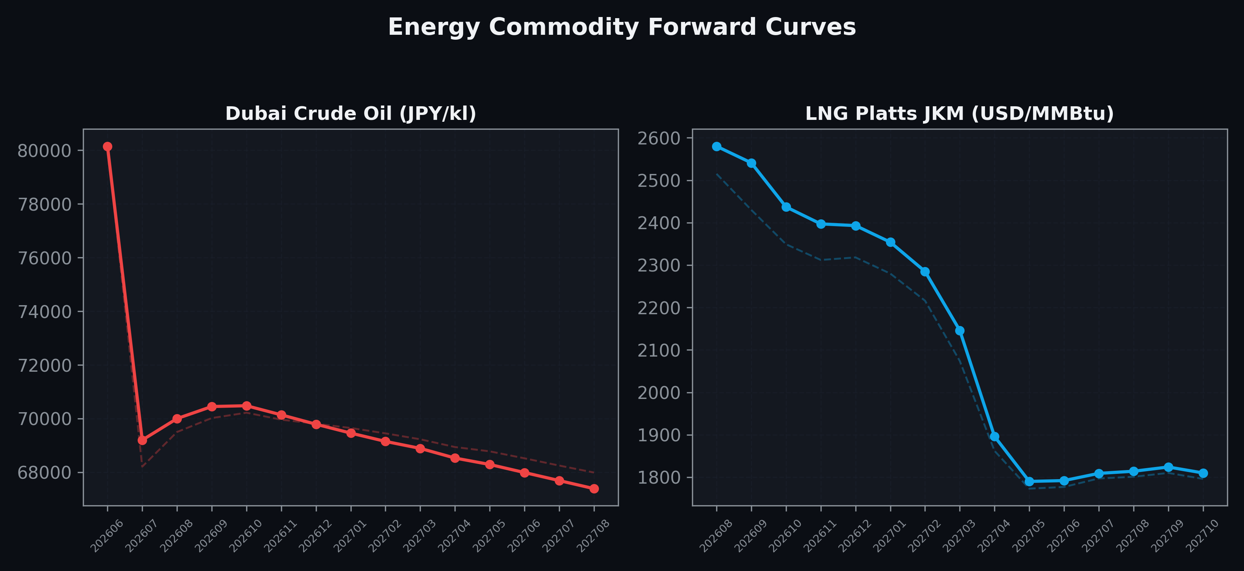
Energy Commodity Forward Curves
Dubai Crude Oil & LNG Platts JKM (2026-06-30)

Slide 6
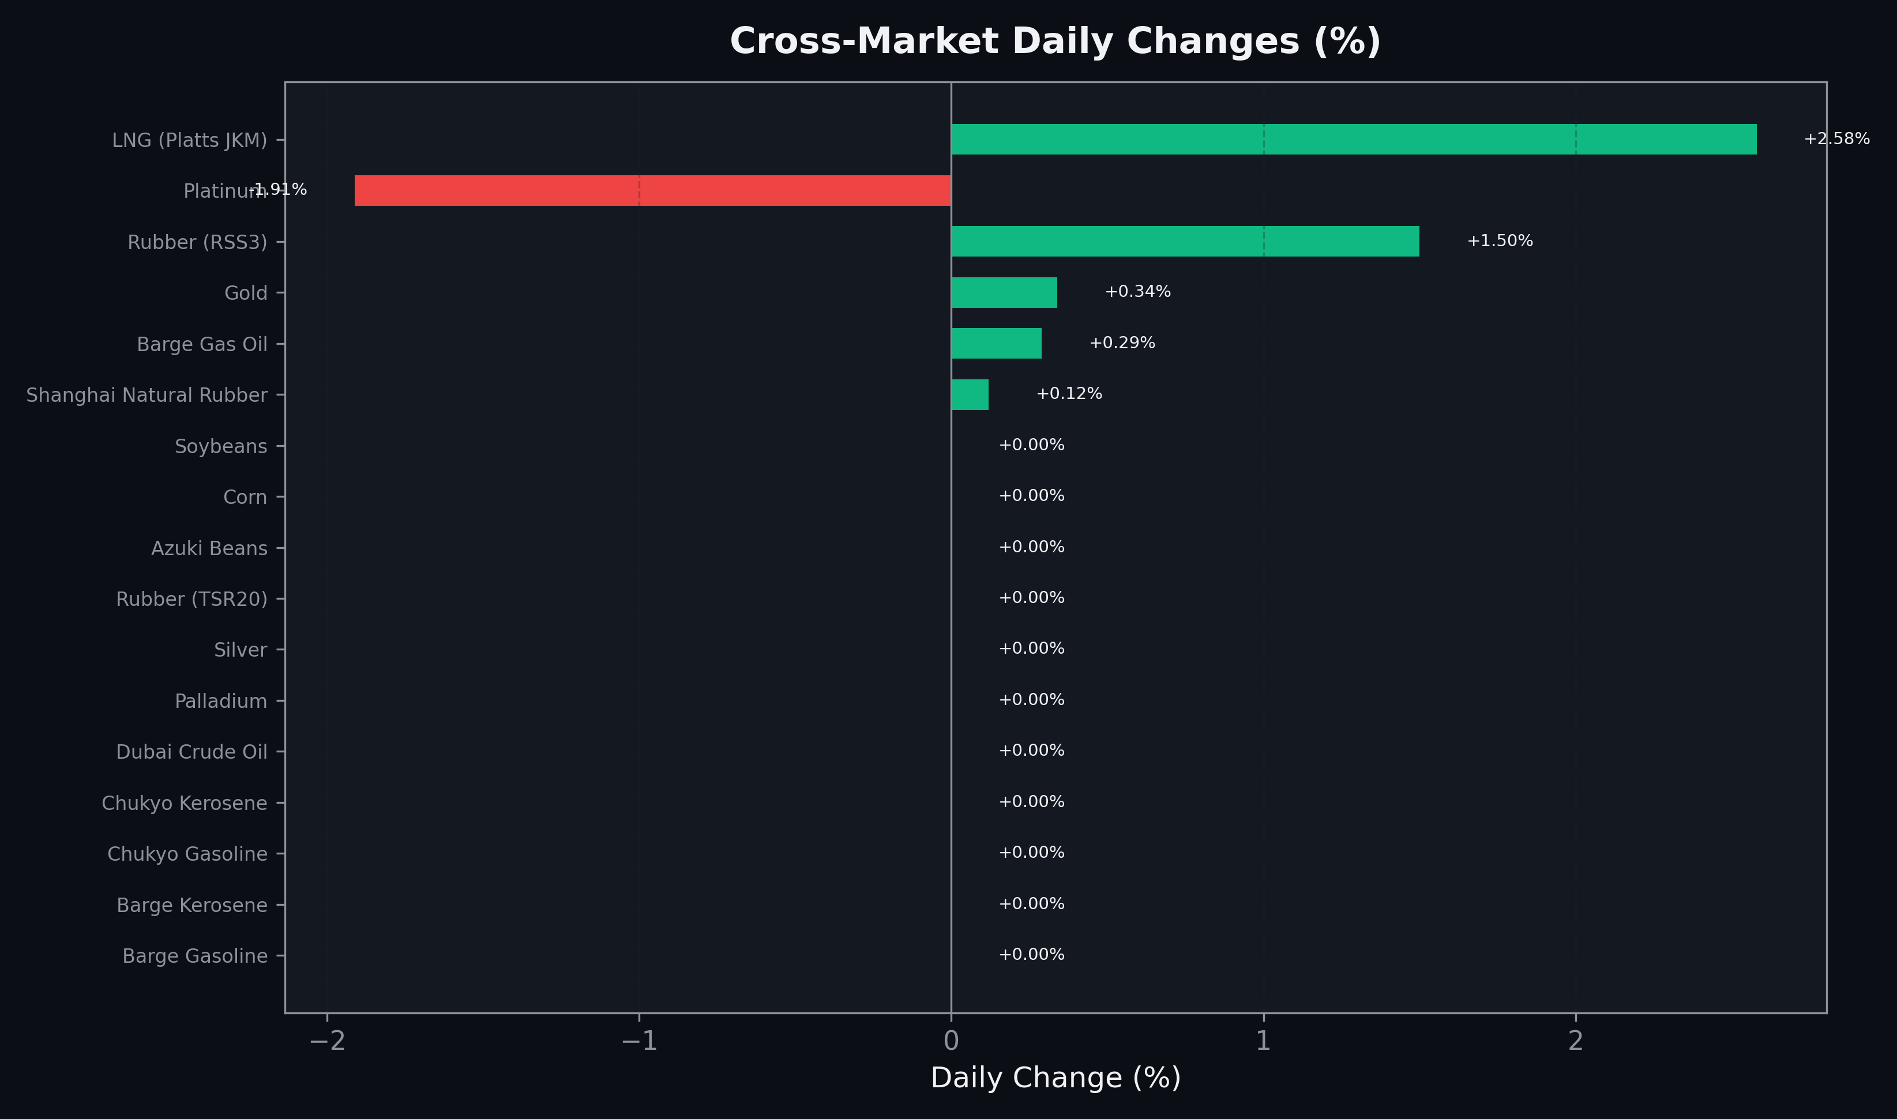
Cross-Market Daily Changes
All commodities sorted by absolute % change

Slide 7
Top Power Futures Movers
Largest absolute settlement price changes vs previous day (2026-06-30)
Instrument | Underlying | Month | Price | Prev | Change | % Chg
FUT_EWPW_260730 | Power West Peak (Weekly) | 20260731 | 19.72 | 21.71 | -1.99 | -9.17%
FUT_EWPW_260702 | Power West Peak (Weekly) | 20260703 | 13.63 | 15.27 | -1.64 | -10.74%
FUT_EWBW_260730 | Power West Base (Weekly) | 20260731 | 15.11 | 16.65 | -1.54 | -9.25%
FUT_EEPW_260730 | Power East Peak (Weekly) | 20260731 | 22.01 | 23.52 | -1.51 | -6.42%
FUT_EEPW_260702 | Power East Peak (Weekly) | 20260703 | 18.76 | 20.23 | -1.47 | -7.27%
FUT_EWPW_260709 | Power West Peak (Weekly) | 20260710 | 19.57 | 20.49 | -0.92 | -4.49%
FUT_ECP_260828 | 電力(中部・日中) | 202608 | 22.69 | 23.52 | -0.83 | -3.53%
FUT_EWP_260730 | Power West Peak (Monthly) | 202607 | 20.56 | 21.37 | -0.81 | -3.79%
FUT_EWBW_260716 | Power West Base (Weekly) | 20260717 | 15.00 | 15.81 | -0.81 | -5.12%
FUT_EEBW_260702 | Power East Base (Weekly) | 20260703 | 16.19 | 16.93 | -0.74 | -4.37%
FUT_EWPW_260723 | Power West Peak (Weekly) | 20260724 | 21.27 | 22.00 | -0.73 | -3.32%
FUT_EWP_260828 | Power West Peak (Monthly) | 202608 | 21.78 | 22.50 | -0.72 | -3.20%
FUT_EWPW_260716 | Power West Peak (Weekly) | 20260717 | 20.32 | 21.00 | -0.68 | -3.24%
FUT_EWBW_260723 | Power West Base (Weekly) | 20260724 | 15.59 | 16.25 | -0.66 | -4.06%
FUT_ECP_260929 | 電力(中部・日中) | 202609 | 22.15 | 22.80 | -0.65 | -2.85%

