Slide 1
Daily Market Report
Trade Date: 2026-05-19
JPX Derivative & Commodity Analytics
DataServer In-House

Slide 2
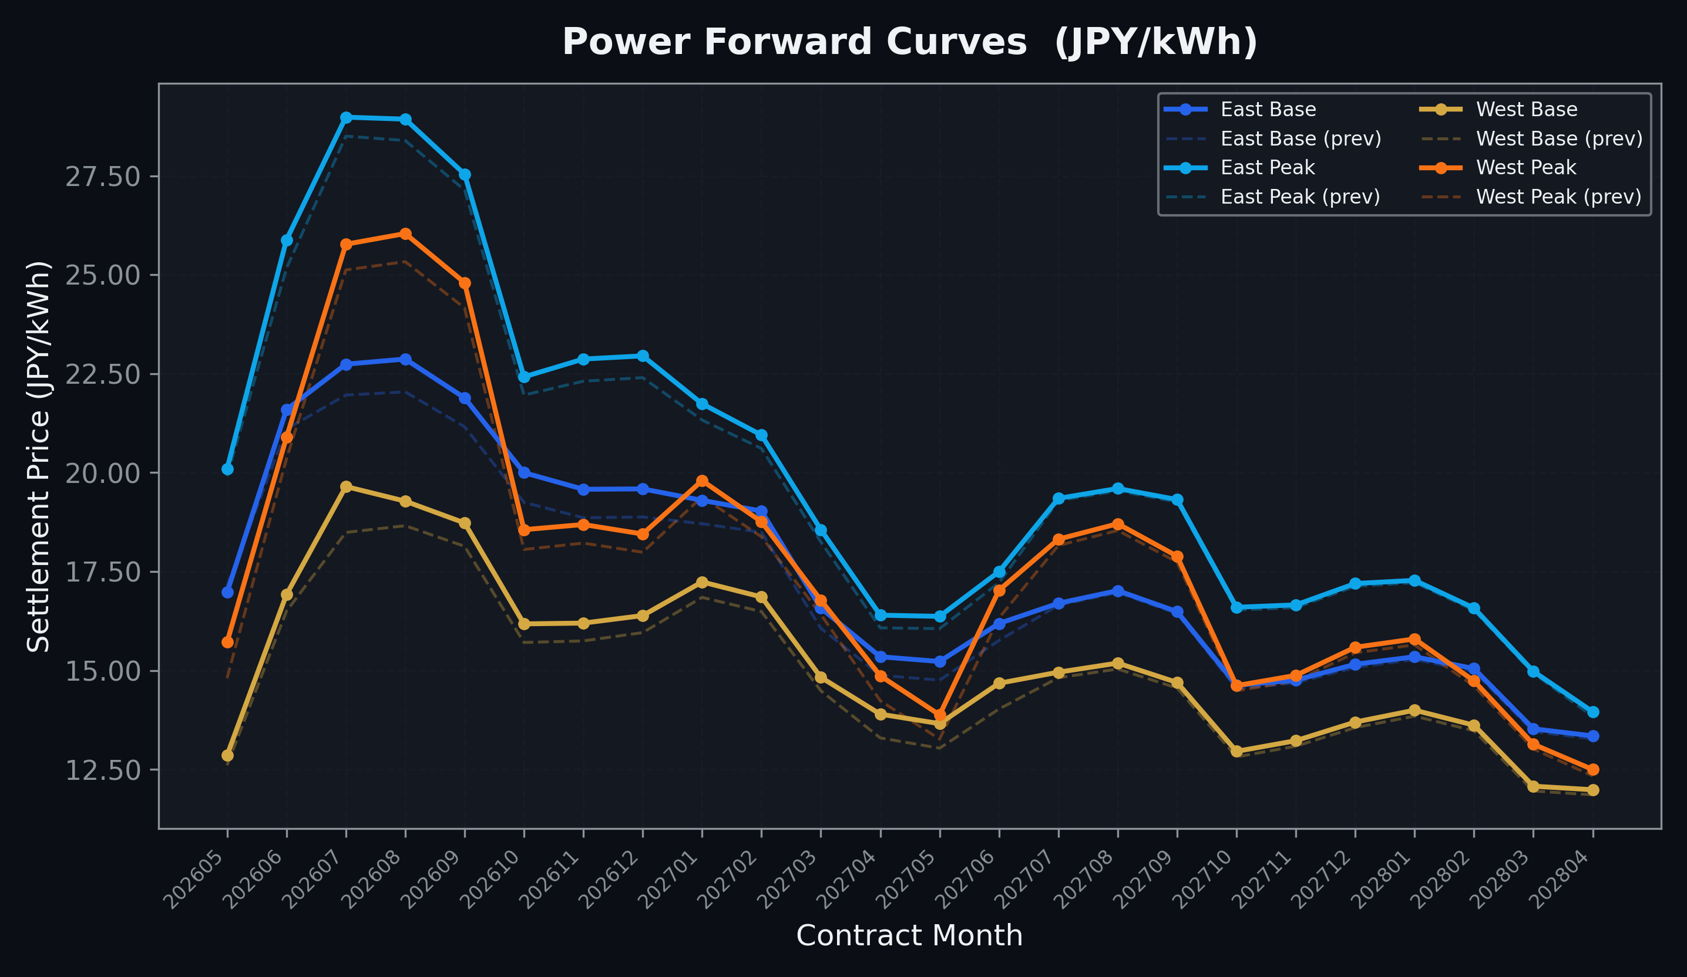
Power Forward Curves
East/West Base & Peak monthly contracts (2026-05-19)

Slide 3
Commodity Snapshot
Front-month settlement prices as of 2026-05-19
Category | Asset | Contract | Settlement | Unit | Change | % Chg
Energy | Barge Gas Oil | 202606 | 109,900.00 | JPY/kl | -300.00 | -0.27%
Energy | Barge Gasoline | 202606 | 100,000.00 | JPY/kl | +0.00 | +0.00%
Energy | Barge Kerosene | 202606 | 105,000.00 | JPY/kl | +0.00 | +0.00%
Energy | Chukyo Gasoline | 202606 | 100,000.00 | JPY/kl | +0.00 | +0.00%
Energy | Chukyo Kerosene | 202606 | 105,000.00 | JPY/kl | +0.00 | +0.00%
Energy | Dubai Crude Oil | 202605 | 104,990.00 | JPY/kl | +1390.00 | +1.34%
Energy | LNG (Platts JKM) | 202607 | 3,014.00 | USD/MMBtu | -28.00 | -0.92%
Metals | Gold | - | 23,154.00 | JPY/g | +74.00 | +0.32%
Metals | Palladium | 202606 | 7,200.00 | JPY/g | +0.00 | +0.00%
Metals | Platinum | - | 9,869.00 | JPY/g | -19.00 | -0.19%
Metals | Silver | 202606 | 395.00 | JPY/10g | +0.00 | +0.00%
Industrial | Rubber (RSS3) | 202605 | 403.50 | JPY/kg | +0.20 | +0.05%
Industrial | Rubber (TSR20) | 202606 | 350.00 | JPY/kg | +0.00 | +0.00%
Industrial | Shanghai Natural Rubber | 202609 | 17,895.00 | JPY/kg | +75.00 | +0.42%
Agriculture | Azuki Beans | 202605 | 12,300.00 | JPY/bag | +0.00 | +0.00%
Agriculture | Corn | 202607 | 39,000.00 | JPY/t | +0.00 | +0.00%
Agriculture | Soybeans | 202606 | 64,000.00 | JPY/t | +0.00 | +0.00%

Slide 4
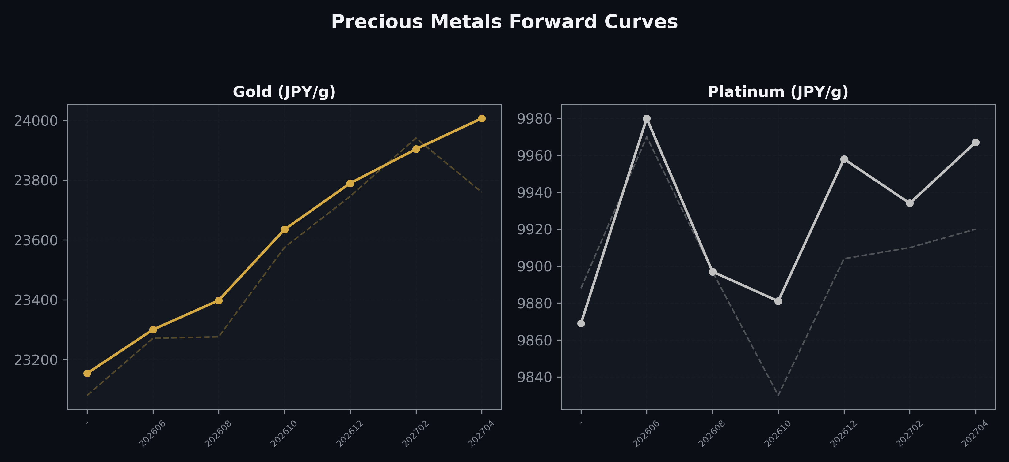
Precious Metals Forward Curves
Gold & Platinum (2026-05-19)

Slide 5
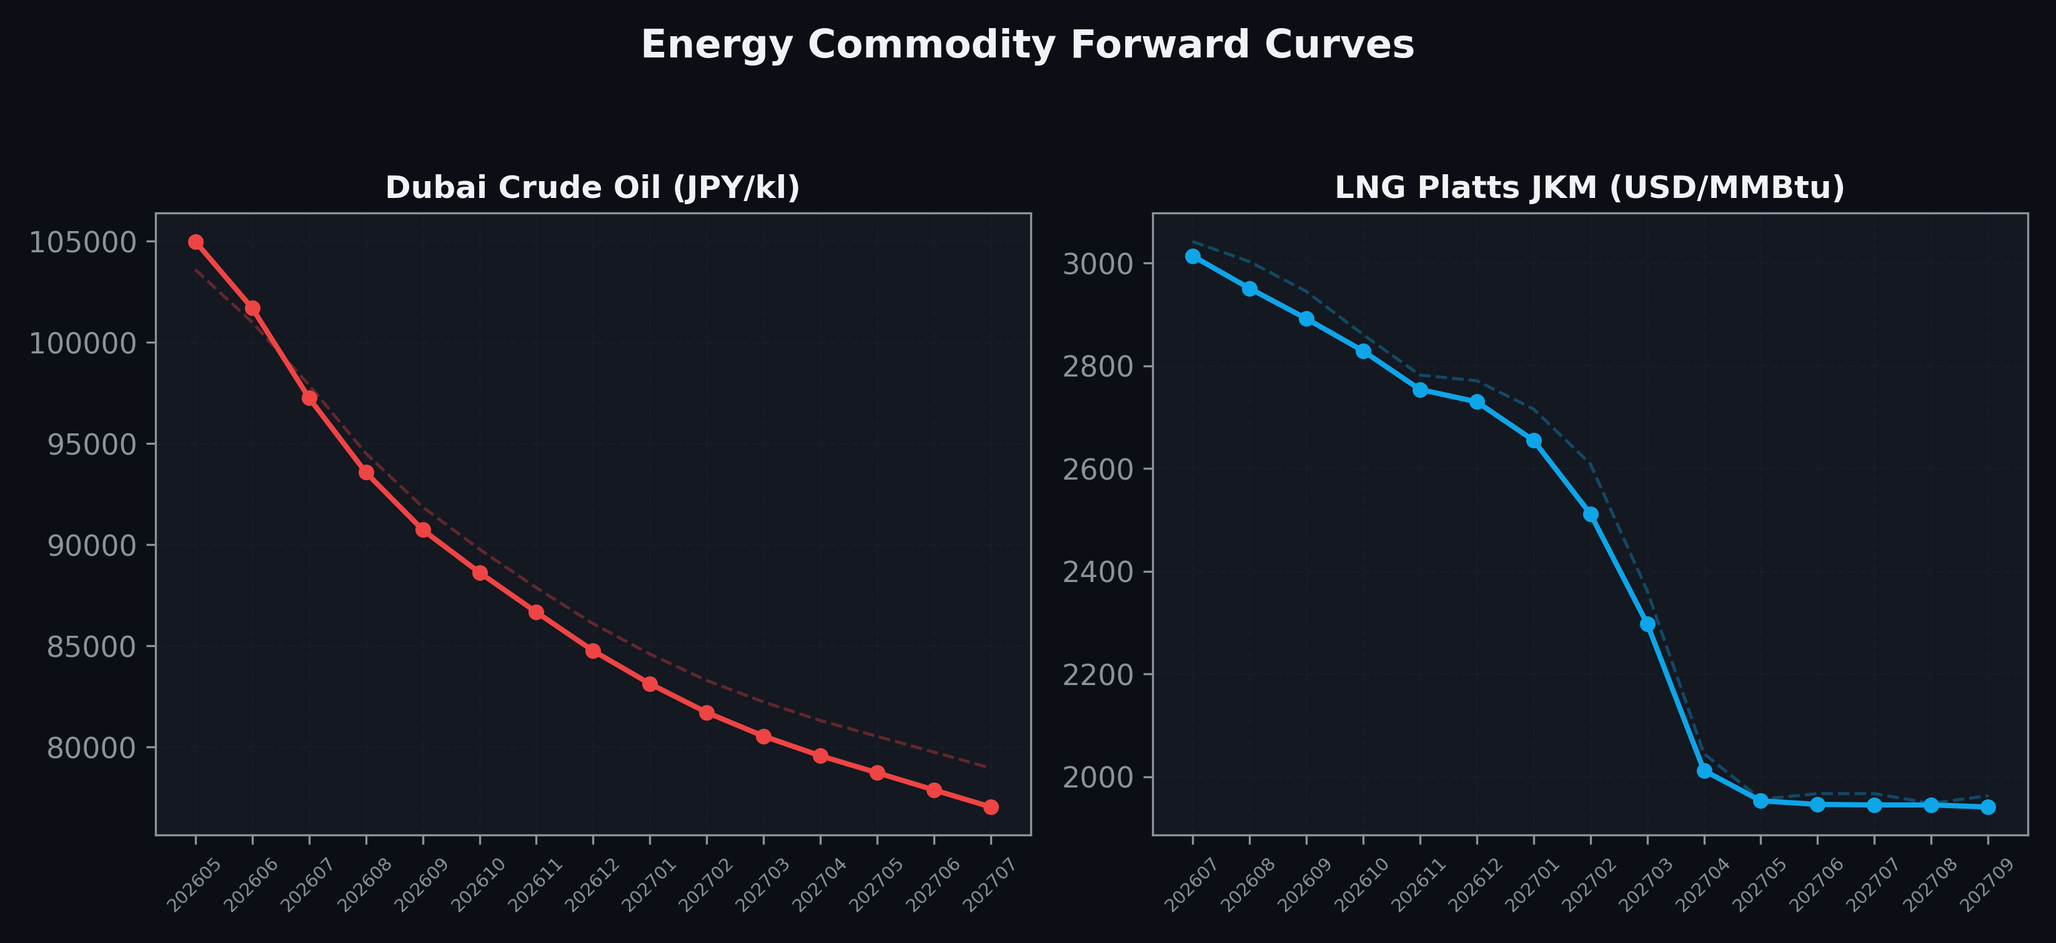
Energy Commodity Forward Curves
Dubai Crude Oil & LNG Platts JKM (2026-05-19)

Slide 6
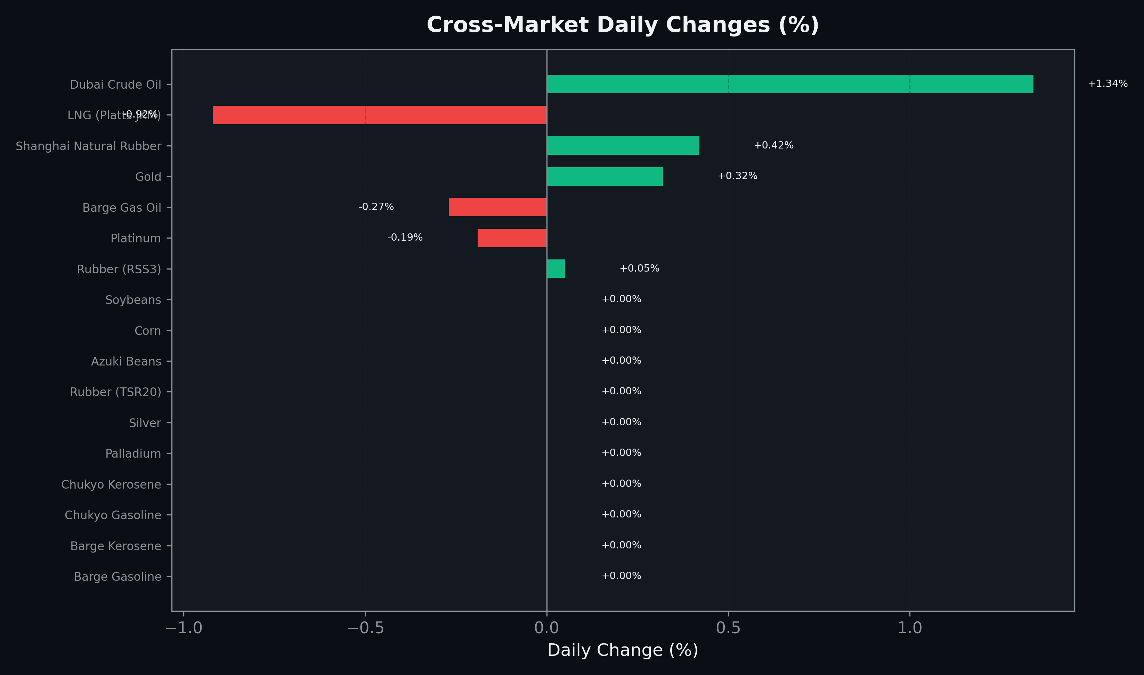
Cross-Market Daily Changes
All commodities sorted by absolute % change

Slide 7
Top Power Futures Movers
Largest absolute settlement price changes vs previous day (2026-05-19)
Instrument | Underlying | Month | Price | Prev | Change | % Chg
FUT_EWPW_260521 | Power West Peak (Weekly) | 20260522 | 18.39 | 15.36 | +3.03 | +19.73%
FUT_EWB_260730 | Power West Base (Monthly) | 202607 | 19.65 | 18.49 | +1.16 | +6.27%
FUT_EEPW_260521 | Power East Peak (Weekly) | 20260522 | 21.32 | 20.20 | +1.12 | +5.54%
FUT_EWBW_260521 | Power West Base (Weekly) | 20260522 | 14.62 | 13.56 | +1.06 | +7.82%
FUT_ECP_260828 | 電力(中部・日中) | 202608 | 27.07 | 26.14 | +0.93 | +3.56%
FUT_EWP_260528 | Power West Peak (Monthly) | 202605 | 15.72 | 14.81 | +0.91 | +6.14%
FUT_EWPW_260528 | Power West Peak (Weekly) | 20260529 | 13.28 | 12.39 | +0.89 | +7.18%
FUT_ECP_260730 | 電力(中部・日中) | 202607 | 26.60 | 25.76 | +0.84 | +3.26%
FUT_EEB_260828 | Power East Base (Monthly) | 202608 | 22.87 | 22.04 | +0.83 | +3.77%
FUT_ECB_260828 | 電力(中部・ベース) | 202608 | 21.42 | 20.63 | +0.79 | +3.83%
FUT_ECP_261127 | 電力(中部・日中) | 202611 | 20.41 | 19.62 | +0.79 | +4.03%
FUT_EEB_260730 | Power East Base (Monthly) | 202607 | 22.74 | 21.96 | +0.78 | +3.55%
FUT_ECP_261228 | 電力(中部・日中) | 202612 | 20.29 | 19.52 | +0.77 | +3.94%
FUT_ECP_260929 | 電力(中部・日中) | 202609 | 26.39 | 25.64 | +0.75 | +2.93%
FUT_EEB_261030 | Power East Base (Monthly) | 202610 | 20.00 | 19.25 | +0.75 | +3.90%

