Slide 1
Daily Market Report
Trade Date: 2026-05-21
JPX Derivative & Commodity Analytics
DataServer In-House

Slide 2
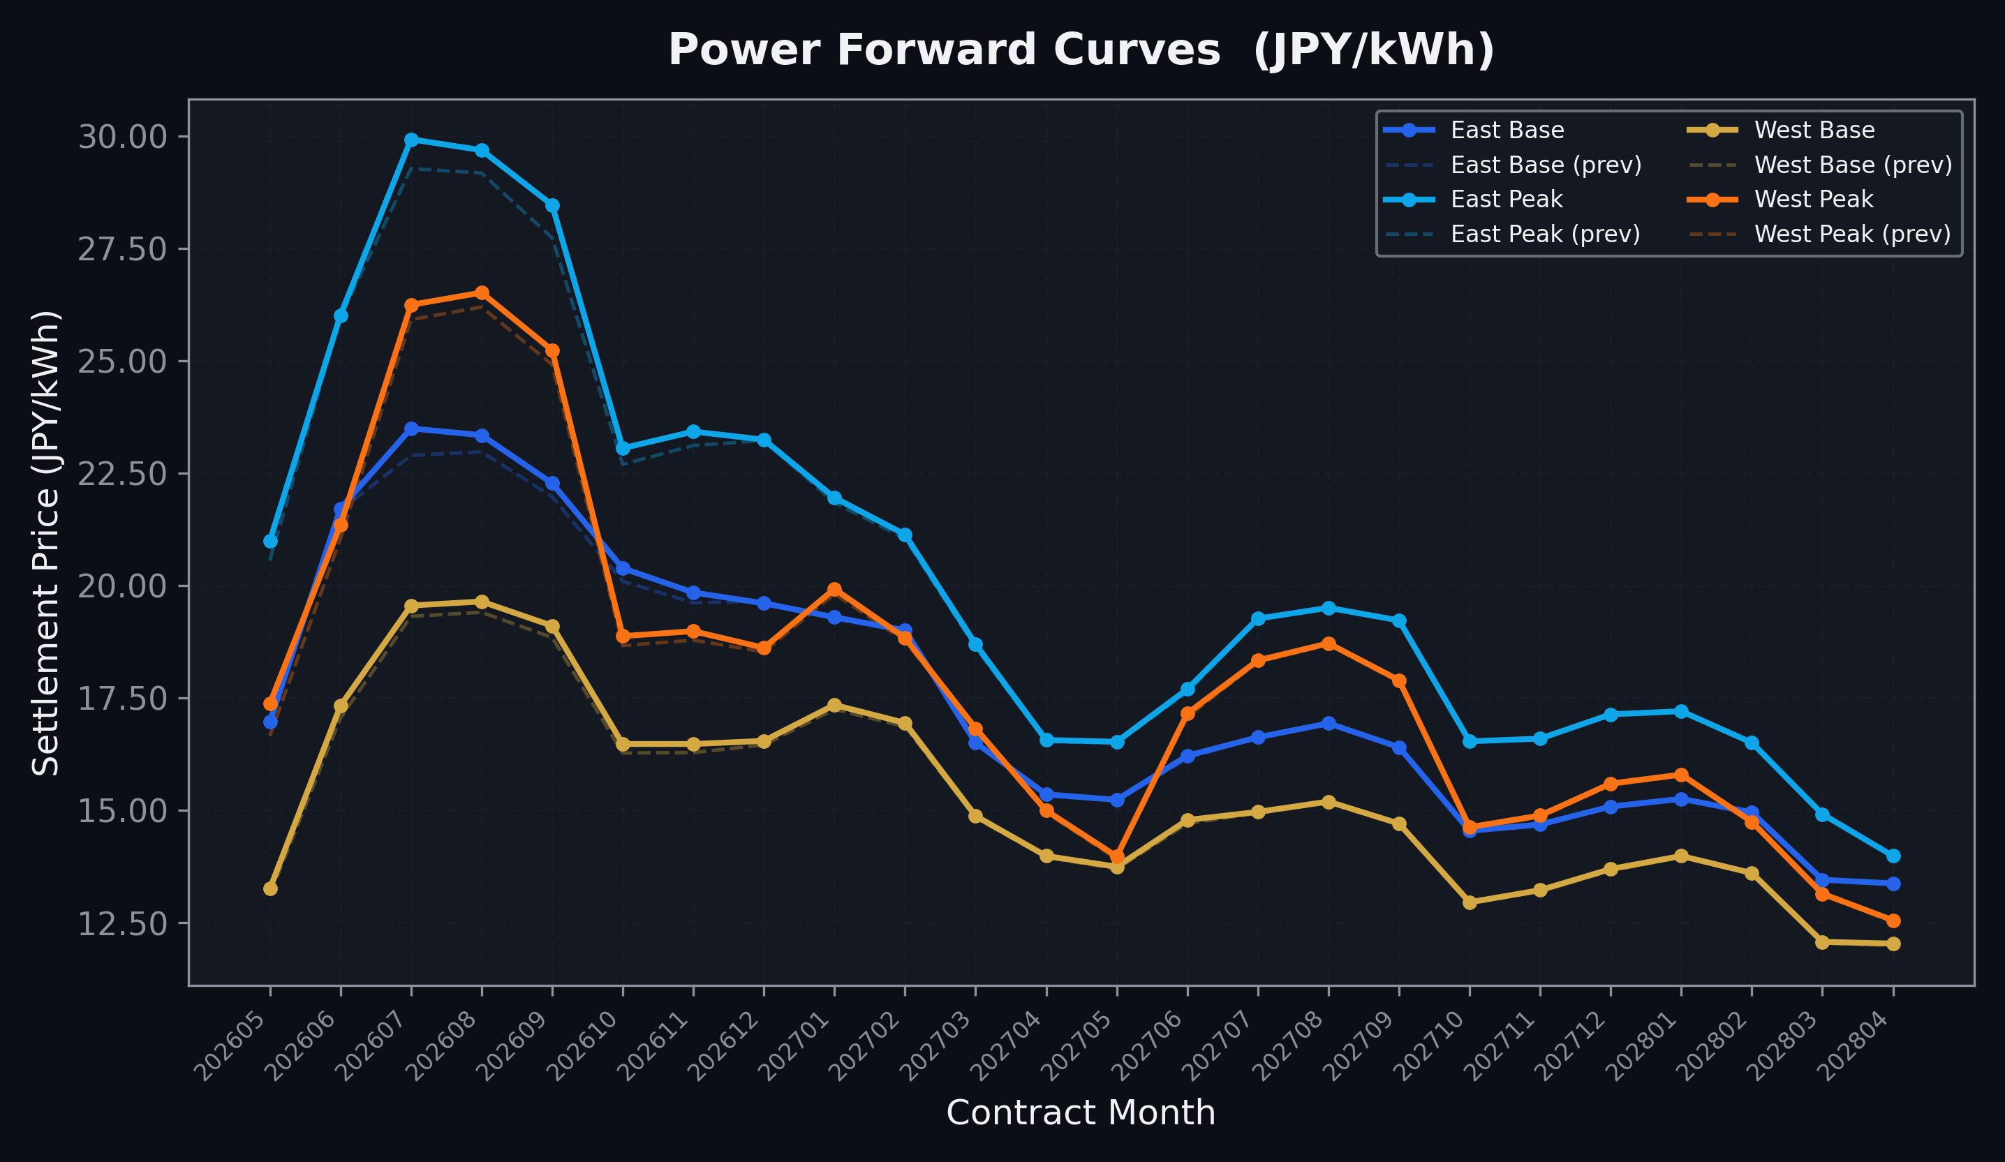
Power Forward Curves
East/West Base & Peak monthly contracts (2026-05-21)

Slide 3
Commodity Snapshot
Front-month settlement prices as of 2026-05-21
Category | Asset | Contract | Settlement | Unit | Change | % Chg
Energy | Barge Gas Oil | 202606 | 109,700.00 | JPY/kl | +0.00 | +0.00%
Energy | Barge Gasoline | 202606 | 100,000.00 | JPY/kl | +0.00 | +0.00%
Energy | Barge Kerosene | 202606 | 105,000.00 | JPY/kl | +0.00 | +0.00%
Energy | Chukyo Gasoline | 202606 | 100,000.00 | JPY/kl | +0.00 | +0.00%
Energy | Chukyo Kerosene | 202606 | 105,000.00 | JPY/kl | +0.00 | +0.00%
Energy | Dubai Crude Oil | 202605 | 102,760.00 | JPY/kl | -1970.00 | -1.88%
Energy | LNG (Platts JKM) | 202607 | 3,001.00 | USD/MMBtu | -130.00 | -4.15%
Metals | Gold | - | 23,004.00 | JPY/g | +314.00 | +1.38%
Metals | Palladium | 202606 | 7,000.00 | JPY/g | +0.00 | +0.00%
Metals | Platinum | - | 9,753.00 | JPY/g | +96.00 | +0.99%
Metals | Silver | 202606 | 390.00 | JPY/10g | +0.00 | +0.00%
Industrial | Rubber (RSS3) | 202605 | 397.00 | JPY/kg | +0.00 | +0.00%
Industrial | Rubber (TSR20) | 202606 | 350.00 | JPY/kg | +0.00 | +0.00%
Industrial | Shanghai Natural Rubber | 202609 | 17,470.00 | JPY/kg | -260.00 | -1.47%
Agriculture | Azuki Beans | 202605 | 12,300.00 | JPY/bag | +0.00 | +0.00%
Agriculture | Corn | 202607 | 39,000.00 | JPY/t | +0.00 | +0.00%
Agriculture | Soybeans | 202606 | 64,000.00 | JPY/t | +0.00 | +0.00%

Slide 4
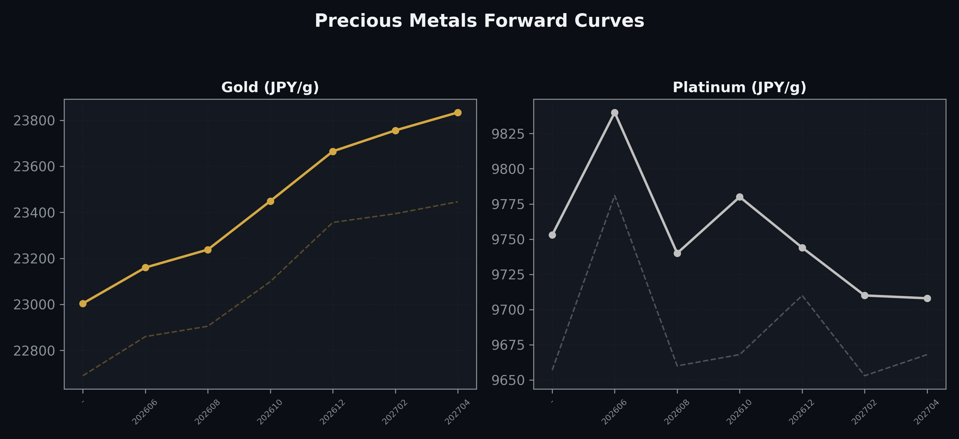
Precious Metals Forward Curves
Gold & Platinum (2026-05-21)

Slide 5
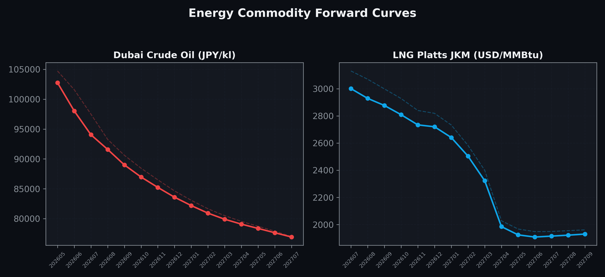
Energy Commodity Forward Curves
Dubai Crude Oil & LNG Platts JKM (2026-05-21)

Slide 6
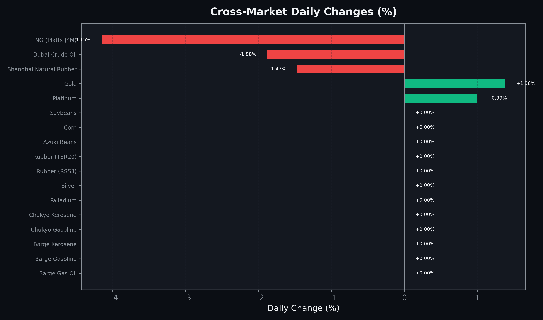
Cross-Market Daily Changes
All commodities sorted by absolute % change

Slide 7
Top Power Futures Movers
Largest absolute settlement price changes vs previous day (2026-05-21)
Instrument | Underlying | Month | Price | Prev | Change | % Chg
FUT_EWPW_260521 | Power West Peak (Weekly) | 20260522 | 23.01 | 21.81 | +1.20 | +5.50%
FUT_ECP_260929 | 電力(中部・日中) | 202609 | 27.47 | 26.43 | +1.04 | +3.93%
FUT_EEPW_260521 | Power East Peak (Weekly) | 20260522 | 24.45 | 23.52 | +0.93 | +3.95%
FUT_ECP_260730 | 電力(中部・日中) | 202607 | 27.58 | 26.66 | +0.92 | +3.45%
FUT_ECB_260929 | 電力(中部・ベース) | 202609 | 21.66 | 20.77 | +0.89 | +4.29%
FUT_EEP_260929 | Power East Peak (Monthly) | 202609 | 28.47 | 27.74 | +0.73 | +2.63%
FUT_ECP_260828 | 電力(中部・日中) | 202608 | 27.82 | 27.10 | +0.72 | +2.66%
FUT_EWP_260528 | Power West Peak (Monthly) | 202605 | 17.38 | 16.66 | +0.72 | +4.32%
FUT_ECB_260730 | 電力(中部・ベース) | 202607 | 22.07 | 21.41 | +0.66 | +3.08%
FUT_EWBW_260521 | Power West Base (Weekly) | 20260522 | 16.60 | 15.94 | +0.66 | +4.14%
FUT_ECP_260528 | 電力(中部・日中) | 202605 | 18.85 | 18.20 | +0.65 | +3.57%
FUT_EEP_260730 | Power East Peak (Monthly) | 202607 | 29.93 | 29.28 | +0.65 | +2.22%
FUT_EWPW_260528 | Power West Peak (Weekly) | 20260529 | 14.66 | 14.05 | +0.61 | +4.34%
FUT_EEB_260730 | Power East Base (Monthly) | 202607 | 23.50 | 22.90 | +0.60 | +2.62%
FUT_ECB_260828 | 電力(中部・ベース) | 202608 | 22.05 | 21.52 | +0.53 | +2.46%

