Slide 1
Daily Market Report
Trade Date: 2026-06-09
JPX Derivative & Commodity Analytics
DataServer In-House

Slide 2
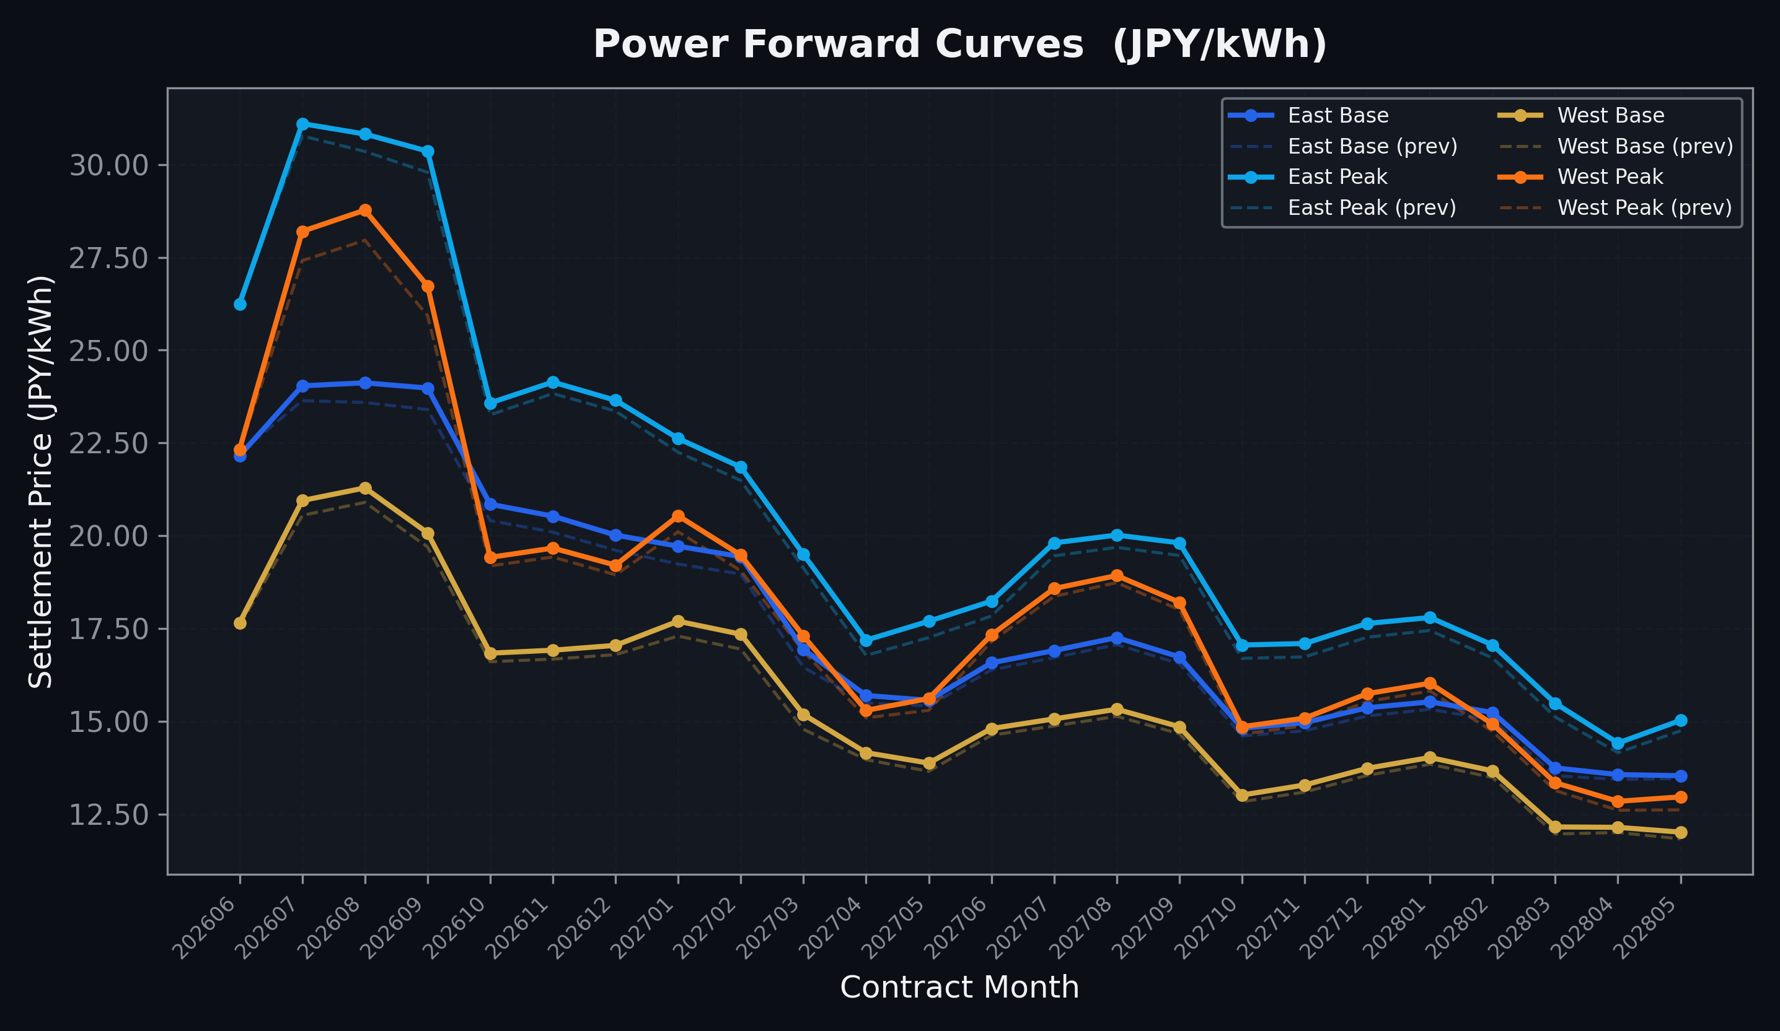
Power Forward Curves
East/West Base & Peak monthly contracts (2026-06-09)

Slide 3
Commodity Snapshot
Front-month settlement prices as of 2026-06-09
Category | Asset | Contract | Settlement | Unit | Change | % Chg
Energy | Barge Gas Oil | 202607 | 106,500.00 | JPY/kl | -400.00 | -0.37%
Energy | Barge Gasoline | 202607 | 100,000.00 | JPY/kl | +0.00 | +0.00%
Energy | Barge Kerosene | 202607 | 110,000.00 | JPY/kl | +0.00 | +0.00%
Energy | Chukyo Gasoline | 202607 | 95,000.00 | JPY/kl | +0.00 | +0.00%
Energy | Chukyo Kerosene | 202607 | 105,000.00 | JPY/kl | +0.00 | +0.00%
Energy | Dubai Crude Oil | 202606 | 91,300.00 | JPY/kl | +500.00 | +0.55%
Energy | LNG (Platts JKM) | 202607 | 3,034.00 | USD/MMBtu | -11.00 | -0.36%
Metals | Gold | - | 22,282.00 | JPY/g | +115.00 | +0.52%
Metals | Palladium | 202606 | 6,300.00 | JPY/g | -200.00 | -3.08%
Metals | Platinum | - | 8,978.00 | JPY/g | -39.00 | -0.43%
Metals | Silver | 202606 | 350.00 | JPY/10g | -5.00 | -1.41%
Industrial | Rubber (RSS3) | 202606 | 410.00 | JPY/kg | -2.40 | -0.58%
Industrial | Rubber (TSR20) | 202607 | 360.00 | JPY/kg | +0.00 | +0.00%
Industrial | Shanghai Natural Rubber | 202609 | 17,720.00 | JPY/kg | +50.00 | +0.28%
Agriculture | Azuki Beans | 202606 | 12,300.00 | JPY/bag | +0.00 | +0.00%
Agriculture | Corn | 202607 | 39,000.00 | JPY/t | +0.00 | +0.00%
Agriculture | Soybeans | 202606 | 64,000.00 | JPY/t | +0.00 | +0.00%

Slide 4
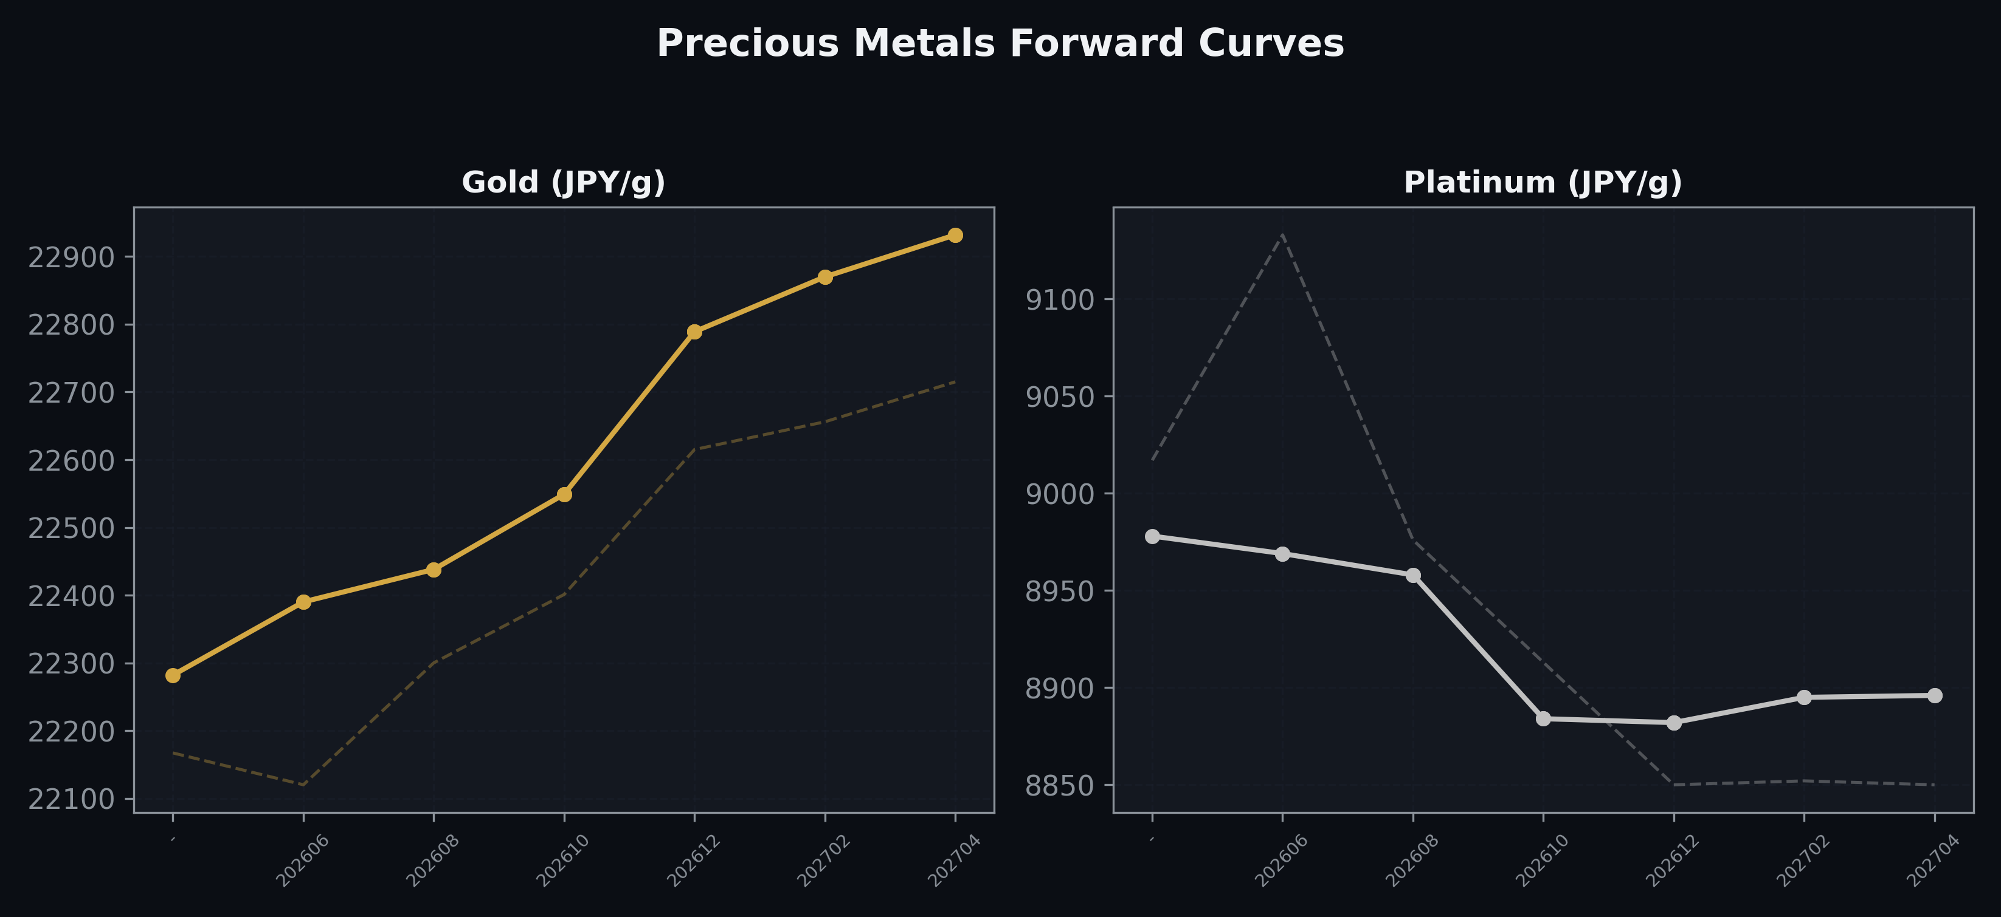
Precious Metals Forward Curves
Gold & Platinum (2026-06-09)

Slide 5
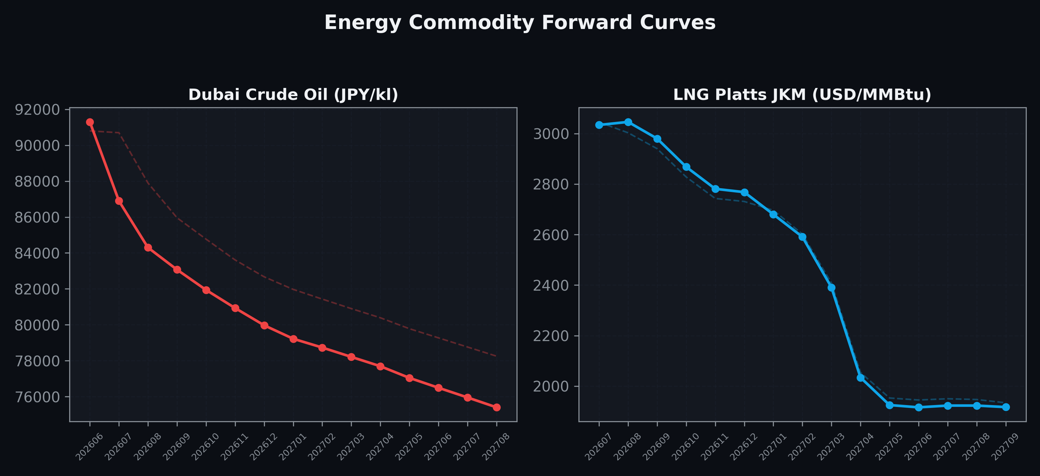
Energy Commodity Forward Curves
Dubai Crude Oil & LNG Platts JKM (2026-06-09)

Slide 6
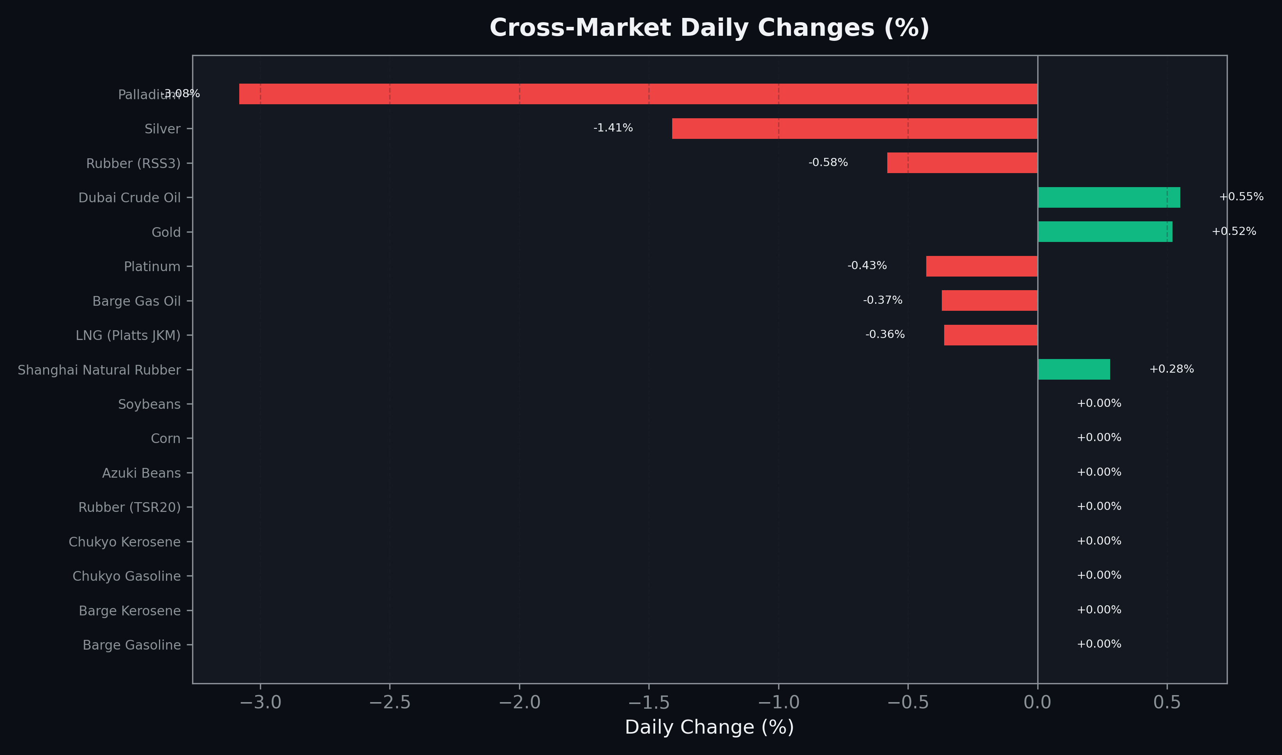
Cross-Market Daily Changes
All commodities sorted by absolute % change

Slide 7
Top Power Futures Movers
Largest absolute settlement price changes vs previous day (2026-06-09)
Instrument | Underlying | Month | Price | Prev | Change | % Chg
FUT_EWPW_260611 | Power West Peak (Weekly) | 20260612 | 19.57 | 21.23 | -1.66 | -7.82%
FUT_EWBW_260611 | Power West Base (Weekly) | 20260612 | 16.37 | 17.23 | -0.86 | -4.99%
FUT_EWP_260828 | Power West Peak (Monthly) | 202608 | 28.77 | 27.96 | +0.81 | +2.90%
FUT_EWP_260929 | Power West Peak (Monthly) | 202609 | 26.73 | 25.93 | +0.80 | +3.09%
FUT_EWP_260730 | Power West Peak (Monthly) | 202607 | 28.20 | 27.41 | +0.79 | +2.88%
FUT_EEB_260929 | Power East Base (Monthly) | 202609 | 23.98 | 23.40 | +0.58 | +2.48%
FUT_EEP_260929 | Power East Peak (Monthly) | 202609 | 30.36 | 29.79 | +0.57 | +1.91%
FUT_EEB_260828 | Power East Base (Monthly) | 202608 | 24.12 | 23.59 | +0.53 | +2.25%
FUT_EEPW_260611 | Power East Peak (Weekly) | 20260612 | 25.01 | 25.54 | -0.53 | -2.08%
FUT_ECB_270129 | 電力(中部・ベース) | 202701 | 18.76 | 18.26 | +0.50 | +2.74%
FUT_ECP_260929 | 電力(中部・日中) | 202609 | 28.87 | 28.37 | +0.50 | +1.76%
FUT_ECB_270226 | 電力(中部・ベース) | 202702 | 18.65 | 18.17 | +0.48 | +2.64%
FUT_ECB_270330 | 電力(中部・ベース) | 202703 | 16.31 | 15.83 | +0.48 | +3.03%
FUT_EEB_270129 | Power East Base (Monthly) | 202701 | 19.72 | 19.24 | +0.48 | +2.49%
FUT_EEB_270330 | Power East Base (Monthly) | 202703 | 16.94 | 16.46 | +0.48 | +2.92%

