Slide 1
Daily Market Report
Trade Date: 2026-04-13
JPX Derivative & Commodity Analytics
DataServer In-House

Slide 2
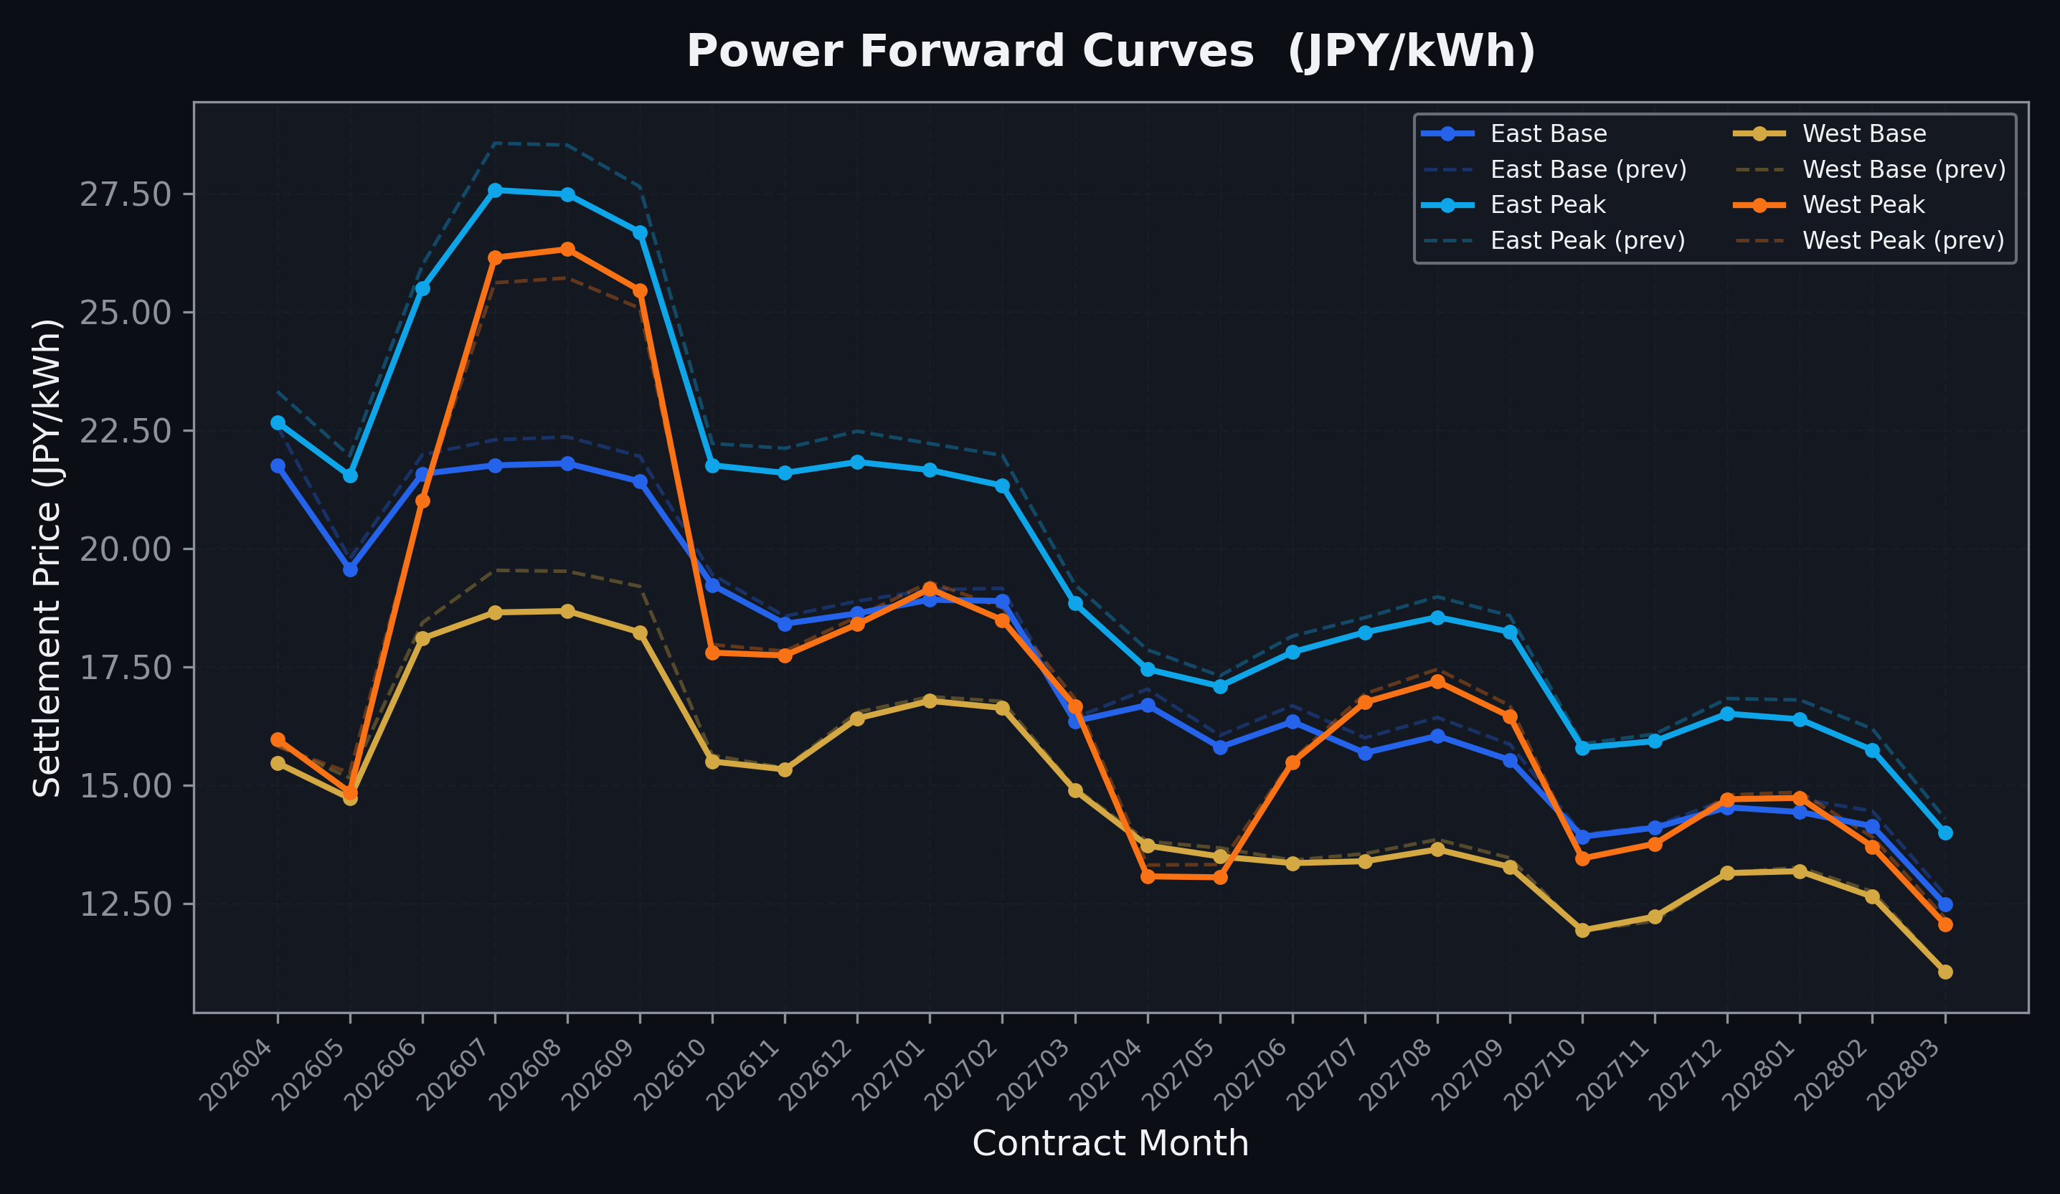
Power Forward Curves
East/West Base & Peak monthly contracts (2026-04-13)

Slide 3
Commodity Snapshot
Front-month settlement prices as of 2026-04-13
Category | Asset | Contract | Settlement | Unit | Change | % Chg
Energy | Barge Gas Oil | 202605 | 114,300.00 | JPY/kl | +1200.00 | +1.06%
Energy | Barge Gasoline | 202605 | 115,000.00 | JPY/kl | +0.00 | +0.00%
Energy | Barge Kerosene | 202605 | 105,000.00 | JPY/kl | +0.00 | +0.00%
Energy | Chukyo Gasoline | 202605 | 110,000.00 | JPY/kl | +0.00 | +0.00%
Energy | Chukyo Kerosene | 202605 | 105,000.00 | JPY/kl | +0.00 | +0.00%
Energy | Dubai Crude Oil | 202604 | 100,750.00 | JPY/kl | -2480.00 | -2.40%
Energy | LNG (Platts JKM) | 202605 | 2,844.00 | USD/MMBtu | -66.00 | -2.27%
Metals | Gold | - | 24,175.00 | JPY/g | -34.00 | -0.14%
Metals | Palladium | 202604 | 7,800.00 | JPY/g | +300.00 | +4.00%
Metals | Platinum | - | 10,371.00 | JPY/g | +37.00 | +0.36%
Metals | Silver | 202604 | 365.00 | JPY/10g | +0.00 | +0.00%
Industrial | Rubber (RSS3) | 202604 | 377.00 | JPY/kg | -2.40 | -0.63%
Industrial | Rubber (TSR20) | 202605 | 320.00 | JPY/kg | +0.00 | +0.00%
Industrial | Shanghai Natural Rubber | 202605 | 16,665.00 | JPY/kg | -45.00 | -0.27%
Agriculture | Azuki Beans | 202604 | 12,300.00 | JPY/bag | +0.00 | +0.00%
Agriculture | Corn | 202605 | 39,000.00 | JPY/t | +0.00 | +0.00%
Agriculture | Soybeans | 202604 | 64,000.00 | JPY/t | +0.00 | +0.00%

Slide 4
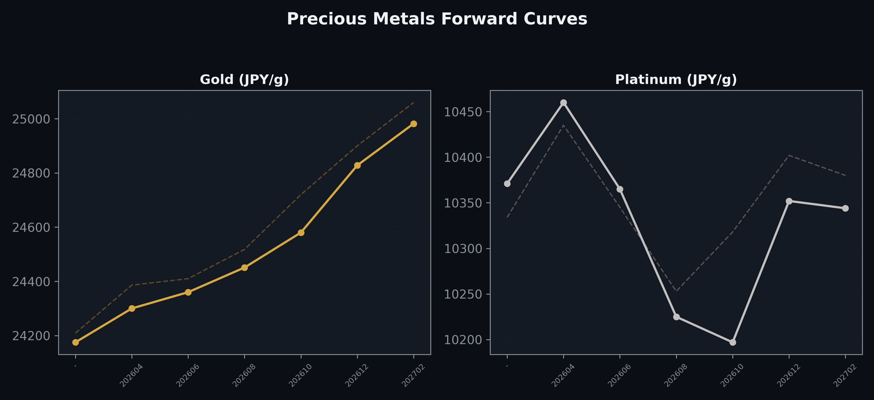
Precious Metals Forward Curves
Gold & Platinum (2026-04-13)

Slide 5
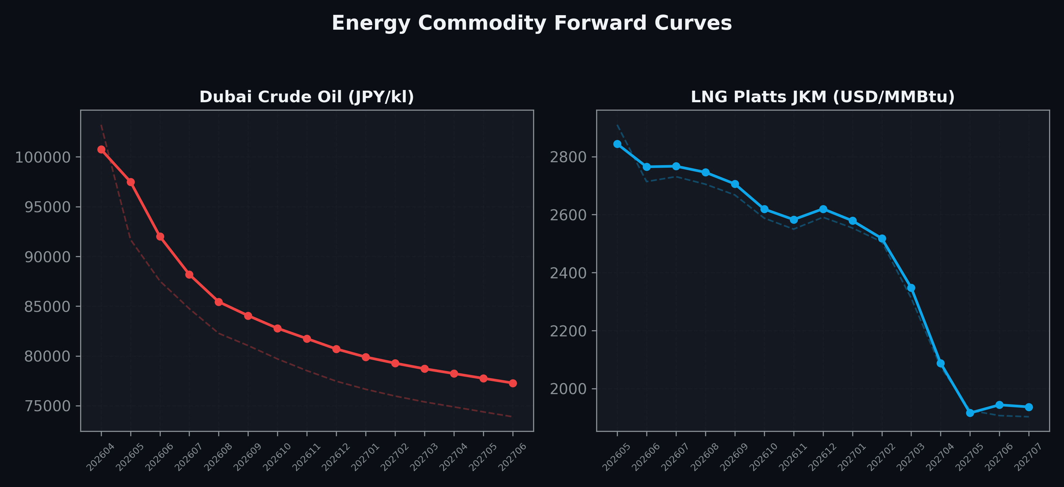
Energy Commodity Forward Curves
Dubai Crude Oil & LNG Platts JKM (2026-04-13)

Slide 6
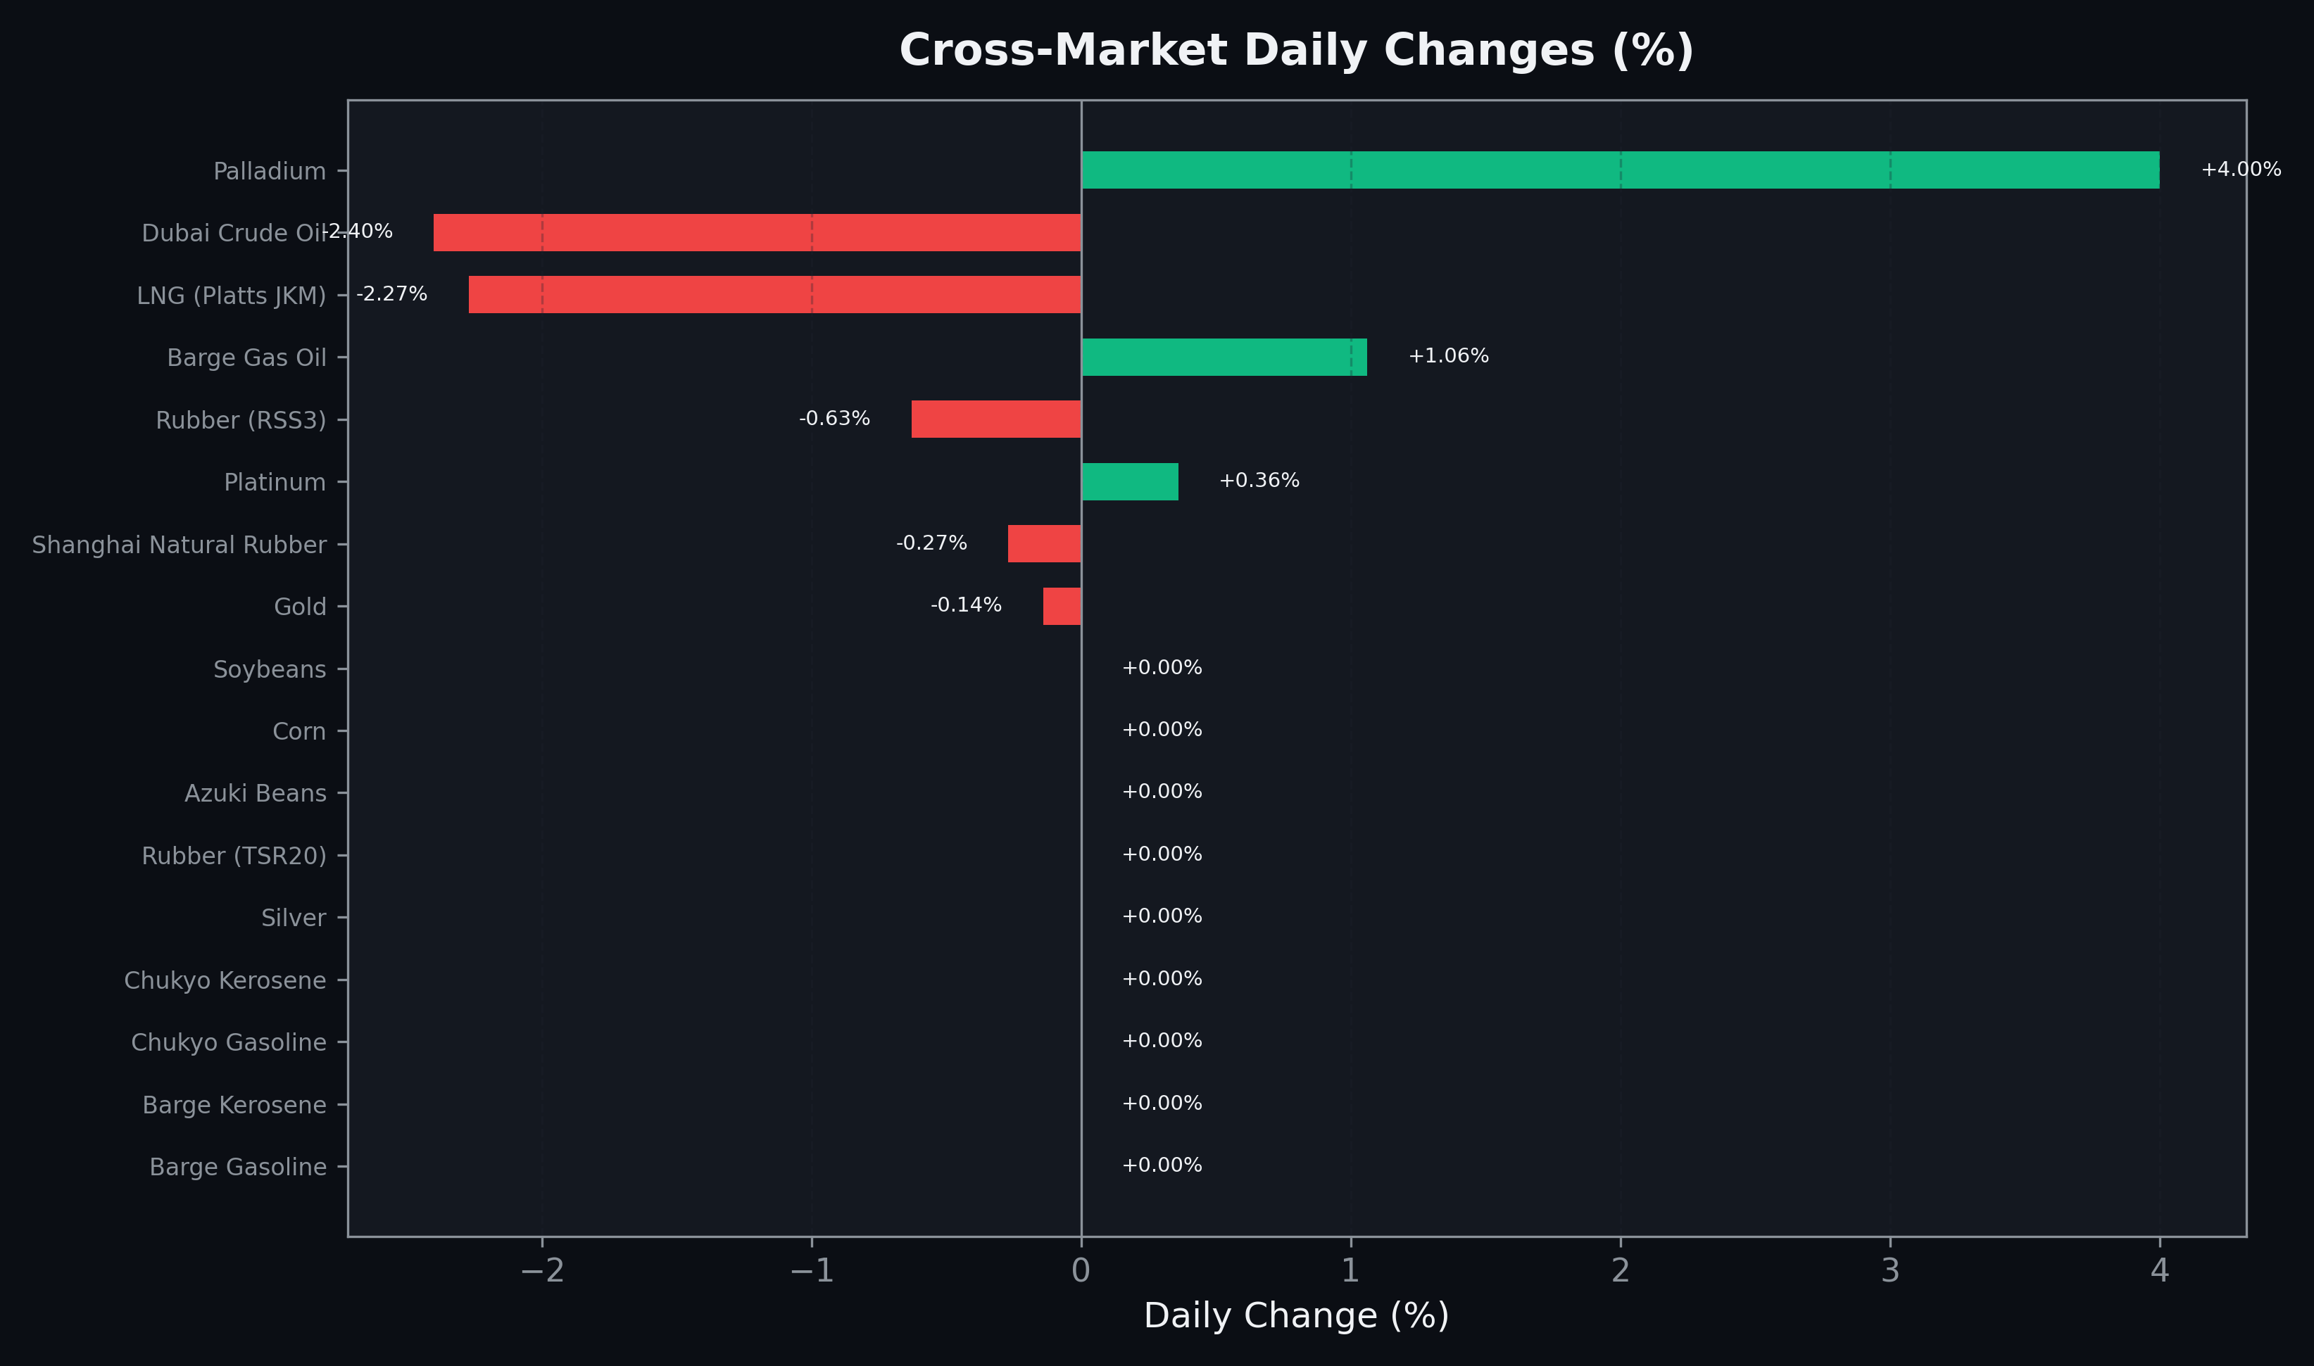
Cross-Market Daily Changes
All commodities sorted by absolute % change

Slide 7
Top Power Futures Movers
Largest absolute settlement price changes vs previous day (2026-04-13)
Instrument | Underlying | Month | Price | Prev | Change | % Chg
FUT_EEBW_260416 | Power East Base (Weekly) | 20260417 | 19.15 | 22.64 | -3.49 | -15.42%
FUT_EWBW_260416 | Power West Base (Weekly) | 20260417 | 13.86 | 16.42 | -2.56 | -15.59%
FUT_EEPW_260416 | Power East Peak (Weekly) | 20260417 | 21.37 | 22.54 | -1.17 | -5.19%
FUT_EEP_260828 | Power East Peak (Monthly) | 202608 | 27.49 | 28.53 | -1.04 | -3.65%
FUT_EEP_260730 | Power East Peak (Monthly) | 202607 | 27.58 | 28.57 | -0.99 | -3.47%
FUT_EWB_260929 | Power West Base (Monthly) | 202609 | 18.23 | 19.20 | -0.97 | -5.05%
FUT_EEP_260929 | Power East Peak (Monthly) | 202609 | 26.69 | 27.65 | -0.96 | -3.47%
FUT_EWB_260730 | Power West Base (Monthly) | 202607 | 18.65 | 19.54 | -0.89 | -4.55%
FUT_EEBW_260423 | Power East Base (Weekly) | 20260424 | 22.00 | 22.88 | -0.88 | -3.85%
FUT_EWB_260828 | Power West Base (Monthly) | 202608 | 18.68 | 19.52 | -0.84 | -4.30%
FUT_EEB_260428 | Power East Base (Monthly) | 202604 | 21.76 | 22.59 | -0.83 | -3.67%
FUT_EWPW_260416 | Power West Peak (Weekly) | 20260417 | 14.85 | 15.68 | -0.83 | -5.29%
FUT_EEBW_260430 | Power East Base (Weekly) | 20260501 | 19.69 | 20.49 | -0.80 | -3.90%
FUT_EEPW_260428 | Power East Peak (Weekly) | 20260501 | 19.56 | 20.32 | -0.76 | -3.74%
FUT_EEP_260428 | Power East Peak (Monthly) | 202604 | 22.67 | 23.32 | -0.65 | -2.79%

