Slide 1
Daily Market Report
Trade Date: 2026-04-23
JPX Derivative & Commodity Analytics
DataServer In-House

Slide 2
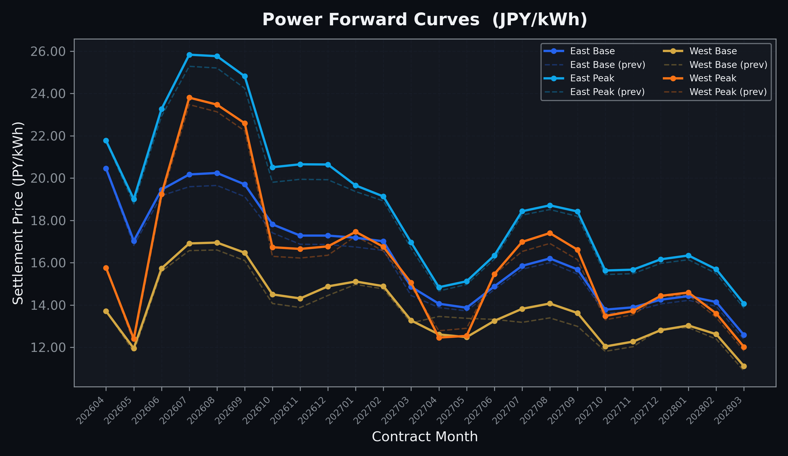
Power Forward Curves
East/West Base & Peak monthly contracts (2026-04-23)

Slide 3
Commodity Snapshot
Front-month settlement prices as of 2026-04-23
Category | Asset | Contract | Settlement | Unit | Change | % Chg
Energy | Barge Gas Oil | 202605 | 115,100.00 | JPY/kl | +200.00 | +0.17%
Energy | Barge Gasoline | 202605 | 105,000.00 | JPY/kl | +0.00 | +0.00%
Energy | Barge Kerosene | 202605 | 105,000.00 | JPY/kl | +0.00 | +0.00%
Energy | Chukyo Gasoline | 202605 | 105,000.00 | JPY/kl | +0.00 | +0.00%
Energy | Chukyo Kerosene | 202605 | 105,000.00 | JPY/kl | +0.00 | +0.00%
Energy | Dubai Crude Oil | 202604 | 104,530.00 | JPY/kl | +1020.00 | +0.99%
Energy | LNG (Platts JKM) | 202606 | 2,596.00 | USD/MMBtu | +85.00 | +3.39%
Metals | Gold | - | 24,136.00 | JPY/g | -195.00 | -0.80%
Metals | Palladium | 202604 | 7,900.00 | JPY/g | -100.00 | -1.25%
Metals | Platinum | - | 10,243.00 | JPY/g | -249.00 | -2.37%
Metals | Silver | 202604 | 383.10 | JPY/10g | +0.00 | +0.00%
Industrial | Rubber (RSS3) | 202604 | 382.80 | JPY/kg | +3.00 | +0.79%
Industrial | Rubber (TSR20) | 202605 | 330.00 | JPY/kg | +5.00 | +1.54%
Industrial | Shanghai Natural Rubber | 202605 | 17,040.00 | JPY/kg | -25.00 | -0.15%
Agriculture | Azuki Beans | 202604 | 12,300.00 | JPY/bag | +0.00 | +0.00%
Agriculture | Corn | 202607 | 39,000.00 | JPY/t | +0.00 | +0.00%
Agriculture | Soybeans | 202606 | 64,000.00 | JPY/t | +0.00 | +0.00%

Slide 4
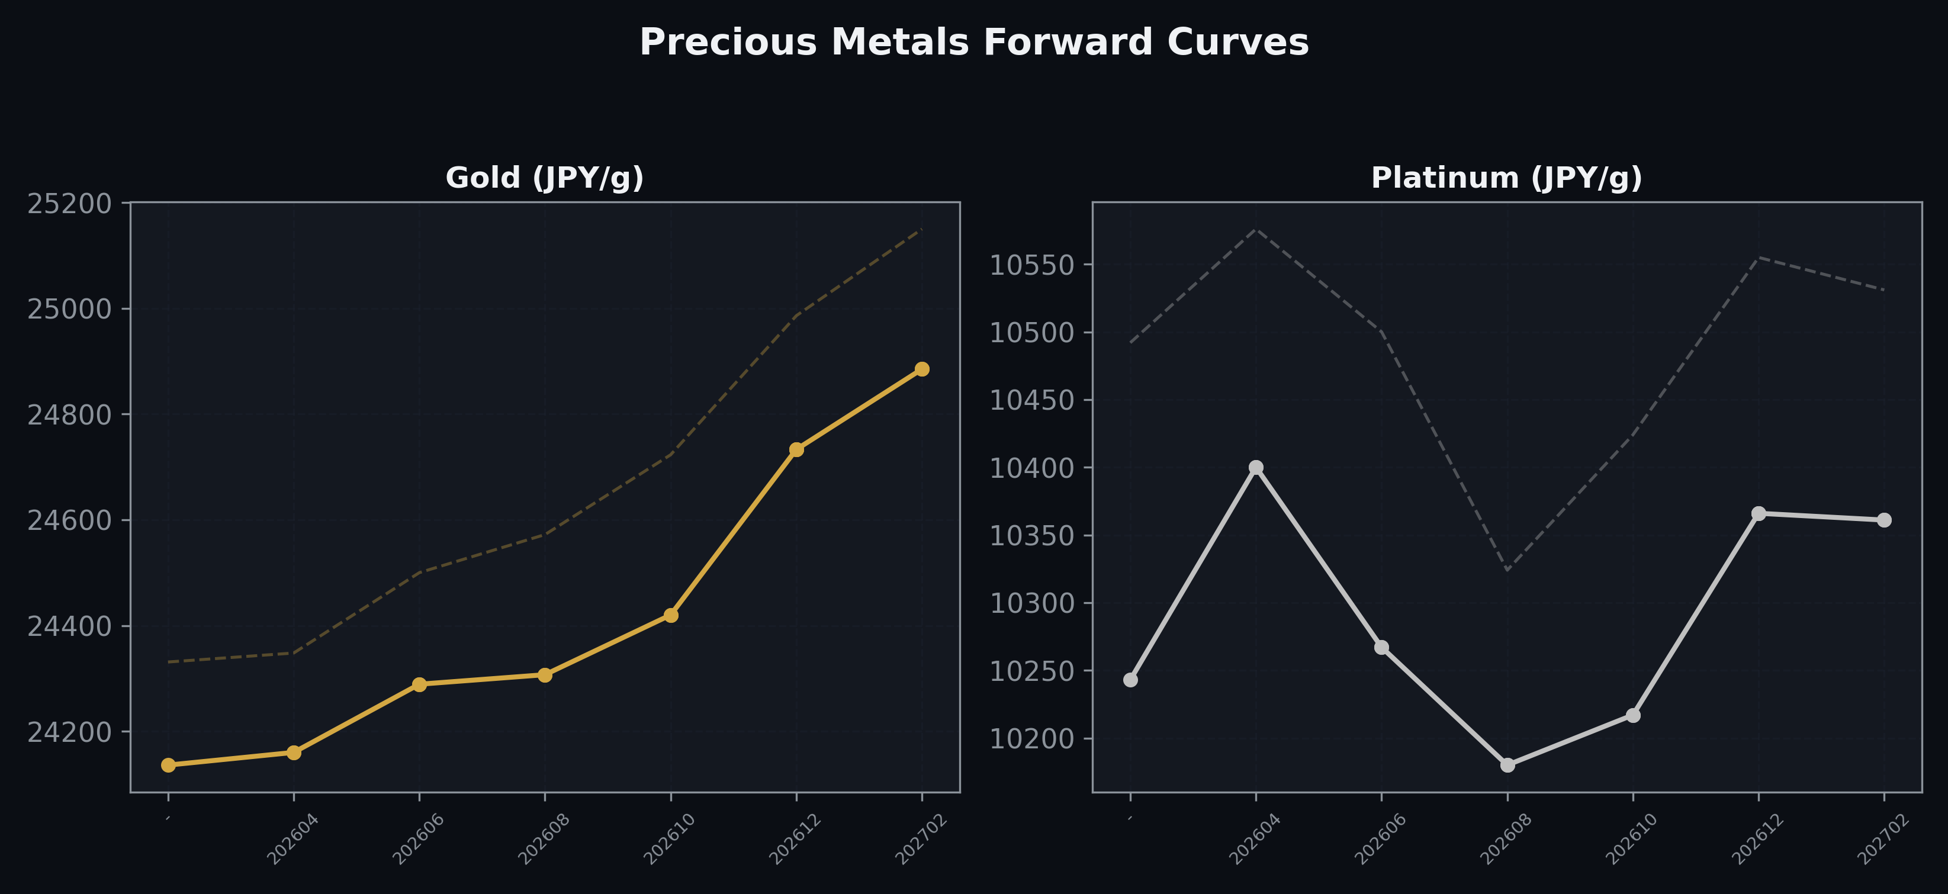
Precious Metals Forward Curves
Gold & Platinum (2026-04-23)

Slide 5
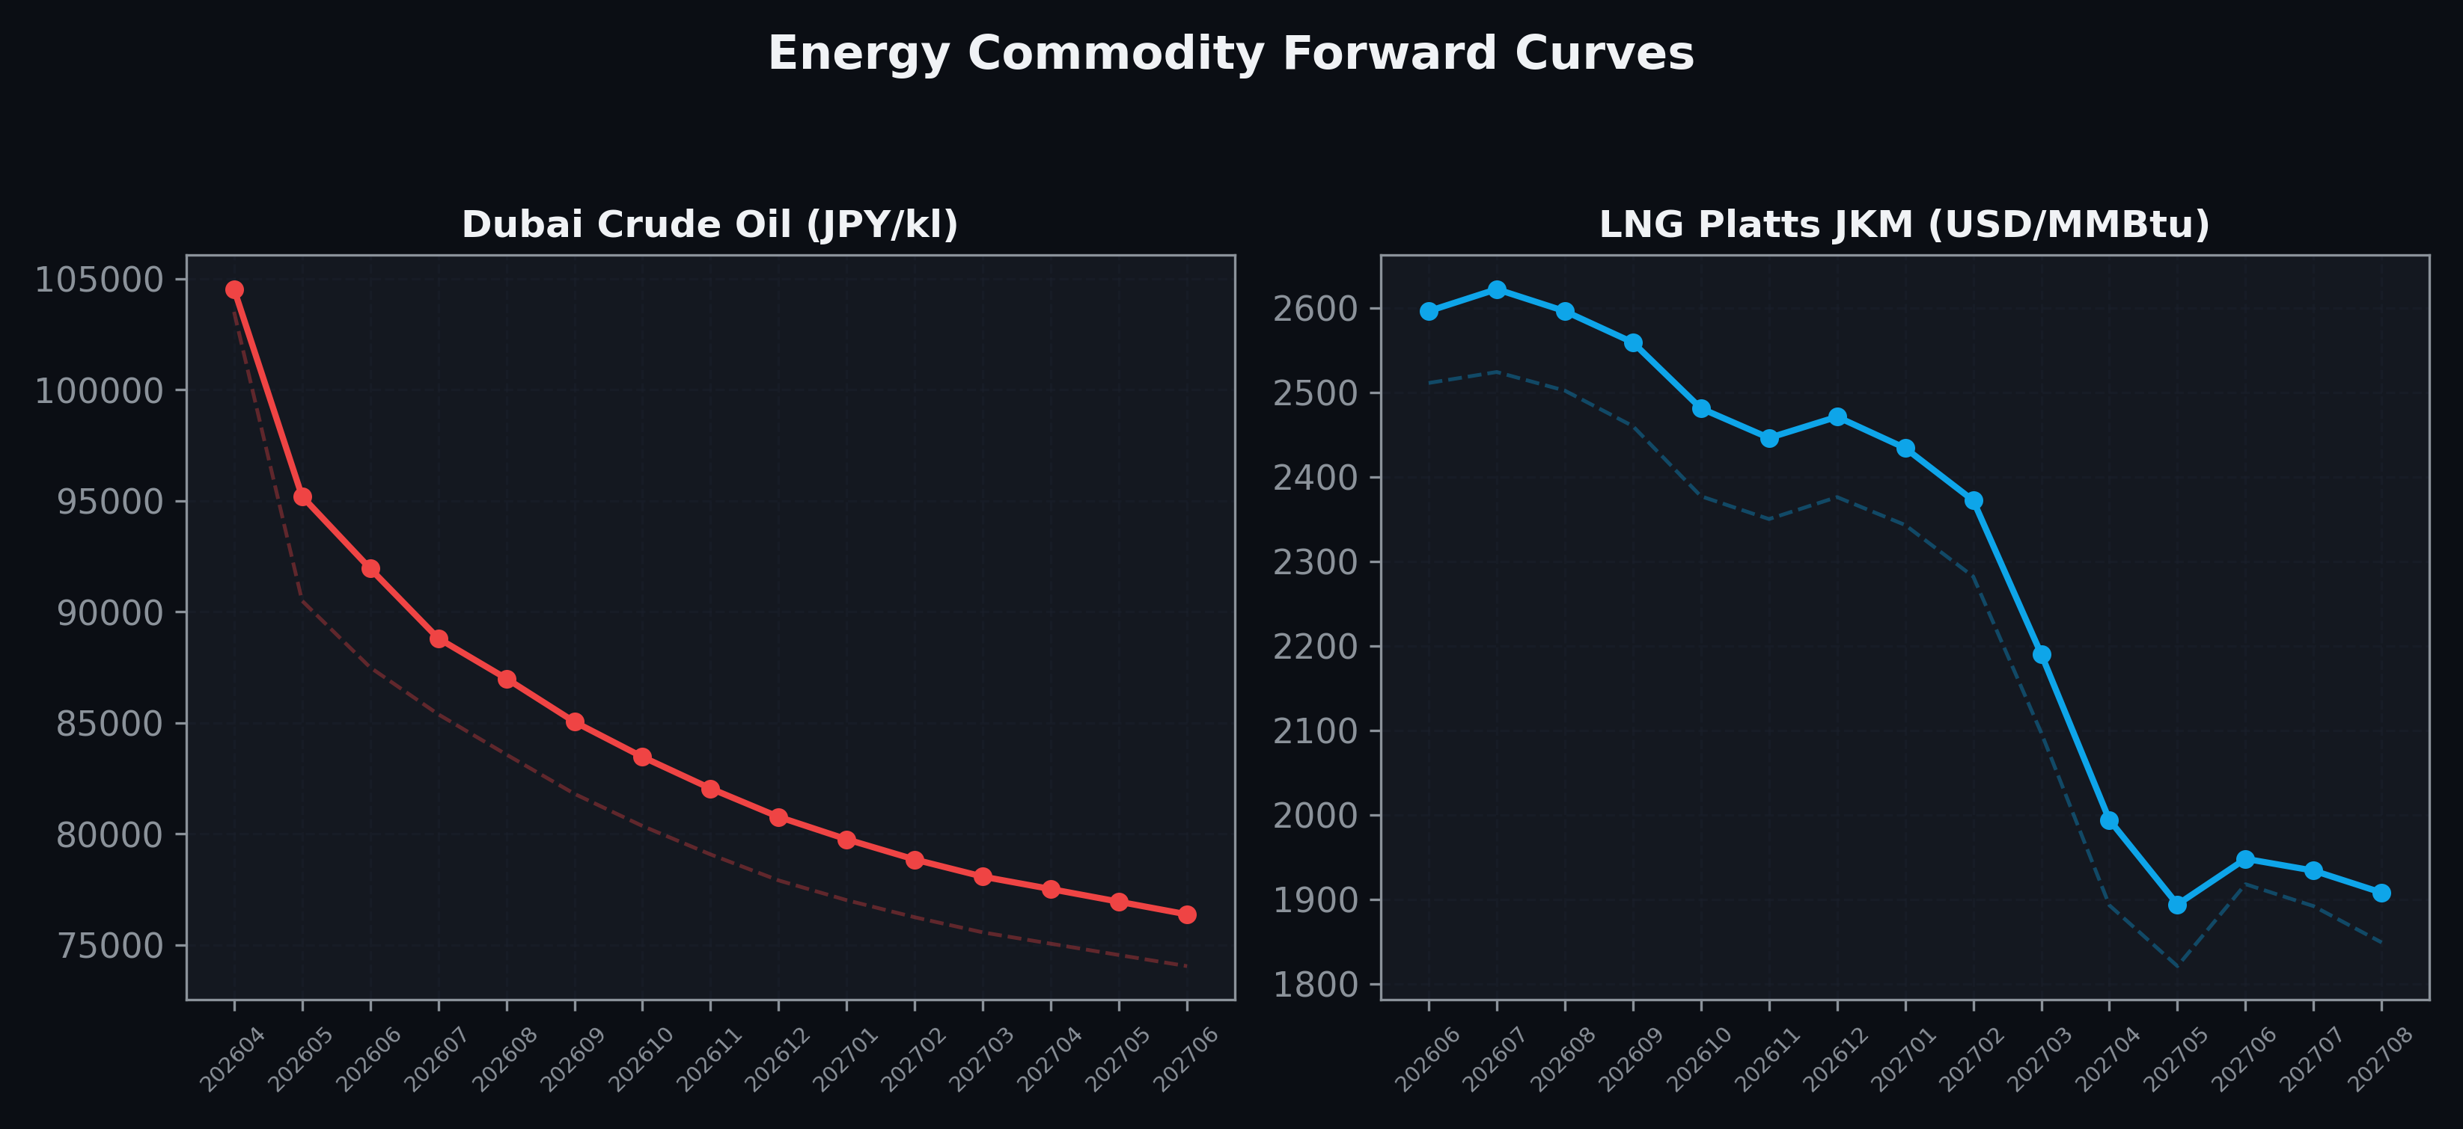
Energy Commodity Forward Curves
Dubai Crude Oil & LNG Platts JKM (2026-04-23)

Slide 6
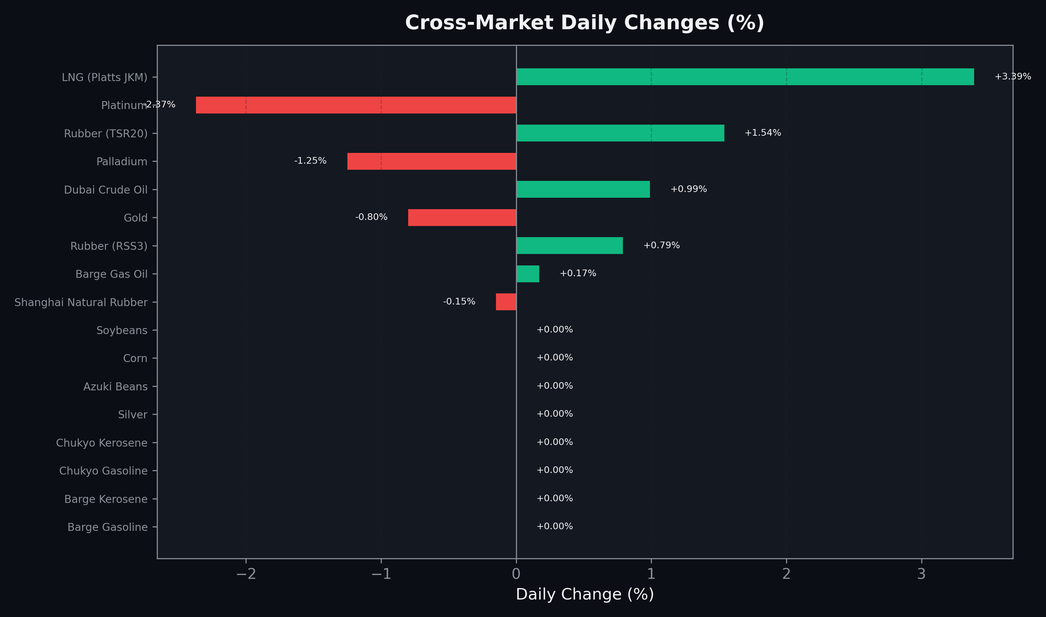
Cross-Market Daily Changes
All commodities sorted by absolute % change

Slide 7
Top Power Futures Movers
Largest absolute settlement price changes vs previous day (2026-04-23)
Instrument | Underlying | Month | Price | Prev | Change | % Chg
FUT_ECP_270528 | 電力(中部・日中) | 202705 | 13.00 | 14.01 | -1.01 | -7.21%
FUT_ECP_270629 | 電力(中部・日中) | 202706 | 15.43 | 16.39 | -0.96 | -5.86%
FUT_ECB_270428 | 電力(中部・ベース) | 202704 | 13.29 | 14.21 | -0.92 | -6.47%
FUT_ECB_270830 | 電力(中部・ベース) | 202708 | 14.93 | 14.02 | +0.91 | +6.49%
FUT_ECB_270929 | 電力(中部・ベース) | 202709 | 14.53 | 13.62 | +0.91 | +6.68%
FUT_ECP_270428 | 電力(中部・日中) | 202704 | 13.31 | 14.22 | -0.91 | -6.40%
FUT_ECB_270730 | 電力(中部・ベース) | 202707 | 14.59 | 13.69 | +0.90 | +6.57%
FUT_EWB_270528 | Power West Base (Monthly) | 202705 | 12.48 | 13.37 | -0.89 | -6.66%
FUT_EWB_270428 | Power West Base (Monthly) | 202704 | 12.61 | 13.46 | -0.85 | -6.32%
FUT_ECB_270528 | 電力(中部・ベース) | 202705 | 13.06 | 13.88 | -0.82 | -5.91%
FUT_EEP_261228 | Power East Peak (Monthly) | 202612 | 20.64 | 19.92 | +0.72 | +3.61%
FUT_EEP_261029 | Power East Peak (Monthly) | 202610 | 20.51 | 19.80 | +0.71 | +3.59%
FUT_EEP_261127 | Power East Peak (Monthly) | 202611 | 20.65 | 19.94 | +0.71 | +3.56%
FUT_ECP_280128 | 電力(中部・日中) | 202801 | 15.14 | 14.44 | +0.70 | +4.85%
FUT_EWB_270830 | Power West Base (Monthly) | 202708 | 14.07 | 13.39 | +0.68 | +5.08%

