Slide 1
Daily Market Report
Trade Date: 2026-05-26
JPX Derivative & Commodity Analytics
DataServer In-House

Slide 2
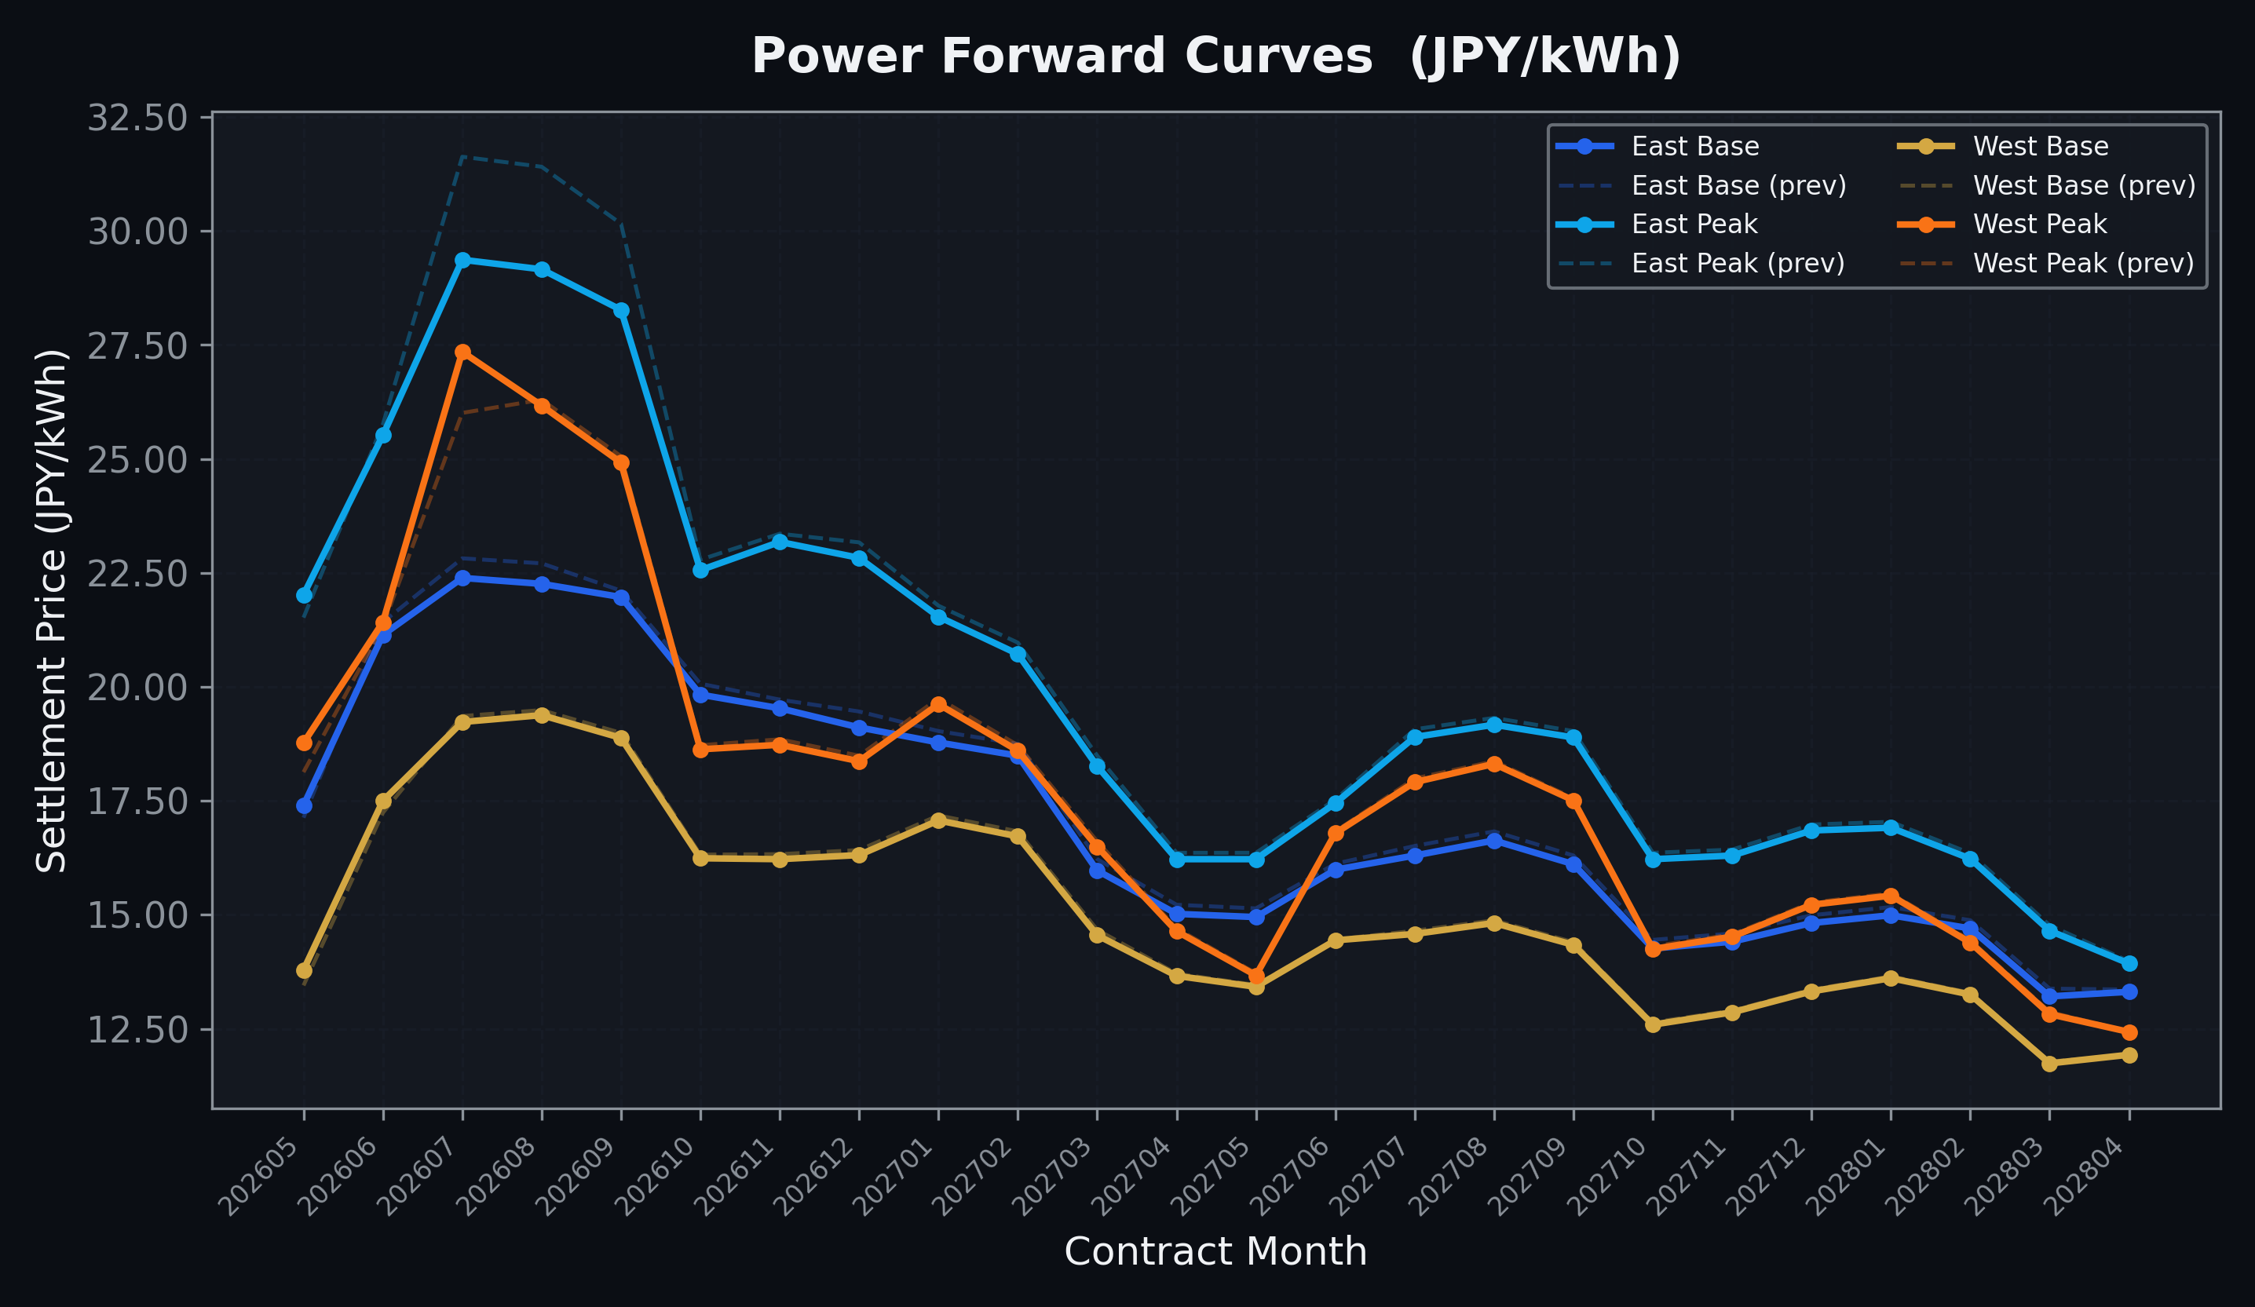
Power Forward Curves
East/West Base & Peak monthly contracts (2026-05-26)

Slide 3
Commodity Snapshot
Front-month settlement prices as of 2026-05-26
Category | Asset | Contract | Settlement | Unit | Change | % Chg
Energy | Barge Gas Oil | 202607 | 109,400.00 | JPY/kl | -300.00 | -0.27%
Energy | Barge Gasoline | 202607 | 100,000.00 | JPY/kl | +0.00 | +0.00%
Energy | Barge Kerosene | 202607 | 105,000.00 | JPY/kl | +0.00 | +0.00%
Energy | Chukyo Gasoline | 202607 | 95,000.00 | JPY/kl | +900.00 | +0.96%
Energy | Chukyo Kerosene | 202607 | 105,000.00 | JPY/kl | +0.00 | +0.00%
Energy | Dubai Crude Oil | 202605 | 101,290.00 | JPY/kl | -710.00 | -0.70%
Energy | LNG (Platts JKM) | 202607 | 2,927.00 | USD/MMBtu | +6.00 | +0.21%
Metals | Gold | - | 23,032.00 | JPY/g | -122.00 | -0.53%
Metals | Palladium | 202606 | 7,000.00 | JPY/g | +0.00 | +0.00%
Metals | Platinum | - | 9,668.00 | JPY/g | +4.00 | +0.04%
Metals | Silver | 202606 | 390.00 | JPY/10g | +0.00 | +0.00%
Industrial | Rubber (RSS3) | 202606 | 392.60 | JPY/kg | -1.40 | -0.36%
Industrial | Rubber (TSR20) | 202606 | 350.00 | JPY/kg | +0.00 | +0.00%
Industrial | Shanghai Natural Rubber | 202609 | 17,375.00 | JPY/kg | -200.00 | -1.14%
Agriculture | Azuki Beans | 202605 | 12,300.00 | JPY/bag | +0.00 | +0.00%
Agriculture | Corn | 202607 | 39,000.00 | JPY/t | +0.00 | +0.00%
Agriculture | Soybeans | 202606 | 64,000.00 | JPY/t | +0.00 | +0.00%

Slide 4
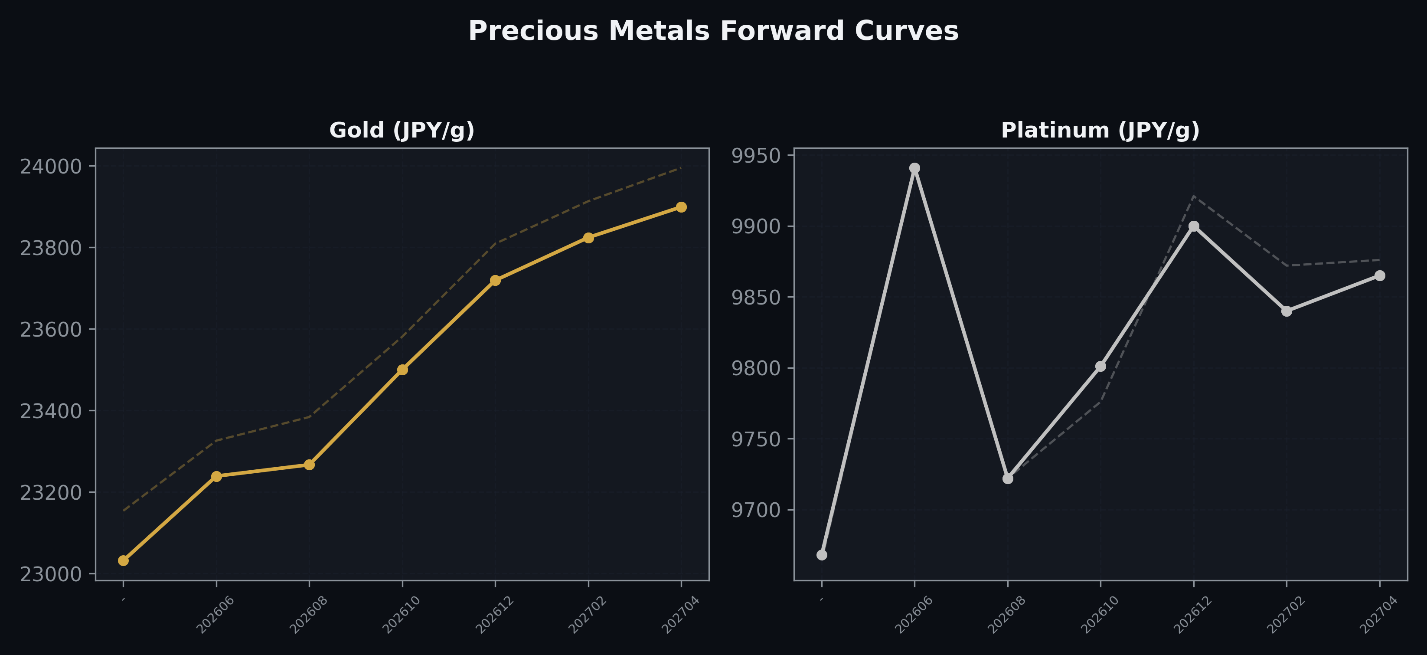
Precious Metals Forward Curves
Gold & Platinum (2026-05-26)

Slide 5
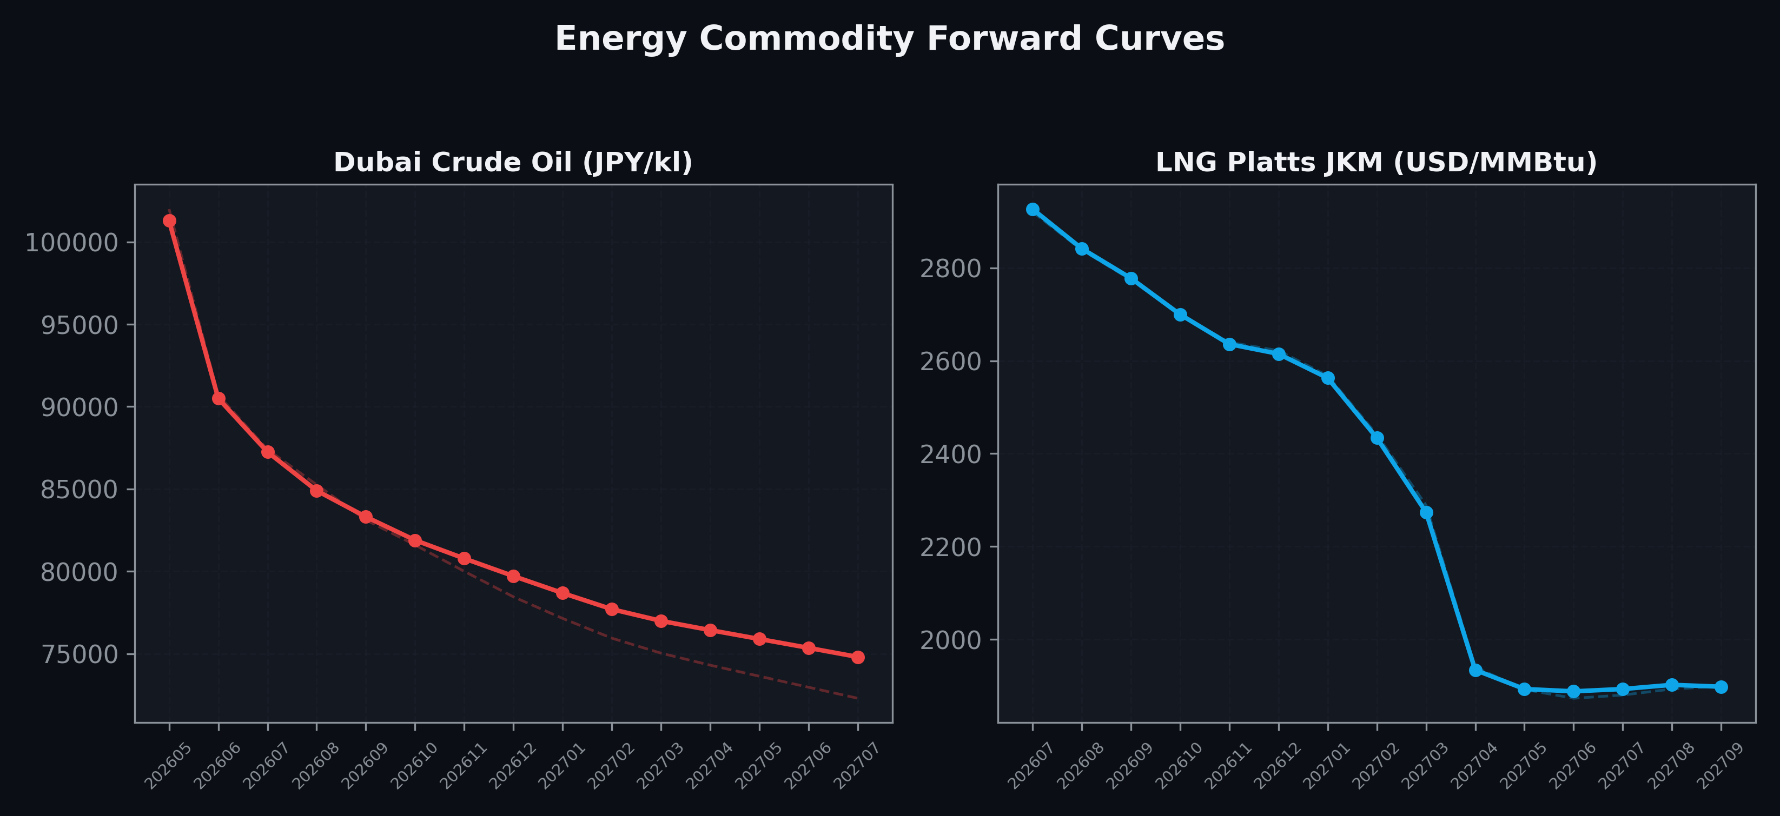
Energy Commodity Forward Curves
Dubai Crude Oil & LNG Platts JKM (2026-05-26)

Slide 6
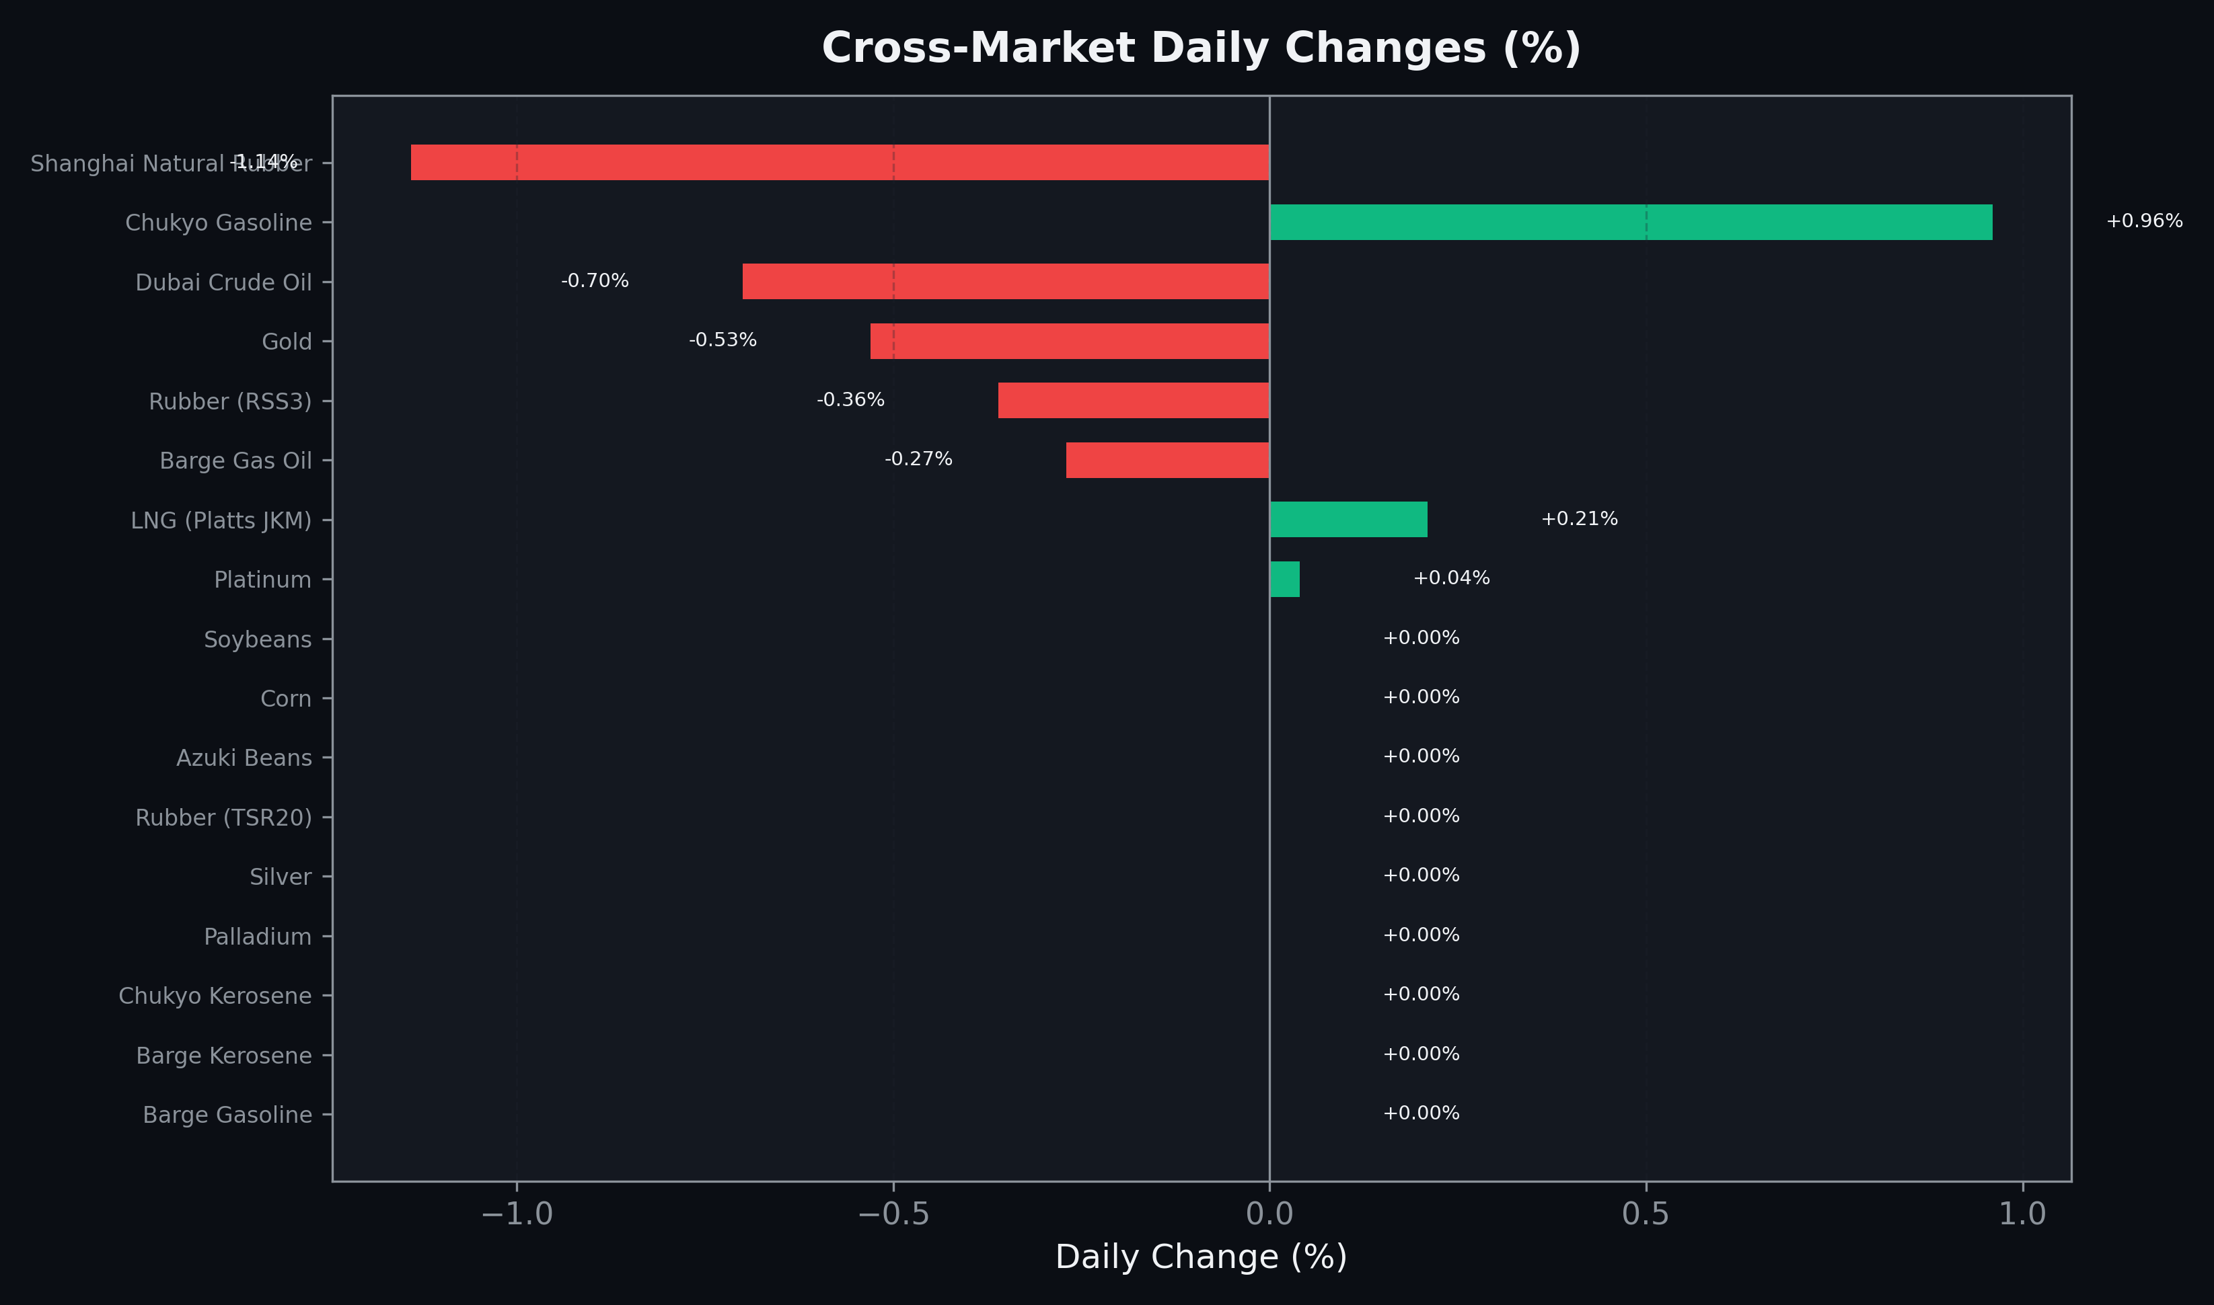
Cross-Market Daily Changes
All commodities sorted by absolute % change

Slide 7
Top Power Futures Movers
Largest absolute settlement price changes vs previous day (2026-05-26)
Instrument | Underlying | Month | Price | Prev | Change | % Chg
FUT_EWPW_260528 | Power West Peak (Weekly) | 20260529 | 19.81 | 17.19 | +2.62 | +15.24%
FUT_EEP_260730 | Power East Peak (Monthly) | 202607 | 29.37 | 31.63 | -2.26 | -7.15%
FUT_EEP_260828 | Power East Peak (Monthly) | 202608 | 29.16 | 31.41 | -2.25 | -7.16%
FUT_EEP_260929 | Power East Peak (Monthly) | 202609 | 28.27 | 30.16 | -1.89 | -6.27%
FUT_EEPW_260528 | Power East Peak (Weekly) | 20260529 | 23.83 | 22.23 | +1.60 | +7.20%
FUT_EWP_260730 | Power West Peak (Monthly) | 202607 | 27.35 | 26.01 | +1.34 | +5.15%
FUT_EWBW_260528 | Power West Base (Weekly) | 20260529 | 17.05 | 15.90 | +1.15 | +7.23%
FUT_EEBW_260528 | Power East Base (Weekly) | 20260529 | 20.81 | 20.11 | +0.70 | +3.48%
FUT_EWPW_260604 | Power West Peak (Weekly) | 20260605 | 20.47 | 19.77 | +0.70 | +3.54%
FUT_EWP_260528 | Power West Peak (Monthly) | 202605 | 18.77 | 18.13 | +0.64 | +3.53%
FUT_ECP_260528 | 電力(中部・日中) | 202605 | 20.27 | 19.64 | +0.63 | +3.21%
FUT_EEP_260528 | Power East Peak (Monthly) | 202605 | 22.02 | 21.52 | +0.50 | +2.32%
FUT_EEB_260828 | Power East Base (Monthly) | 202608 | 22.26 | 22.71 | -0.45 | -1.98%
FUT_EEB_260730 | Power East Base (Monthly) | 202607 | 22.39 | 22.82 | -0.43 | -1.88%
FUT_ECB_260730 | 電力(中部・ベース) | 202607 | 21.44 | 21.85 | -0.41 | -1.88%

