Slide 1
Daily Market Report
Trade Date: 2026-05-14
JPX Derivative & Commodity Analytics
DataServer In-House

Slide 2
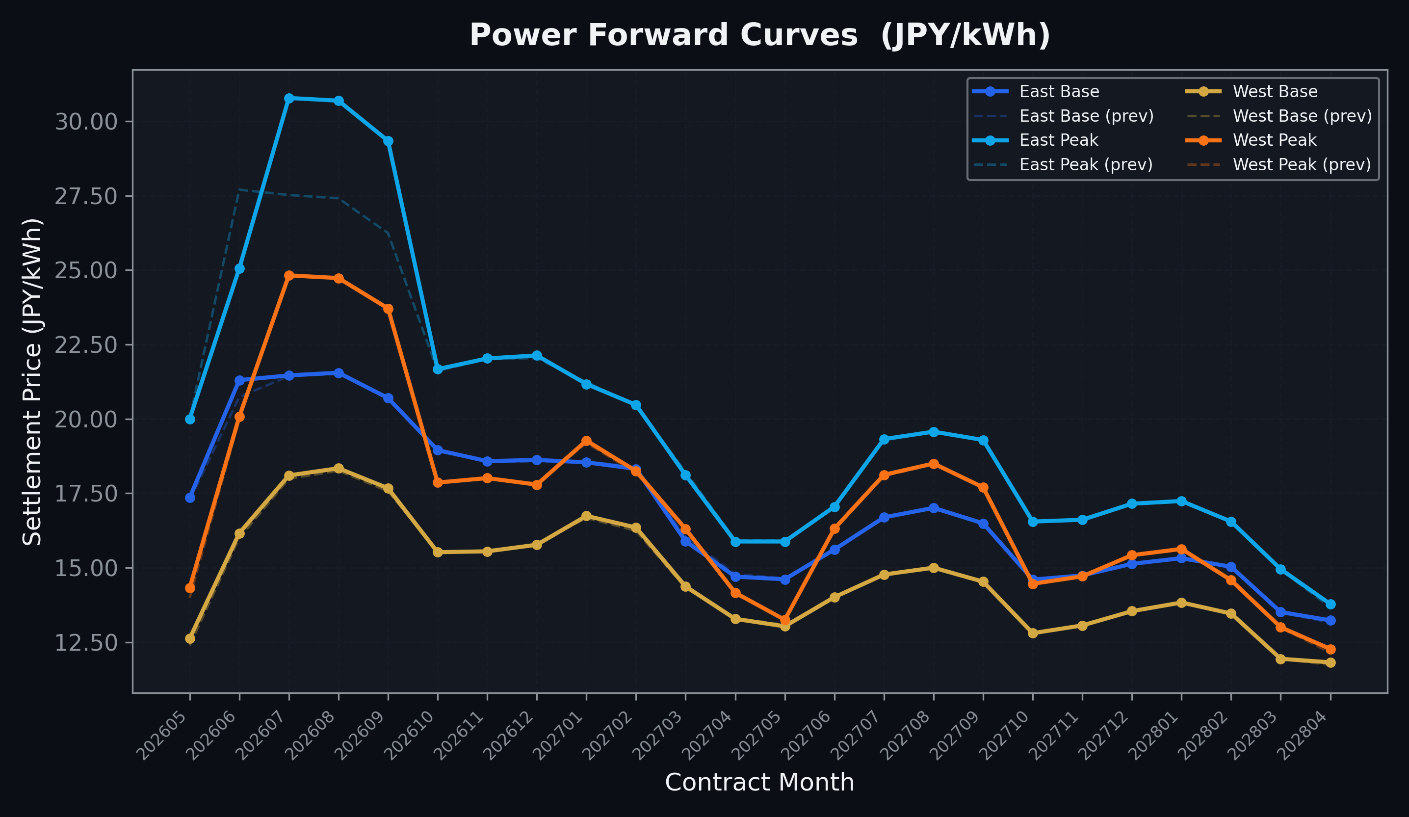
Power Forward Curves
East/West Base & Peak monthly contracts (2026-05-14)

Slide 3
Commodity Snapshot
Front-month settlement prices as of 2026-05-14
Category | Asset | Contract | Settlement | Unit | Change | % Chg
Energy | Barge Gas Oil | 202606 | 110,500.00 | JPY/kl | -200.00 | -0.18%
Energy | Barge Gasoline | 202606 | 100,000.00 | JPY/kl | +0.00 | +0.00%
Energy | Barge Kerosene | 202606 | 105,000.00 | JPY/kl | +0.00 | +0.00%
Energy | Chukyo Gasoline | 202606 | 100,000.00 | JPY/kl | +0.00 | +0.00%
Energy | Chukyo Kerosene | 202606 | 105,000.00 | JPY/kl | +0.00 | +0.00%
Energy | Dubai Crude Oil | 202605 | 100,940.00 | JPY/kl | -1110.00 | -1.09%
Energy | LNG (Platts JKM) | 202606 | 2,701.00 | USD/MMBtu | +1.00 | +0.04%
Metals | Gold | - | 23,762.00 | JPY/g | +106.00 | +0.45%
Metals | Palladium | 202606 | 7,500.00 | JPY/g | +0.00 | +0.00%
Metals | Platinum | - | 10,654.00 | JPY/g | +97.00 | +0.92%
Metals | Silver | 202606 | 420.00 | JPY/10g | +0.00 | +0.00%
Industrial | Rubber (RSS3) | 202605 | 405.30 | JPY/kg | -2.70 | -0.66%
Industrial | Rubber (TSR20) | 202606 | 350.00 | JPY/kg | +0.00 | +0.00%
Industrial | Shanghai Natural Rubber | 202605 | 18,215.00 | JPY/kg | +310.00 | +1.73%
Agriculture | Azuki Beans | 202605 | 12,300.00 | JPY/bag | +0.00 | +0.00%
Agriculture | Corn | 202607 | 39,000.00 | JPY/t | +0.00 | +0.00%
Agriculture | Soybeans | 202606 | 64,000.00 | JPY/t | +0.00 | +0.00%

Slide 4
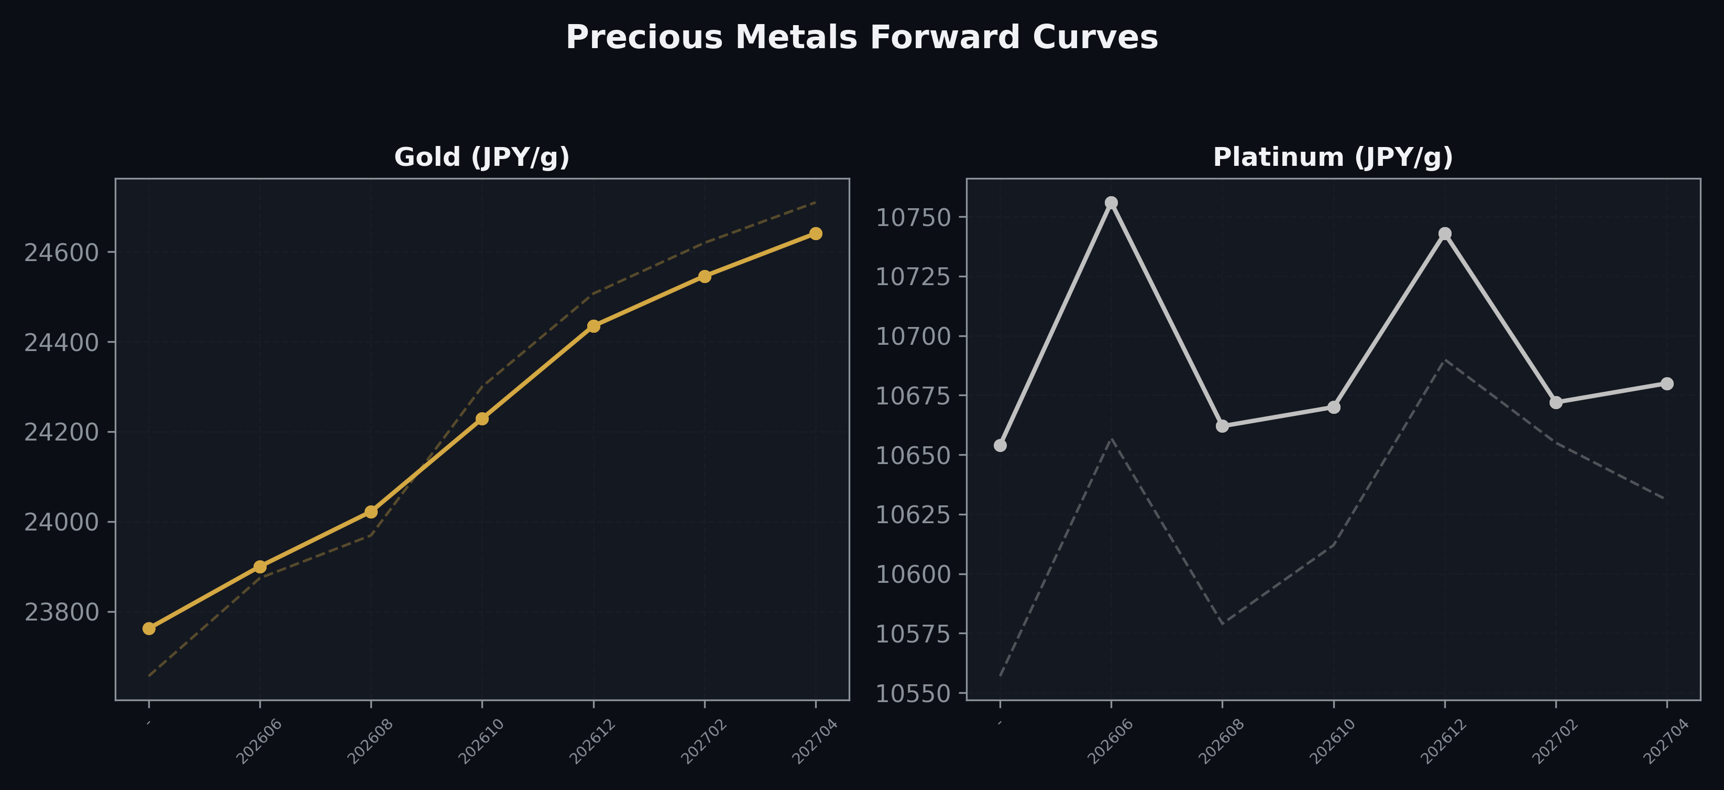
Precious Metals Forward Curves
Gold & Platinum (2026-05-14)

Slide 5
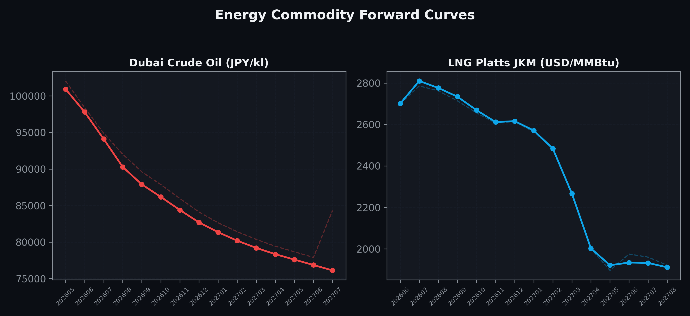
Energy Commodity Forward Curves
Dubai Crude Oil & LNG Platts JKM (2026-05-14)

Slide 6
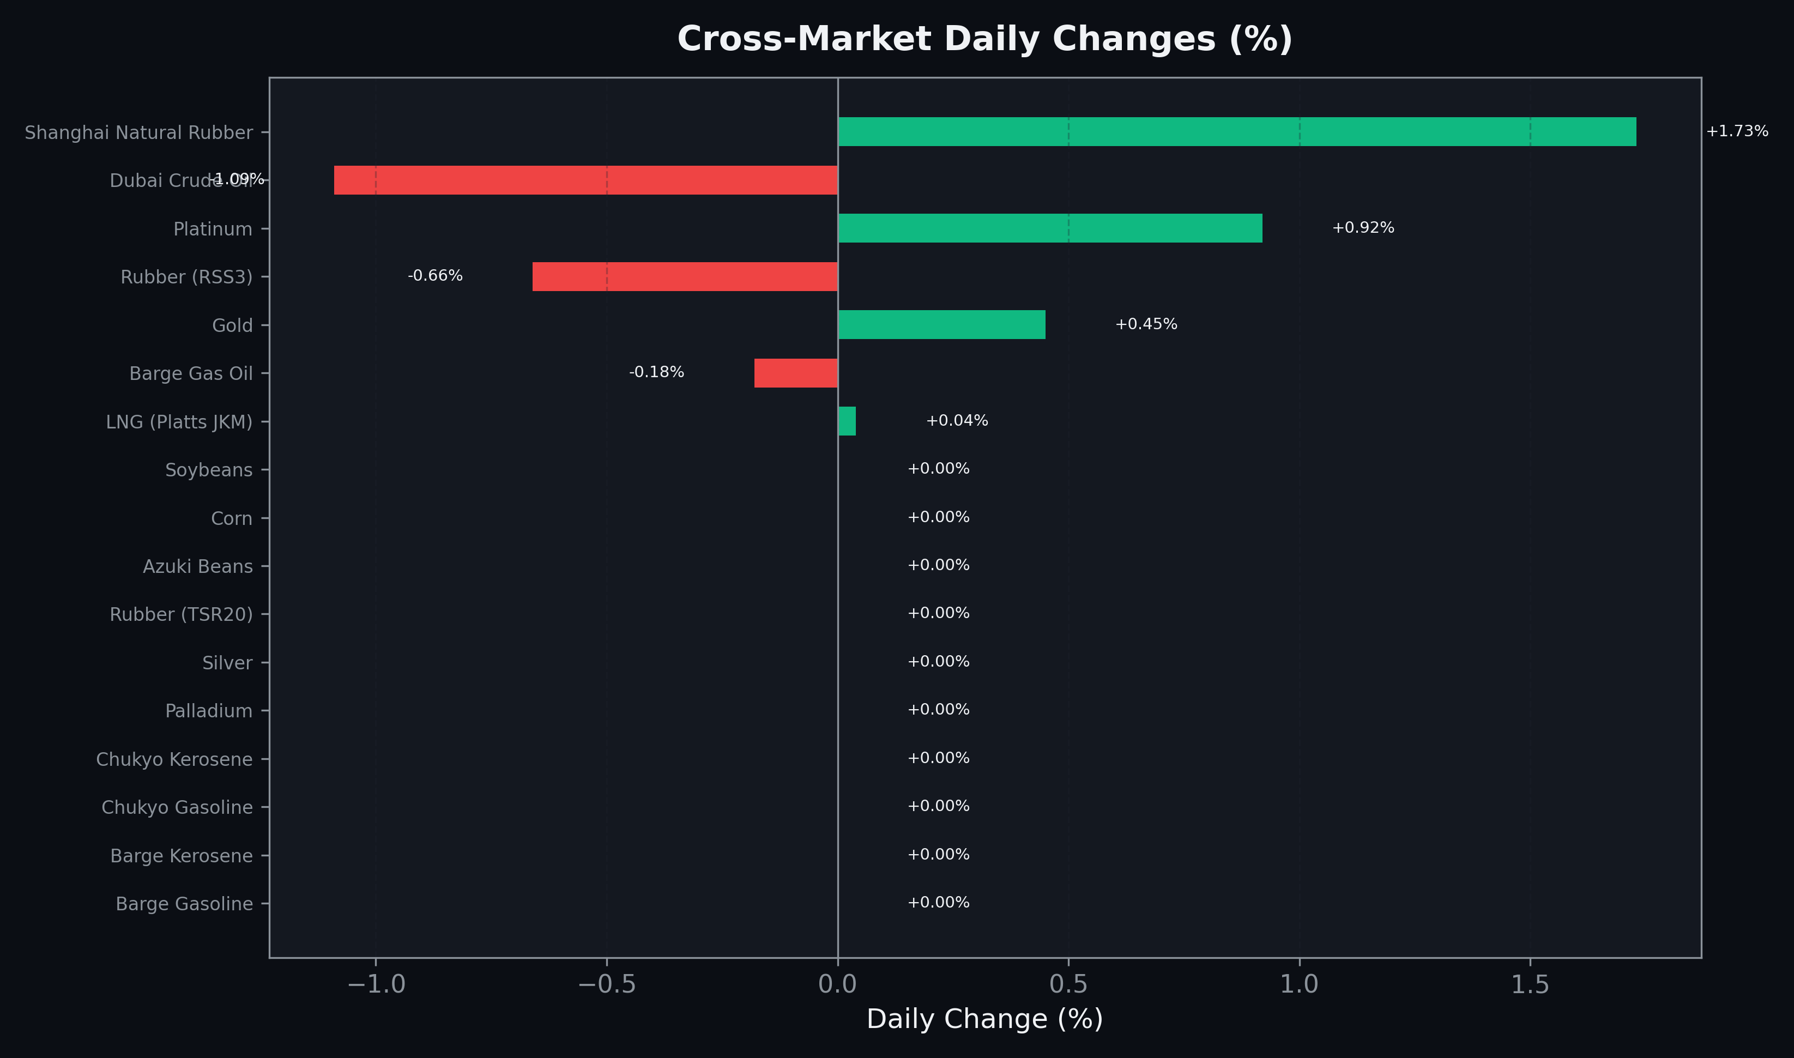
Cross-Market Daily Changes
All commodities sorted by absolute % change

Slide 7
Top Power Futures Movers
Largest absolute settlement price changes vs previous day (2026-05-14)
Instrument | Underlying | Month | Price | Prev | Change | % Chg
FUT_EEP_260828 | Power East Peak (Monthly) | 202608 | 30.69 | 27.41 | +3.28 | +11.97%
FUT_EEP_260730 | Power East Peak (Monthly) | 202607 | 30.78 | 27.52 | +3.26 | +11.85%
FUT_EEP_260929 | Power East Peak (Monthly) | 202609 | 29.34 | 26.24 | +3.10 | +11.81%
FUT_EEP_260629 | Power East Peak (Monthly) | 202606 | 25.05 | 27.70 | -2.65 | -9.57%
FUT_EEPW_260604 | Power East Peak (Weekly) | 20260605 | 22.77 | 23.93 | -1.16 | -4.85%
FUT_EWPW_260514 | Power West Peak (Weekly) | 20260515 | 15.32 | 14.63 | +0.69 | +4.72%
FUT_EEB_260629 | Power East Base (Monthly) | 202606 | 21.30 | 20.73 | +0.57 | +2.75%
FUT_EEPW_260514 | Power East Peak (Weekly) | 20260515 | 19.25 | 19.79 | -0.54 | -2.73%
FUT_EEBW_260521 | Power East Base (Weekly) | 20260522 | 19.27 | 19.80 | -0.53 | -2.68%
FUT_EWBW_260514 | Power West Base (Weekly) | 20260515 | 13.17 | 12.65 | +0.52 | +4.11%
FUT_EWPW_260521 | Power West Peak (Weekly) | 20260522 | 12.77 | 12.27 | +0.50 | +4.07%
FUT_EWBW_260521 | Power West Base (Weekly) | 20260522 | 13.43 | 12.96 | +0.47 | +3.63%
FUT_EWBW_260528 | Power West Base (Weekly) | 20260529 | 13.20 | 12.81 | +0.39 | +3.04%
FUT_EWP_260528 | Power West Peak (Monthly) | 202605 | 14.32 | 13.99 | +0.33 | +2.36%
FUT_EWPW_260604 | Power West Peak (Weekly) | 20260605 | 18.05 | 17.72 | +0.33 | +1.86%

