Slide 1
Daily Market Report
Trade Date: 2026-04-20
JPX Derivative & Commodity Analytics
DataServer In-House

Slide 2
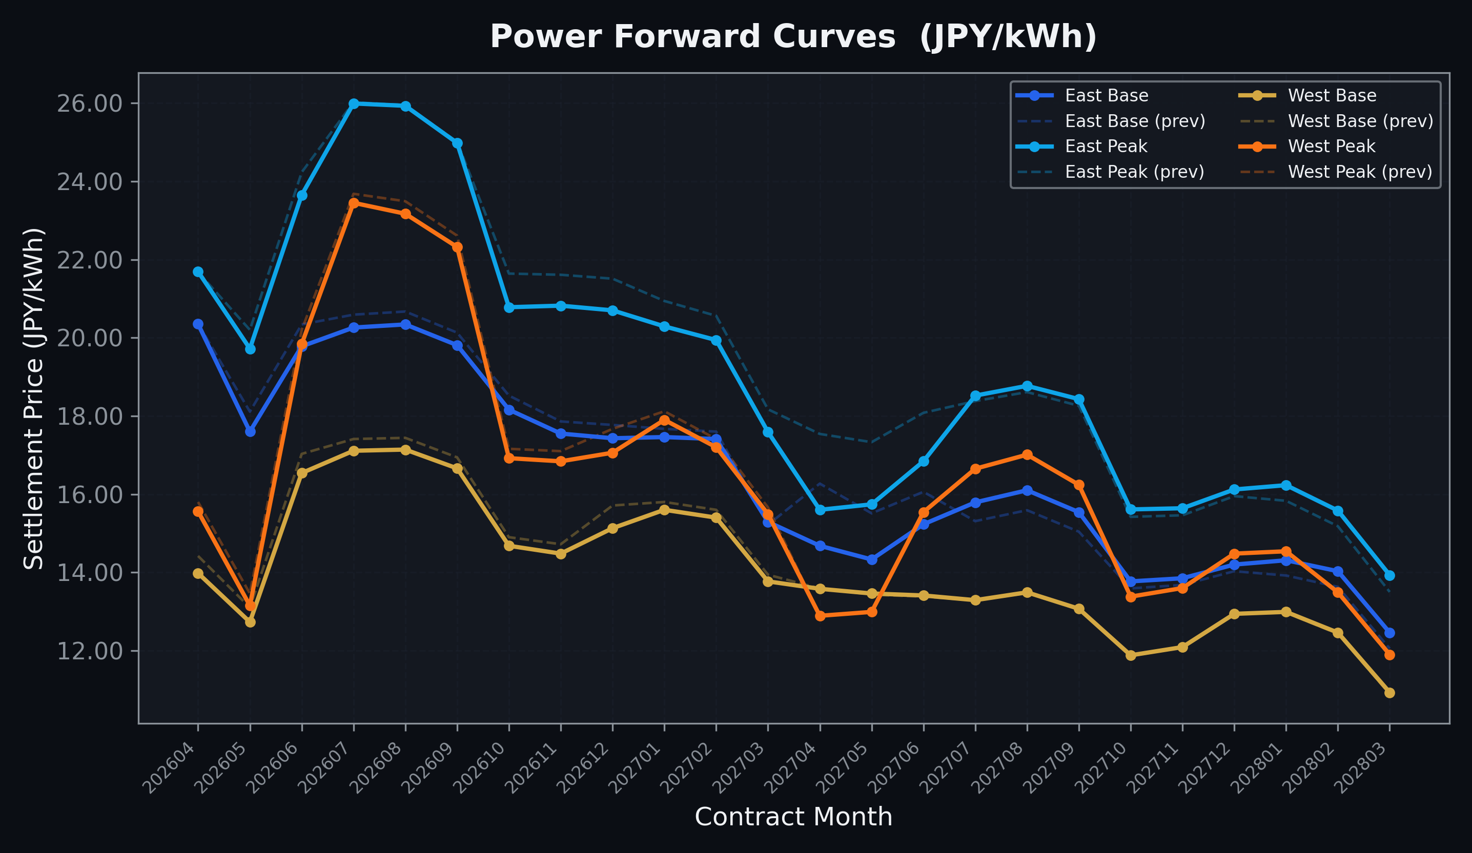
Power Forward Curves
East/West Base & Peak monthly contracts (2026-04-20)

Slide 3
Commodity Snapshot
Front-month settlement prices as of 2026-04-20
Category | Asset | Contract | Settlement | Unit | Change | % Chg
Energy | Barge Gas Oil | 202605 | 114,900.00 | JPY/kl | -1000.00 | -0.86%
Energy | Barge Gasoline | 202605 | 105,000.00 | JPY/kl | +0.00 | +0.00%
Energy | Barge Kerosene | 202605 | 105,000.00 | JPY/kl | +0.00 | +0.00%
Energy | Chukyo Gasoline | 202605 | 105,000.00 | JPY/kl | +0.00 | +0.00%
Energy | Chukyo Kerosene | 202605 | 105,000.00 | JPY/kl | +0.00 | +0.00%
Energy | Dubai Crude Oil | 202604 | 99,580.00 | JPY/kl | -4560.00 | -4.38%
Energy | LNG (Platts JKM) | 202606 | 2,429.00 | USD/MMBtu | -118.00 | -4.63%
Metals | Gold | - | 24,375.00 | JPY/g | -47.00 | -0.19%
Metals | Palladium | 202604 | 8,000.00 | JPY/g | +0.00 | +0.00%
Metals | Platinum | - | 10,578.00 | JPY/g | -163.00 | -1.52%
Metals | Silver | 202604 | 383.10 | JPY/10g | +0.00 | +0.00%
Industrial | Rubber (RSS3) | 202604 | 378.30 | JPY/kg | +3.30 | +0.88%
Industrial | Rubber (TSR20) | 202605 | 325.00 | JPY/kg | +0.00 | +0.00%
Industrial | Shanghai Natural Rubber | 202605 | 16,950.00 | JPY/kg | +465.00 | +2.82%
Agriculture | Azuki Beans | 202604 | 12,300.00 | JPY/bag | +0.00 | +0.00%
Agriculture | Corn | 202607 | 39,000.00 | JPY/t | +0.00 | +0.00%
Agriculture | Soybeans | 202606 | 64,000.00 | JPY/t | +0.00 | +0.00%

Slide 4
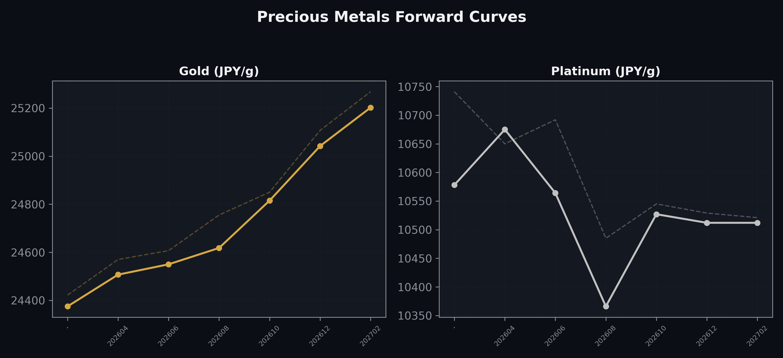
Precious Metals Forward Curves
Gold & Platinum (2026-04-20)

Slide 5
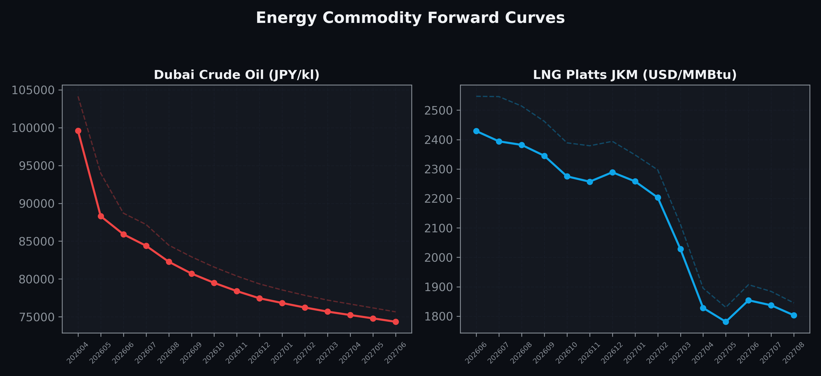
Energy Commodity Forward Curves
Dubai Crude Oil & LNG Platts JKM (2026-04-20)

Slide 6
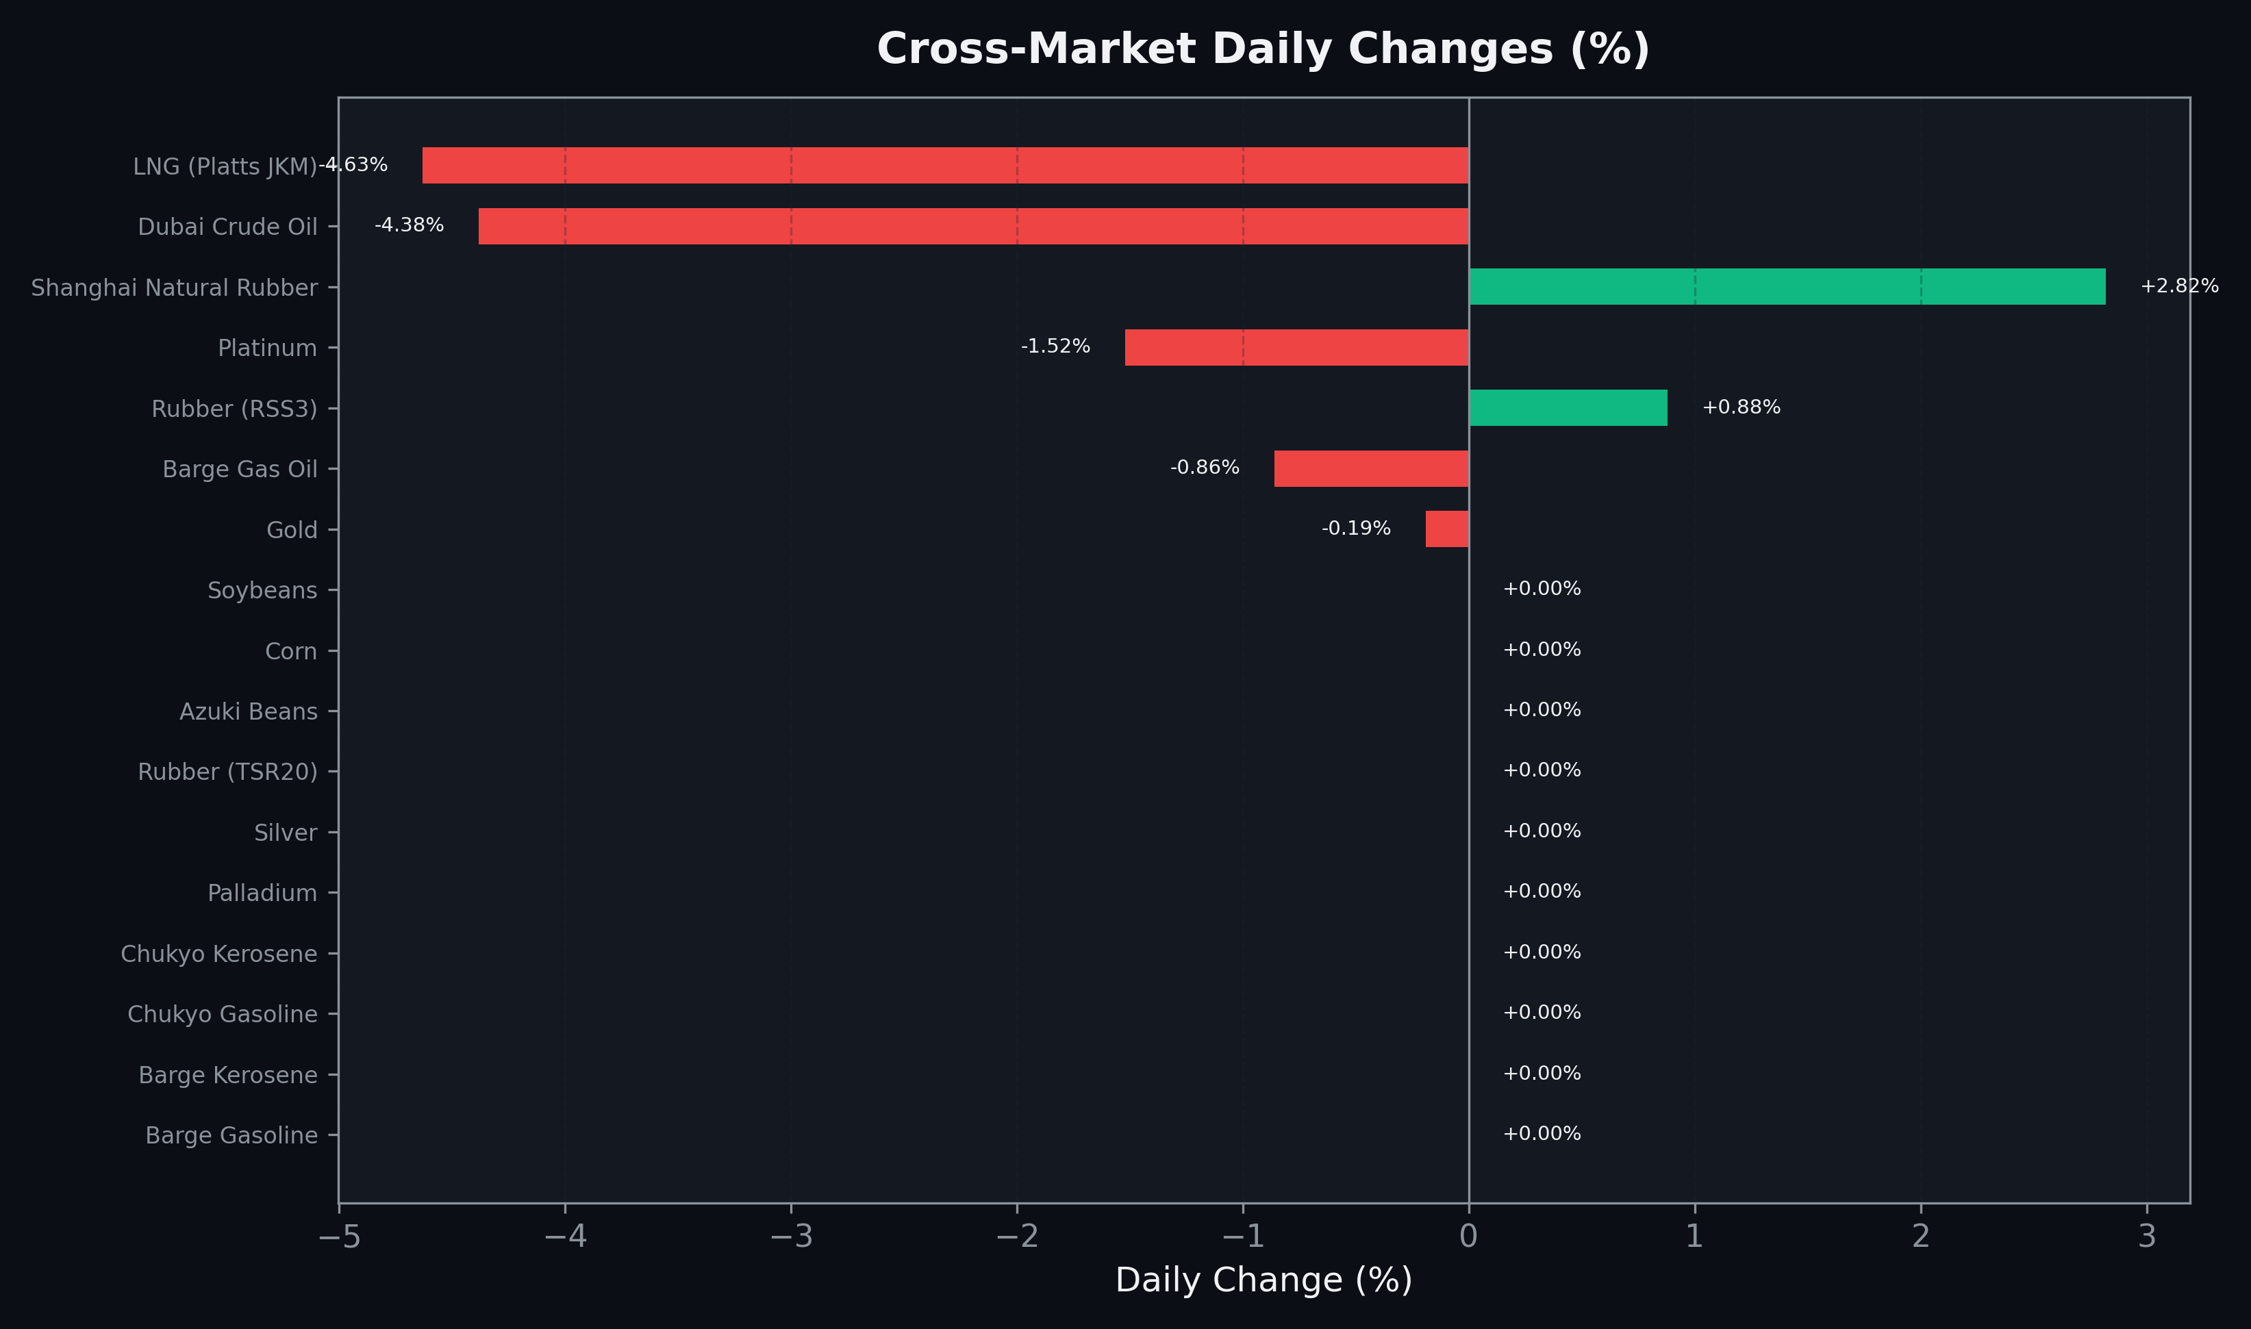
Cross-Market Daily Changes
All commodities sorted by absolute % change

Slide 7
Top Power Futures Movers
Largest absolute settlement price changes vs previous day (2026-04-20)
Instrument | Underlying | Month | Price | Prev | Change | % Chg
FUT_EWBW_260423 | Power West Base (Weekly) | 20260424 | 10.99 | 14.03 | -3.04 | -21.67%
FUT_EEP_270428 | Power East Peak (Monthly) | 202704 | 15.60 | 17.54 | -1.94 | -11.06%
FUT_EEB_270428 | Power East Base (Monthly) | 202704 | 14.68 | 16.27 | -1.59 | -9.77%
FUT_EEP_270528 | Power East Peak (Monthly) | 202705 | 15.74 | 17.33 | -1.59 | -9.17%
FUT_EEP_270629 | Power East Peak (Monthly) | 202706 | 16.84 | 18.08 | -1.24 | -6.86%
FUT_EEB_270528 | Power East Base (Monthly) | 202705 | 14.33 | 15.51 | -1.18 | -7.61%
FUT_EWPW_260423 | Power West Peak (Weekly) | 20260424 | 12.04 | 13.03 | -0.99 | -7.60%
FUT_EEBW_260423 | Power East Base (Weekly) | 20260424 | 19.07 | 20.04 | -0.97 | -4.84%
FUT_EEP_261029 | Power East Peak (Monthly) | 202610 | 20.78 | 21.64 | -0.86 | -3.97%
FUT_EEBW_260521 | Power East Base (Weekly) | 20260522 | 18.47 | 19.32 | -0.85 | -4.40%
FUT_EEB_270629 | Power East Base (Monthly) | 202706 | 15.23 | 16.06 | -0.83 | -5.17%
FUT_EEP_261228 | Power East Peak (Monthly) | 202612 | 20.70 | 21.51 | -0.81 | -3.77%
FUT_EWBW_260521 | Power West Base (Weekly) | 20260522 | 13.11 | 13.91 | -0.80 | -5.75%
FUT_EEP_261127 | Power East Peak (Monthly) | 202611 | 20.82 | 21.61 | -0.79 | -3.66%
FUT_EEPW_260521 | Power East Peak (Weekly) | 20260522 | 19.82 | 20.56 | -0.74 | -3.60%

