Slide 1
Daily Market Report
Trade Date: 2026-04-03
JPX Derivative & Commodity Analytics
DataServer In-House

Slide 2
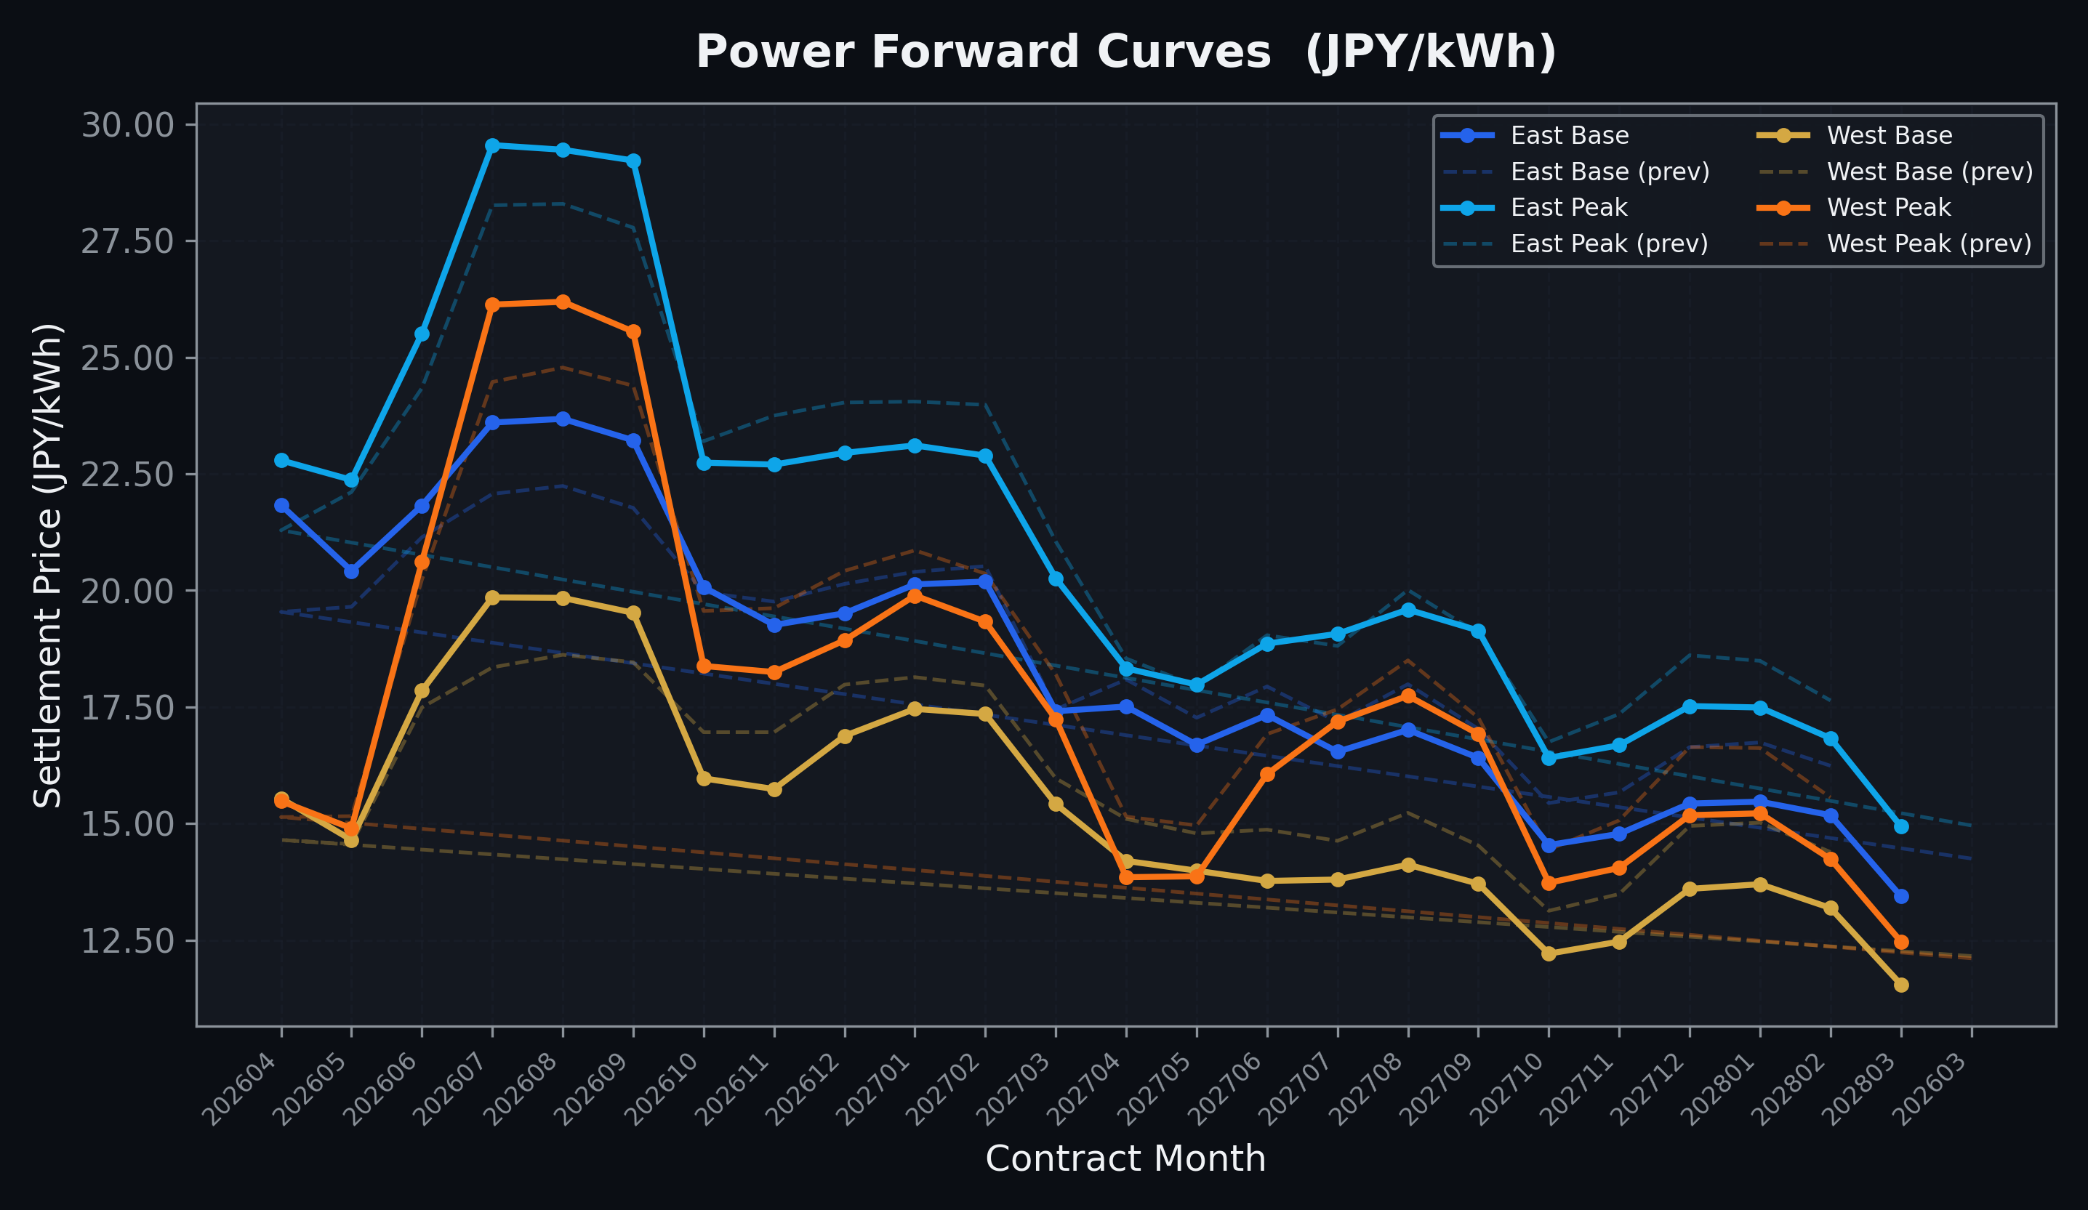
Power Forward Curves
East/West Base & Peak monthly contracts (2026-04-03)

Slide 3
Commodity Snapshot
Front-month settlement prices as of 2026-04-03
Category | Asset | Contract | Settlement | Unit | Change | % Chg
Energy | Barge Gas Oil | 202605 | 110,400.00 | JPY/kl | +5500.00 | +5.24%
Energy | Barge Gasoline | 202605 | 130,000.00 | JPY/kl | -20000.00 | -13.33%
Energy | Barge Kerosene | 202605 | 120,000.00 | JPY/kl | -20000.00 | -14.29%
Energy | Chukyo Gasoline | 202605 | 120,000.00 | JPY/kl | -20000.00 | -14.29%
Energy | Chukyo Kerosene | 202605 | 110,000.00 | JPY/kl | -20000.00 | -15.38%
Energy | Dubai Crude Oil | 202604 | 120,810.00 | JPY/kl | -6860.00 | -5.37%
Energy | LNG (Platts JKM) | 202605 | 3,130.00 | USD/MMBtu | -64.00 | -2.00%
Metals | Gold | - | 23,801.00 | JPY/g | +1098.00 | +4.84%
Metals | Palladium | 202604 | 7,300.00 | JPY/g | +100.00 | +1.39%
Metals | Platinum | - | 9,707.00 | JPY/g | +374.00 | +4.01%
Metals | Silver | 202604 | 360.00 | JPY/10g | +0.00 | +0.00%
Industrial | Rubber (RSS3) | 202604 | 378.60 | JPY/kg | +13.60 | +3.73%
Industrial | Rubber (TSR20) | 202605 | 312.00 | JPY/kg | +0.00 | +0.00%
Industrial | Shanghai Natural Rubber | 202605 | 16,905.00 | JPY/kg | +370.00 | +2.24%
Agriculture | Azuki Beans | 202604 | 12,300.00 | JPY/bag | +0.00 | +0.00%
Agriculture | Corn | 202605 | 39,000.00 | JPY/t | +0.00 | +0.00%
Agriculture | Soybeans | 202604 | 64,000.00 | JPY/t | +0.00 | +0.00%

Slide 4
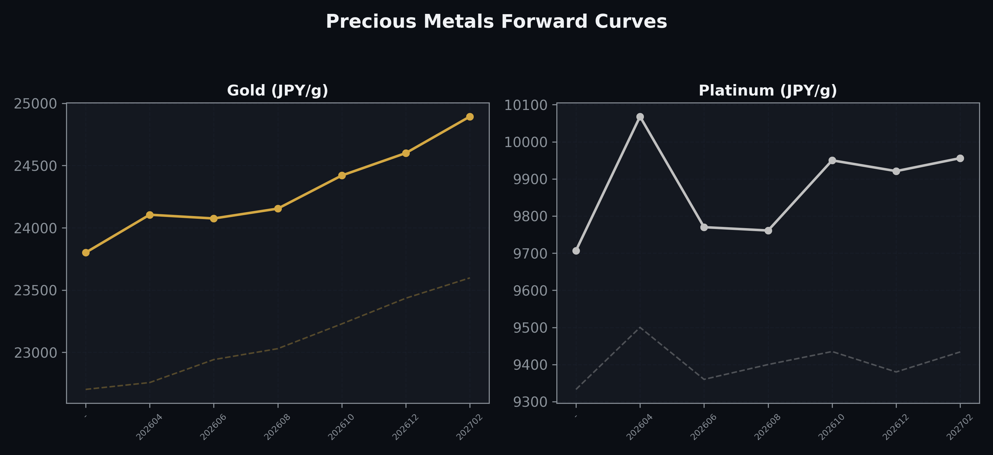
Precious Metals Forward Curves
Gold & Platinum (2026-04-03)

Slide 5
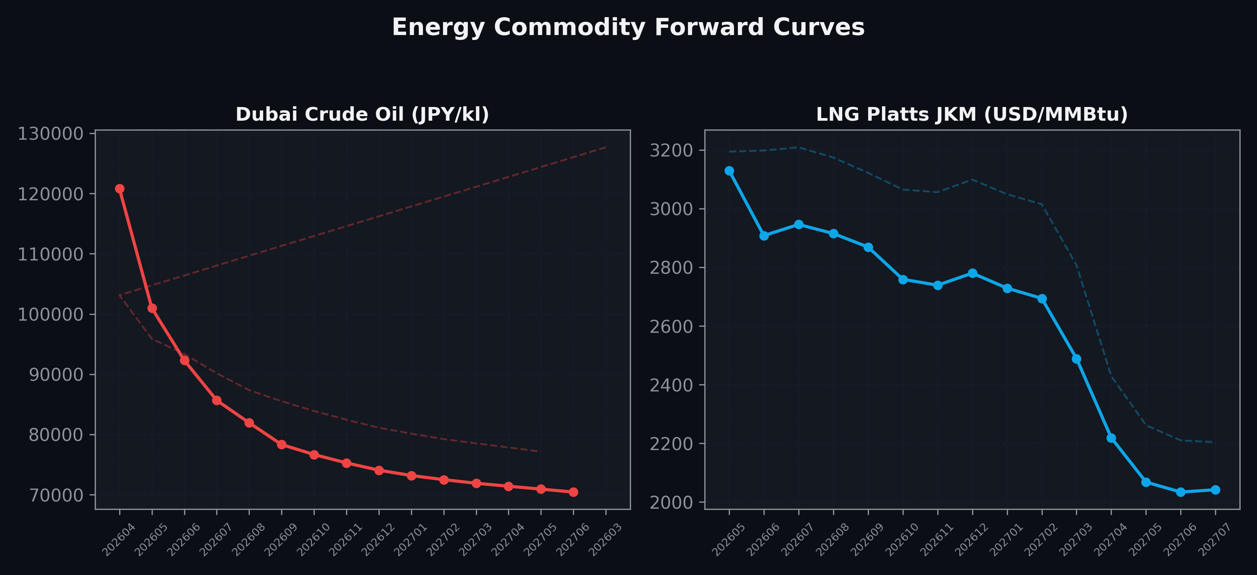
Energy Commodity Forward Curves
Dubai Crude Oil & LNG Platts JKM (2026-04-03)

Slide 6
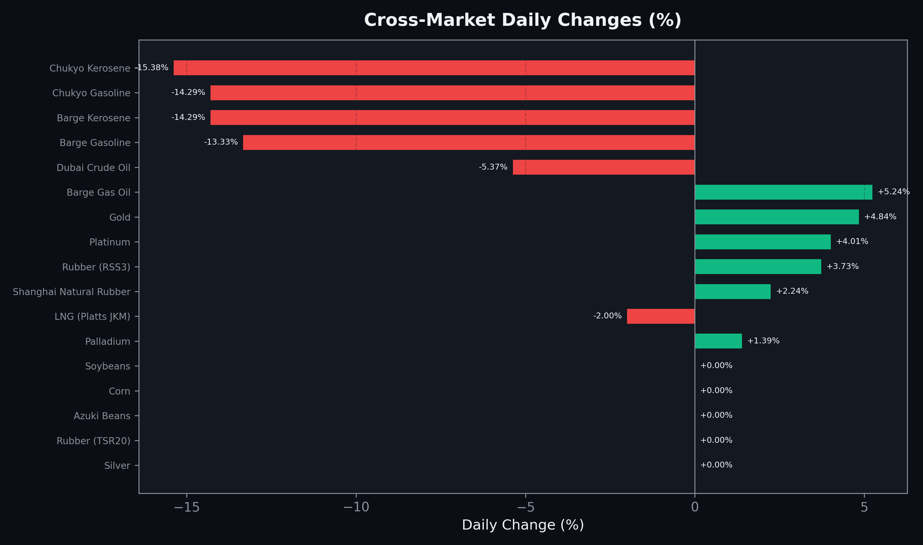
Cross-Market Daily Changes
All commodities sorted by absolute % change

Slide 7
Top Power Futures Movers
Largest absolute settlement price changes vs previous day (2026-04-03)
Instrument | Underlying | Month | Price | Prev | Change | % Chg
FUT_EEBW_260409 | Power East Base (Weekly) | 20260410 | 22.30 | 19.29 | +3.01 | +15.60%
FUT_EEPW_260428 | Power East Peak (Weekly) | 20260501 | 19.00 | 21.83 | -2.83 | -12.96%
FUT_EEB_260428 | Power East Base (Monthly) | 202604 | 21.83 | 19.54 | +2.29 | +11.72%
FUT_EEBW_260416 | Power East Base (Weekly) | 20260417 | 21.85 | 19.59 | +2.26 | +11.54%
FUT_EWPW_260428 | Power West Peak (Weekly) | 20260501 | 12.73 | 14.69 | -1.96 | -13.34%
FUT_EWP_260730 | Power West Peak (Monthly) | 202607 | 26.13 | 24.47 | +1.66 | +6.78%
FUT_EEB_260730 | Power East Base (Monthly) | 202607 | 23.60 | 22.07 | +1.53 | +6.93%
FUT_EEP_260428 | Power East Peak (Monthly) | 202604 | 22.79 | 21.29 | +1.50 | +7.05%
FUT_EWB_260730 | Power West Base (Monthly) | 202607 | 19.85 | 18.35 | +1.50 | +8.17%
FUT_EWP_261228 | Power West Peak (Monthly) | 202612 | 18.93 | 20.42 | -1.49 | -7.30%
FUT_EWP_271228 | Power West Peak (Monthly) | 202712 | 15.18 | 16.64 | -1.46 | -8.77%
FUT_EEB_260929 | Power East Base (Monthly) | 202609 | 23.22 | 21.77 | +1.45 | +6.66%
FUT_EWBW_260409 | Power West Base (Weekly) | 20260410 | 15.87 | 14.42 | +1.45 | +10.06%
FUT_EEB_260828 | Power East Base (Monthly) | 202608 | 23.68 | 22.24 | +1.44 | +6.47%
FUT_EEP_260929 | Power East Peak (Monthly) | 202609 | 29.22 | 27.78 | +1.44 | +5.18%

