Slide 1
Daily Market Report
Trade Date: 2026-06-17
JPX Derivative & Commodity Analytics
DataServer In-House

Slide 2
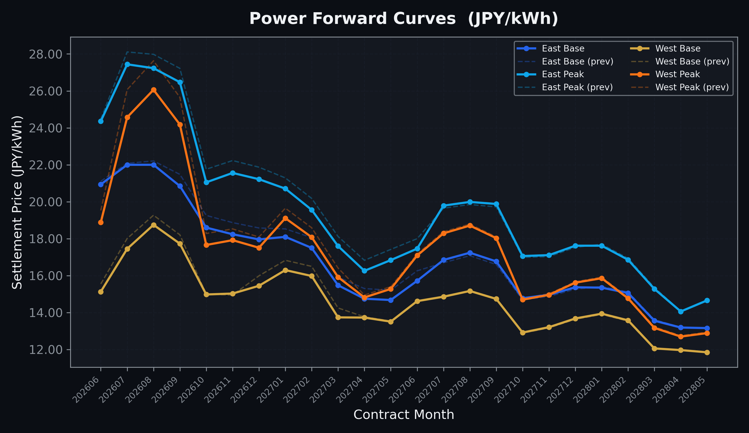
Power Forward Curves
East/West Base & Peak monthly contracts (2026-06-17)

Slide 3
Commodity Snapshot
Front-month settlement prices as of 2026-06-17
Category | Asset | Contract | Settlement | Unit | Change | % Chg
Energy | Barge Gas Oil | 202607 | 105,100.00 | JPY/kl | -400.00 | -0.38%
Energy | Barge Gasoline | 202607 | 98,000.00 | JPY/kl | +0.00 | +0.00%
Energy | Barge Kerosene | 202607 | 109,000.00 | JPY/kl | -1000.00 | -0.91%
Energy | Chukyo Gasoline | 202607 | 95,000.00 | JPY/kl | +0.00 | +0.00%
Energy | Chukyo Kerosene | 202607 | 105,000.00 | JPY/kl | +0.00 | +0.00%
Energy | Dubai Crude Oil | 202606 | 80,780.00 | JPY/kl | -6220.00 | -7.15%
Energy | LNG (Platts JKM) | 202608 | 2,547.00 | USD/MMBtu | -85.00 | -3.23%
Metals | Gold | - | 22,338.00 | JPY/g | +98.00 | +0.44%
Metals | Palladium | 202606 | 6,900.00 | JPY/g | +100.00 | +1.47%
Metals | Platinum | - | 9,192.00 | JPY/g | +225.00 | +2.51%
Metals | Silver | 202606 | 350.00 | JPY/10g | +5.00 | +1.45%
Industrial | Rubber (RSS3) | 202606 | 430.00 | JPY/kg | -3.60 | -0.83%
Industrial | Rubber (TSR20) | 202607 | 365.00 | JPY/kg | +3.00 | +0.83%
Industrial | Shanghai Natural Rubber | 202609 | 18,050.00 | JPY/kg | -150.00 | -0.82%
Agriculture | Azuki Beans | 202606 | 12,300.00 | JPY/bag | +0.00 | +0.00%
Agriculture | Corn | 202609 | 39,000.00 | JPY/t | +0.00 | +0.00%
Agriculture | Soybeans | 202608 | 64,000.00 | JPY/t | +0.00 | +0.00%

Slide 4
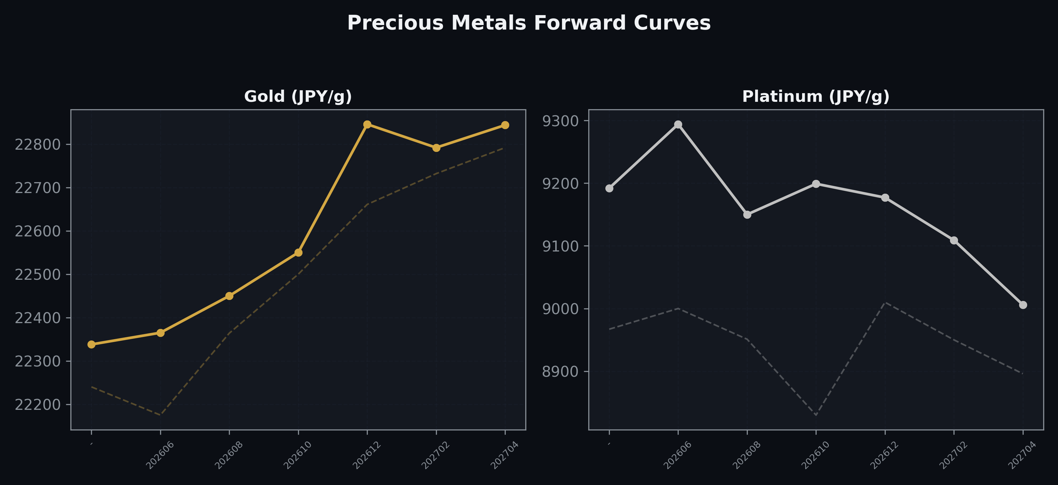
Precious Metals Forward Curves
Gold & Platinum (2026-06-17)

Slide 5
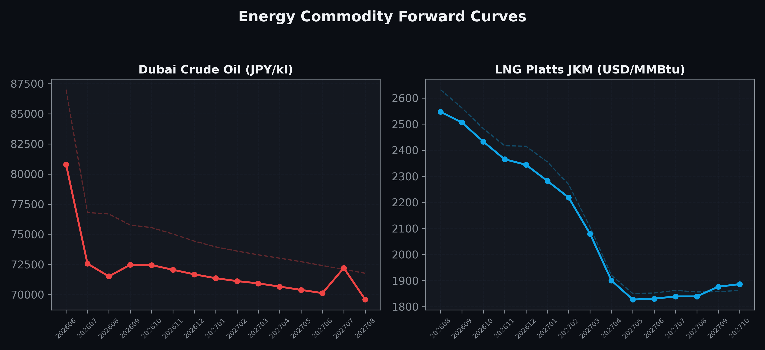
Energy Commodity Forward Curves
Dubai Crude Oil & LNG Platts JKM (2026-06-17)

Slide 6
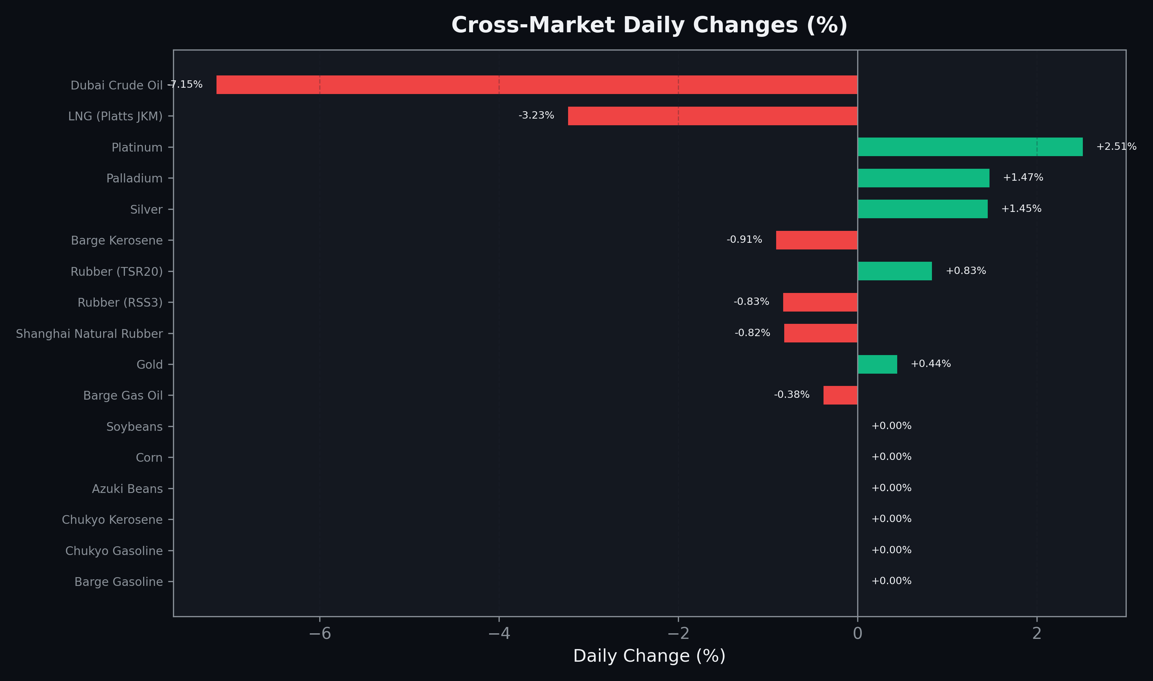
Cross-Market Daily Changes
All commodities sorted by absolute % change

Slide 7
Top Power Futures Movers
Largest absolute settlement price changes vs previous day (2026-06-17)
Instrument | Underlying | Month | Price | Prev | Change | % Chg
FUT_EWP_260828 | Power West Peak (Monthly) | 202608 | 26.06 | 27.63 | -1.57 | -5.68%
FUT_EWP_260730 | Power West Peak (Monthly) | 202607 | 24.57 | 26.07 | -1.50 | -5.75%
FUT_EWP_260929 | Power West Peak (Monthly) | 202609 | 24.18 | 25.65 | -1.47 | -5.73%
FUT_EWPW_260625 | Power West Peak (Weekly) | 20260626 | 18.56 | 19.71 | -1.15 | -5.83%
FUT_EWPW_260709 | Power West Peak (Weekly) | 20260710 | 22.75 | 23.89 | -1.14 | -4.77%
FUT_EWPW_260702 | Power West Peak (Weekly) | 20260703 | 21.33 | 22.24 | -0.91 | -4.09%
FUT_EWPW_260716 | Power West Peak (Weekly) | 20260717 | 22.83 | 23.71 | -0.88 | -3.71%
FUT_EEP_260828 | Power East Peak (Monthly) | 202608 | 27.23 | 27.98 | -0.75 | -2.68%
FUT_EEP_260929 | Power East Peak (Monthly) | 202609 | 26.47 | 27.22 | -0.75 | -2.76%
FUT_EEP_261029 | Power East Peak (Monthly) | 202610 | 21.05 | 21.76 | -0.71 | -3.26%
FUT_EEPW_260716 | Power East Peak (Weekly) | 20260717 | 26.97 | 27.68 | -0.71 | -2.57%
FUT_EWBW_260625 | Power West Base (Weekly) | 20260626 | 14.66 | 15.35 | -0.69 | -4.50%
FUT_EEP_260730 | Power East Peak (Monthly) | 202607 | 27.44 | 28.11 | -0.67 | -2.38%
FUT_EEP_261127 | Power East Peak (Monthly) | 202611 | 21.56 | 22.23 | -0.67 | -3.01%
FUT_EWBW_260702 | Power West Base (Weekly) | 20260703 | 15.48 | 16.15 | -0.67 | -4.15%

