Slide 1
Daily Market Report
Trade Date: 2026-05-15
JPX Derivative & Commodity Analytics
DataServer In-House

Slide 2
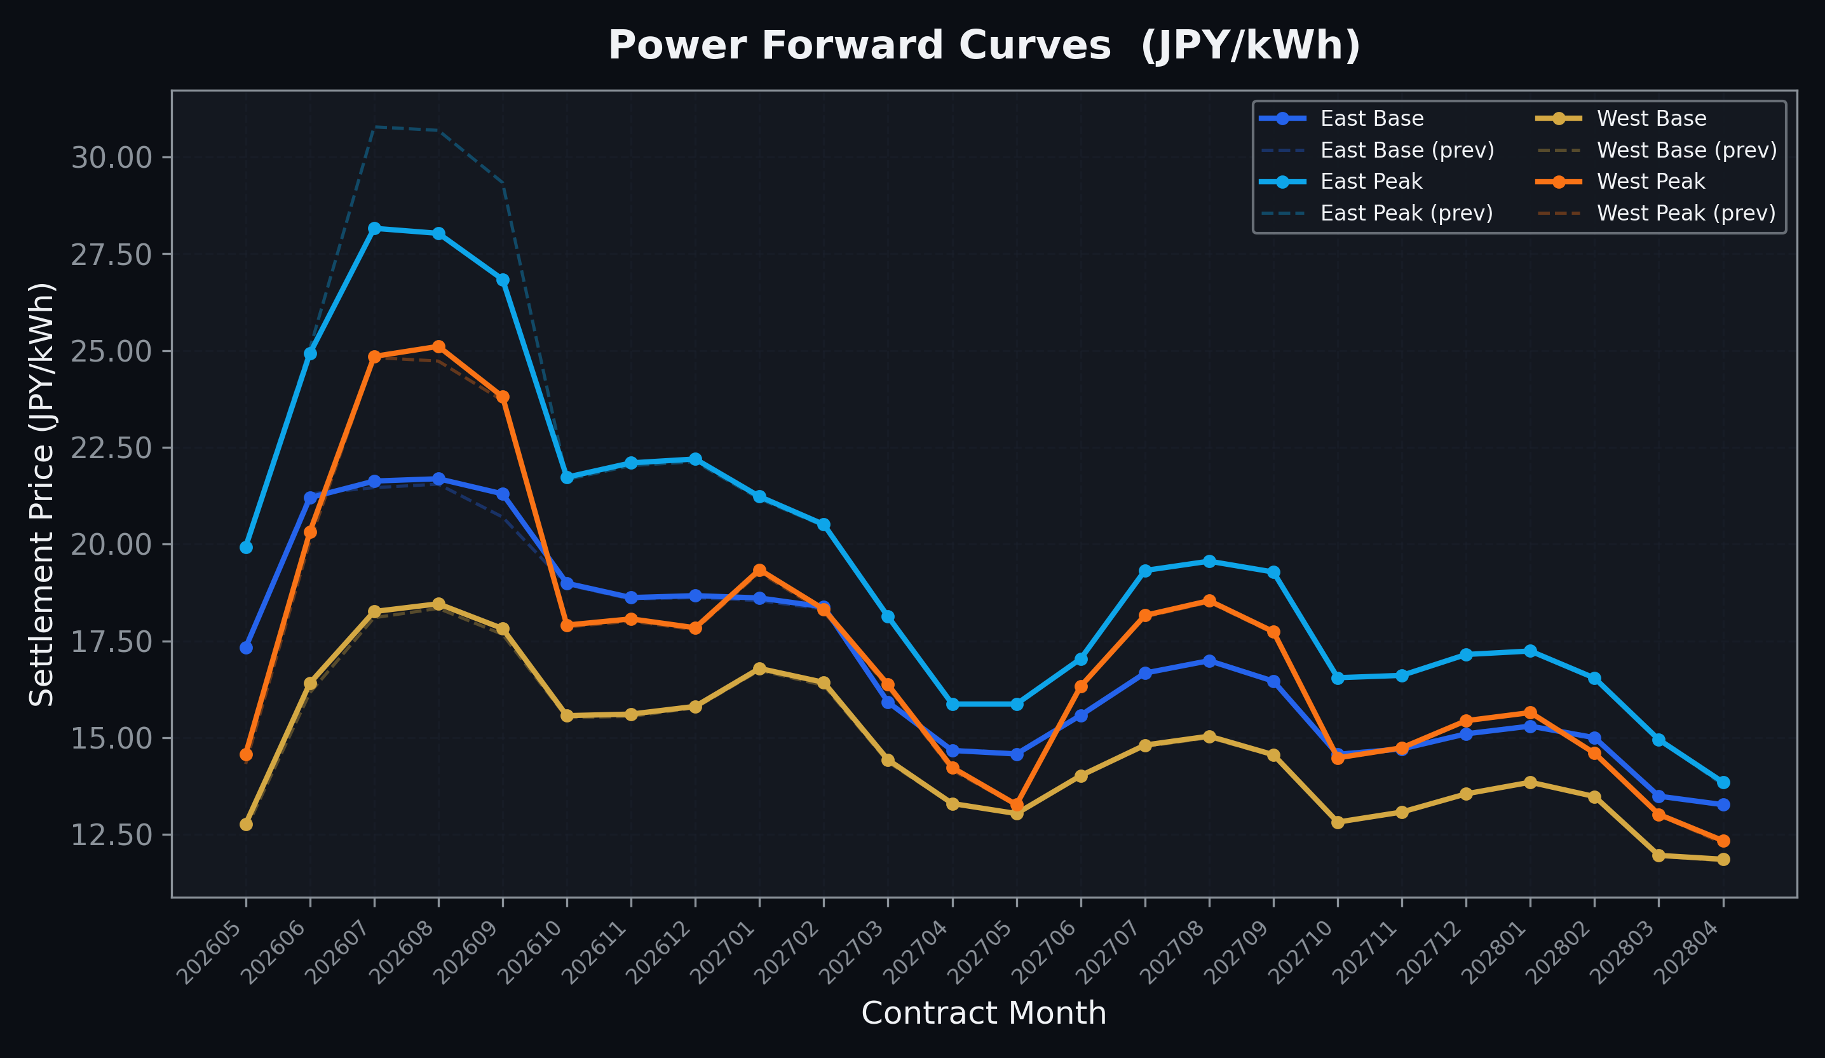
Power Forward Curves
East/West Base & Peak monthly contracts (2026-05-15)

Slide 3
Commodity Snapshot
Front-month settlement prices as of 2026-05-15
Category | Asset | Contract | Settlement | Unit | Change | % Chg
Energy | Barge Gas Oil | 202606 | 110,200.00 | JPY/kl | -300.00 | -0.27%
Energy | Barge Gasoline | 202606 | 100,000.00 | JPY/kl | +0.00 | +0.00%
Energy | Barge Kerosene | 202606 | 105,000.00 | JPY/kl | +0.00 | +0.00%
Energy | Chukyo Gasoline | 202606 | 100,000.00 | JPY/kl | +0.00 | +0.00%
Energy | Chukyo Kerosene | 202606 | 105,000.00 | JPY/kl | +0.00 | +0.00%
Energy | Dubai Crude Oil | 202605 | 101,240.00 | JPY/kl | +300.00 | +0.30%
Energy | LNG (Platts JKM) | 202606 | 2,701.00 | USD/MMBtu | +0.00 | +0.00%
Metals | Gold | - | 23,266.00 | JPY/g | -496.00 | -2.09%
Metals | Palladium | 202606 | 7,300.00 | JPY/g | -200.00 | -2.67%
Metals | Platinum | - | 10,046.00 | JPY/g | -608.00 | -5.71%
Metals | Silver | 202606 | 410.00 | JPY/10g | -10.00 | -2.38%
Industrial | Rubber (RSS3) | 202605 | 399.70 | JPY/kg | -5.60 | -1.38%
Industrial | Rubber (TSR20) | 202606 | 350.00 | JPY/kg | +0.00 | +0.00%
Industrial | Shanghai Natural Rubber | 202605 | 17,910.00 | JPY/kg | -305.00 | -1.67%
Agriculture | Azuki Beans | 202605 | 12,300.00 | JPY/bag | +0.00 | +0.00%
Agriculture | Corn | 202607 | 39,000.00 | JPY/t | +0.00 | +0.00%
Agriculture | Soybeans | 202606 | 64,000.00 | JPY/t | +0.00 | +0.00%

Slide 4
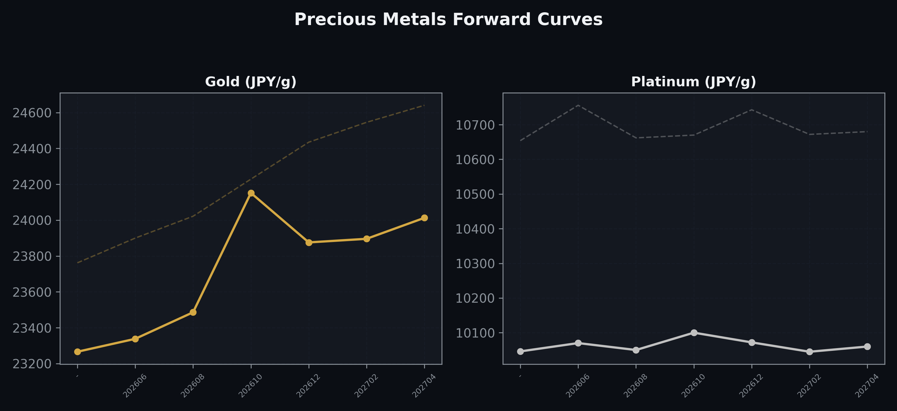
Precious Metals Forward Curves
Gold & Platinum (2026-05-15)

Slide 5
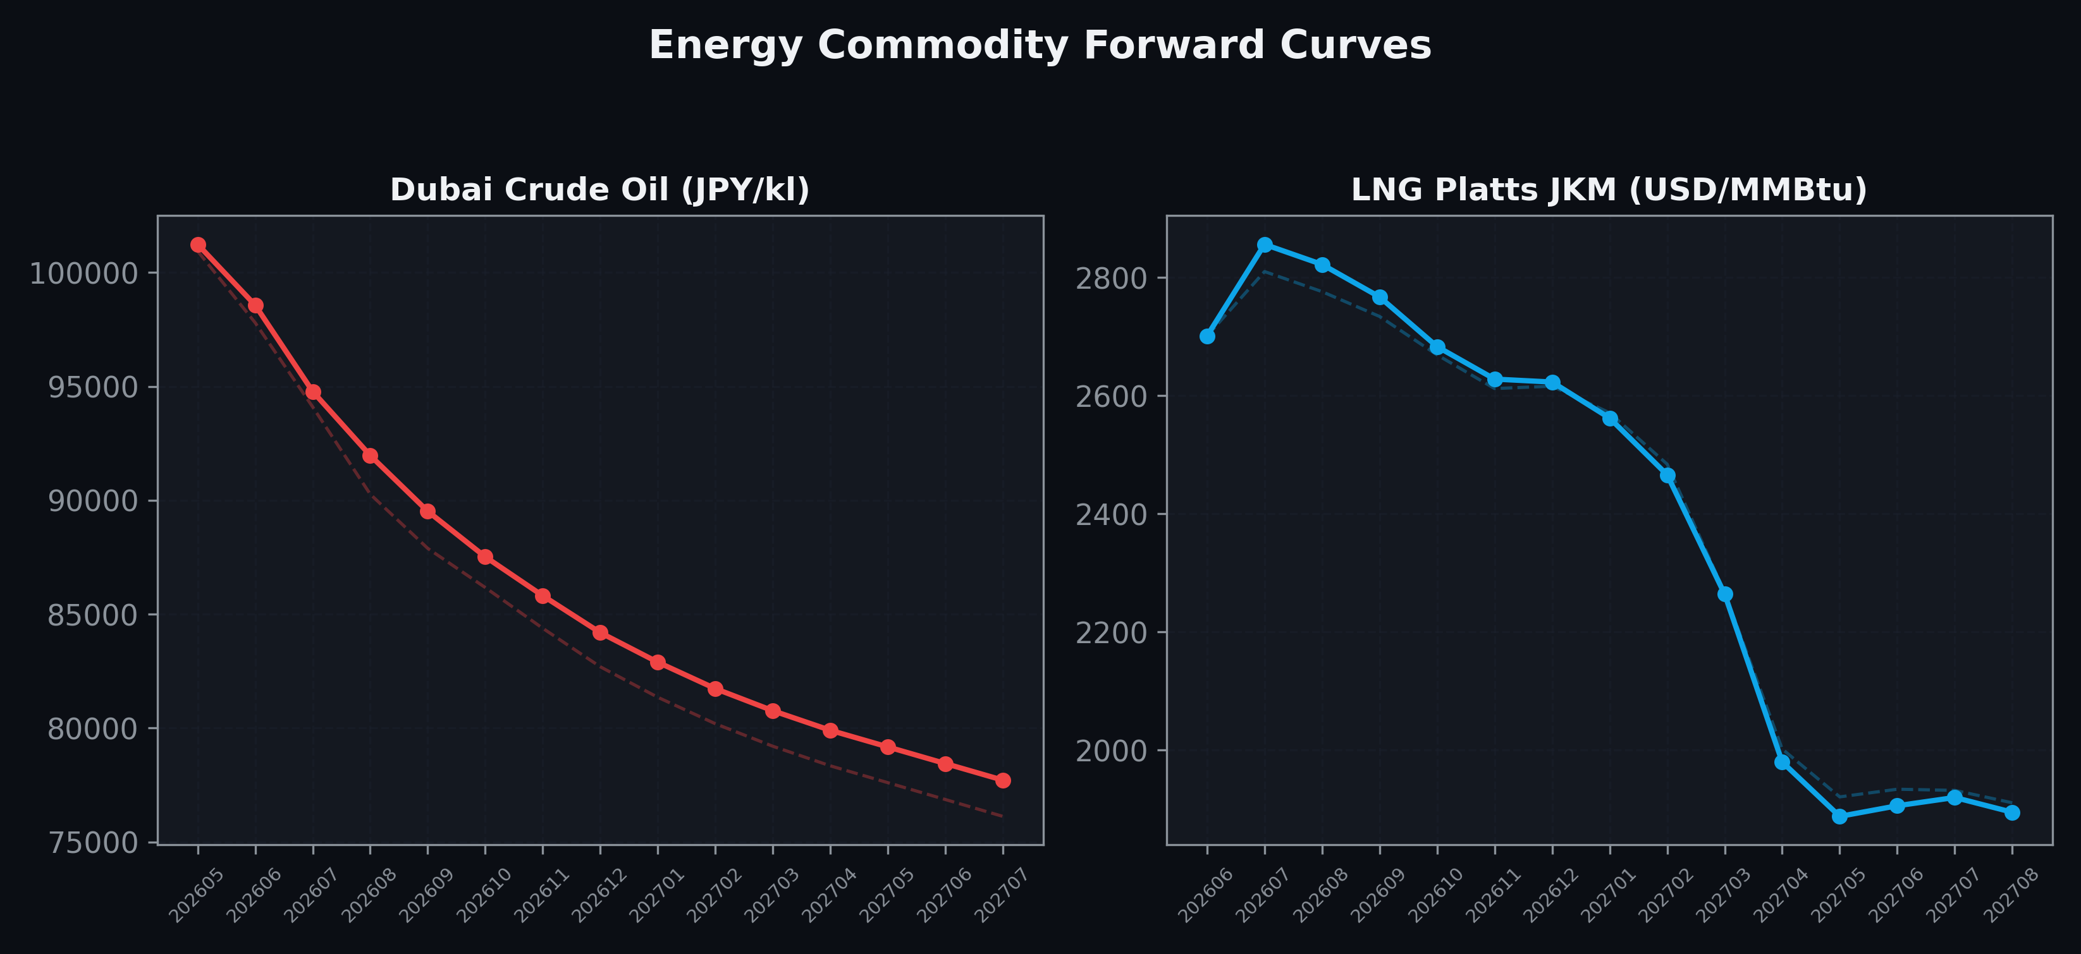
Energy Commodity Forward Curves
Dubai Crude Oil & LNG Platts JKM (2026-05-15)

Slide 6
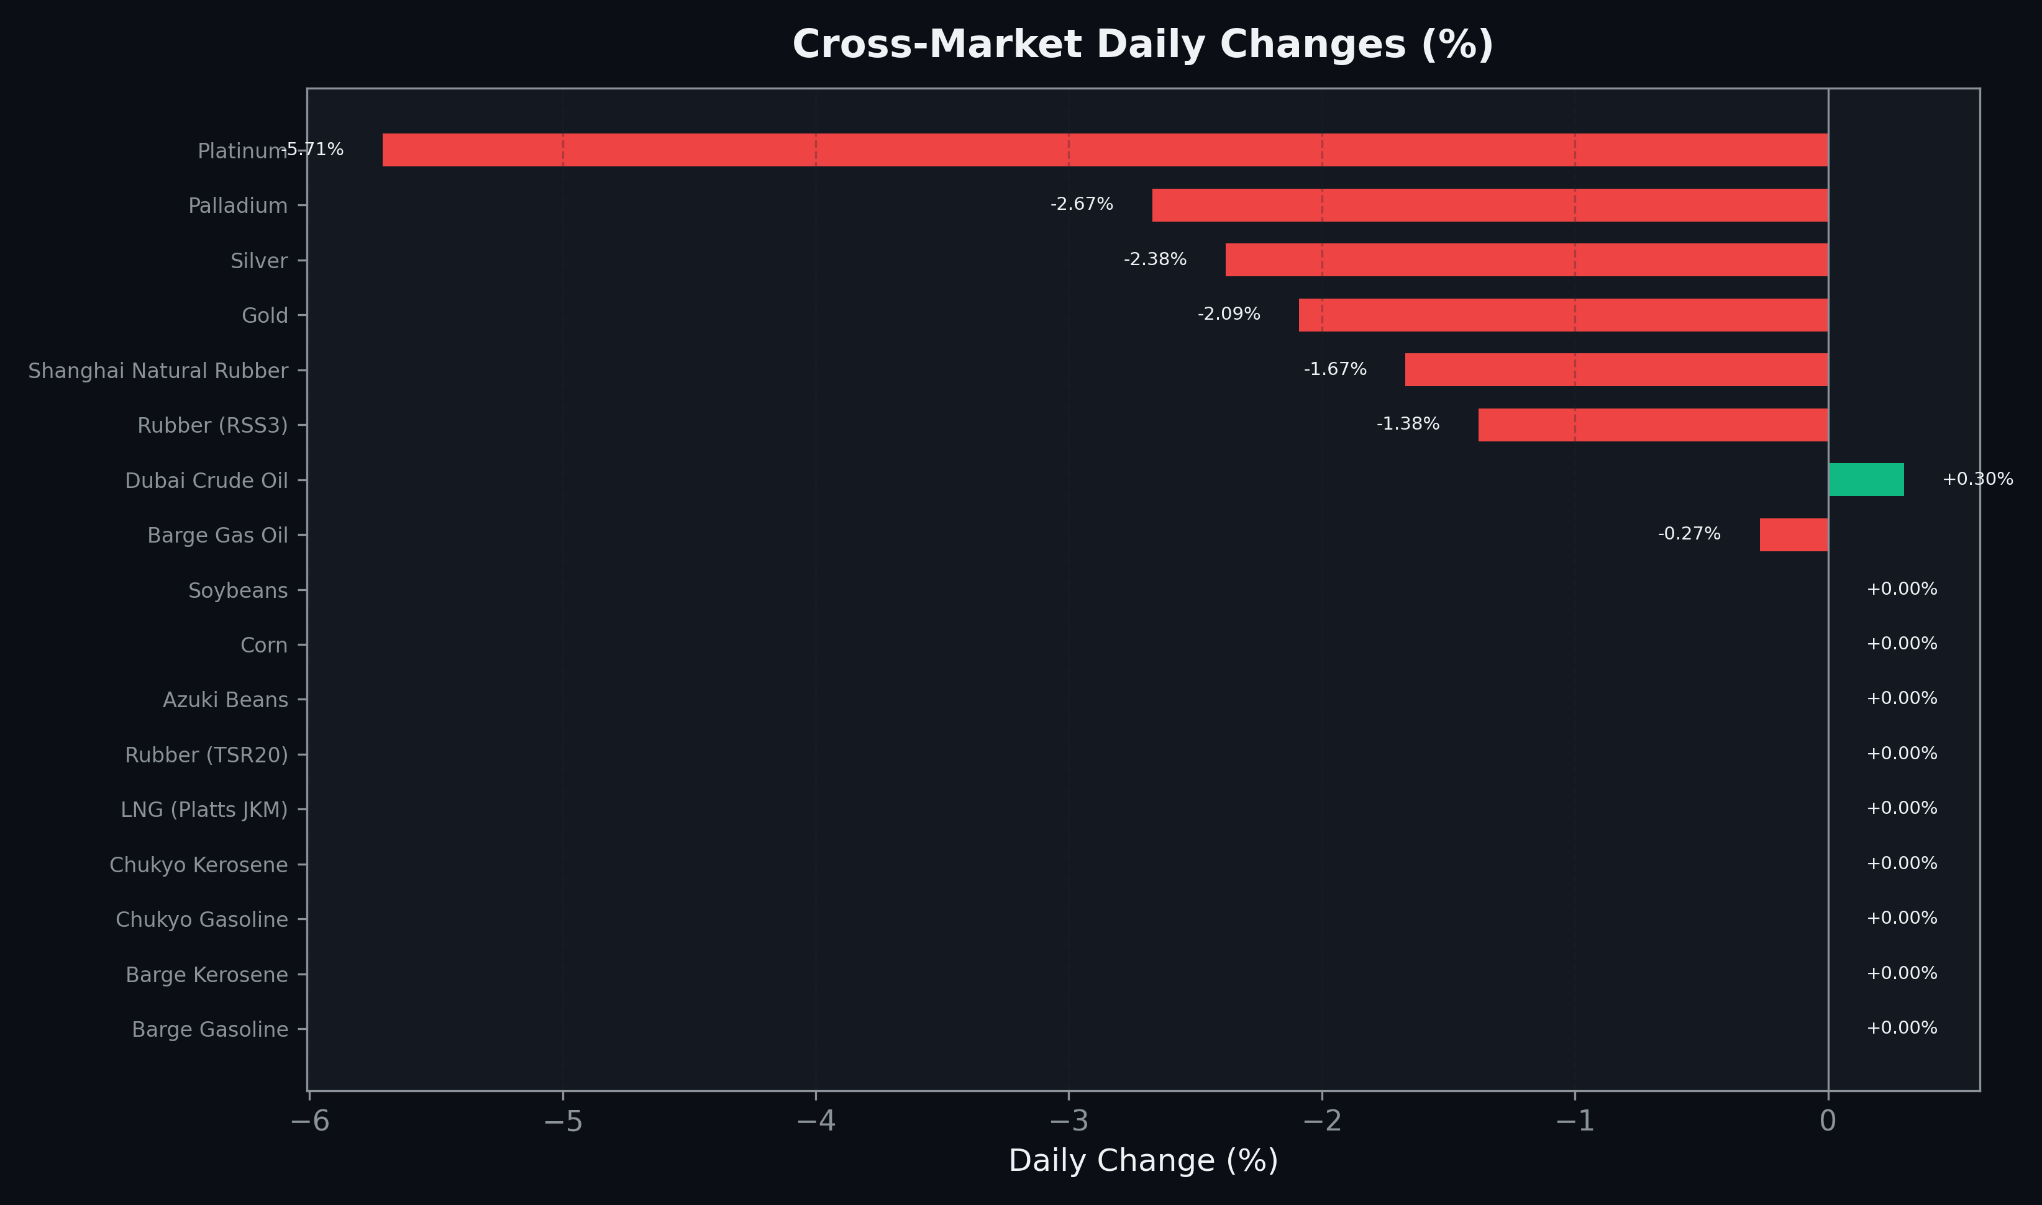
Cross-Market Daily Changes
All commodities sorted by absolute % change

Slide 7
Top Power Futures Movers
Largest absolute settlement price changes vs previous day (2026-05-15)
Instrument | Underlying | Month | Price | Prev | Change | % Chg
FUT_EEP_260828 | Power East Peak (Monthly) | 202608 | 28.03 | 30.69 | -2.66 | -8.67%
FUT_EEP_260730 | Power East Peak (Monthly) | 202607 | 28.16 | 30.78 | -2.62 | -8.51%
FUT_EEP_260929 | Power East Peak (Monthly) | 202609 | 26.84 | 29.34 | -2.50 | -8.52%
FUT_EEBW_260521 | Power East Base (Weekly) | 20260522 | 20.05 | 19.27 | +0.78 | +4.05%
FUT_EWPW_260604 | Power West Peak (Weekly) | 20260605 | 18.66 | 18.05 | +0.61 | +3.38%
FUT_EEB_260929 | Power East Base (Monthly) | 202609 | 21.30 | 20.70 | +0.60 | +2.90%
FUT_EWBW_260604 | Power West Base (Weekly) | 20260605 | 15.82 | 15.33 | +0.49 | +3.20%
FUT_EWBW_260611 | Power West Base (Weekly) | 20260612 | 16.06 | 15.64 | +0.42 | +2.69%
FUT_EWPW_260611 | Power West Peak (Weekly) | 20260612 | 19.28 | 18.88 | +0.40 | +2.12%
FUT_EWP_260828 | Power West Peak (Monthly) | 202608 | 25.11 | 24.73 | +0.38 | +1.54%
FUT_EWBW_260528 | Power West Base (Weekly) | 20260529 | 13.52 | 13.20 | +0.32 | +2.42%
FUT_EWBW_260521 | Power West Base (Weekly) | 20260522 | 13.72 | 13.43 | +0.29 | +2.16%
FUT_EEPW_260604 | Power East Peak (Weekly) | 20260605 | 23.04 | 22.77 | +0.27 | +1.19%
FUT_EWPW_260521 | Power West Peak (Weekly) | 20260522 | 13.04 | 12.77 | +0.27 | +2.11%
FUT_EWP_260528 | Power West Peak (Monthly) | 202605 | 14.58 | 14.32 | +0.26 | +1.82%

