Slide 1
Daily Market Report
Trade Date: 2026-07-02
JPX Derivative & Commodity Analytics
DataServer In-House

Slide 2
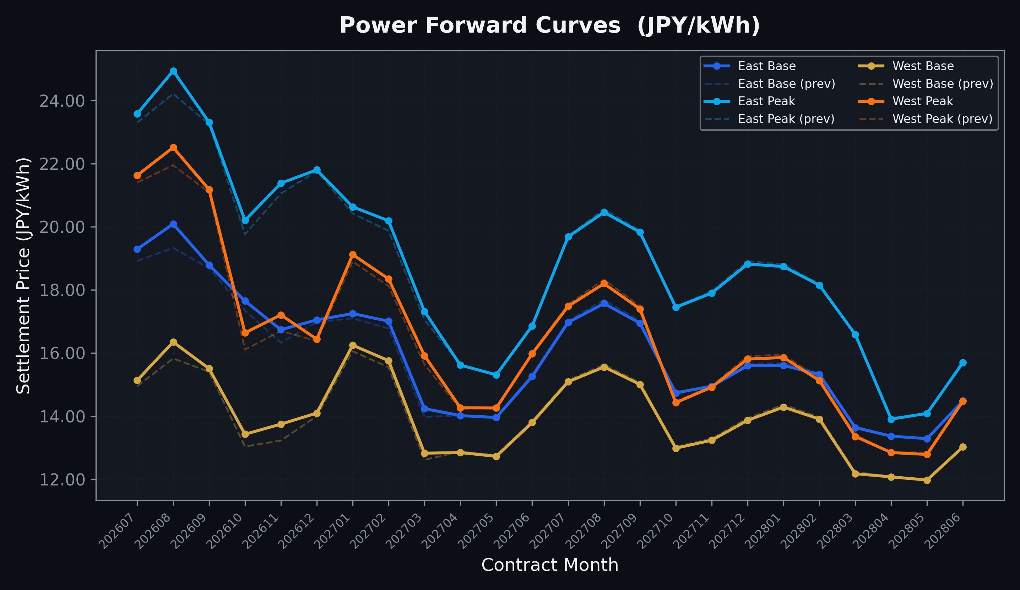
Power Forward Curves
East/West Base & Peak monthly contracts (2026-07-02)

Slide 3
Commodity Snapshot
Front-month settlement prices as of 2026-07-02
Category | Asset | Contract | Settlement | Unit | Change | % Chg
Energy | Barge Gas Oil | 202608 | 105,500.00 | JPY/kl | +0.00 | +0.00%
Energy | Barge Gasoline | 202608 | 97,000.00 | JPY/kl | +0.00 | +0.00%
Energy | Barge Kerosene | 202608 | 108,000.00 | JPY/kl | +0.00 | +0.00%
Energy | Chukyo Gasoline | 202608 | 95,000.00 | JPY/kl | +0.00 | +0.00%
Energy | Chukyo Kerosene | 202608 | 105,000.00 | JPY/kl | +0.00 | +0.00%
Energy | Dubai Crude Oil | 202607 | 66,000.00 | JPY/kl | -4440.00 | -6.30%
Energy | LNG (Platts JKM) | 202608 | 2,628.00 | USD/MMBtu | -9.00 | -0.34%
Metals | Gold | - | 21,200.00 | JPY/g | +398.00 | +1.91%
Metals | Palladium | 202608 | 6,400.00 | JPY/g | +0.00 | +0.00%
Metals | Platinum | - | 8,240.00 | JPY/g | +213.00 | +2.65%
Metals | Silver | 202608 | 300.00 | JPY/10g | +0.00 | +0.00%
Industrial | Rubber (RSS3) | 202607 | 398.00 | JPY/kg | -8.80 | -2.16%
Industrial | Rubber (TSR20) | 202608 | 338.00 | JPY/kg | -2.00 | -0.59%
Industrial | Shanghai Natural Rubber | 202609 | 16,555.00 | JPY/kg | +105.00 | +0.64%
Agriculture | Azuki Beans | 202607 | 12,300.00 | JPY/bag | +0.00 | +0.00%
Agriculture | Corn | 202609 | 39,000.00 | JPY/t | +0.00 | +0.00%
Agriculture | Soybeans | 202608 | 64,000.00 | JPY/t | +0.00 | +0.00%

Slide 4
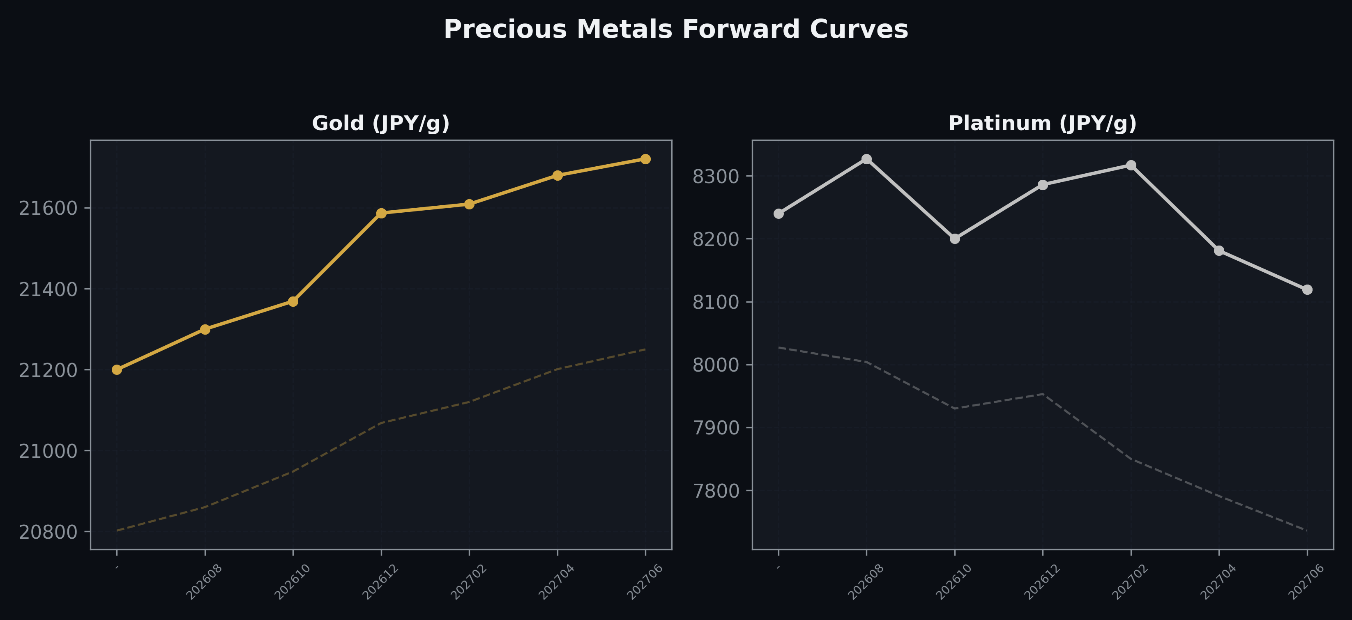
Precious Metals Forward Curves
Gold & Platinum (2026-07-02)

Slide 5
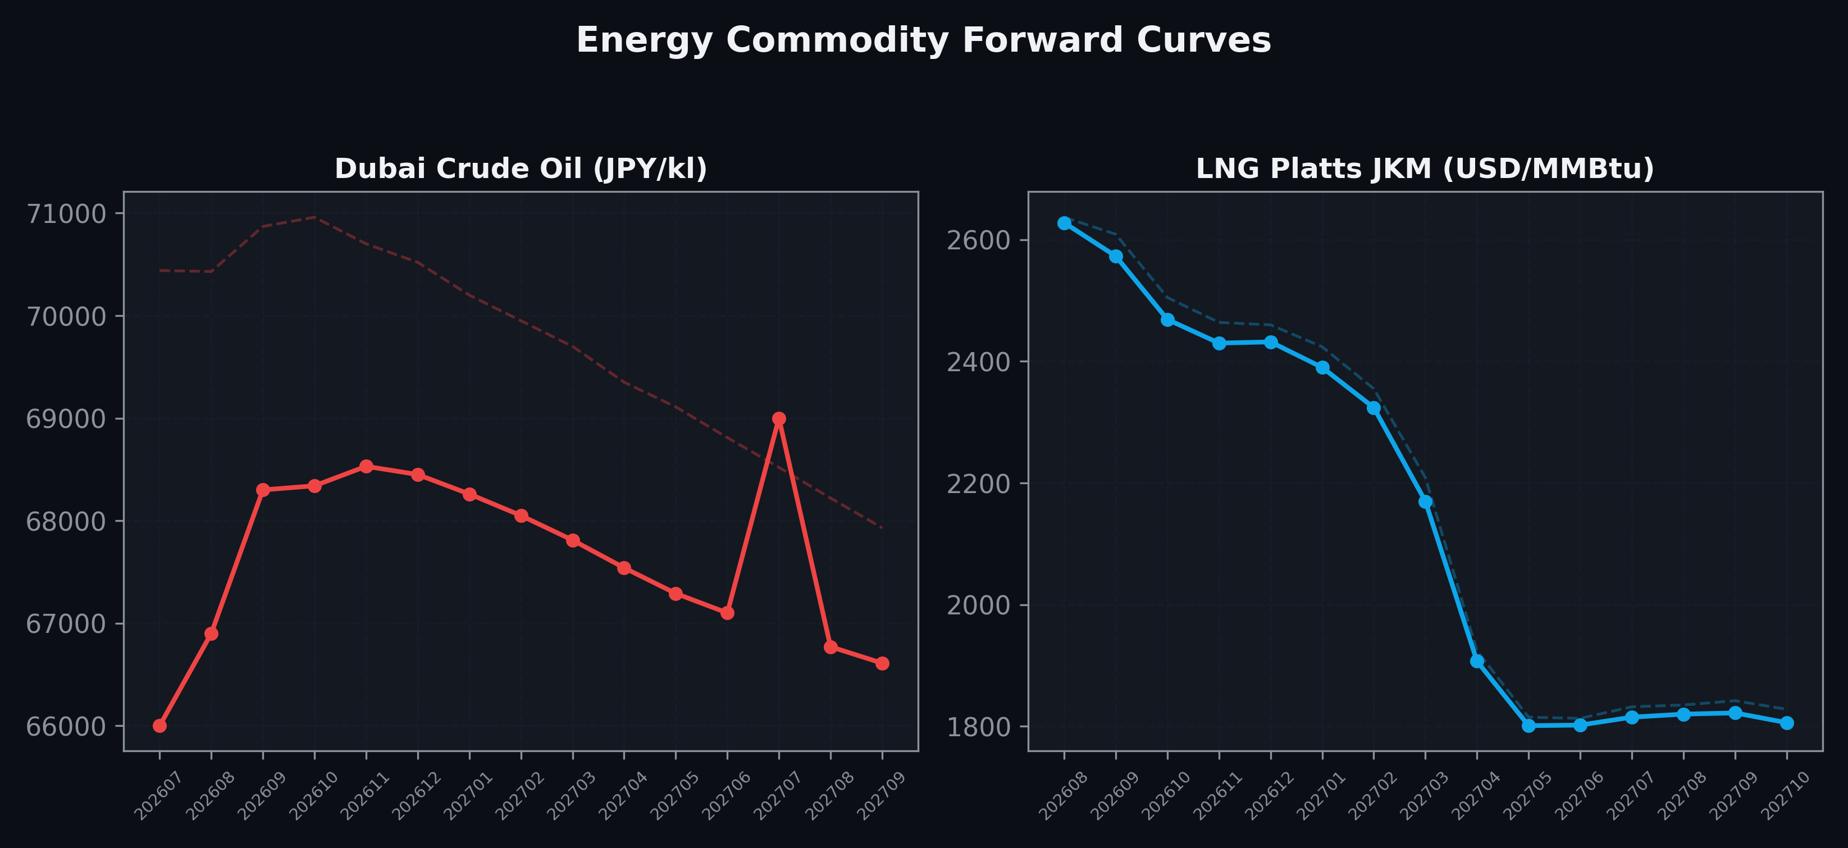
Energy Commodity Forward Curves
Dubai Crude Oil & LNG Platts JKM (2026-07-02)

Slide 6
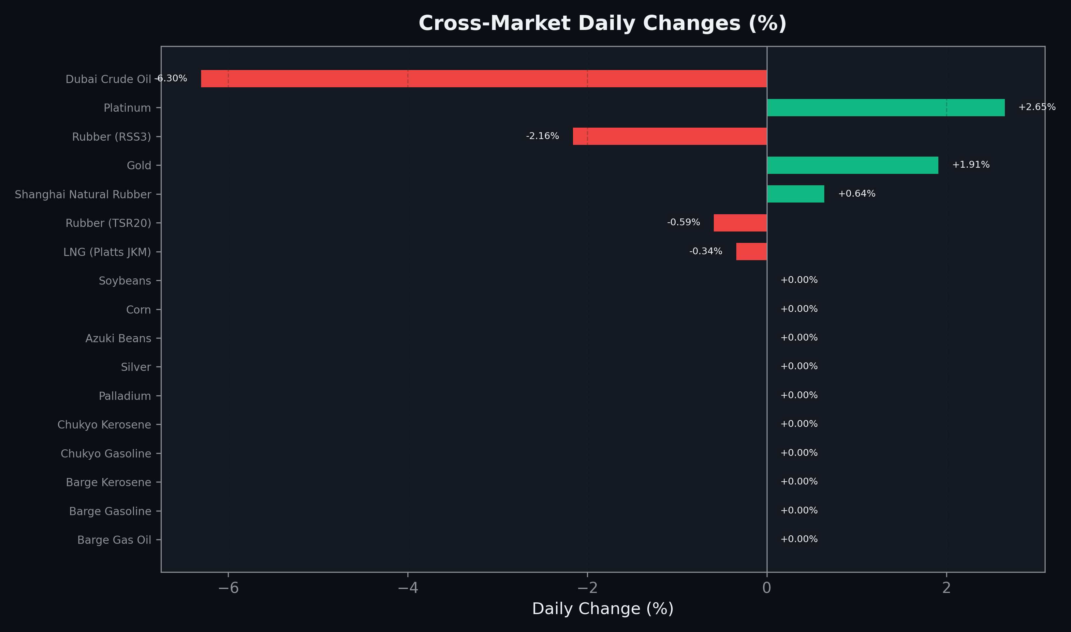
Cross-Market Daily Changes
All commodities sorted by absolute % change

Slide 7
Top Power Futures Movers
Largest absolute settlement price changes vs previous day (2026-07-02)
Instrument | Underlying | Month | Price | Prev | Change | % Chg
FUT_EEPW_260702 | Power East Peak (Weekly) | 20260703 | 17.37 | 18.22 | -0.85 | -4.67%
FUT_EWPW_260702 | Power West Peak (Weekly) | 20260703 | 12.02 | 12.86 | -0.84 | -6.53%
FUT_EEB_260828 | Power East Base (Monthly) | 202608 | 20.09 | 19.33 | +0.76 | +3.93%
FUT_EEP_260828 | Power East Peak (Monthly) | 202608 | 24.94 | 24.21 | +0.73 | +3.02%
FUT_ECP_260828 | 電力(中部・日中) | 202608 | 24.30 | 23.58 | +0.72 | +3.05%
FUT_ECB_260828 | 電力(中部・ベース) | 202608 | 19.25 | 18.54 | +0.71 | +3.83%
FUT_EWP_260828 | Power West Peak (Monthly) | 202608 | 22.51 | 21.95 | +0.56 | +2.55%
FUT_EWP_261029 | Power West Peak (Monthly) | 202610 | 16.64 | 16.11 | +0.53 | +3.29%
FUT_EWB_260828 | Power West Base (Monthly) | 202608 | 16.35 | 15.83 | +0.52 | +3.28%
FUT_EWB_261127 | Power West Base (Monthly) | 202611 | 13.75 | 13.23 | +0.52 | +3.93%
FUT_EWP_261127 | Power West Peak (Monthly) | 202611 | 17.21 | 16.70 | +0.51 | +3.05%
FUT_ECP_261029 | 電力(中部・日中) | 202610 | 18.83 | 18.35 | +0.48 | +2.62%
FUT_ECB_261127 | 電力(中部・ベース) | 202611 | 16.08 | 15.62 | +0.46 | +2.94%
FUT_EEP_261029 | Power East Peak (Monthly) | 202610 | 20.20 | 19.76 | +0.44 | +2.23%
FUT_EWPW_260709 | Power West Peak (Weekly) | 20260710 | 20.28 | 19.85 | +0.43 | +2.17%

