Slide 1
Daily Market Report
Trade Date: 2026-03-27
JPX Derivative & Commodity Analytics
DataServer In-House

Slide 2
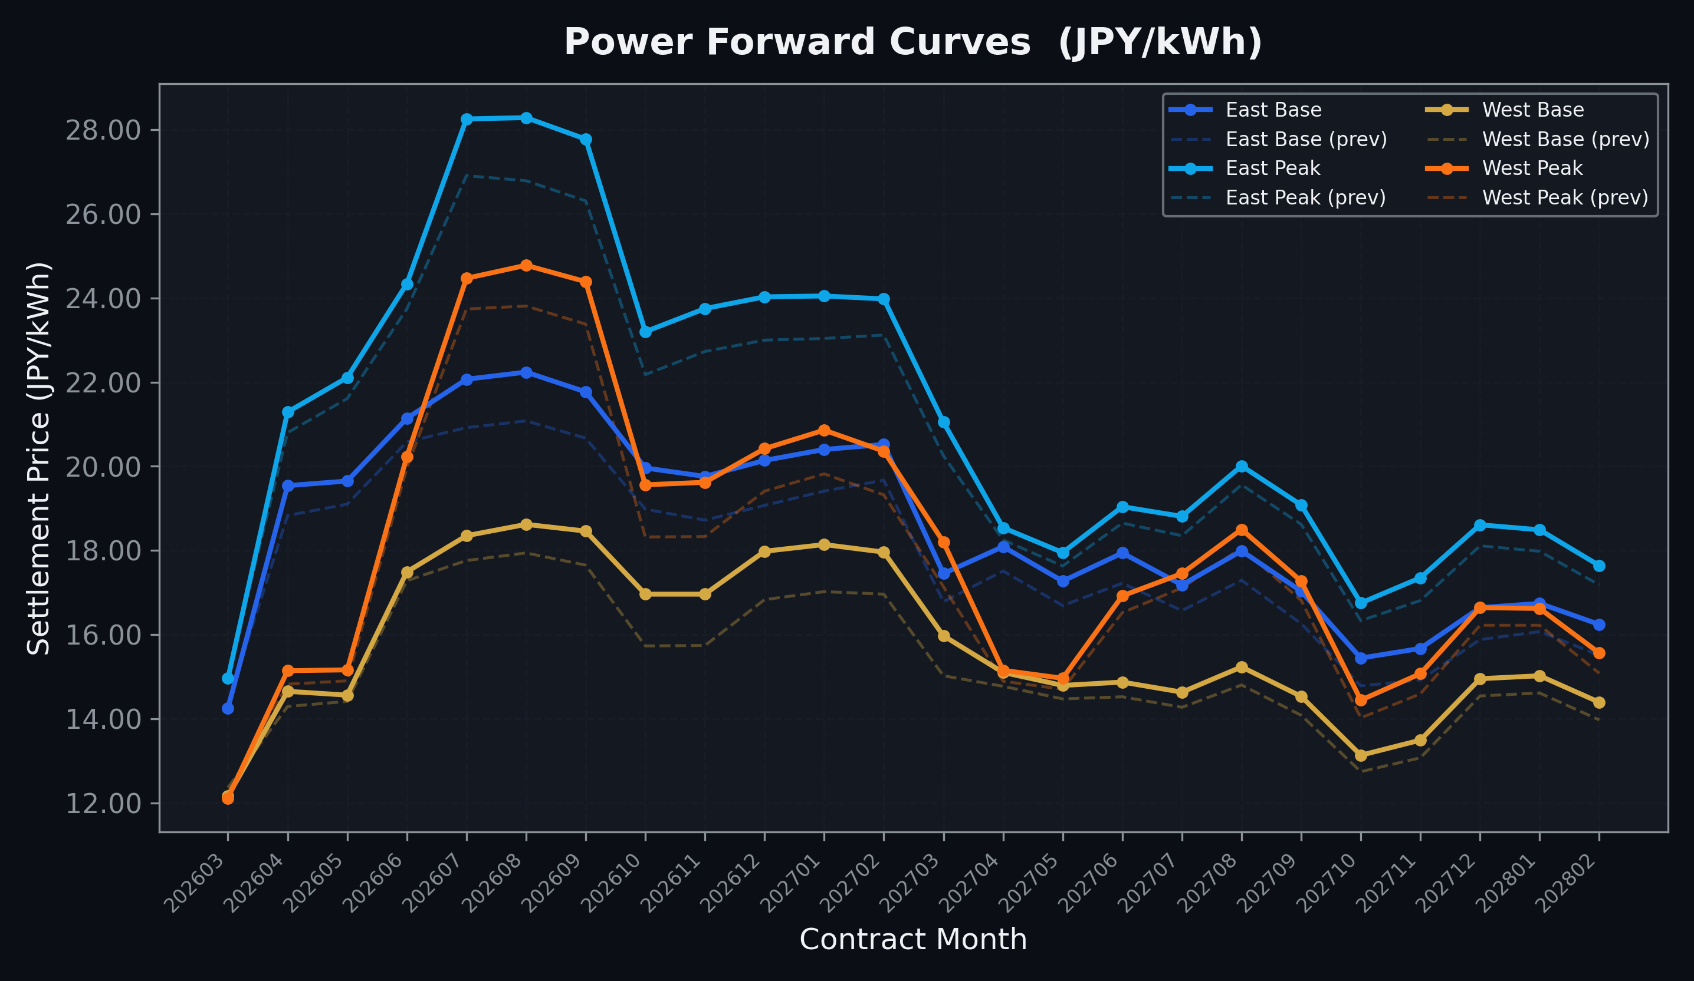
Power Forward Curves
East/West Base & Peak monthly contracts (2026-03-27)

Slide 3
Commodity Snapshot
Front-month settlement prices as of 2026-03-27
Category | Asset | Contract | Settlement | Unit | Change | % Chg
Energy | Barge Gas Oil | 202605 | 104,900.00 | JPY/kl | -3300.00 | -3.05%
Energy | Barge Gasoline | 202605 | 150,000.00 | JPY/kl | +0.00 | +0.00%
Energy | Barge Kerosene | 202605 | 140,000.00 | JPY/kl | +0.00 | +0.00%
Energy | Chukyo Gasoline | 202605 | 140,000.00 | JPY/kl | +0.00 | +0.00%
Energy | Chukyo Kerosene | 202605 | 130,000.00 | JPY/kl | +0.00 | +0.00%
Energy | Dubai Crude Oil | 202603 | 127,670.00 | JPY/kl | -4980.00 | -3.75%
Energy | LNG (Platts JKM) | 202605 | 3,194.00 | USD/MMBtu | +92.00 | +2.97%
Metals | Gold | - | 22,703.00 | JPY/g | -676.00 | -2.89%
Metals | Palladium | 202604 | 7,200.00 | JPY/g | -300.00 | -4.00%
Metals | Platinum | - | 9,333.00 | JPY/g | -35.00 | -0.37%
Metals | Silver | 202604 | 360.00 | JPY/10g | +0.00 | +0.00%
Industrial | Rubber (RSS3) | 202604 | 365.00 | JPY/kg | +4.00 | +1.11%
Industrial | Rubber (TSR20) | 202604 | 312.00 | JPY/kg | +5.00 | +1.63%
Industrial | Shanghai Natural Rubber | 202605 | 16,535.00 | JPY/kg | +65.00 | +0.39%
Agriculture | Azuki Beans | 202604 | 12,300.00 | JPY/bag | +0.00 | +0.00%
Agriculture | Corn | 202605 | 39,000.00 | JPY/t | +0.00 | +0.00%
Agriculture | Soybeans | 202604 | 64,000.00 | JPY/t | +0.00 | +0.00%

Slide 4
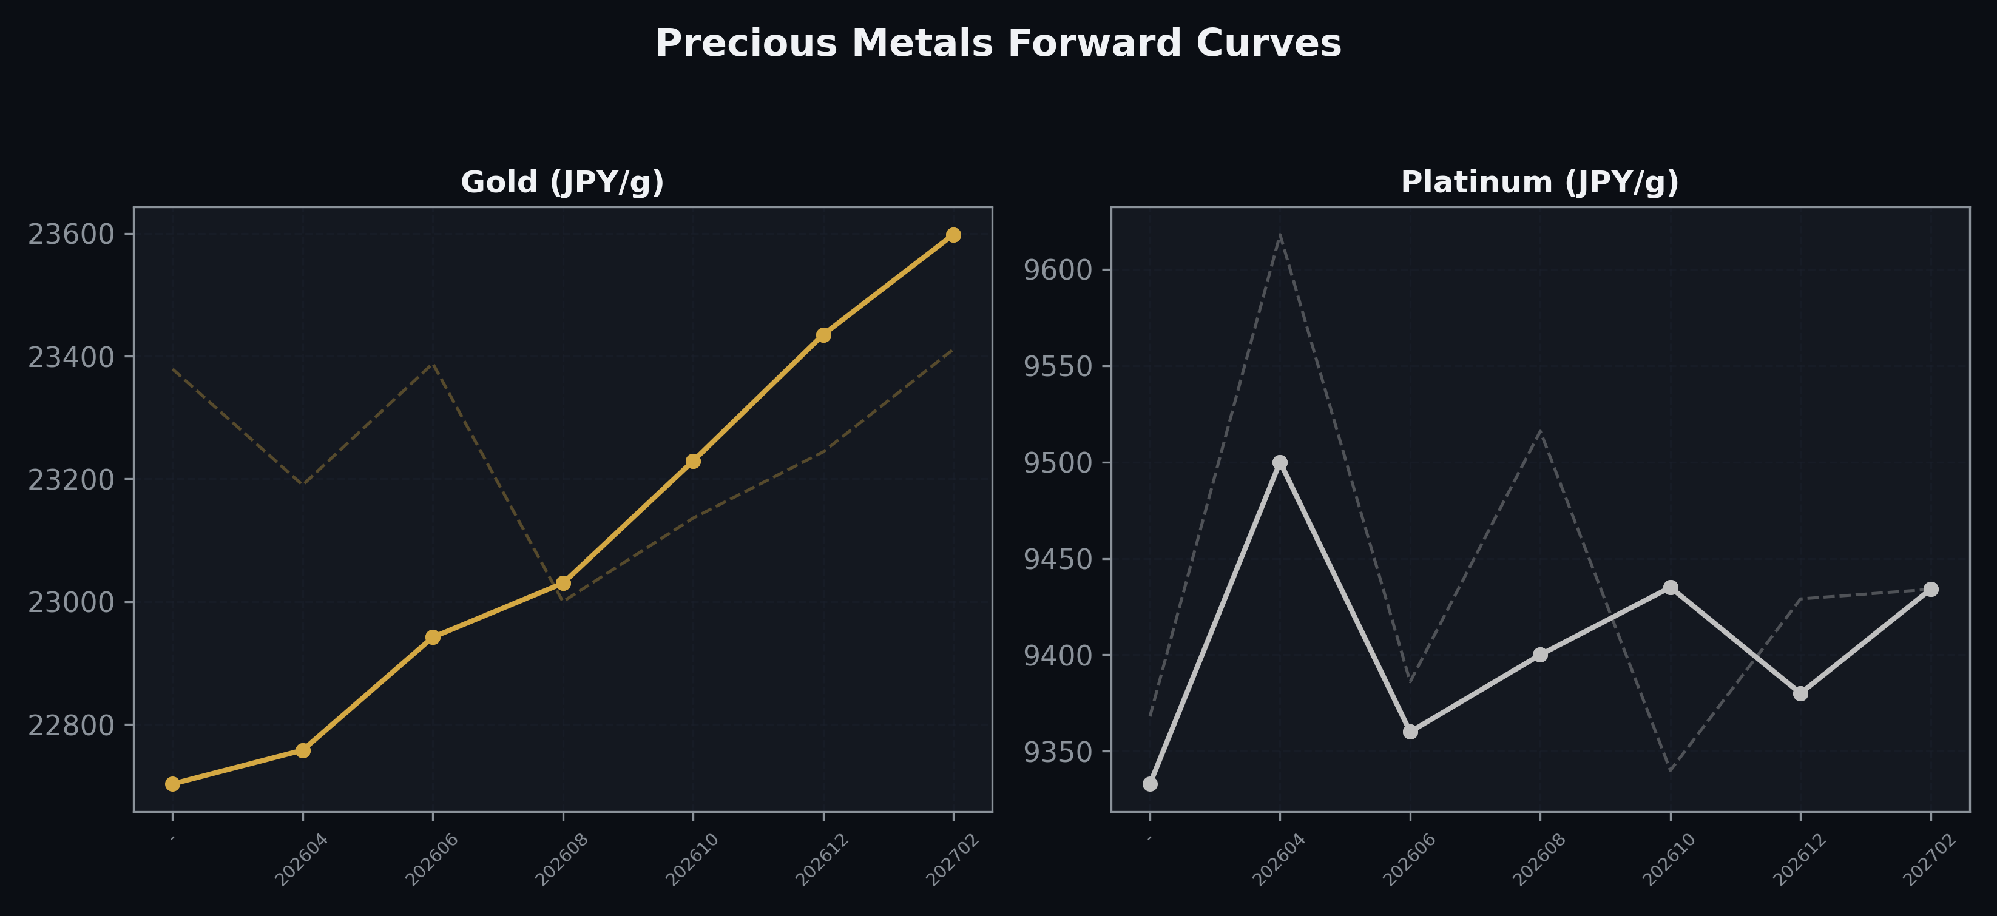
Precious Metals Forward Curves
Gold & Platinum (2026-03-27)

Slide 5
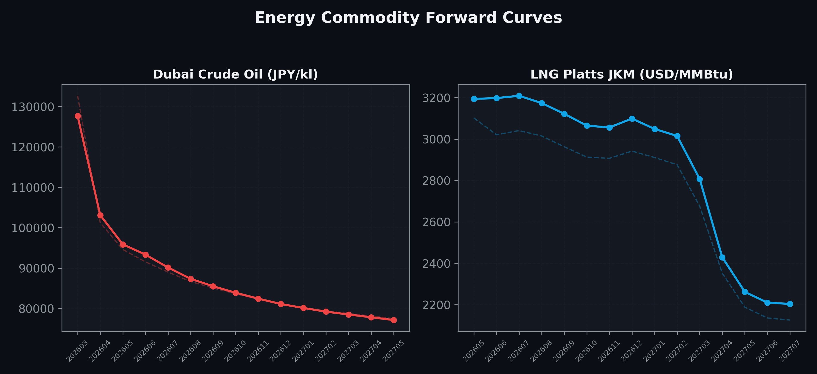
Energy Commodity Forward Curves
Dubai Crude Oil & LNG Platts JKM (2026-03-27)

Slide 6
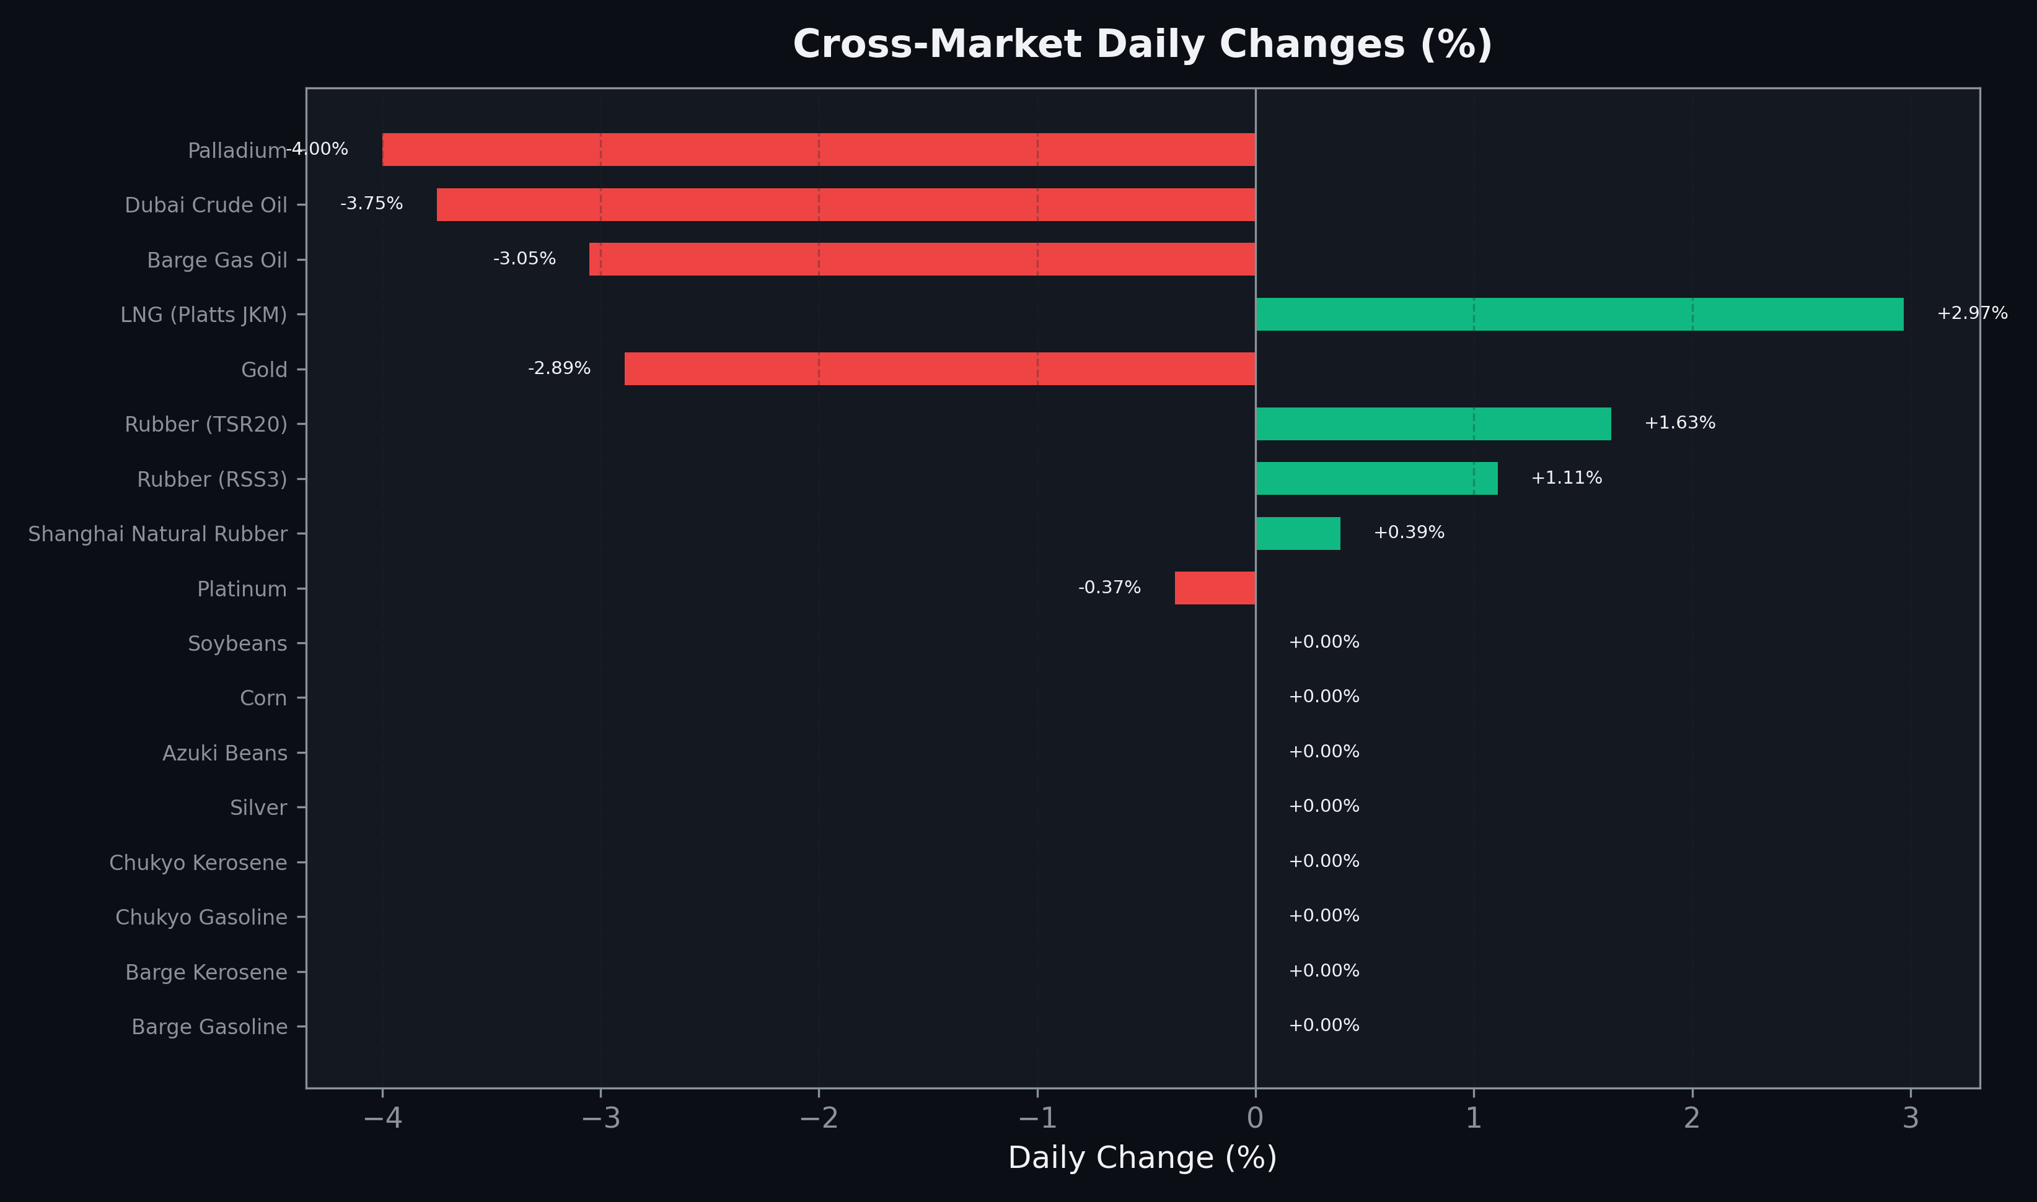
Cross-Market Daily Changes
All commodities sorted by absolute % change

Slide 7
Top Power Futures Movers
Largest absolute settlement price changes vs previous day (2026-03-27)
Instrument | Underlying | Month | Price | Prev | Change | % Chg
FUT_EEP_260828 | Power East Peak (Monthly) | 202608 | 28.29 | 26.79 | +1.50 | +5.60%
FUT_EEP_260929 | Power East Peak (Monthly) | 202609 | 27.78 | 26.31 | +1.47 | +5.59%
FUT_EEP_260730 | Power East Peak (Monthly) | 202607 | 28.26 | 26.91 | +1.35 | +5.02%
FUT_EWP_261127 | Power West Peak (Monthly) | 202611 | 19.62 | 18.33 | +1.29 | +7.04%
FUT_EWP_261029 | Power West Peak (Monthly) | 202610 | 19.56 | 18.32 | +1.24 | +6.77%
FUT_EWB_261030 | Power West Base (Monthly) | 202610 | 16.96 | 15.73 | +1.23 | +7.82%
FUT_EWB_261127 | Power West Base (Monthly) | 202611 | 16.96 | 15.74 | +1.22 | +7.75%
FUT_EEB_260828 | Power East Base (Monthly) | 202608 | 22.24 | 21.08 | +1.16 | +5.50%
FUT_EEB_260730 | Power East Base (Monthly) | 202607 | 22.07 | 20.92 | +1.15 | +5.50%
FUT_EWB_261230 | Power West Base (Monthly) | 202612 | 17.98 | 16.83 | +1.15 | +6.83%
FUT_EWB_270129 | Power West Base (Monthly) | 202701 | 18.14 | 17.02 | +1.12 | +6.58%
FUT_EEB_260929 | Power East Base (Monthly) | 202609 | 21.77 | 20.67 | +1.10 | +5.32%
FUT_EEB_261230 | Power East Base (Monthly) | 202612 | 20.14 | 19.07 | +1.07 | +5.61%
FUT_EWP_270330 | Power West Peak (Monthly) | 202703 | 18.20 | 17.14 | +1.06 | +6.18%
FUT_EEB_261127 | Power East Base (Monthly) | 202611 | 19.76 | 18.72 | +1.04 | +5.56%

