Slide 1
Daily Market Report
Trade Date: 2026-04-09
JPX Derivative & Commodity Analytics
DataServer In-House

Slide 2
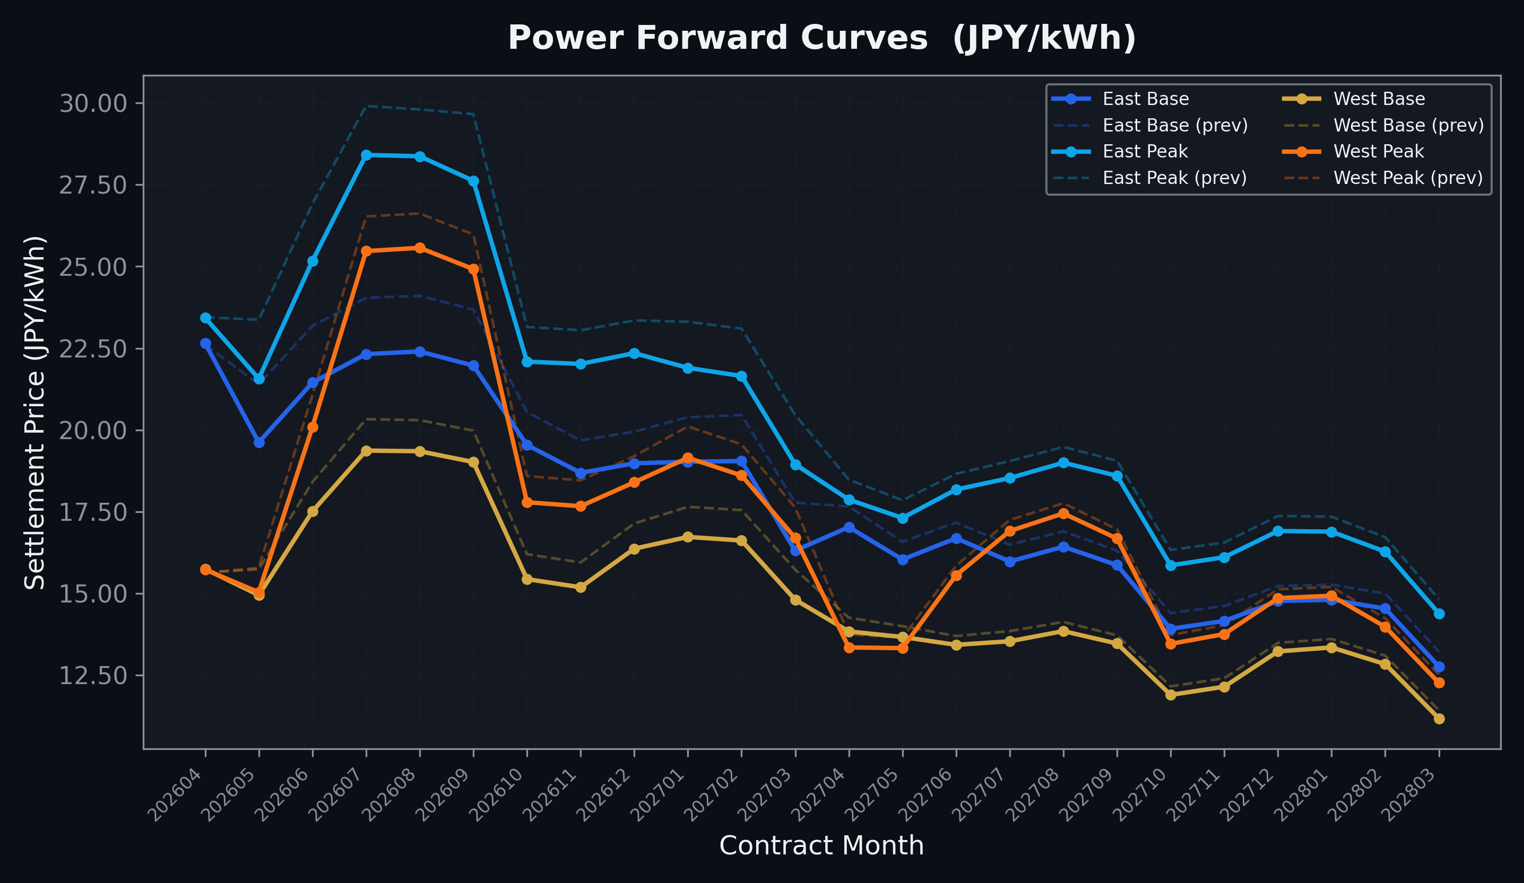
Power Forward Curves
East/West Base & Peak monthly contracts (2026-04-09)

Slide 3
Commodity Snapshot
Front-month settlement prices as of 2026-04-09
Category | Asset | Contract | Settlement | Unit | Change | % Chg
Energy | Barge Gas Oil | 202605 | 112,900.00 | JPY/kl | +2100.00 | +1.90%
Energy | Barge Gasoline | 202605 | 115,000.00 | JPY/kl | +0.00 | +0.00%
Energy | Barge Kerosene | 202605 | 105,000.00 | JPY/kl | +0.00 | +0.00%
Energy | Chukyo Gasoline | 202605 | 110,000.00 | JPY/kl | +0.00 | +0.00%
Energy | Chukyo Kerosene | 202605 | 105,000.00 | JPY/kl | +0.00 | +0.00%
Energy | Dubai Crude Oil | 202604 | 100,980.00 | JPY/kl | -17190.00 | -14.55%
Energy | LNG (Platts JKM) | 202605 | 2,883.00 | USD/MMBtu | -247.00 | -7.89%
Metals | Gold | - | 23,995.00 | JPY/g | -354.00 | -1.45%
Metals | Palladium | 202604 | 7,500.00 | JPY/g | +0.00 | +0.00%
Metals | Platinum | - | 10,219.00 | JPY/g | +164.00 | +1.63%
Metals | Silver | 202604 | 365.00 | JPY/10g | +0.00 | +0.00%
Industrial | Rubber (RSS3) | 202604 | 382.90 | JPY/kg | -0.40 | -0.10%
Industrial | Rubber (TSR20) | 202605 | 320.00 | JPY/kg | +0.00 | +0.00%
Industrial | Shanghai Natural Rubber | 202605 | 17,030.00 | JPY/kg | +20.00 | +0.12%
Agriculture | Azuki Beans | 202604 | 12,300.00 | JPY/bag | +0.00 | +0.00%
Agriculture | Corn | 202605 | 39,000.00 | JPY/t | +0.00 | +0.00%
Agriculture | Soybeans | 202604 | 64,000.00 | JPY/t | +0.00 | +0.00%

Slide 4
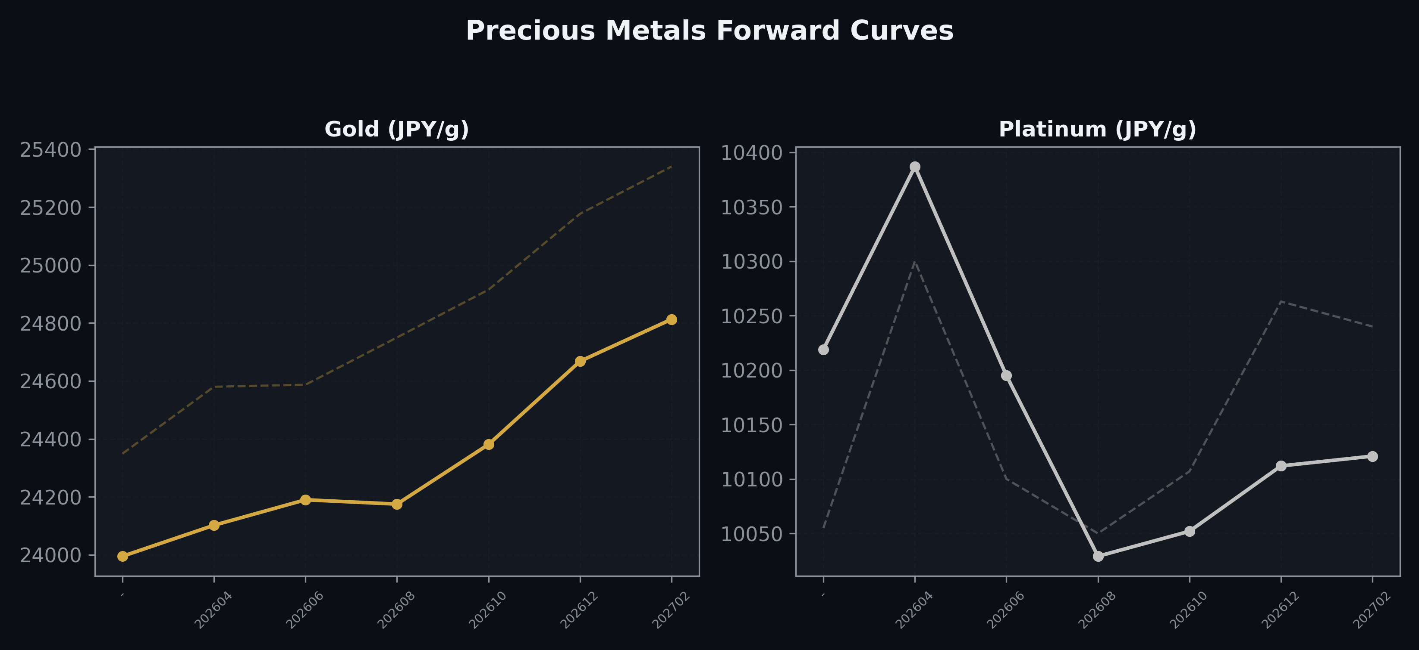
Precious Metals Forward Curves
Gold & Platinum (2026-04-09)

Slide 5
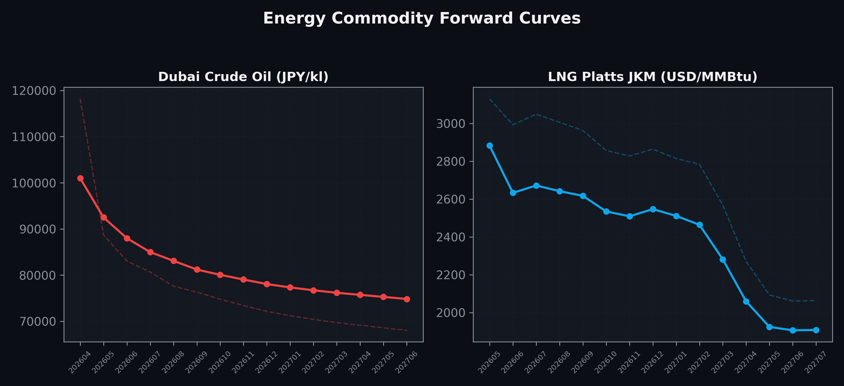
Energy Commodity Forward Curves
Dubai Crude Oil & LNG Platts JKM (2026-04-09)

Slide 6
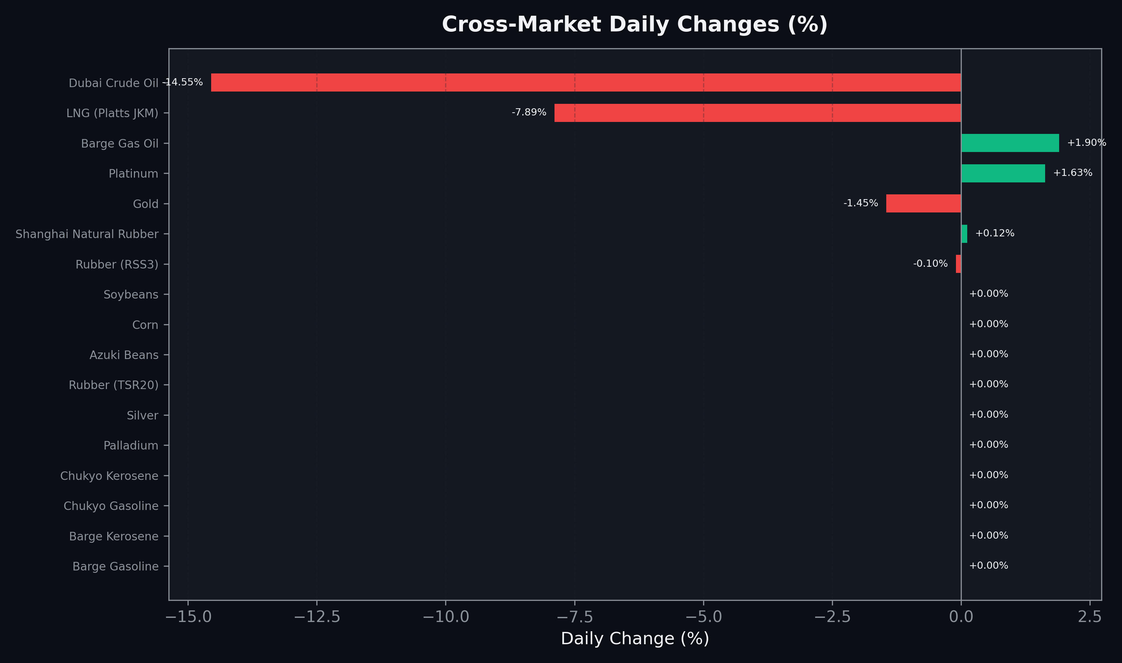
Cross-Market Daily Changes
All commodities sorted by absolute % change

Slide 7
Top Power Futures Movers
Largest absolute settlement price changes vs previous day (2026-04-09)
Instrument | Underlying | Month | Price | Prev | Change | % Chg
FUT_EWPW_260409 | Power West Peak (Weekly) | 20260410 | 20.26 | 17.84 | +2.42 | +13.57%
FUT_EEP_260929 | Power East Peak (Monthly) | 202609 | 27.62 | 29.66 | -2.04 | -6.88%
FUT_EEP_260528 | Power East Peak (Monthly) | 202605 | 21.57 | 23.37 | -1.80 | -7.70%
FUT_EEB_260529 | Power East Base (Monthly) | 202605 | 19.62 | 21.40 | -1.78 | -8.32%
FUT_EEP_260629 | Power East Peak (Monthly) | 202606 | 25.17 | 26.92 | -1.75 | -6.50%
FUT_EEB_260629 | Power East Base (Monthly) | 202606 | 21.45 | 23.18 | -1.73 | -7.46%
FUT_EEB_260730 | Power East Base (Monthly) | 202607 | 22.32 | 24.04 | -1.72 | -7.15%
FUT_EEB_260929 | Power East Base (Monthly) | 202609 | 21.97 | 23.68 | -1.71 | -7.22%
FUT_EEB_260828 | Power East Base (Monthly) | 202608 | 22.40 | 24.10 | -1.70 | -7.05%
FUT_EEPW_260507 | Power East Peak (Weekly) | 20260508 | 20.28 | 21.87 | -1.59 | -7.27%
FUT_EEP_270330 | Power East Peak (Monthly) | 202703 | 18.95 | 20.46 | -1.51 | -7.38%
FUT_EEP_260730 | Power East Peak (Monthly) | 202607 | 28.41 | 29.91 | -1.50 | -5.02%
FUT_EEB_270330 | Power East Base (Monthly) | 202703 | 16.31 | 17.78 | -1.47 | -8.27%
FUT_EEP_270225 | Power East Peak (Monthly) | 202702 | 21.65 | 23.10 | -1.45 | -6.28%
FUT_EEBW_260507 | Power East Base (Weekly) | 20260508 | 17.87 | 19.32 | -1.45 | -7.51%

