Slide 1
Daily Market Report
Trade Date: 2026-05-18
JPX Derivative & Commodity Analytics
DataServer In-House

Slide 2
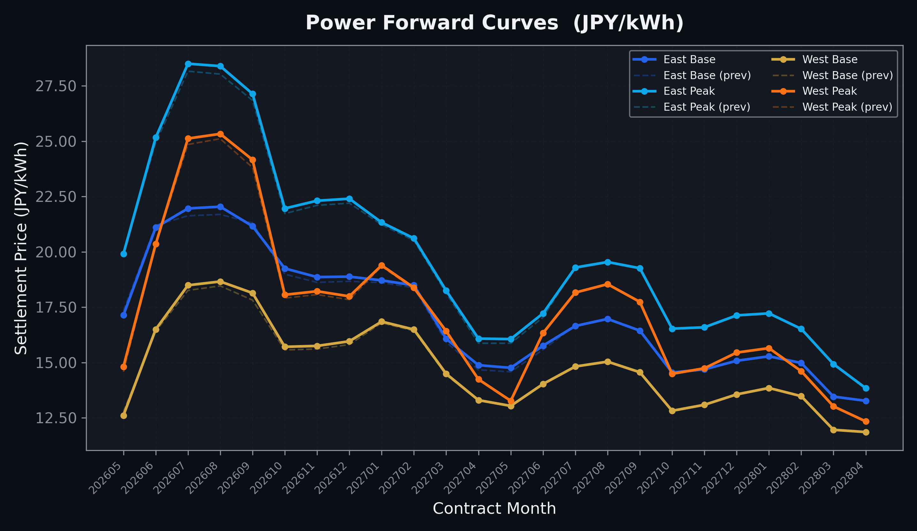
Power Forward Curves
East/West Base & Peak monthly contracts (2026-05-18)

Slide 3
Commodity Snapshot
Front-month settlement prices as of 2026-05-18
Category | Asset | Contract | Settlement | Unit | Change | % Chg
Energy | Barge Gas Oil | 202606 | 110,200.00 | JPY/kl | +0.00 | +0.00%
Energy | Barge Gasoline | 202606 | 100,000.00 | JPY/kl | +0.00 | +0.00%
Energy | Barge Kerosene | 202606 | 105,000.00 | JPY/kl | +0.00 | +0.00%
Energy | Chukyo Gasoline | 202606 | 100,000.00 | JPY/kl | +0.00 | +0.00%
Energy | Chukyo Kerosene | 202606 | 105,000.00 | JPY/kl | +0.00 | +0.00%
Energy | Dubai Crude Oil | 202605 | 103,600.00 | JPY/kl | +2360.00 | +2.33%
Energy | LNG (Platts JKM) | 202607 | 3,042.00 | USD/MMBtu | +341.00 | +12.62%
Metals | Gold | - | 23,080.00 | JPY/g | -186.00 | -0.80%
Metals | Palladium | 202606 | 7,200.00 | JPY/g | -100.00 | -1.37%
Metals | Platinum | - | 9,888.00 | JPY/g | -158.00 | -1.57%
Metals | Silver | 202606 | 395.00 | JPY/10g | -15.00 | -3.66%
Industrial | Rubber (RSS3) | 202605 | 403.30 | JPY/kg | +3.60 | +0.90%
Industrial | Rubber (TSR20) | 202606 | 350.00 | JPY/kg | +0.00 | +0.00%
Industrial | Shanghai Natural Rubber | 202609 | 17,820.00 | JPY/kg | -90.00 | -0.50%
Agriculture | Azuki Beans | 202605 | 12,300.00 | JPY/bag | +0.00 | +0.00%
Agriculture | Corn | 202607 | 39,000.00 | JPY/t | +0.00 | +0.00%
Agriculture | Soybeans | 202606 | 64,000.00 | JPY/t | +0.00 | +0.00%

Slide 4
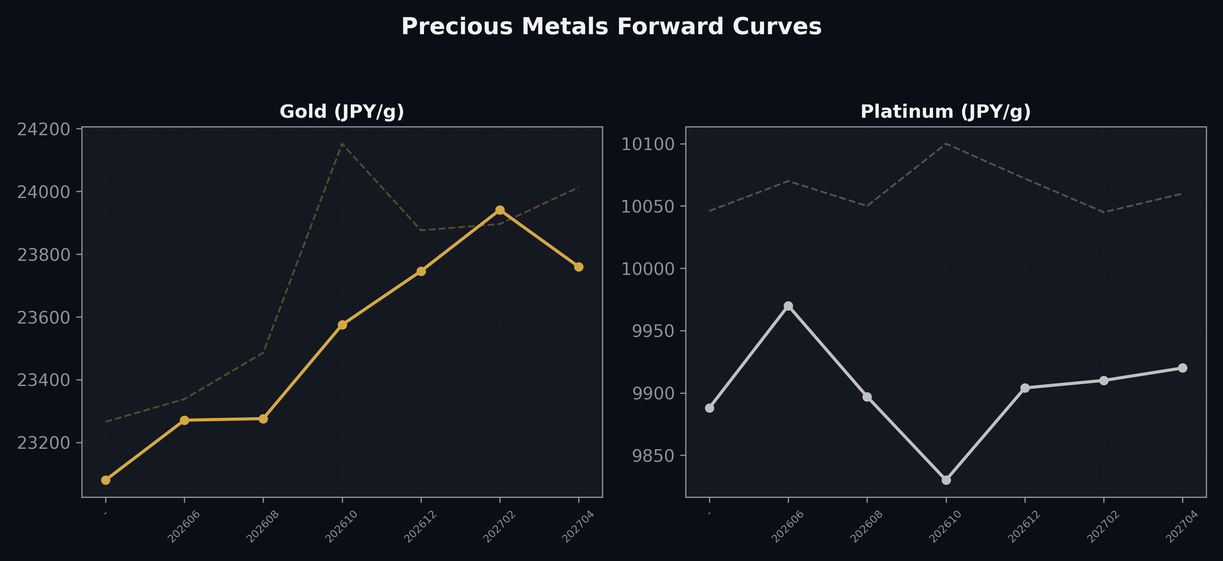
Precious Metals Forward Curves
Gold & Platinum (2026-05-18)

Slide 5
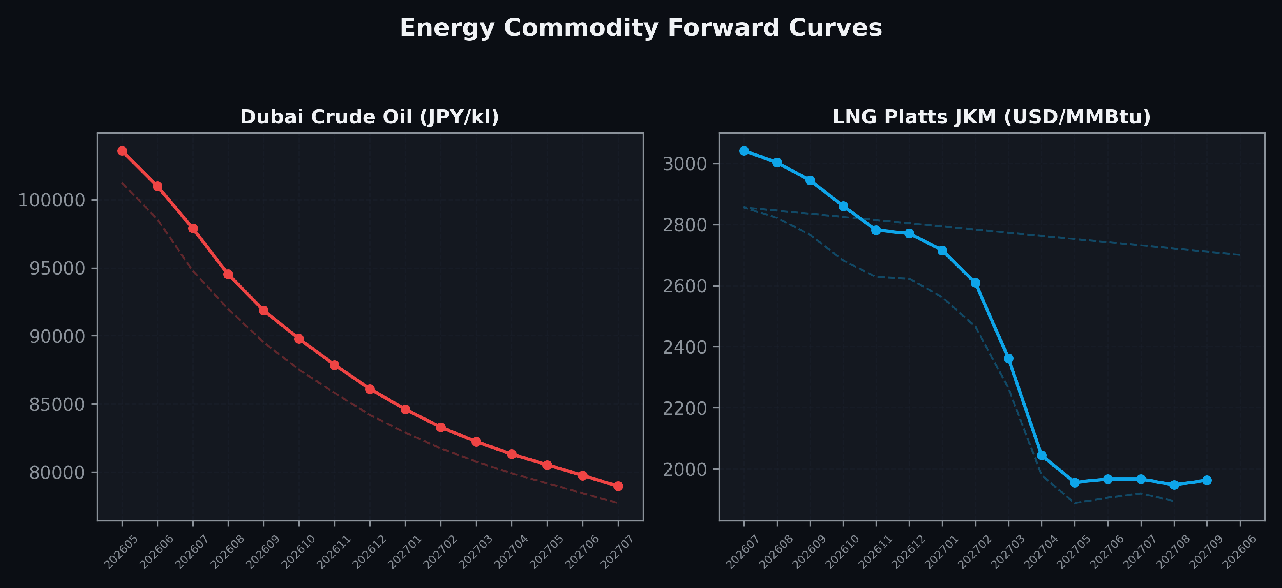
Energy Commodity Forward Curves
Dubai Crude Oil & LNG Platts JKM (2026-05-18)

Slide 6
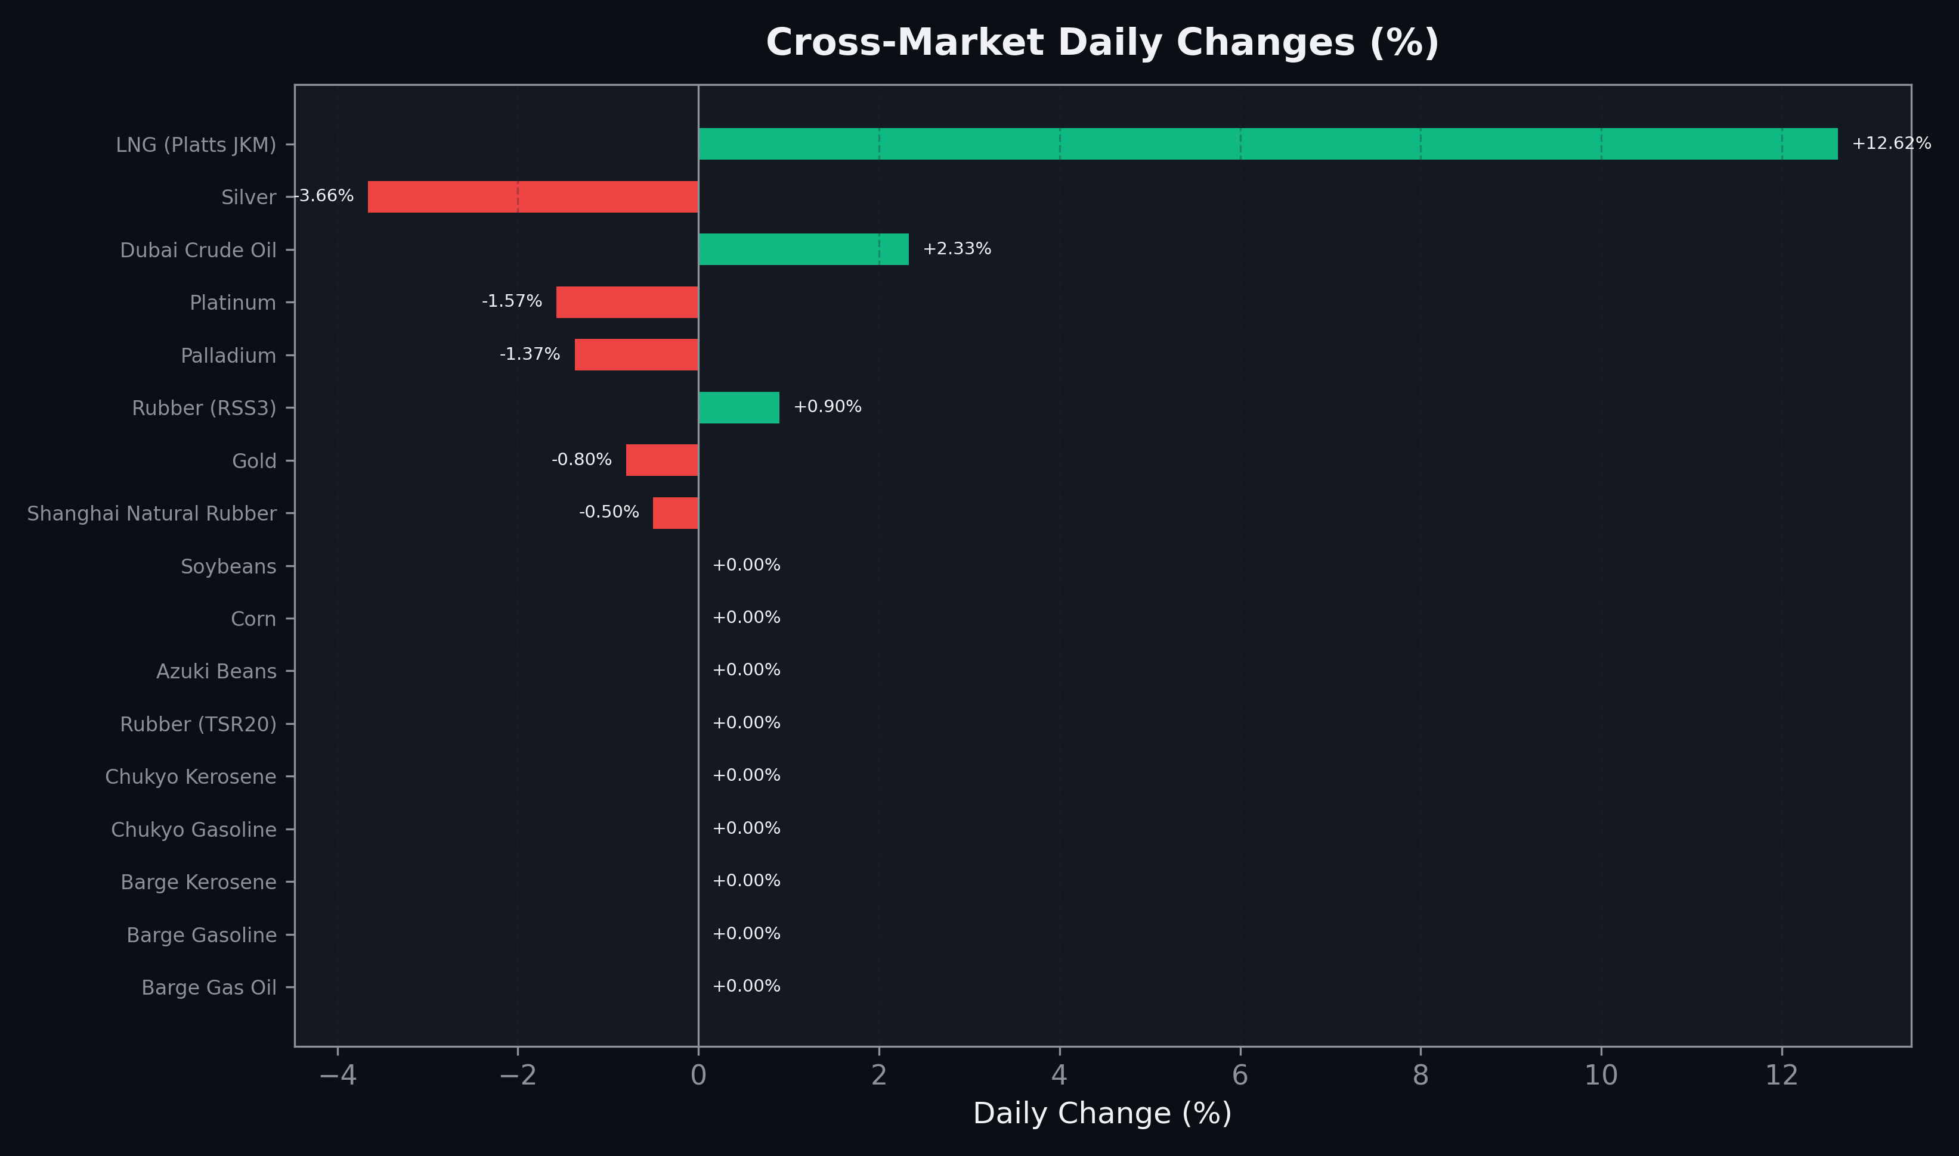
Cross-Market Daily Changes
All commodities sorted by absolute % change

Slide 7
Top Power Futures Movers
Largest absolute settlement price changes vs previous day (2026-05-18)
Instrument | Underlying | Month | Price | Prev | Change | % Chg
FUT_EWPW_260521 | Power West Peak (Weekly) | 20260522 | 15.36 | 13.04 | +2.32 | +17.79%
FUT_EEBW_260521 | Power East Base (Weekly) | 20260522 | 17.90 | 20.05 | -2.15 | -10.72%
FUT_EEPW_260604 | Power East Peak (Weekly) | 20260605 | 23.49 | 23.04 | +0.45 | +1.95%
FUT_ECP_260828 | 電力(中部・日中) | 202608 | 26.14 | 25.78 | +0.36 | +1.40%
FUT_EEP_260828 | Power East Peak (Monthly) | 202608 | 28.39 | 28.03 | +0.36 | +1.28%
FUT_EEB_260828 | Power East Base (Monthly) | 202608 | 22.04 | 21.69 | +0.35 | +1.61%
FUT_EWP_260929 | Power West Peak (Monthly) | 202609 | 24.16 | 23.81 | +0.35 | +1.47%
FUT_EEP_260730 | Power East Peak (Monthly) | 202607 | 28.50 | 28.16 | +0.34 | +1.21%
FUT_EEB_260730 | Power East Base (Monthly) | 202607 | 21.96 | 21.63 | +0.33 | +1.53%
FUT_ECB_260730 | 電力(中部・ベース) | 202607 | 20.47 | 20.15 | +0.32 | +1.59%
FUT_ECP_260730 | 電力(中部・日中) | 202607 | 25.76 | 25.44 | +0.32 | +1.26%
FUT_EWB_260929 | Power West Base (Monthly) | 202609 | 18.14 | 17.82 | +0.32 | +1.80%
FUT_ECB_260828 | 電力(中部・ベース) | 202608 | 20.63 | 20.33 | +0.30 | +1.48%
FUT_EEP_260929 | Power East Peak (Monthly) | 202609 | 27.14 | 26.84 | +0.30 | +1.12%
FUT_EEPW_260611 | Power East Peak (Weekly) | 20260612 | 23.85 | 23.55 | +0.30 | +1.27%

