Slide 1
Daily Market Report
Trade Date: 2026-06-01
JPX Derivative & Commodity Analytics
DataServer In-House

Slide 2
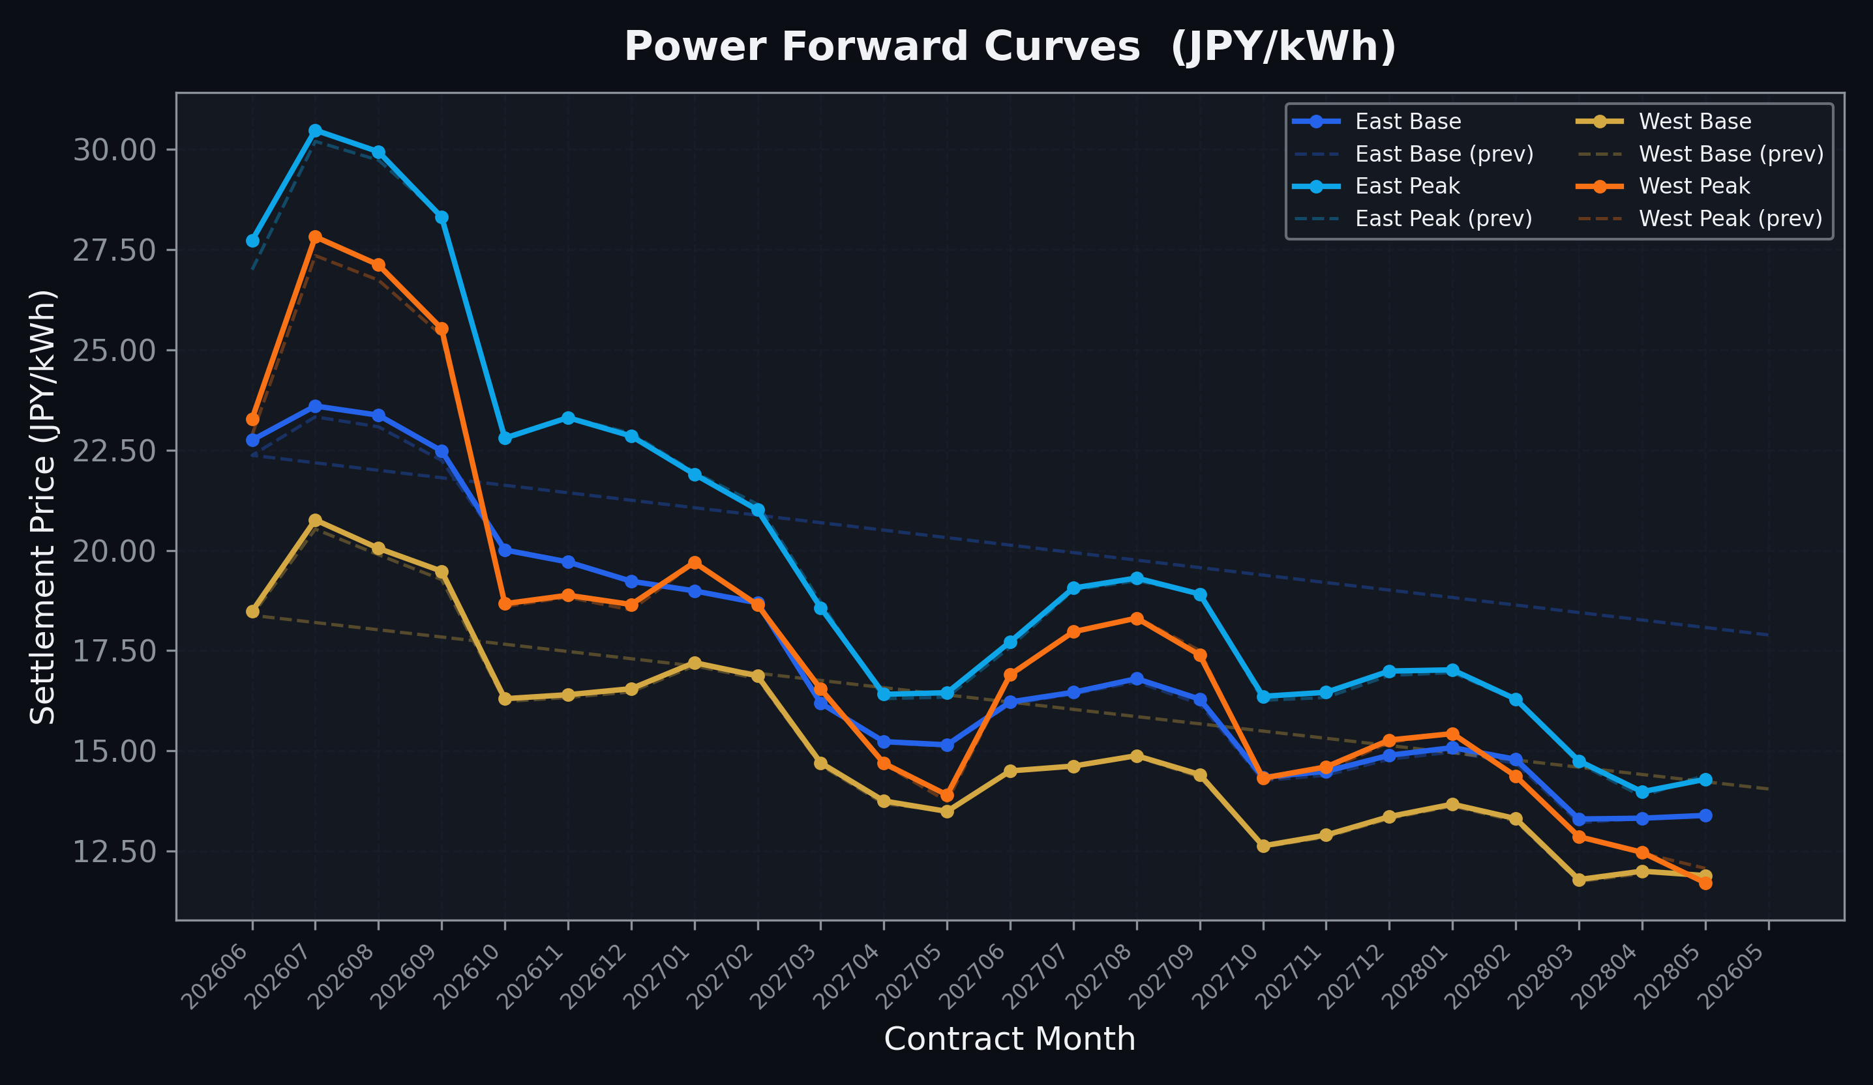
Power Forward Curves
East/West Base & Peak monthly contracts (2026-06-01)

Slide 3
Commodity Snapshot
Front-month settlement prices as of 2026-06-01
Category | Asset | Contract | Settlement | Unit | Change | % Chg
Energy | Barge Gas Oil | 202607 | 110,300.00 | JPY/kl | -600.00 | -0.54%
Energy | Barge Gasoline | 202607 | 100,000.00 | JPY/kl | +0.00 | +0.00%
Energy | Barge Kerosene | 202607 | 105,000.00 | JPY/kl | +0.00 | +0.00%
Energy | Chukyo Gasoline | 202607 | 95,000.00 | JPY/kl | +0.00 | +0.00%
Energy | Chukyo Kerosene | 202607 | 105,000.00 | JPY/kl | +0.00 | +0.00%
Energy | Dubai Crude Oil | 202606 | 91,000.00 | JPY/kl | -10650.00 | -10.48%
Energy | LNG (Platts JKM) | 202607 | 2,896.00 | USD/MMBtu | -32.00 | -1.09%
Metals | Gold | - | 23,461.00 | JPY/g | +391.00 | +1.69%
Metals | Palladium | 202606 | 7,000.00 | JPY/g | +0.00 | +0.00%
Metals | Platinum | - | 9,592.00 | JPY/g | -53.00 | -0.55%
Metals | Silver | 202606 | 390.00 | JPY/10g | +0.00 | +0.00%
Industrial | Rubber (RSS3) | 202606 | 406.70 | JPY/kg | -1.80 | -0.44%
Industrial | Rubber (TSR20) | 202607 | 350.00 | JPY/kg | +0.00 | +0.00%
Industrial | Shanghai Natural Rubber | 202609 | 18,565.00 | JPY/kg | +565.00 | +3.14%
Agriculture | Azuki Beans | 202606 | 12,300.00 | JPY/bag | +0.00 | +0.00%
Agriculture | Corn | 202607 | 39,000.00 | JPY/t | +0.00 | +0.00%
Agriculture | Soybeans | 202606 | 64,000.00 | JPY/t | +0.00 | +0.00%

Slide 4
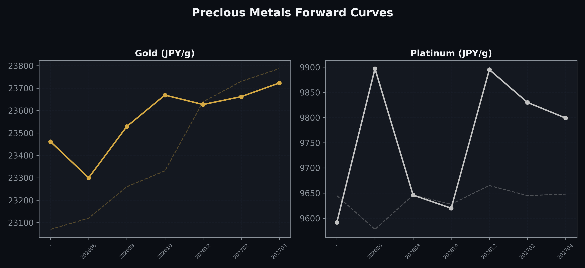
Precious Metals Forward Curves
Gold & Platinum (2026-06-01)

Slide 5
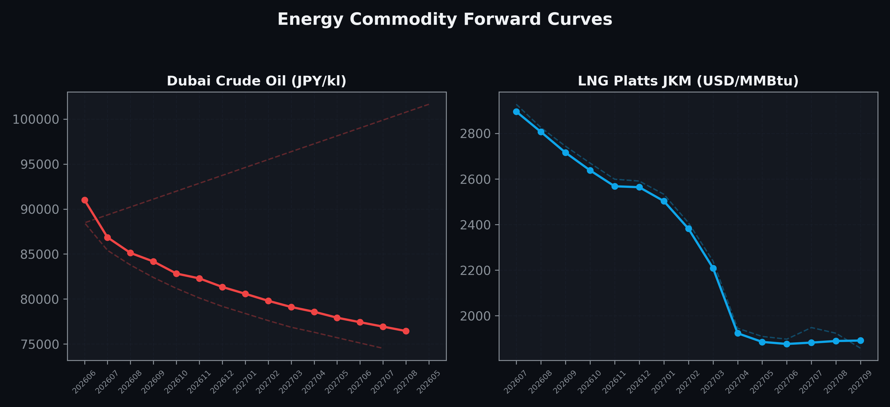
Energy Commodity Forward Curves
Dubai Crude Oil & LNG Platts JKM (2026-06-01)

Slide 6
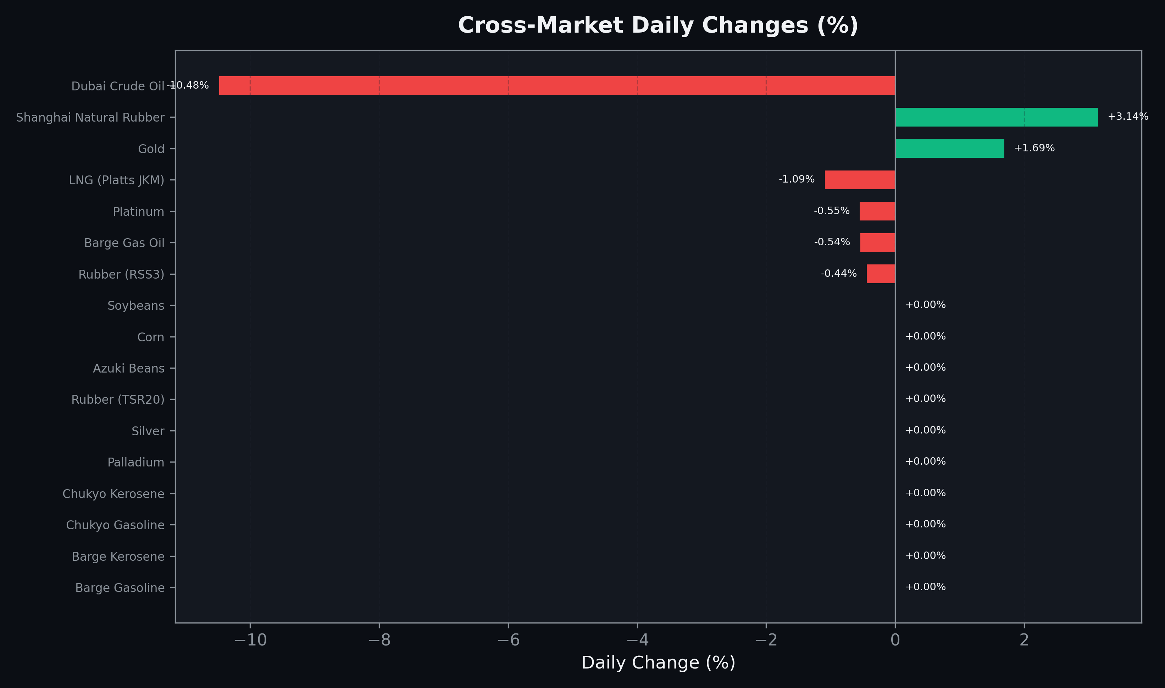
Cross-Market Daily Changes
All commodities sorted by absolute % change

Slide 7
Top Power Futures Movers
Largest absolute settlement price changes vs previous day (2026-06-01)
Instrument | Underlying | Month | Price | Prev | Change | % Chg
FUT_EWBW_260604 | Power West Base (Weekly) | 20260605 | 16.74 | 18.50 | -1.76 | -9.51%
FUT_EEPW_260604 | Power East Peak (Weekly) | 20260605 | 26.95 | 25.51 | +1.44 | +5.64%
FUT_EEBW_260625 | Power East Base (Weekly) | 20260626 | 23.67 | 22.48 | +1.19 | +5.29%
FUT_EEBW_260618 | Power East Base (Weekly) | 20260619 | 23.60 | 22.42 | +1.18 | +5.26%
FUT_EEBW_260611 | Power East Base (Weekly) | 20260612 | 23.54 | 22.40 | +1.14 | +5.09%
FUT_EWBW_260625 | Power West Base (Weekly) | 20260626 | 19.60 | 18.59 | +1.01 | +5.43%
FUT_EWBW_260618 | Power West Base (Weekly) | 20260619 | 19.36 | 18.39 | +0.97 | +5.27%
FUT_EWPW_260604 | Power West Peak (Weekly) | 20260605 | 22.92 | 22.13 | +0.79 | +3.57%
FUT_EEP_260629 | Power East Peak (Monthly) | 202606 | 27.73 | 27.00 | +0.73 | +2.70%
FUT_EEBW_260702 | Power East Base (Weekly) | 20260703 | 23.76 | 23.04 | +0.72 | +3.13%
FUT_EEPW_260618 | Power East Peak (Weekly) | 20260619 | 26.06 | 25.38 | +0.68 | +2.68%
FUT_EEPW_260625 | Power East Peak (Weekly) | 20260626 | 26.77 | 26.10 | +0.67 | +2.57%
FUT_EWBW_260611 | Power West Base (Weekly) | 20260612 | 18.90 | 18.23 | +0.67 | +3.68%
FUT_EEBW_260604 | Power East Base (Weekly) | 20260605 | 22.35 | 21.69 | +0.66 | +3.04%
FUT_ECP_260629 | 電力(中部・日中) | 202606 | 25.23 | 24.60 | +0.63 | +2.56%

