Slide 1
Daily Market Report
Trade Date: 2026-05-11
JPX Derivative & Commodity Analytics
DataServer In-House

Slide 2
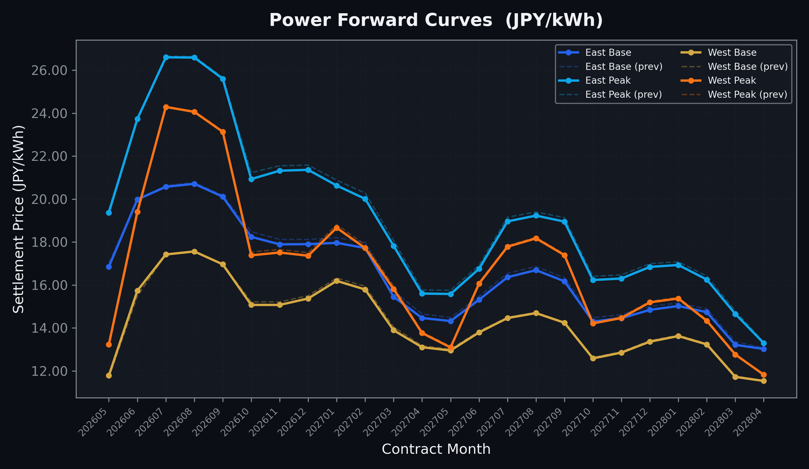
Power Forward Curves
East/West Base & Peak monthly contracts (2026-05-11)

Slide 3
Commodity Snapshot
Front-month settlement prices as of 2026-05-11
Category | Asset | Contract | Settlement | Unit | Change | % Chg
Energy | Barge Gas Oil | 202606 | 111,200.00 | JPY/kl | -500.00 | -0.45%
Energy | Barge Gasoline | 202606 | 100,000.00 | JPY/kl | +0.00 | +0.00%
Energy | Barge Kerosene | 202606 | 105,000.00 | JPY/kl | +0.00 | +0.00%
Energy | Chukyo Gasoline | 202606 | 100,000.00 | JPY/kl | +0.00 | +0.00%
Energy | Chukyo Kerosene | 202606 | 105,000.00 | JPY/kl | +0.00 | +0.00%
Energy | Dubai Crude Oil | 202605 | 99,800.00 | JPY/kl | +4270.00 | +4.47%
Energy | LNG (Platts JKM) | 202606 | 2,700.00 | USD/MMBtu | -6.00 | -0.22%
Metals | Gold | - | 23,463.00 | JPY/g | -291.00 | -1.23%
Metals | Palladium | 202606 | 7,500.00 | JPY/g | -100.00 | -1.32%
Metals | Platinum | - | 10,164.00 | JPY/g | -163.00 | -1.58%
Metals | Silver | 202606 | 390.00 | JPY/10g | +0.00 | +0.00%
Industrial | Rubber (RSS3) | 202605 | 396.50 | JPY/kg | -7.20 | -1.78%
Industrial | Rubber (TSR20) | 202606 | 340.00 | JPY/kg | +0.00 | +0.00%
Industrial | Shanghai Natural Rubber | 202605 | 17,750.00 | JPY/kg | -105.00 | -0.59%
Agriculture | Azuki Beans | 202605 | 12,300.00 | JPY/bag | +0.00 | +0.00%
Agriculture | Corn | 202607 | 39,000.00 | JPY/t | +0.00 | +0.00%
Agriculture | Soybeans | 202606 | 64,000.00 | JPY/t | +0.00 | +0.00%

Slide 4
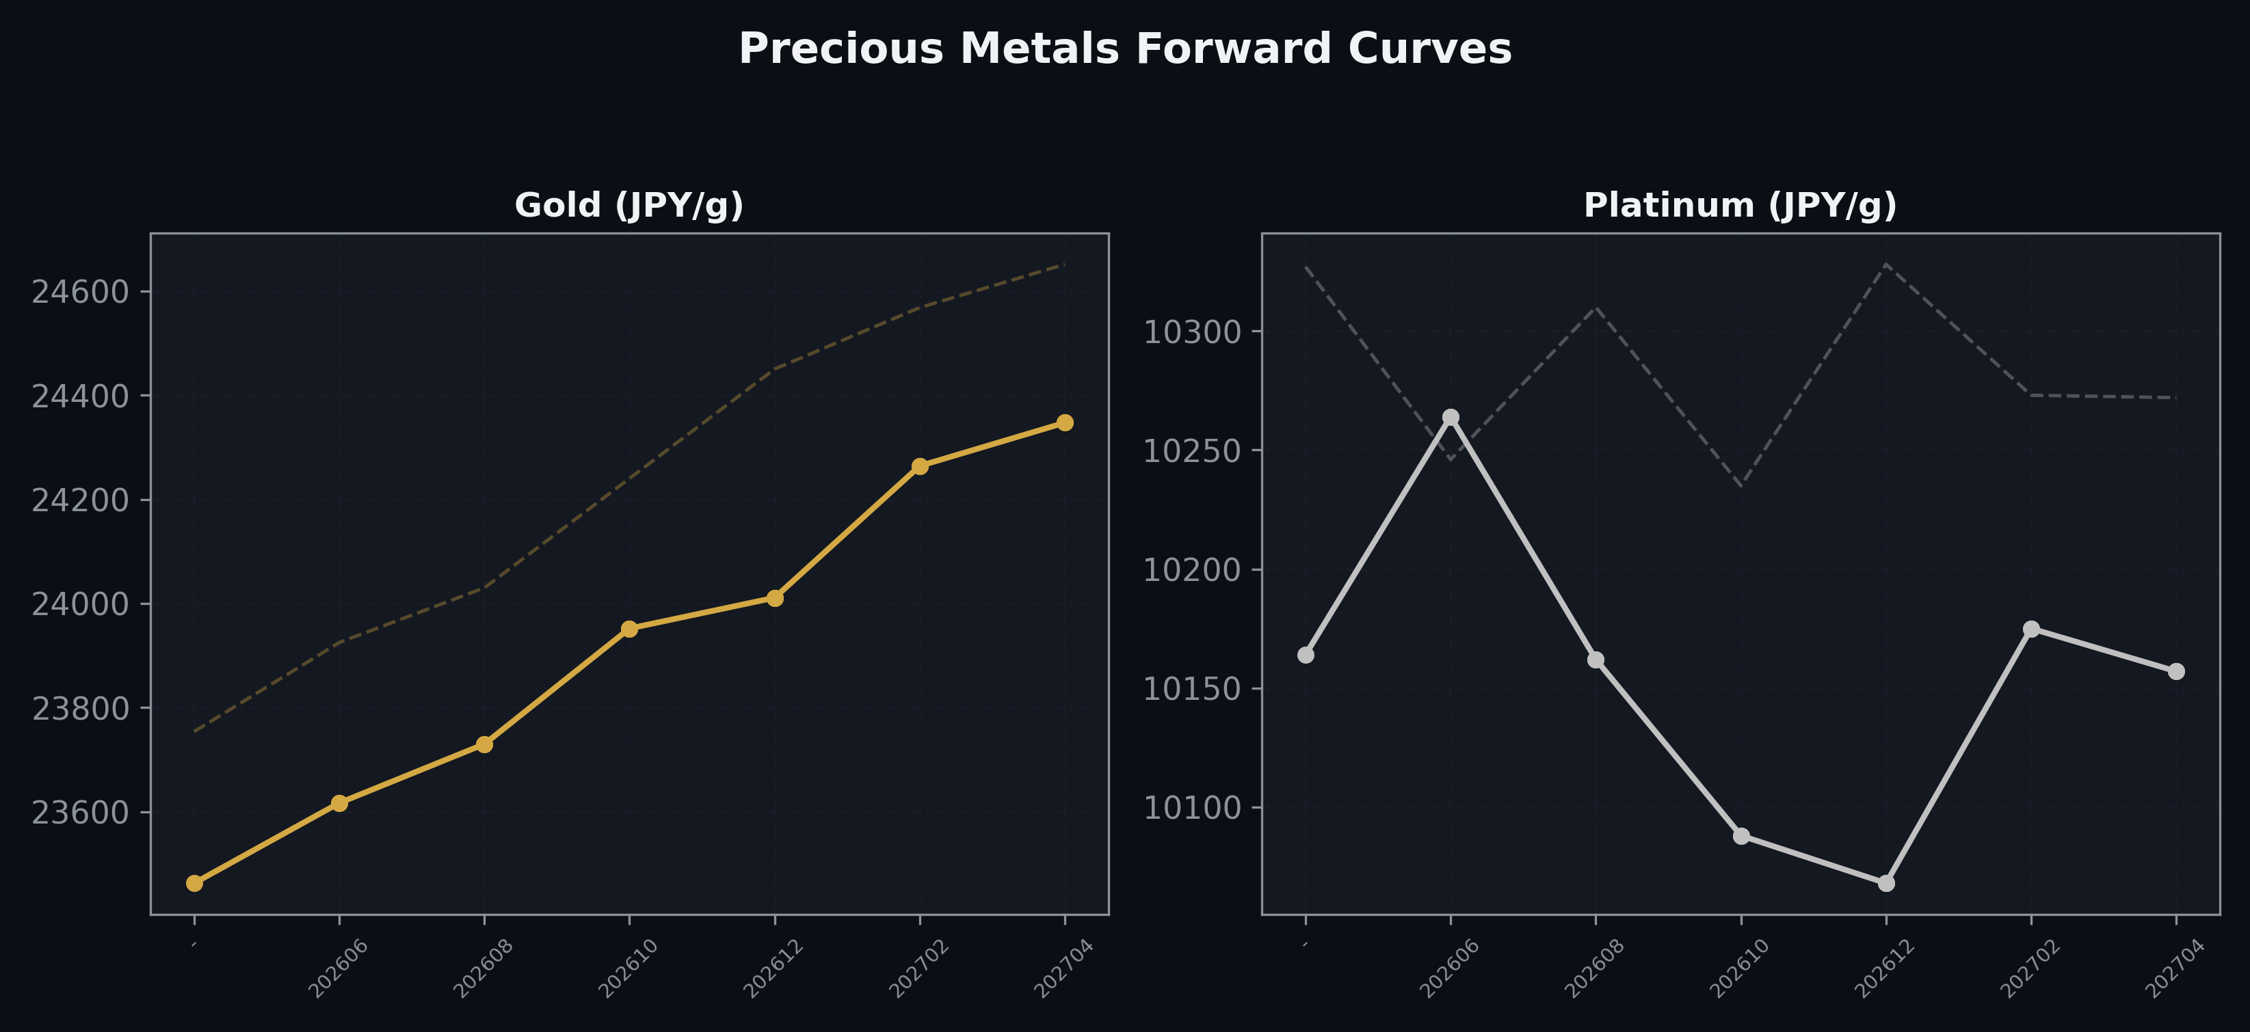
Precious Metals Forward Curves
Gold & Platinum (2026-05-11)

Slide 5
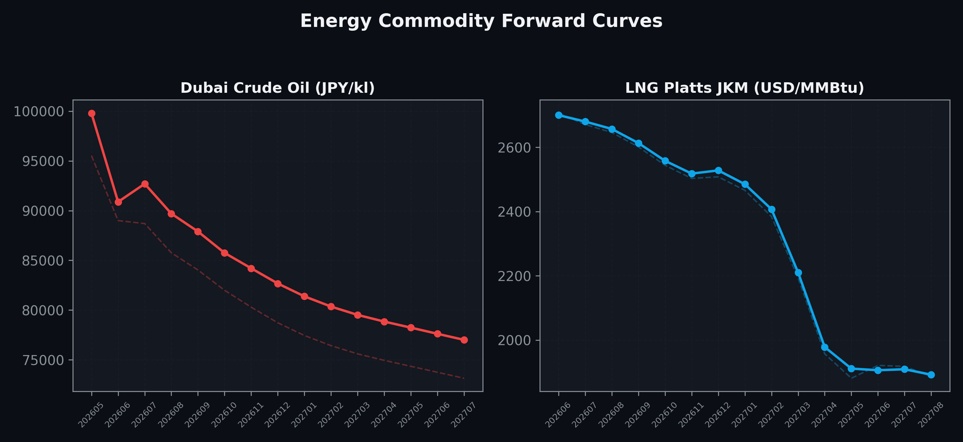
Energy Commodity Forward Curves
Dubai Crude Oil & LNG Platts JKM (2026-05-11)

Slide 6
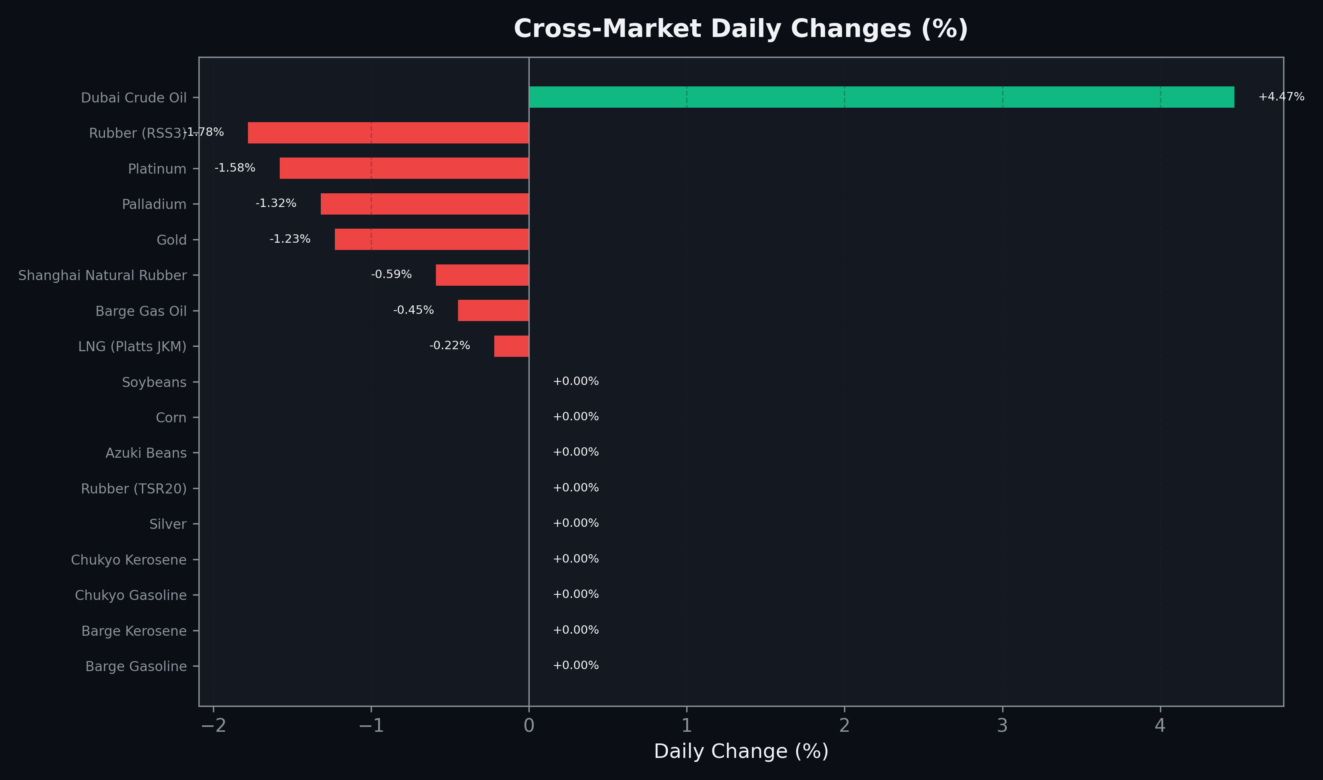
Cross-Market Daily Changes
All commodities sorted by absolute % change

Slide 7
Top Power Futures Movers
Largest absolute settlement price changes vs previous day (2026-05-11)
Instrument | Underlying | Month | Price | Prev | Change | % Chg
FUT_EEBW_260514 | Power East Base (Weekly) | 20260515 | 15.73 | 17.40 | -1.67 | -9.60%
FUT_EWPW_260514 | Power West Peak (Weekly) | 20260515 | 12.28 | 11.44 | +0.84 | +7.34%
FUT_EWBW_260514 | Power West Base (Weekly) | 20260515 | 11.11 | 11.63 | -0.52 | -4.47%
FUT_EEBW_260521 | Power East Base (Weekly) | 20260522 | 17.91 | 18.40 | -0.49 | -2.66%
FUT_EWPW_260611 | Power West Peak (Weekly) | 20260612 | 18.47 | 18.05 | +0.42 | +2.33%
FUT_ECP_260929 | 電力(中部・日中) | 202609 | 24.69 | 24.28 | +0.41 | +1.69%
FUT_EEPW_260528 | Power East Peak (Weekly) | 20260529 | 19.58 | 19.99 | -0.41 | -2.05%
FUT_EWPW_260604 | Power West Peak (Weekly) | 20260605 | 17.06 | 16.65 | +0.41 | +2.46%
FUT_EWBW_260611 | Power West Base (Weekly) | 20260612 | 15.21 | 14.84 | +0.37 | +2.49%
FUT_EWBW_260604 | Power West Base (Weekly) | 20260605 | 14.58 | 14.26 | +0.32 | +2.24%
FUT_EEP_261029 | Power East Peak (Monthly) | 202610 | 20.93 | 21.23 | -0.30 | -1.41%
FUT_EEPW_260521 | Power East Peak (Weekly) | 20260522 | 18.56 | 18.85 | -0.29 | -1.54%
FUT_EEBW_260528 | Power East Base (Weekly) | 20260529 | 18.01 | 18.29 | -0.28 | -1.53%
FUT_EWBW_260521 | Power West Base (Weekly) | 20260522 | 12.09 | 11.81 | +0.28 | +2.37%
FUT_ECP_260528 | 電力(中部・日中) | 202605 | 15.95 | 15.68 | +0.27 | +1.72%

