Slide 1
Daily Market Report
Trade Date: 2026-06-15
JPX Derivative & Commodity Analytics
DataServer In-House

Slide 2
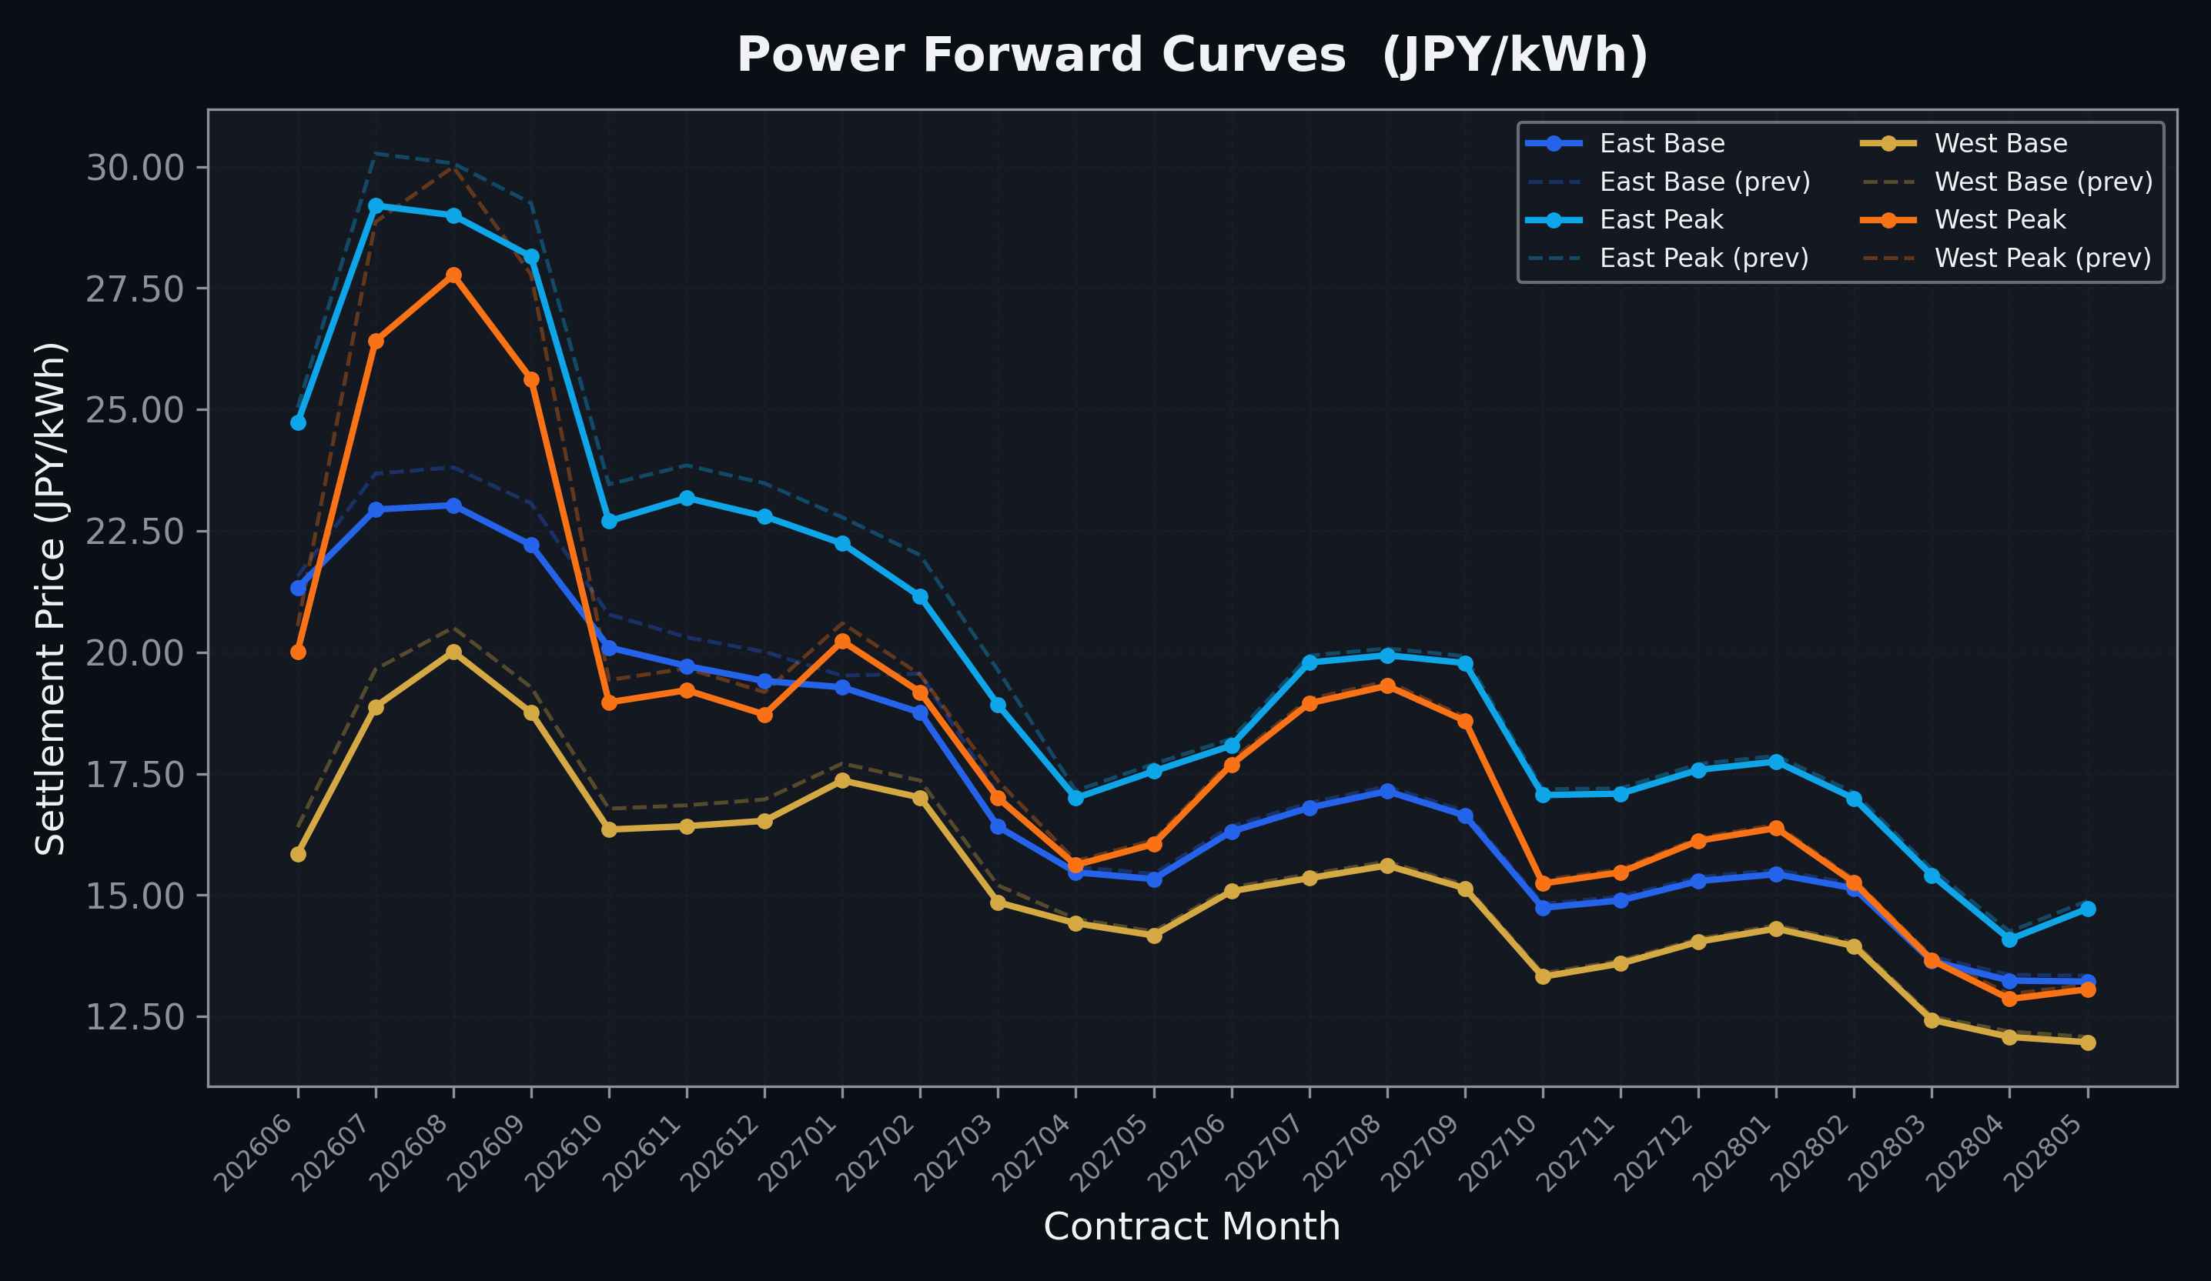
Power Forward Curves
East/West Base & Peak monthly contracts (2026-06-15)

Slide 3
Commodity Snapshot
Front-month settlement prices as of 2026-06-15
Category | Asset | Contract | Settlement | Unit | Change | % Chg
Energy | Barge Gas Oil | 202607 | 105,500.00 | JPY/kl | -500.00 | -0.47%
Energy | Barge Gasoline | 202607 | 100,000.00 | JPY/kl | +0.00 | +0.00%
Energy | Barge Kerosene | 202607 | 110,000.00 | JPY/kl | +0.00 | +0.00%
Energy | Chukyo Gasoline | 202607 | 95,000.00 | JPY/kl | +0.00 | +0.00%
Energy | Chukyo Kerosene | 202607 | 105,000.00 | JPY/kl | +0.00 | +0.00%
Energy | Dubai Crude Oil | 202606 | 87,220.00 | JPY/kl | +1000.00 | +1.16%
Energy | LNG (Platts JKM) | 202607 | 3,020.00 | USD/MMBtu | +0.00 | +0.00%
Metals | Gold | - | 22,191.00 | JPY/g | +717.00 | +3.34%
Metals | Palladium | 202606 | 6,800.00 | JPY/g | +200.00 | +3.03%
Metals | Platinum | - | 9,038.00 | JPY/g | +128.00 | +1.44%
Metals | Silver | 202606 | 337.00 | JPY/10g | +7.00 | +2.12%
Industrial | Rubber (RSS3) | 202606 | 424.90 | JPY/kg | +6.00 | +1.43%
Industrial | Rubber (TSR20) | 202607 | 362.00 | JPY/kg | +2.00 | +0.56%
Industrial | Shanghai Natural Rubber | 202609 | 17,550.00 | JPY/kg | -175.00 | -0.99%
Agriculture | Azuki Beans | 202606 | 12,300.00 | JPY/bag | +0.00 | +0.00%
Agriculture | Corn | 202607 | 39,000.00 | JPY/t | +0.00 | +0.00%
Agriculture | Soybeans | 202606 | 64,000.00 | JPY/t | +0.00 | +0.00%

Slide 4
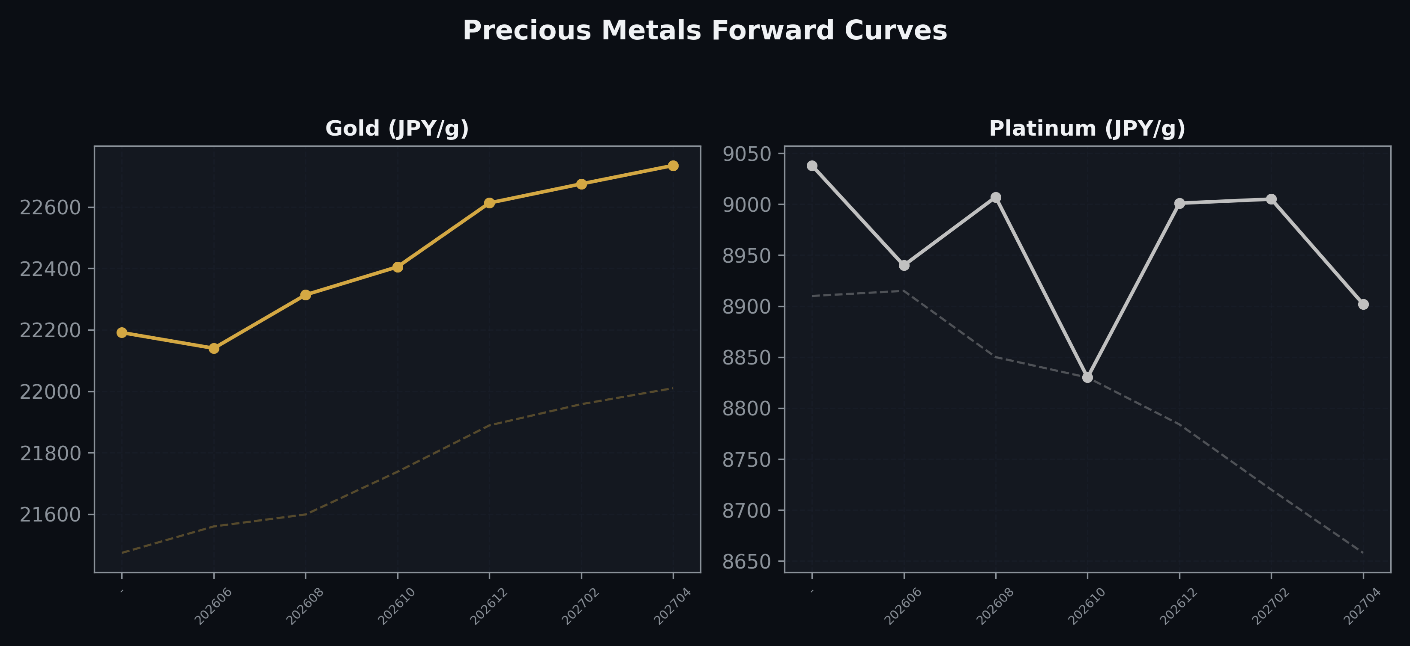
Precious Metals Forward Curves
Gold & Platinum (2026-06-15)

Slide 5
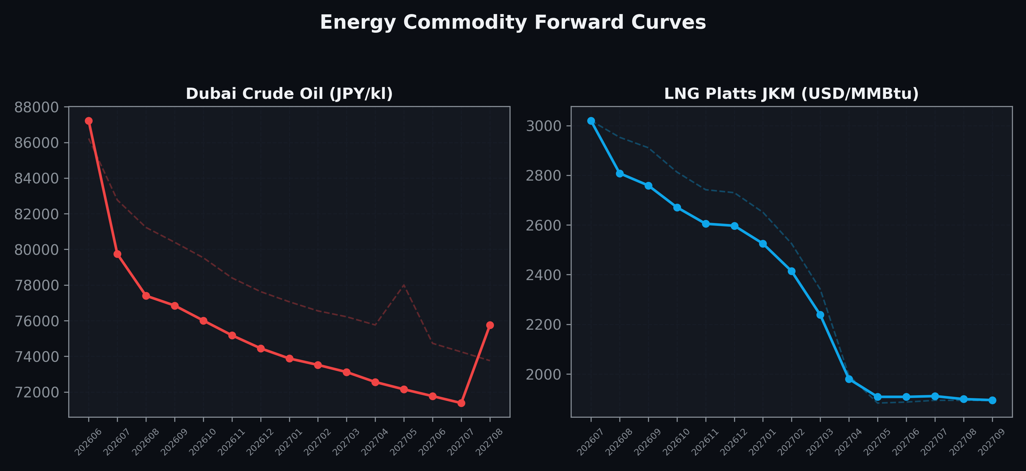
Energy Commodity Forward Curves
Dubai Crude Oil & LNG Platts JKM (2026-06-15)

Slide 6
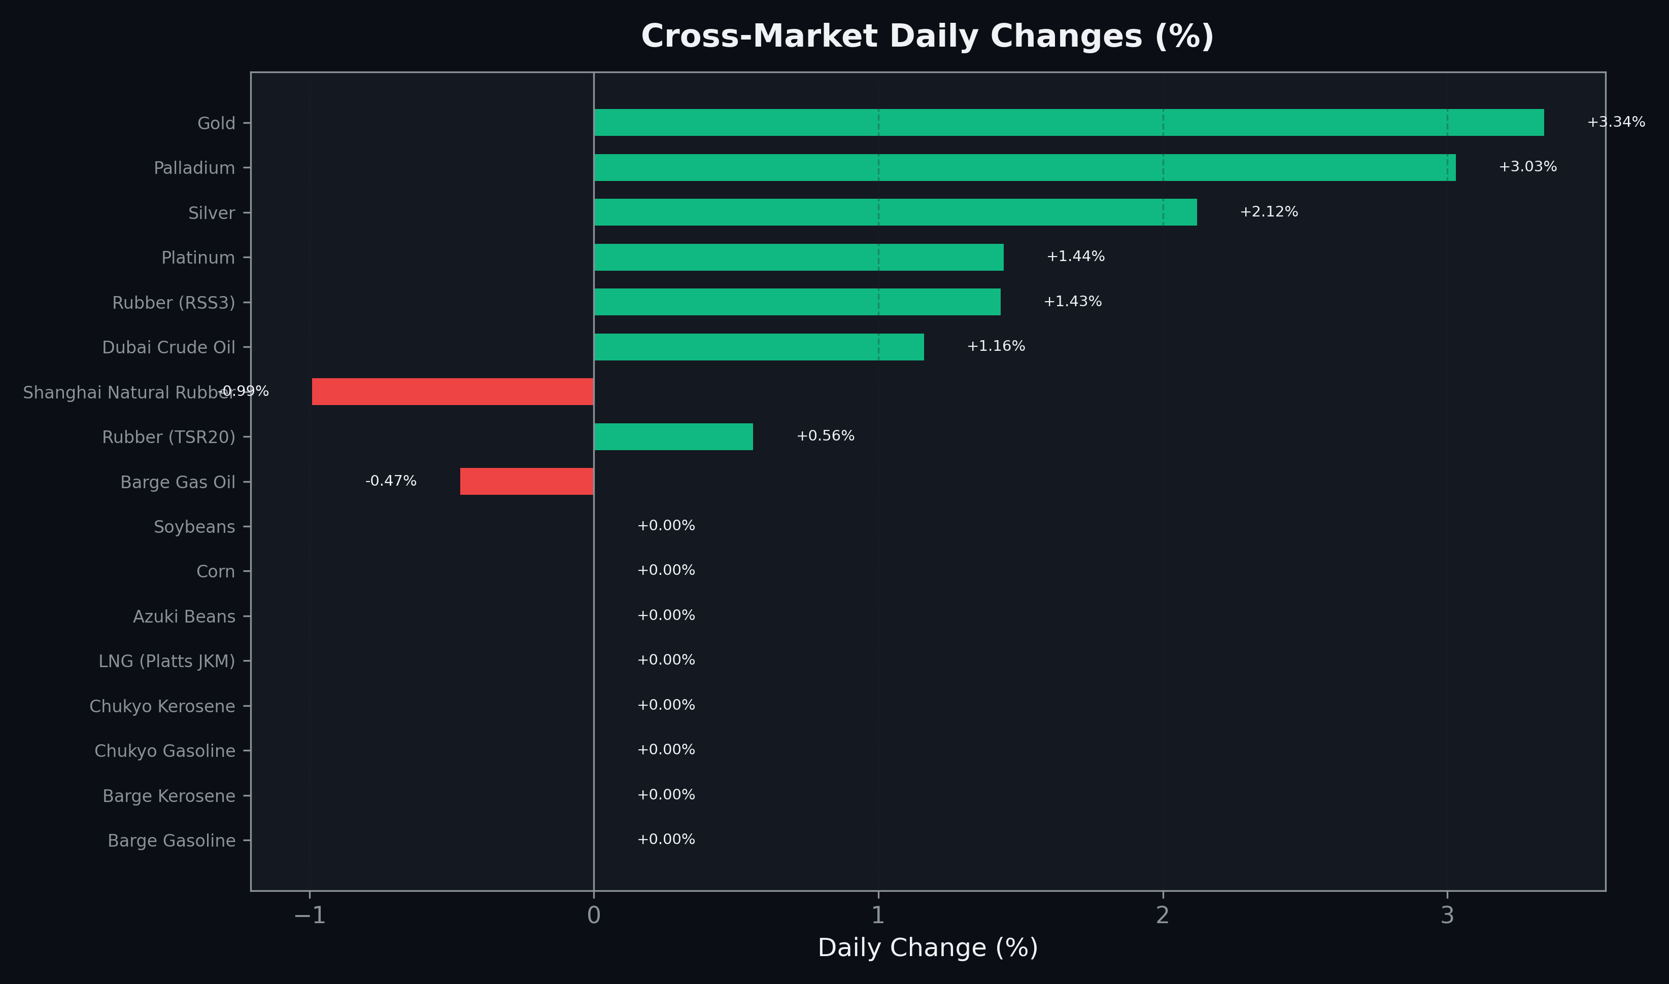
Cross-Market Daily Changes
All commodities sorted by absolute % change

Slide 7
Top Power Futures Movers
Largest absolute settlement price changes vs previous day (2026-06-15)
Instrument | Underlying | Month | Price | Prev | Change | % Chg
FUT_EWBW_260618 | Power West Base (Weekly) | 20260619 | 13.28 | 16.58 | -3.30 | -19.90%
FUT_EWPW_260618 | Power West Peak (Weekly) | 20260619 | 17.64 | 20.15 | -2.51 | -12.46%
FUT_EWP_260730 | Power West Peak (Monthly) | 202607 | 26.41 | 28.86 | -2.45 | -8.49%
FUT_EWP_260828 | Power West Peak (Monthly) | 202608 | 27.77 | 30.00 | -2.23 | -7.43%
FUT_EWP_260929 | Power West Peak (Monthly) | 202609 | 25.63 | 27.78 | -2.15 | -7.74%
FUT_EWPW_260709 | Power West Peak (Weekly) | 20260710 | 24.60 | 26.50 | -1.90 | -7.17%
FUT_EWPW_260702 | Power West Peak (Weekly) | 20260703 | 22.68 | 24.07 | -1.39 | -5.77%
FUT_EWPW_260716 | Power West Peak (Weekly) | 20260717 | 25.20 | 26.43 | -1.23 | -4.65%
FUT_EEBW_260618 | Power East Base (Weekly) | 20260619 | 20.84 | 21.95 | -1.11 | -5.06%
FUT_EEP_260929 | Power East Peak (Monthly) | 202609 | 28.15 | 29.25 | -1.10 | -3.76%
FUT_EEP_260730 | Power East Peak (Monthly) | 202607 | 29.20 | 30.27 | -1.07 | -3.53%
FUT_EEP_260828 | Power East Peak (Monthly) | 202608 | 29.00 | 30.07 | -1.07 | -3.56%
FUT_EWBW_260716 | Power West Base (Weekly) | 20260717 | 18.96 | 19.96 | -1.00 | -5.01%
FUT_EWBW_260709 | Power West Base (Weekly) | 20260710 | 18.53 | 19.42 | -0.89 | -4.58%
FUT_ECB_260730 | 電力(中部・ベース) | 202607 | 21.58 | 22.46 | -0.88 | -3.92%

