Slide 1
Daily Market Report
Trade Date: 2026-06-12
JPX Derivative & Commodity Analytics
DataServer In-House

Slide 2
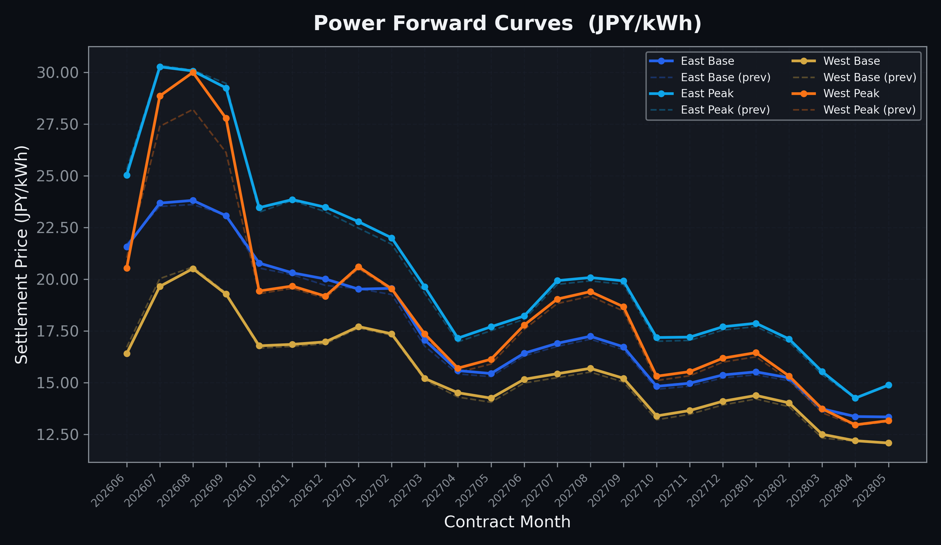
Power Forward Curves
East/West Base & Peak monthly contracts (2026-06-12)

Slide 3
Commodity Snapshot
Front-month settlement prices as of 2026-06-12
Category | Asset | Contract | Settlement | Unit | Change | % Chg
Energy | Barge Gas Oil | 202607 | 106,000.00 | JPY/kl | -200.00 | -0.19%
Energy | Barge Gasoline | 202607 | 100,000.00 | JPY/kl | +0.00 | +0.00%
Energy | Barge Kerosene | 202607 | 110,000.00 | JPY/kl | +0.00 | +0.00%
Energy | Chukyo Gasoline | 202607 | 95,000.00 | JPY/kl | +0.00 | +0.00%
Energy | Chukyo Kerosene | 202607 | 105,000.00 | JPY/kl | +0.00 | +0.00%
Energy | Dubai Crude Oil | 202606 | 86,220.00 | JPY/kl | -4700.00 | -5.17%
Energy | LNG (Platts JKM) | 202607 | 3,020.00 | USD/MMBtu | +1.00 | +0.03%
Metals | Gold | - | 21,474.00 | JPY/g | +444.00 | +2.11%
Metals | Palladium | 202606 | 6,600.00 | JPY/g | +200.00 | +3.12%
Metals | Platinum | - | 8,910.00 | JPY/g | +374.00 | +4.38%
Metals | Silver | 202606 | 330.00 | JPY/10g | +0.00 | +0.00%
Industrial | Rubber (RSS3) | 202606 | 418.90 | JPY/kg | +3.80 | +0.92%
Industrial | Rubber (TSR20) | 202607 | 360.00 | JPY/kg | +0.00 | +0.00%
Industrial | Shanghai Natural Rubber | 202609 | 17,725.00 | JPY/kg | +160.00 | +0.91%
Agriculture | Azuki Beans | 202606 | 12,300.00 | JPY/bag | +0.00 | +0.00%
Agriculture | Corn | 202607 | 39,000.00 | JPY/t | +0.00 | +0.00%
Agriculture | Soybeans | 202606 | 64,000.00 | JPY/t | +0.00 | +0.00%

Slide 4
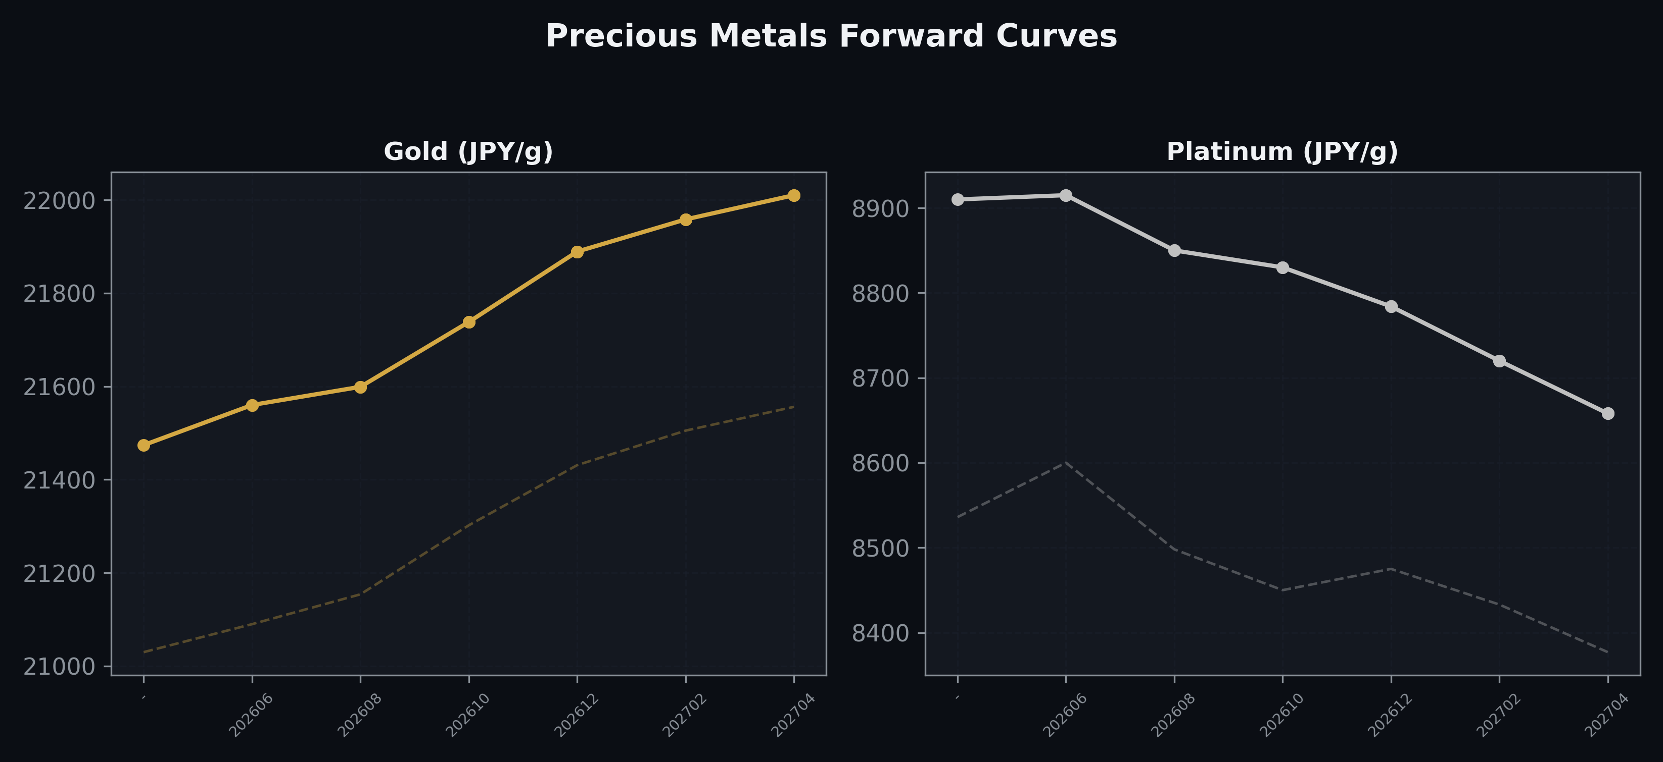
Precious Metals Forward Curves
Gold & Platinum (2026-06-12)

Slide 5
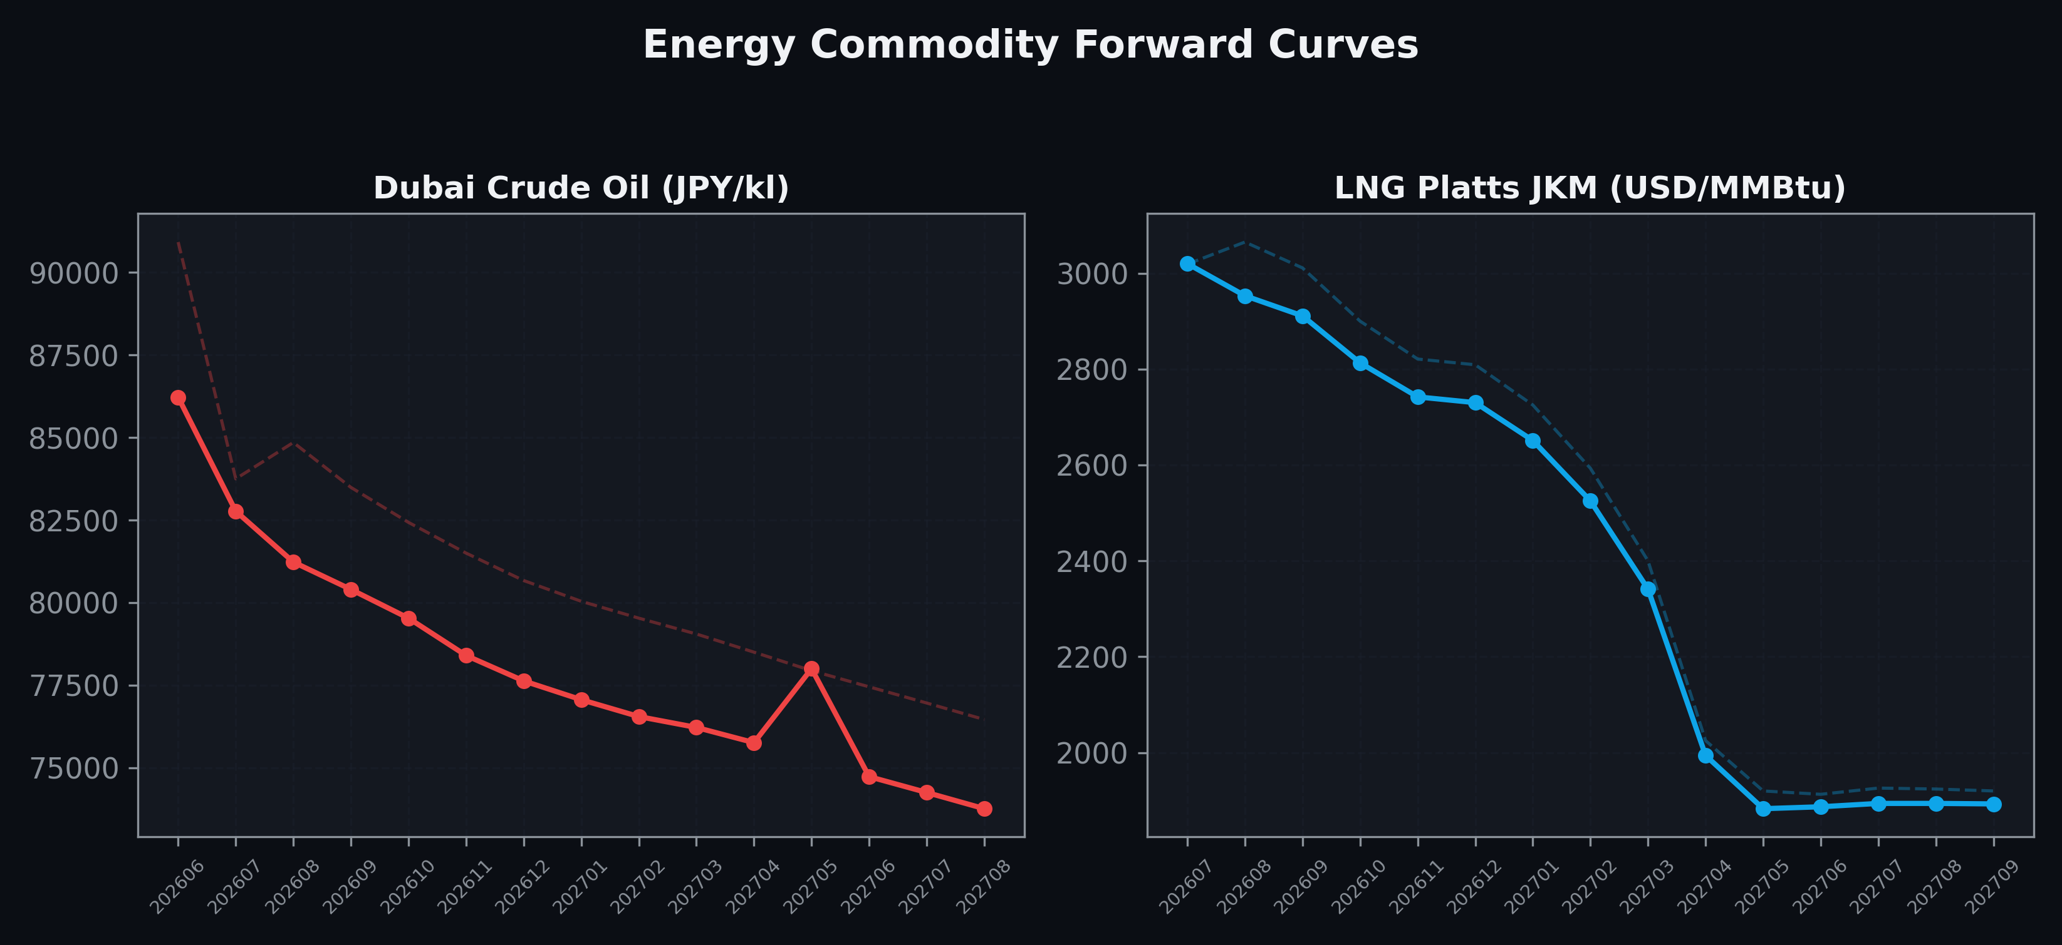
Energy Commodity Forward Curves
Dubai Crude Oil & LNG Platts JKM (2026-06-12)

Slide 6
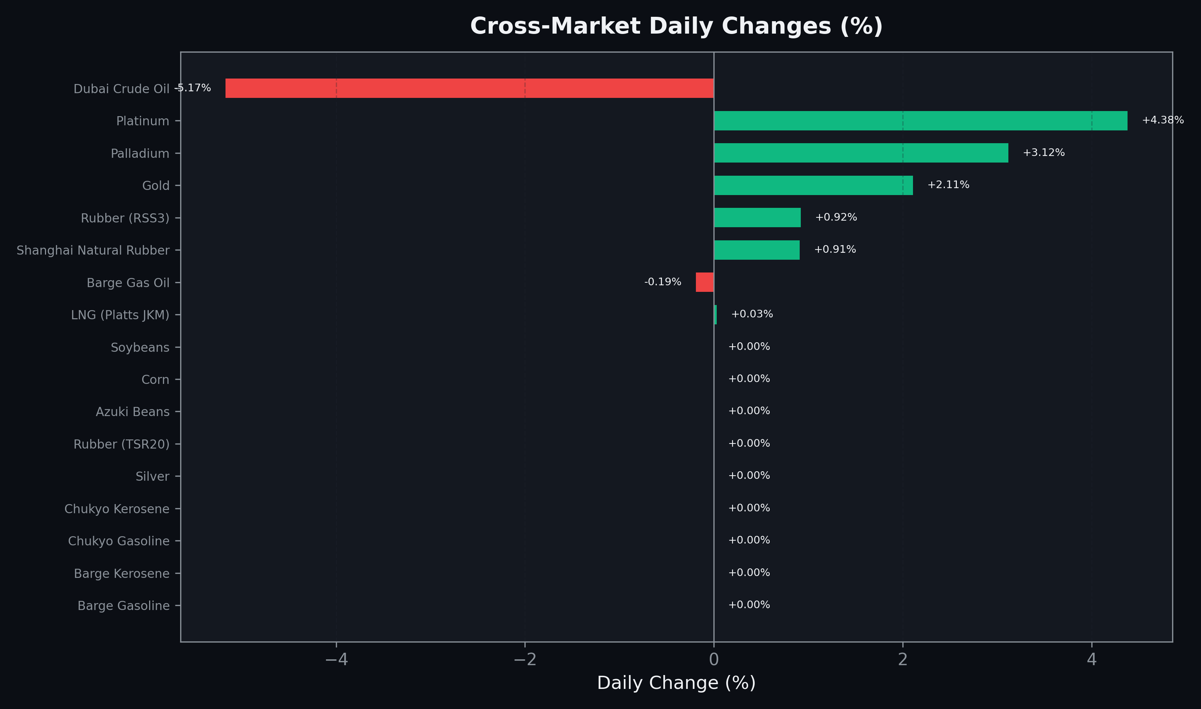
Cross-Market Daily Changes
All commodities sorted by absolute % change

Slide 7
Top Power Futures Movers
Largest absolute settlement price changes vs previous day (2026-06-12)
Instrument | Underlying | Month | Price | Prev | Change | % Chg
FUT_EWP_260828 | Power West Peak (Monthly) | 202608 | 30.00 | 28.21 | +1.79 | +6.35%
FUT_EWP_260929 | Power West Peak (Monthly) | 202609 | 27.78 | 26.13 | +1.65 | +6.31%
FUT_EWP_260730 | Power West Peak (Monthly) | 202607 | 28.86 | 27.39 | +1.47 | +5.37%
FUT_EWP_260629 | Power West Peak (Monthly) | 202606 | 20.54 | 21.04 | -0.50 | -2.38%
FUT_ECP_260629 | 電力(中部・日中) | 202606 | 22.83 | 23.27 | -0.44 | -1.89%
FUT_EWPW_260709 | Power West Peak (Weekly) | 20260710 | 26.50 | 26.06 | +0.44 | +1.69%
FUT_ECP_270528 | 電力(中部・日中) | 202705 | 16.19 | 15.79 | +0.40 | +2.53%
FUT_ECP_270729 | 電力(中部・日中) | 202707 | 18.89 | 18.50 | +0.39 | +2.11%
FUT_ECP_270830 | 電力(中部・日中) | 202708 | 19.31 | 18.92 | +0.39 | +2.06%
FUT_ECP_270929 | 電力(中部・日中) | 202709 | 19.06 | 18.67 | +0.39 | +2.09%
FUT_EWB_260730 | Power West Base (Monthly) | 202607 | 19.65 | 20.03 | -0.38 | -1.90%
FUT_ECPY_270326 | 電力(中部・年度日中) | 202704 | 16.91 | 16.54 | +0.37 | +2.24%
FUT_ECP_270428 | 電力(中部・日中) | 202704 | 15.84 | 15.47 | +0.37 | +2.39%
FUT_ECP_270629 | 電力(中部・日中) | 202706 | 17.53 | 17.16 | +0.37 | +2.16%
FUT_ECP_271228 | 電力(中部・日中) | 202712 | 16.77 | 16.40 | +0.37 | +2.26%

