Slide 1
Daily Market Report
Trade Date: 2026-04-22
JPX Derivative & Commodity Analytics
DataServer In-House

Slide 2
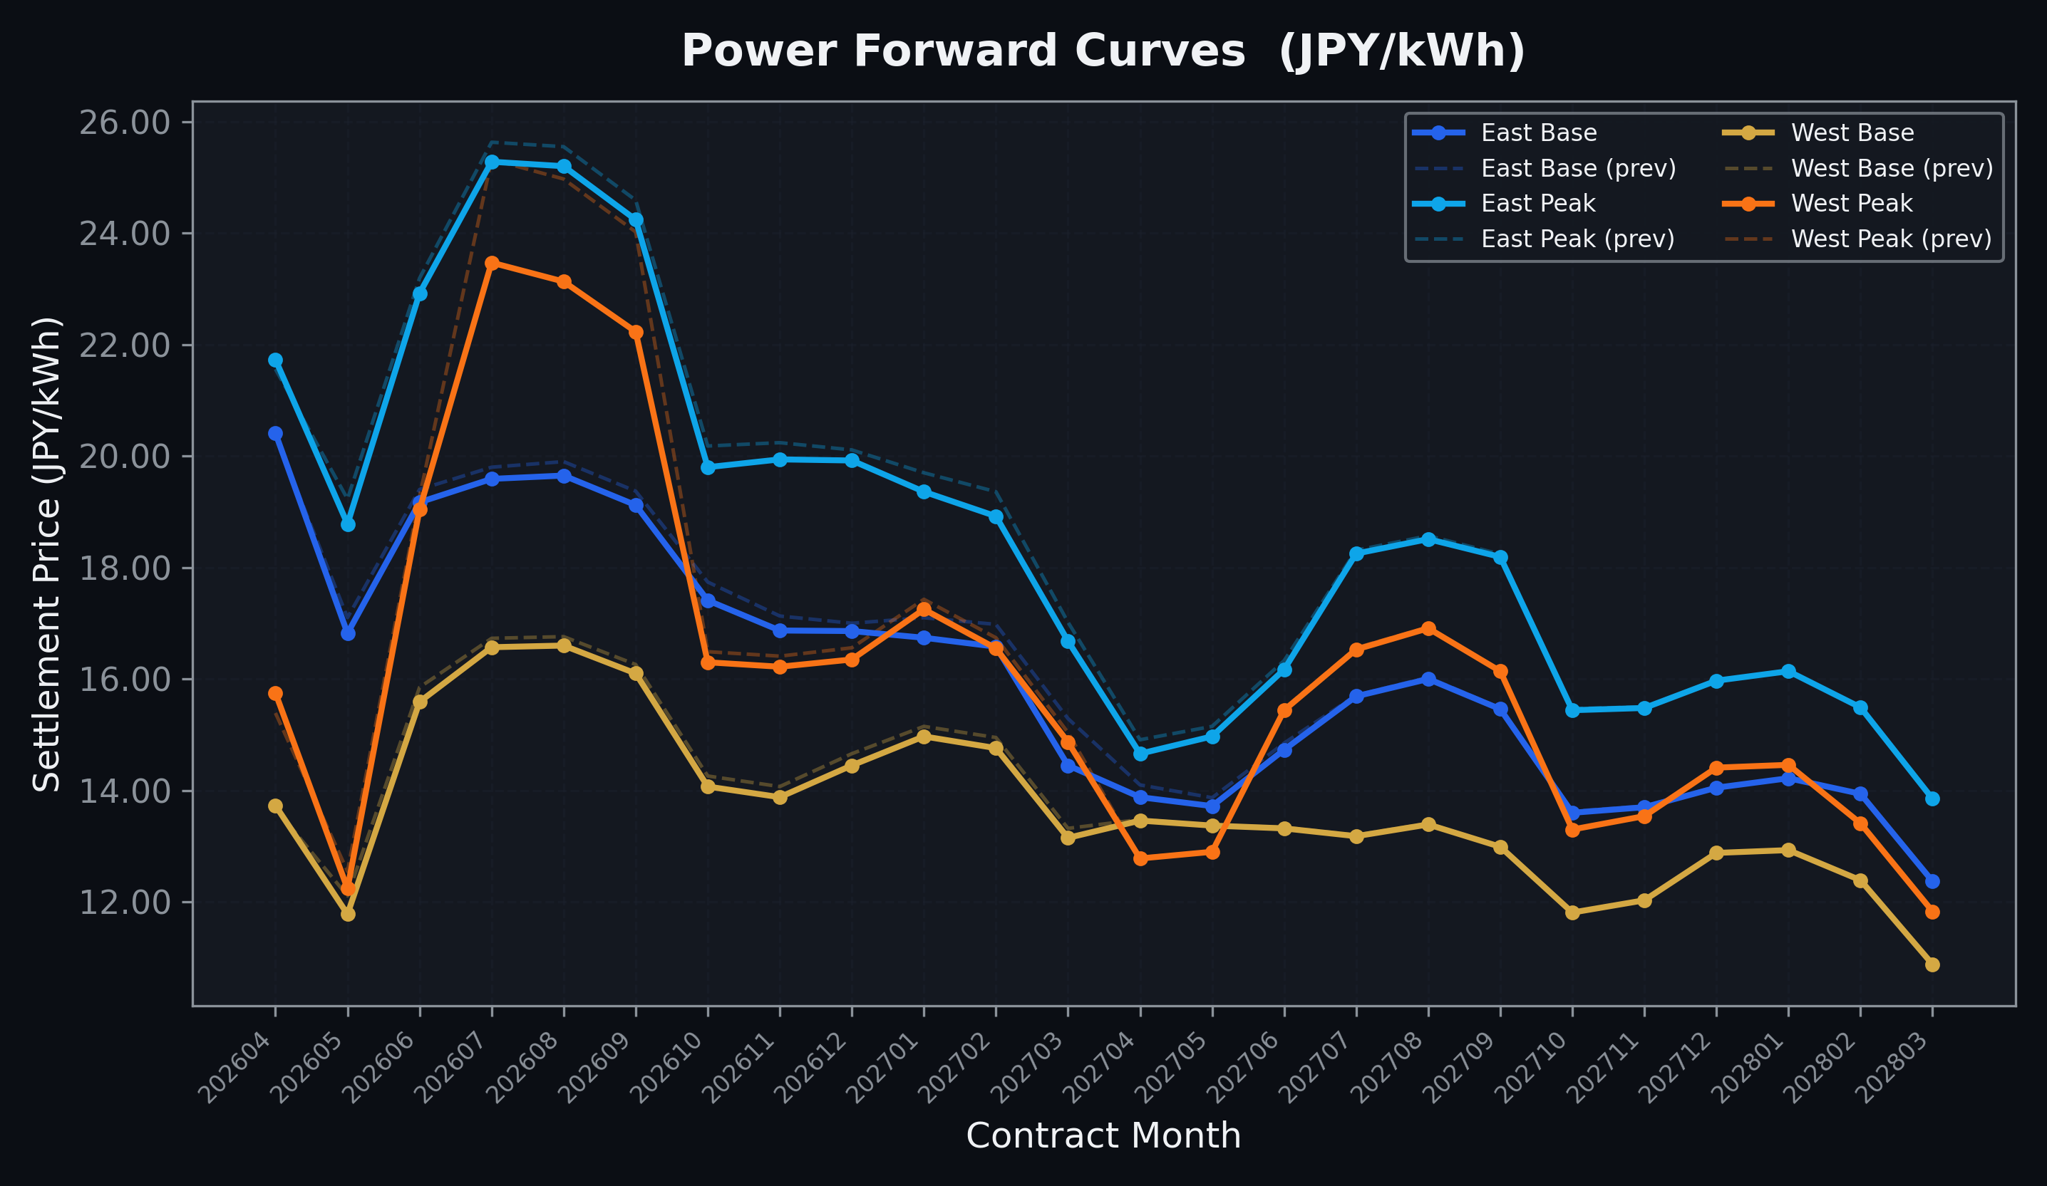
Power Forward Curves
East/West Base & Peak monthly contracts (2026-04-22)

Slide 3
Commodity Snapshot
Front-month settlement prices as of 2026-04-22
Category | Asset | Contract | Settlement | Unit | Change | % Chg
Energy | Barge Gas Oil | 202605 | 114,900.00 | JPY/kl | +0.00 | +0.00%
Energy | Barge Gasoline | 202605 | 105,000.00 | JPY/kl | +0.00 | +0.00%
Energy | Barge Kerosene | 202605 | 105,000.00 | JPY/kl | +0.00 | +0.00%
Energy | Chukyo Gasoline | 202605 | 105,000.00 | JPY/kl | +0.00 | +0.00%
Energy | Chukyo Kerosene | 202605 | 105,000.00 | JPY/kl | +0.00 | +0.00%
Energy | Dubai Crude Oil | 202604 | 103,510.00 | JPY/kl | +2290.00 | +2.26%
Energy | LNG (Platts JKM) | 202606 | 2,511.00 | USD/MMBtu | +123.00 | +5.15%
Metals | Gold | - | 24,331.00 | JPY/g | -155.00 | -0.63%
Metals | Palladium | 202604 | 8,000.00 | JPY/g | +0.00 | +0.00%
Metals | Platinum | - | 10,492.00 | JPY/g | -52.00 | -0.49%
Metals | Silver | 202604 | 383.10 | JPY/10g | +0.00 | +0.00%
Industrial | Rubber (RSS3) | 202604 | 379.80 | JPY/kg | +0.00 | +0.00%
Industrial | Rubber (TSR20) | 202605 | 325.00 | JPY/kg | +0.00 | +0.00%
Industrial | Shanghai Natural Rubber | 202605 | 17,065.00 | JPY/kg | +130.00 | +0.77%
Agriculture | Azuki Beans | 202604 | 12,300.00 | JPY/bag | +0.00 | +0.00%
Agriculture | Corn | 202607 | 39,000.00 | JPY/t | +0.00 | +0.00%
Agriculture | Soybeans | 202606 | 64,000.00 | JPY/t | +0.00 | +0.00%

Slide 4
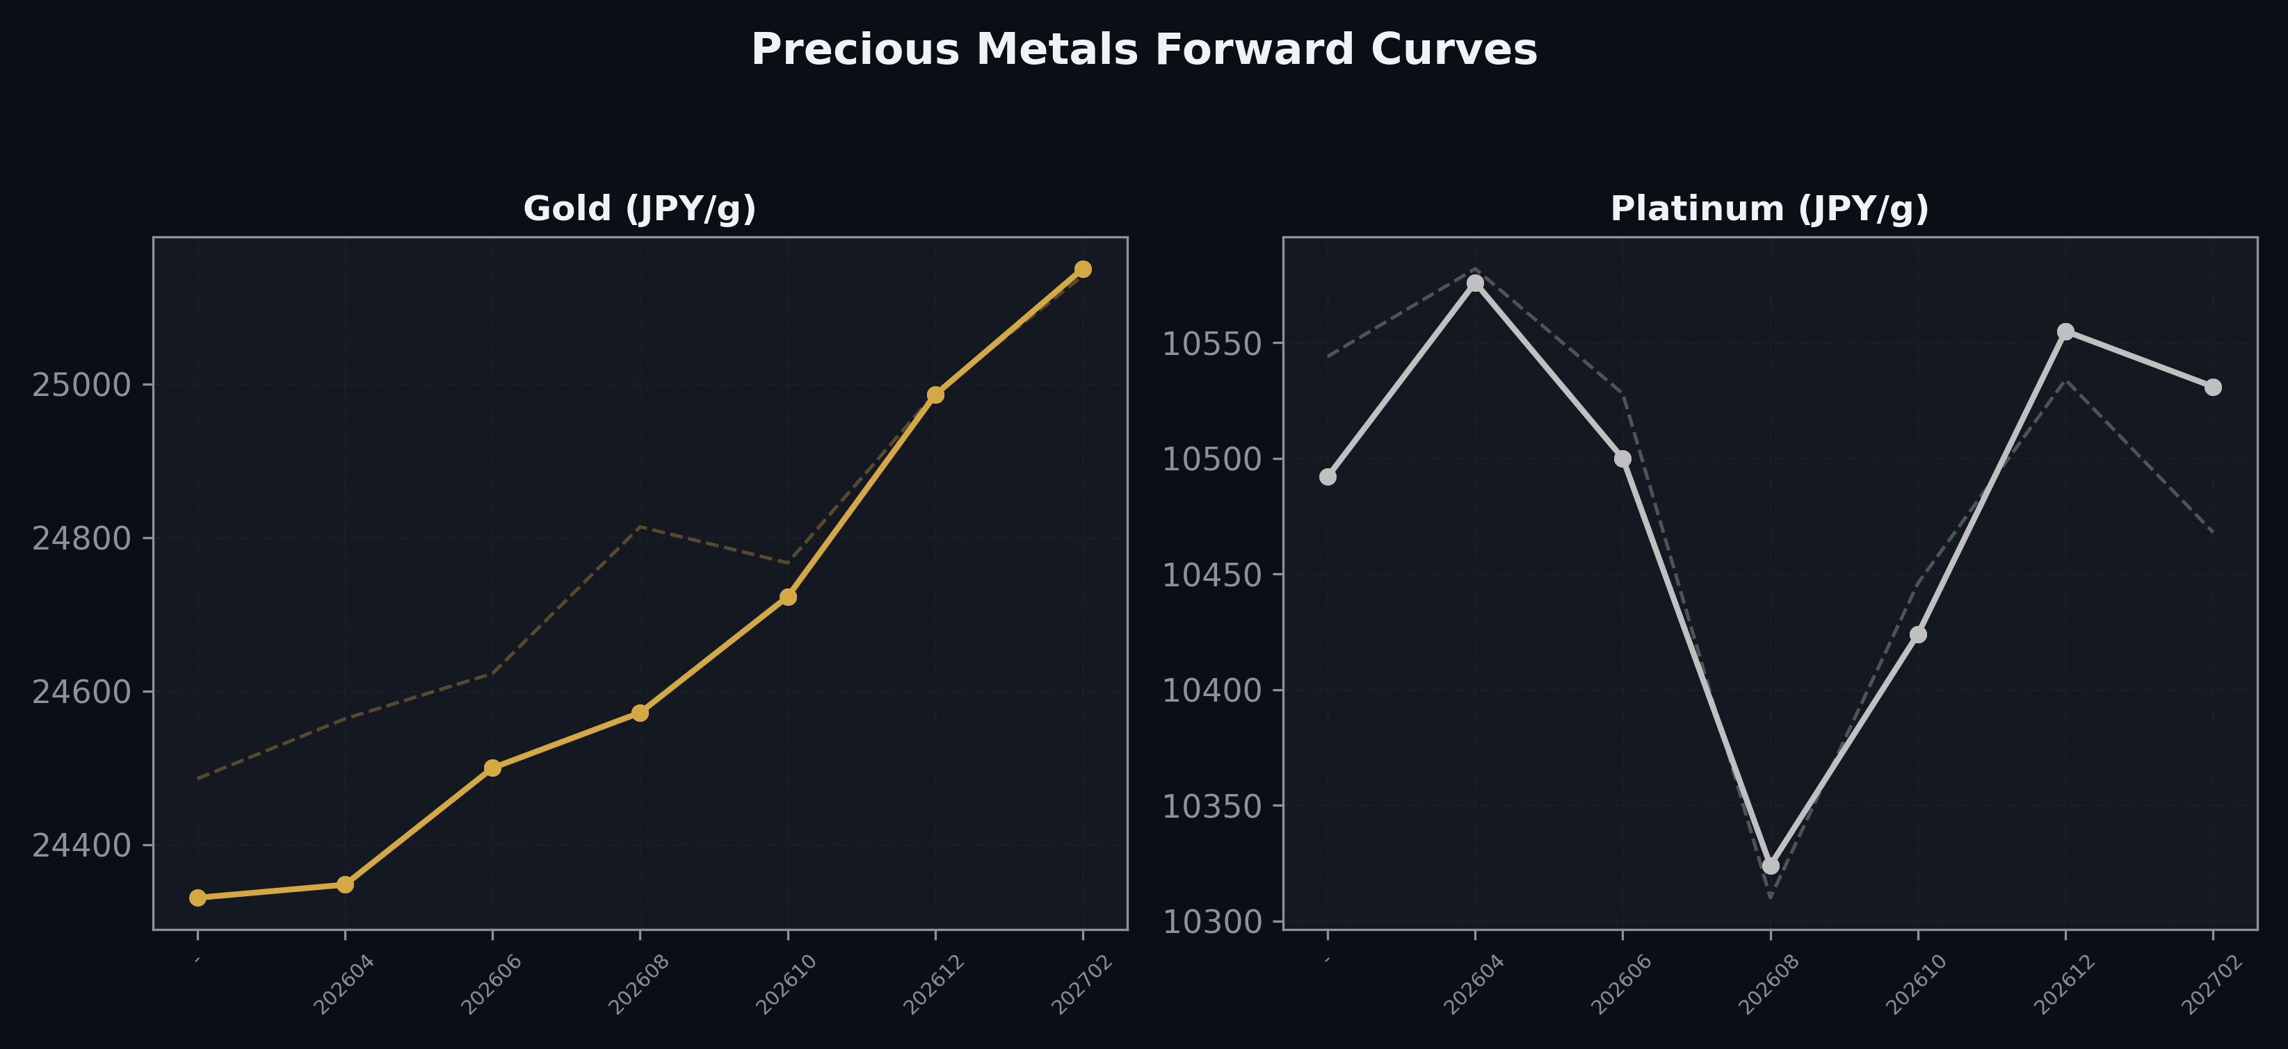
Precious Metals Forward Curves
Gold & Platinum (2026-04-22)

Slide 5
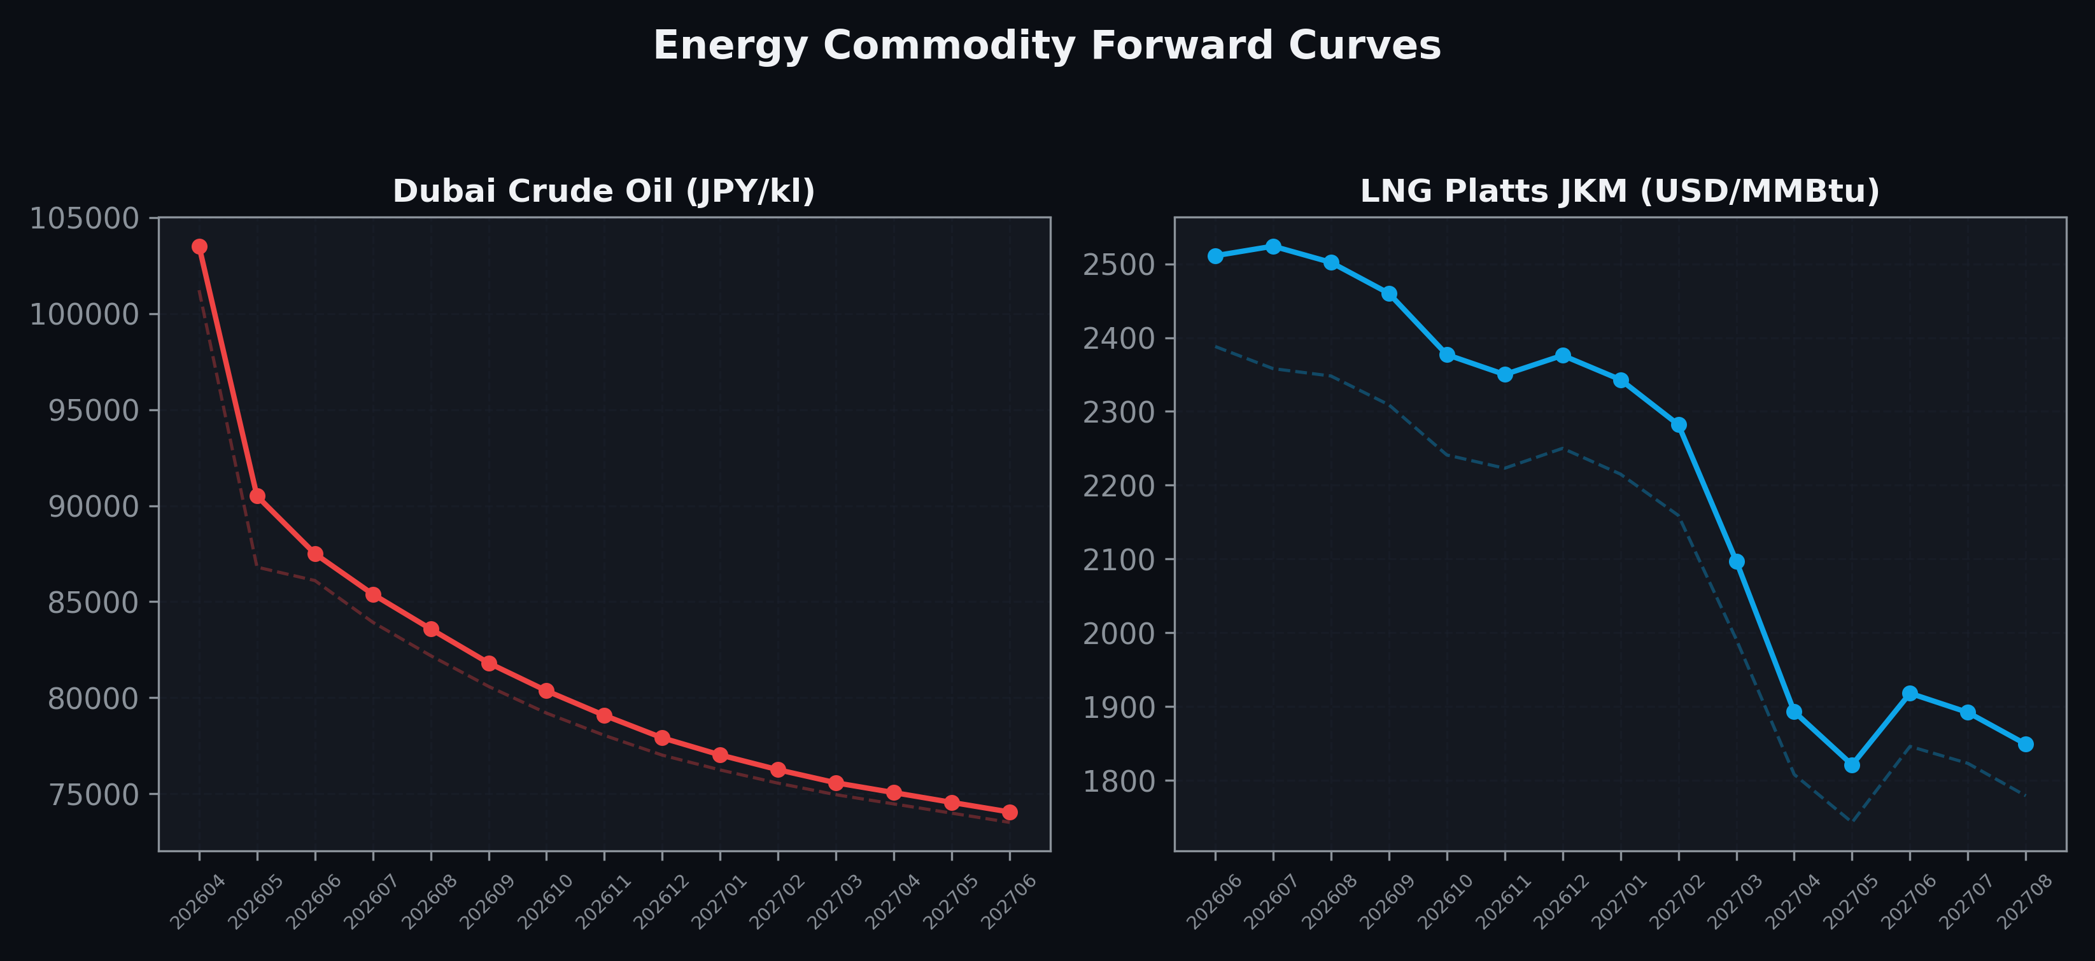
Energy Commodity Forward Curves
Dubai Crude Oil & LNG Platts JKM (2026-04-22)

Slide 6
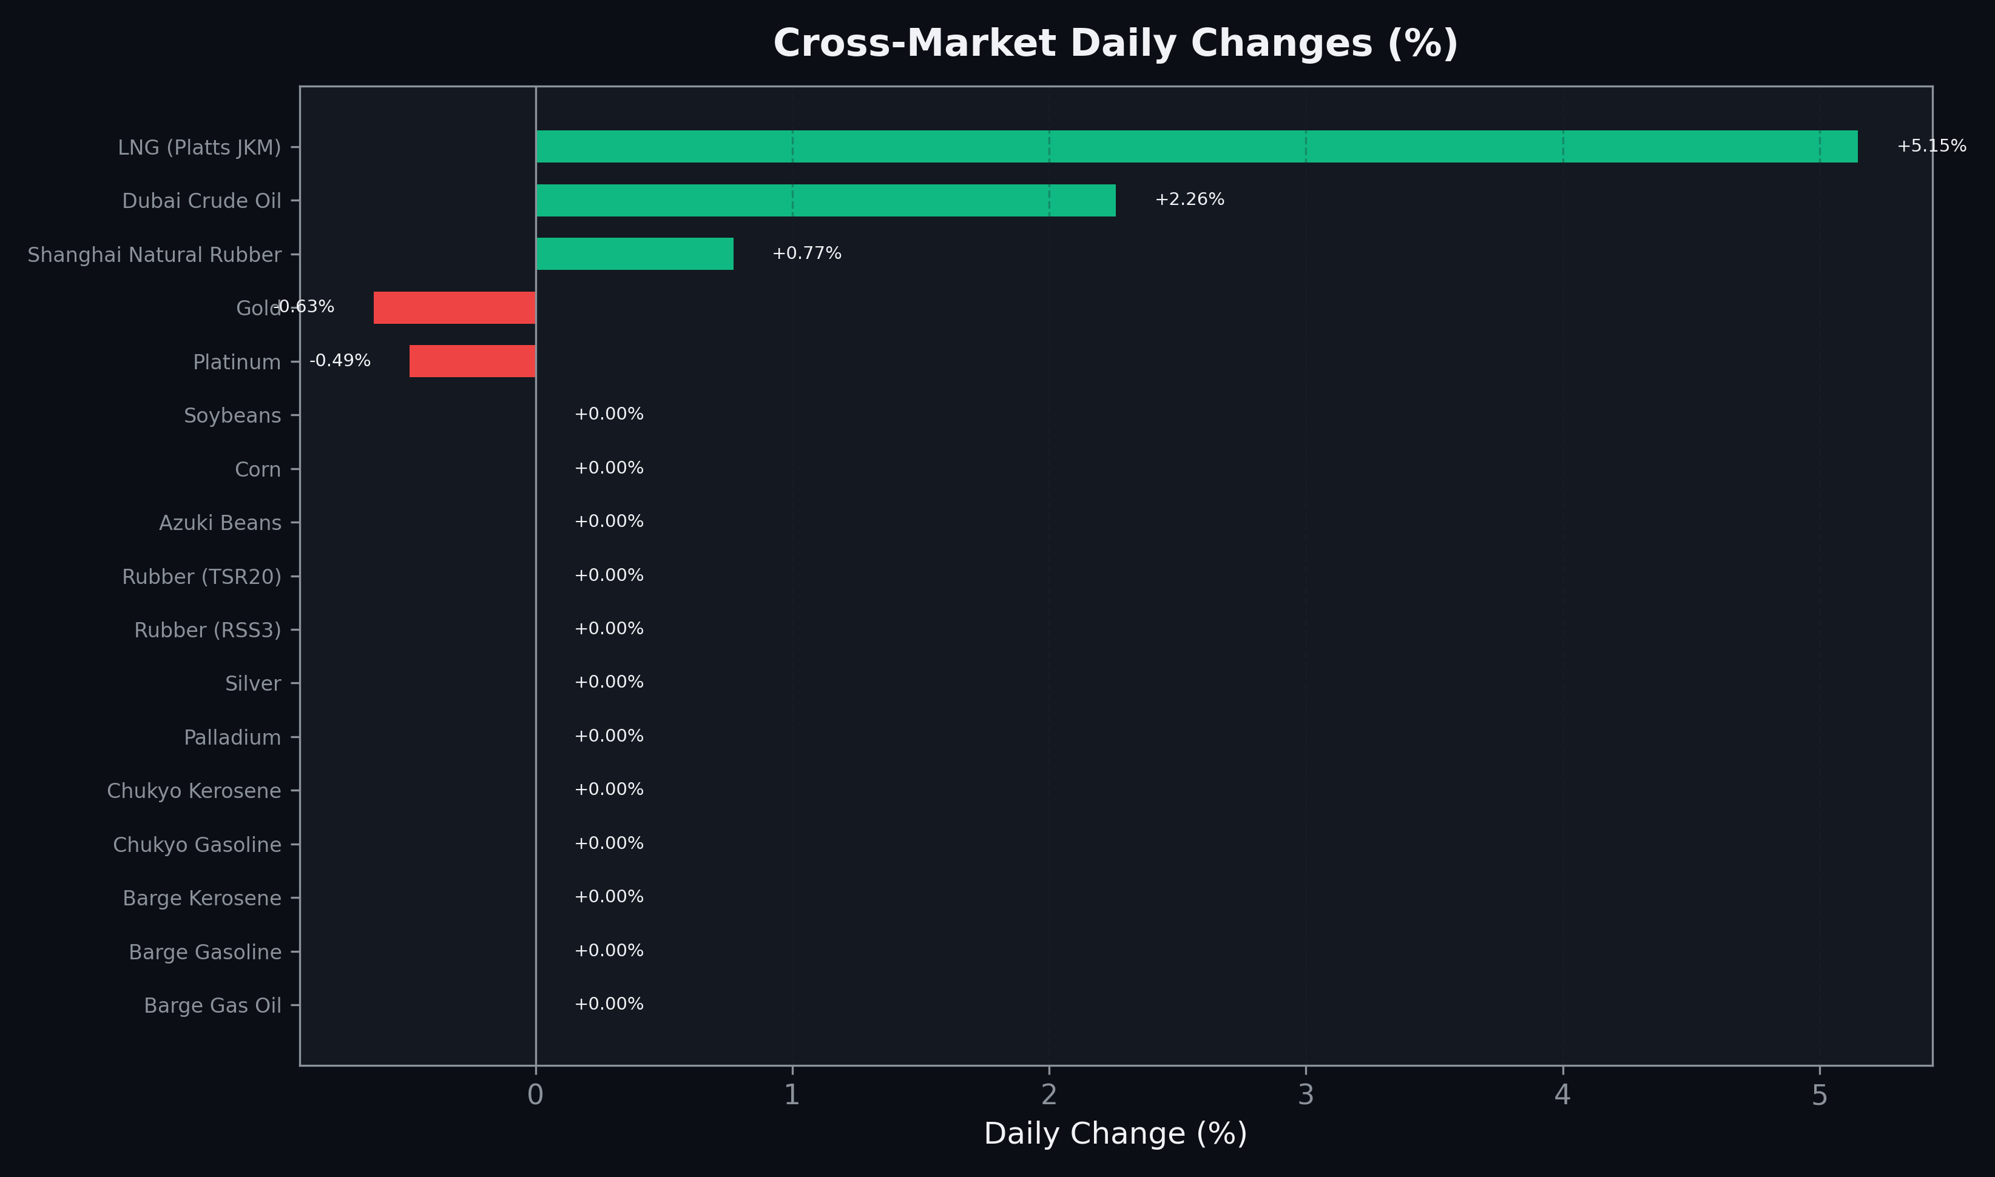
Cross-Market Daily Changes
All commodities sorted by absolute % change

Slide 7
Top Power Futures Movers
Largest absolute settlement price changes vs previous day (2026-04-22)
Instrument | Underlying | Month | Price | Prev | Change | % Chg
FUT_EWPW_260423 | Power West Peak (Weekly) | 20260424 | 14.43 | 12.03 | +2.40 | +19.95%
FUT_EWP_260730 | Power West Peak (Monthly) | 202607 | 23.47 | 25.32 | -1.85 | -7.31%
FUT_EWP_260828 | Power West Peak (Monthly) | 202608 | 23.13 | 24.97 | -1.84 | -7.37%
FUT_EWP_260929 | Power West Peak (Monthly) | 202609 | 22.23 | 24.02 | -1.79 | -7.45%
FUT_EEPW_260423 | Power East Peak (Weekly) | 20260424 | 21.12 | 19.60 | +1.52 | +7.76%
FUT_EEB_270330 | Power East Base (Monthly) | 202703 | 14.45 | 15.29 | -0.84 | -5.49%
FUT_EWBW_260423 | Power West Base (Weekly) | 20260424 | 11.26 | 10.47 | +0.79 | +7.55%
FUT_EWBW_260521 | Power West Base (Weekly) | 20260522 | 11.68 | 12.23 | -0.55 | -4.50%
FUT_EEPW_260514 | Power East Peak (Weekly) | 20260515 | 18.21 | 18.69 | -0.48 | -2.57%
FUT_EEP_260528 | Power East Peak (Monthly) | 202605 | 18.78 | 19.23 | -0.45 | -2.34%
FUT_EEP_270225 | Power East Peak (Monthly) | 202702 | 18.92 | 19.36 | -0.44 | -2.27%
FUT_EEBW_260521 | Power East Base (Weekly) | 20260522 | 17.35 | 17.79 | -0.44 | -2.47%
FUT_EWPW_260521 | Power West Peak (Weekly) | 20260522 | 10.97 | 11.41 | -0.44 | -3.86%
FUT_ECP_260629 | 電力(中部・日中) | 202606 | 20.39 | 20.82 | -0.43 | -2.07%
FUT_EEPW_260507 | Power East Peak (Weekly) | 20260508 | 17.54 | 17.97 | -0.43 | -2.39%

