Slide 1
Daily Market Report
Trade Date: 2026-03-25
JPX Derivative & Commodity Analytics
DataServer In-House

Slide 2
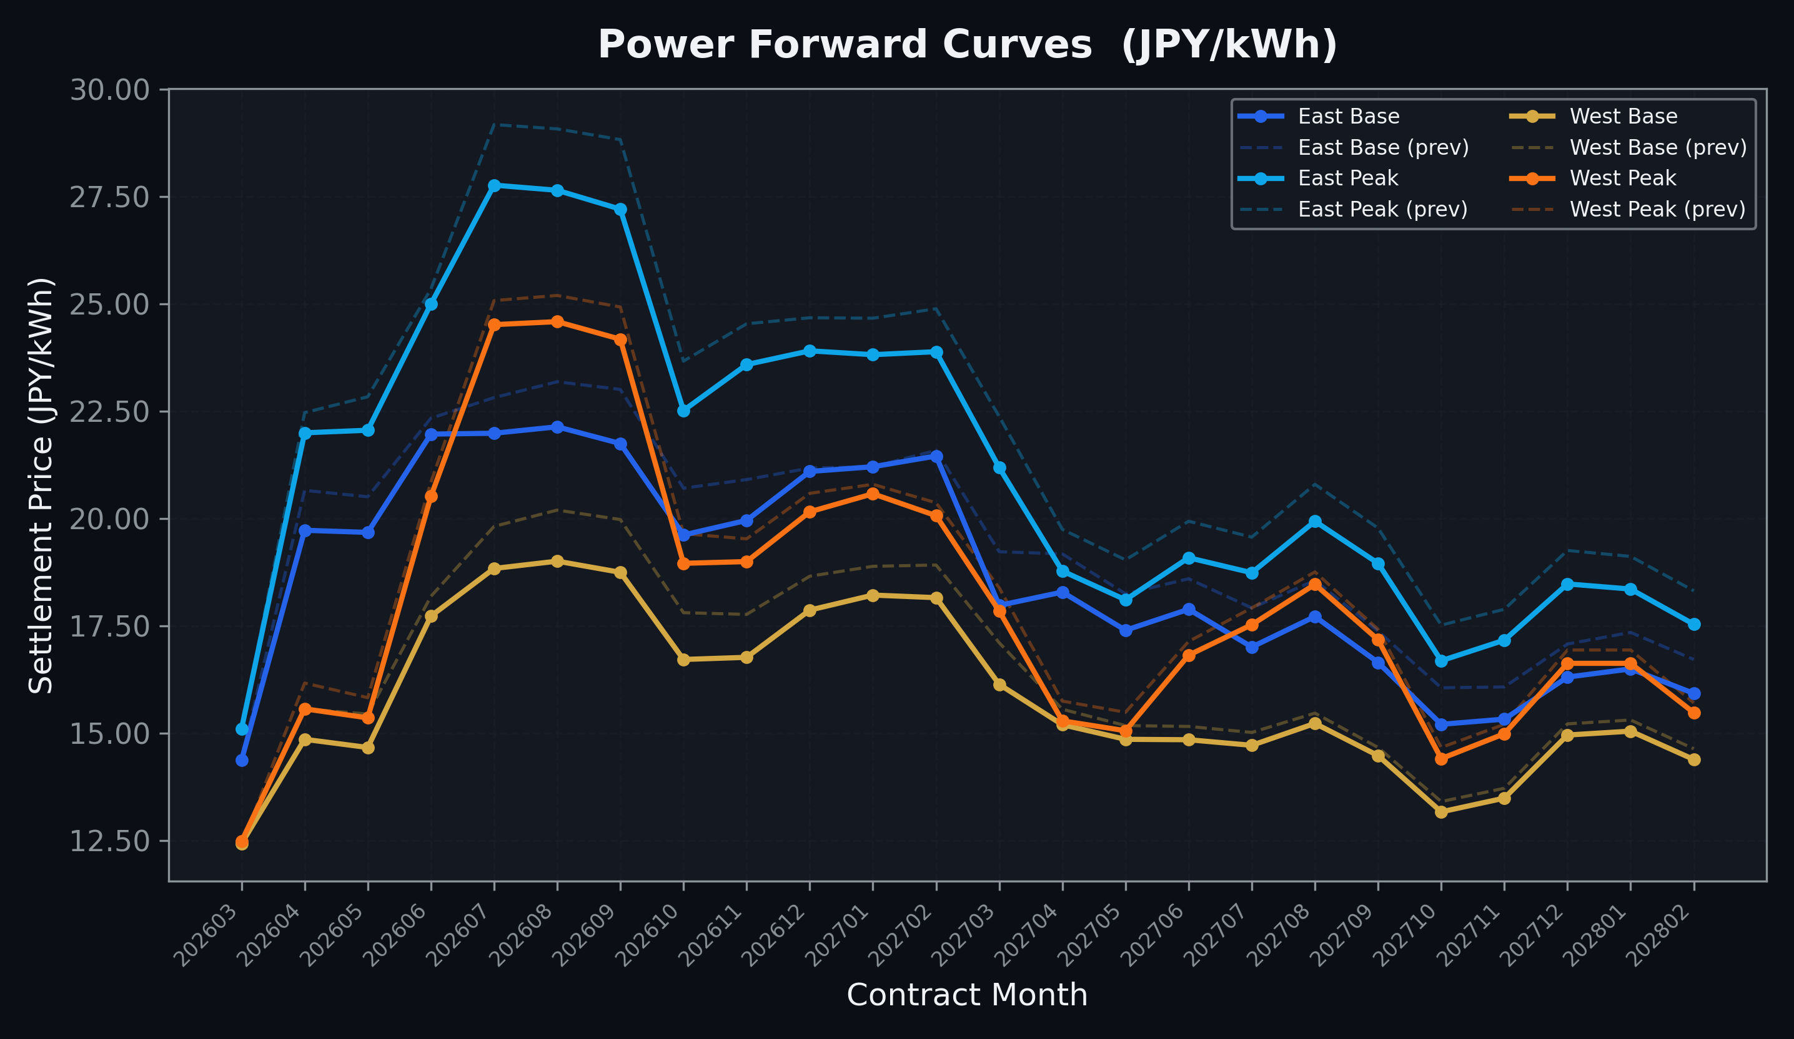
Power Forward Curves
East/West Base & Peak monthly contracts (2026-03-25)

Slide 3
Commodity Snapshot
Front-month settlement prices as of 2026-03-25
Category | Asset | Contract | Settlement | Unit | Change | % Chg
Energy | Barge Gas Oil | 202604 | 112,900.00 | JPY/kl | +0.00 | +0.00%
Energy | Barge Gasoline | 202604 | 150,000.00 | JPY/kl | +0.00 | +0.00%
Energy | Barge Kerosene | 202604 | 140,000.00 | JPY/kl | +0.00 | +0.00%
Energy | Chukyo Gasoline | 202604 | 140,000.00 | JPY/kl | +0.00 | +0.00%
Energy | Chukyo Kerosene | 202604 | 130,000.00 | JPY/kl | +0.00 | +0.00%
Energy | Dubai Crude Oil | 202603 | 135,080.00 | JPY/kl | +400.00 | +0.30%
Energy | LNG (Platts JKM) | 202605 | 3,189.00 | USD/MMBtu | -146.00 | -4.38%
Metals | Gold | - | 23,142.00 | JPY/g | +746.00 | +3.33%
Metals | Palladium | 202604 | 7,500.00 | JPY/g | +300.00 | +4.17%
Metals | Platinum | - | 9,817.00 | JPY/g | +652.00 | +7.11%
Metals | Silver | 202604 | 360.00 | JPY/10g | +10.00 | +2.86%
Industrial | Rubber (RSS3) | 202603 | 364.80 | JPY/kg | -5.20 | -1.41%
Industrial | Rubber (TSR20) | 202604 | 307.00 | JPY/kg | +0.00 | +0.00%
Industrial | Shanghai Natural Rubber | 202605 | 16,460.00 | JPY/kg | +215.00 | +1.32%
Agriculture | Azuki Beans | 202603 | 12,300.00 | JPY/bag | +0.00 | +0.00%
Agriculture | Corn | 202605 | 39,000.00 | JPY/t | +0.00 | +0.00%
Agriculture | Soybeans | 202604 | 64,000.00 | JPY/t | +0.00 | +0.00%

Slide 4
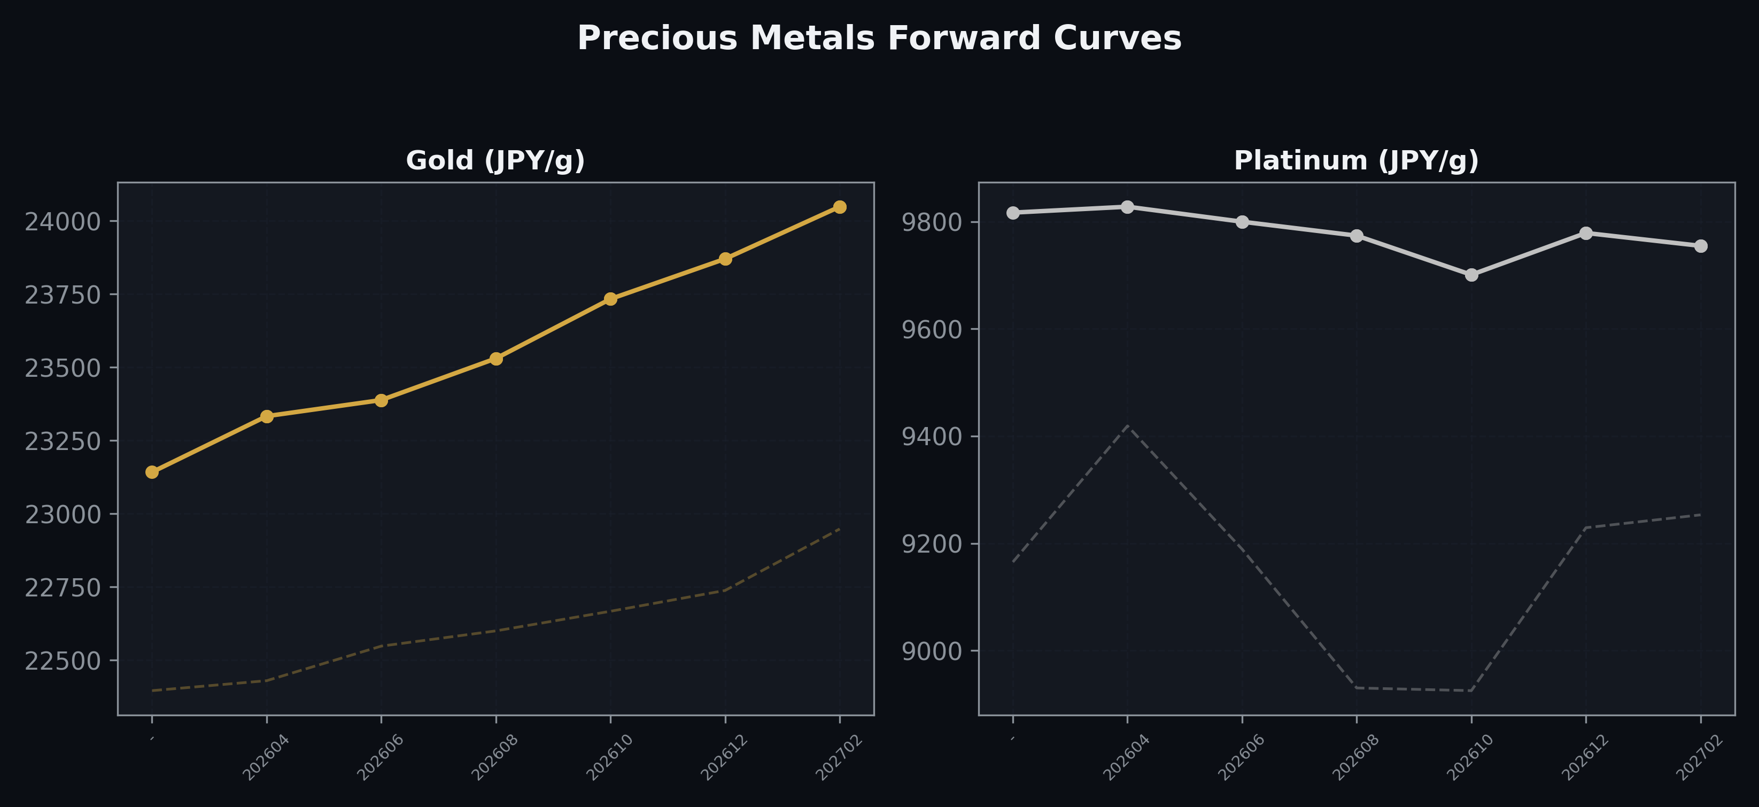
Precious Metals Forward Curves
Gold & Platinum (2026-03-25)

Slide 5
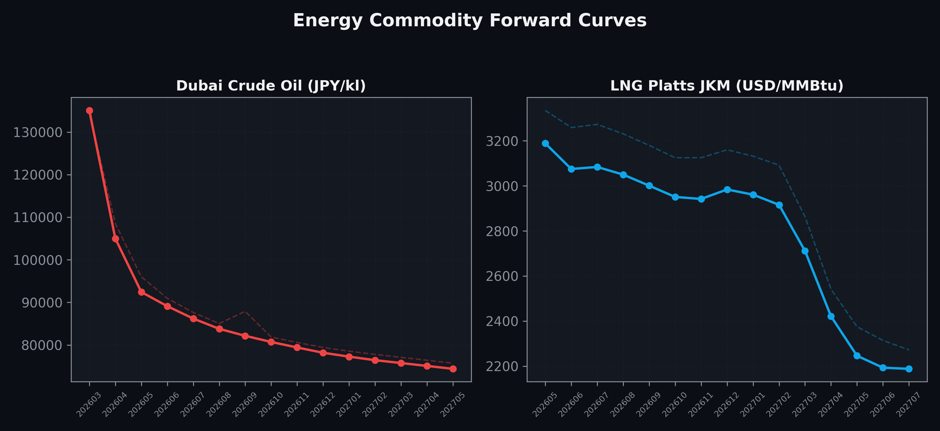
Energy Commodity Forward Curves
Dubai Crude Oil & LNG Platts JKM (2026-03-25)

Slide 6
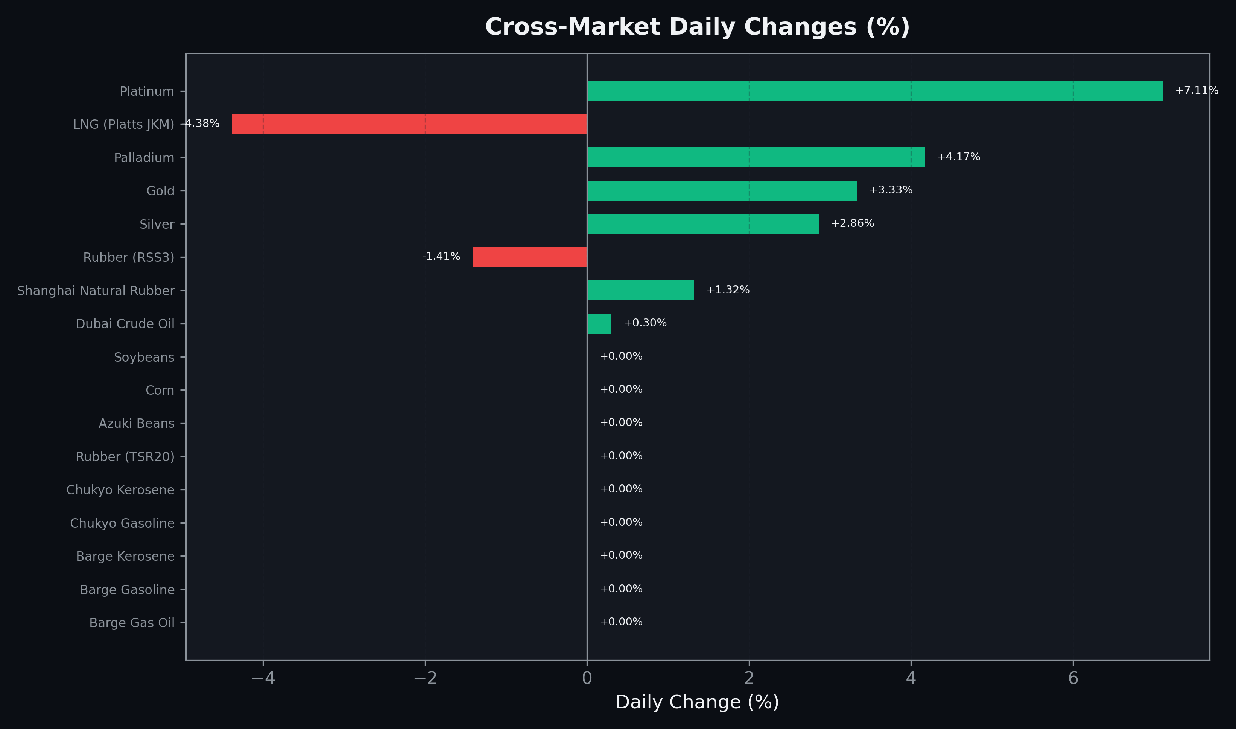
Cross-Market Daily Changes
All commodities sorted by absolute % change

Slide 7
Top Power Futures Movers
Largest absolute settlement price changes vs previous day (2026-03-25)
Instrument | Underlying | Month | Price | Prev | Change | % Chg
FUT_EEP_260929 | Power East Peak (Monthly) | 202609 | 27.21 | 28.83 | -1.62 | -5.62%
FUT_EEP_260828 | Power East Peak (Monthly) | 202608 | 27.65 | 29.08 | -1.43 | -4.92%
FUT_EEP_260730 | Power East Peak (Monthly) | 202607 | 27.77 | 29.18 | -1.41 | -4.83%
FUT_EEB_260929 | Power East Base (Monthly) | 202609 | 21.75 | 23.01 | -1.26 | -5.48%
FUT_EEB_270330 | Power East Base (Monthly) | 202703 | 17.98 | 19.23 | -1.25 | -6.50%
FUT_EWB_260929 | Power West Base (Monthly) | 202609 | 18.75 | 19.98 | -1.23 | -6.16%
FUT_EEP_270330 | Power East Peak (Monthly) | 202703 | 21.19 | 22.38 | -1.19 | -5.32%
FUT_EWB_260828 | Power West Base (Monthly) | 202608 | 19.01 | 20.20 | -1.19 | -5.89%
FUT_EEP_261029 | Power East Peak (Monthly) | 202610 | 22.52 | 23.67 | -1.15 | -4.86%
FUT_EEB_261030 | Power East Base (Monthly) | 202610 | 19.62 | 20.71 | -1.09 | -5.26%
FUT_EWB_261030 | Power West Base (Monthly) | 202610 | 16.72 | 17.81 | -1.09 | -6.12%
FUT_EEB_260828 | Power East Base (Monthly) | 202608 | 22.14 | 23.19 | -1.05 | -4.53%
FUT_EEPY_260326 | Power East Peak (Yearly) | 202604 | 24.23 | 25.23 | -1.00 | -3.96%
FUT_EEP_270225 | Power East Peak (Monthly) | 202702 | 23.89 | 24.89 | -1.00 | -4.02%
FUT_EWB_261127 | Power West Base (Monthly) | 202611 | 16.77 | 17.77 | -1.00 | -5.63%

