Slide 1
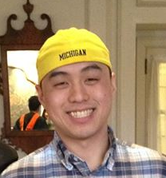
Ho-Zhen Chen
Graduate Student

