Slide 1
Relative Humidity Forecasting
With Deep Recurrent Neural Nets

Slide 2
CONTENT
Problem Overview
Data
Data Pipeline
Model Architecture
Hyper-parameter Tuning
Optimisation
Regularisation
Baseline
Other Works
Further Improvements

Slide 3
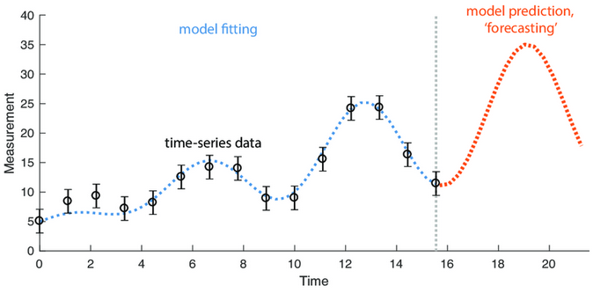
PROBLEM OVERVIEW
Using two weeks worth of data (168 hours) to perform multi-Step forecasting (all 24 hours in the future)
Multiple output strategy chosen a over recursive or direct strategy.

Slide 4
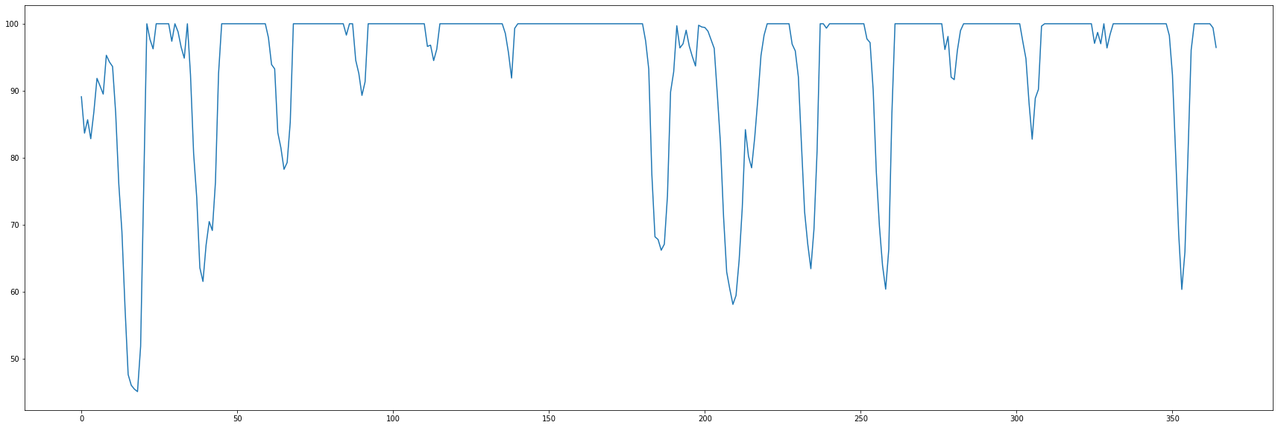
DATA
Weather data collected from US NREL Station 878848 (GMT -6)
22 years of hourly readings compiled into the NSRDB using the PSM model

Slide 5
DATA PIPELINE PART 1
Download CSV from NSRDB website
Load CSV into memory using pd.read_csv()
Normalise using numpy vectorization
Train Split (80-20) followed by a 70-30 Valid/Test Split

Slide 6
DATA PIPELINE PART 2
Setup a tf.data.datasets pipeline
Create windows of 192 steps and split into (168,24)
Create batches of 100 samples each
Prefetch and feed into model.fit()

Slide 7
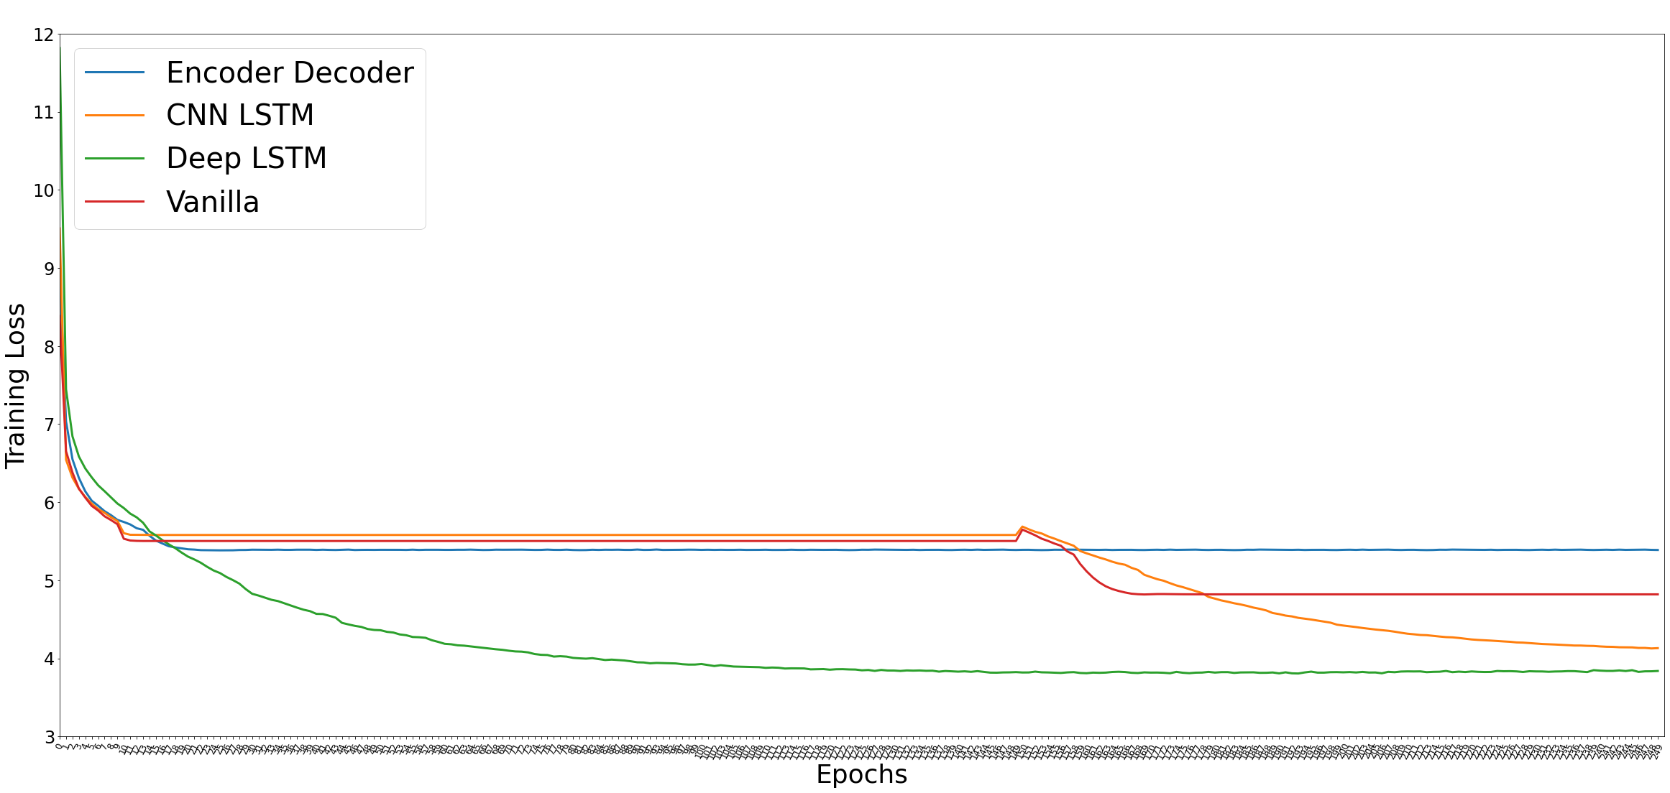
MODEL ARCHITECTURES

Slide 8
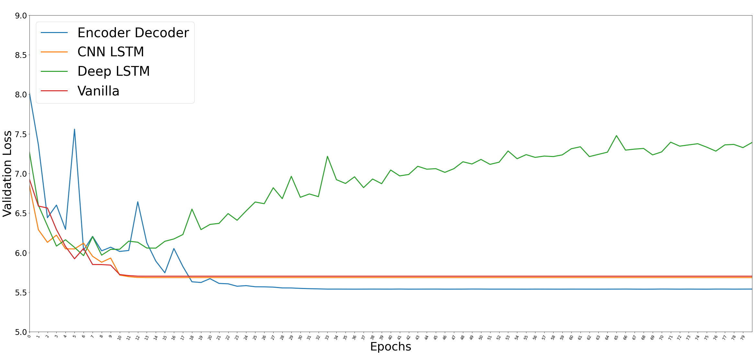
MODEL ARCHITECTURES

Slide 9
MODEL ARCHITECTURES
 | Val MAE | Val MSE | Val MAPE
Encoder Decoder | 5.96 | 90.9 | 9.19
CNN LSTM | 6.12 | 93.0 | 9.51
Deep LSTM | 6.42 | 96.8 | 9.79
Vanilla LSTM | 6.14 | 93.9 | 9.50

Slide 10
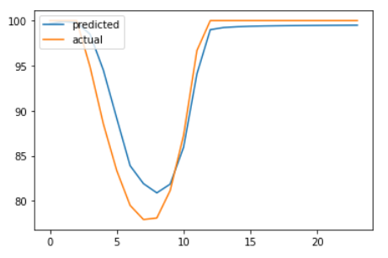
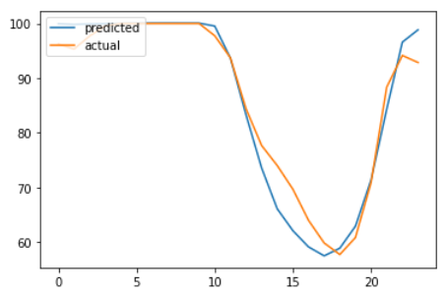
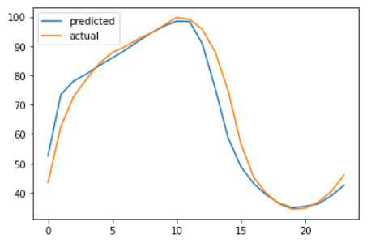
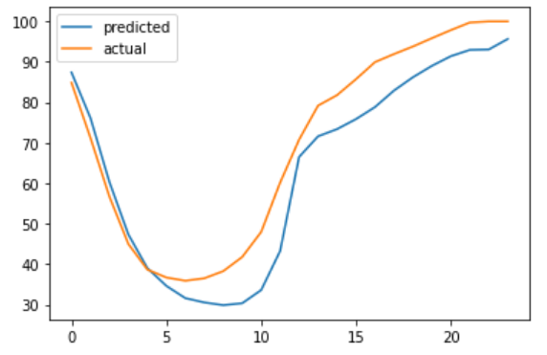
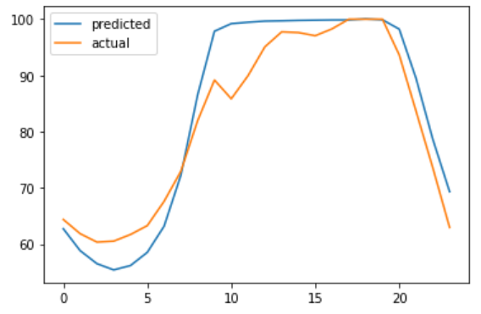
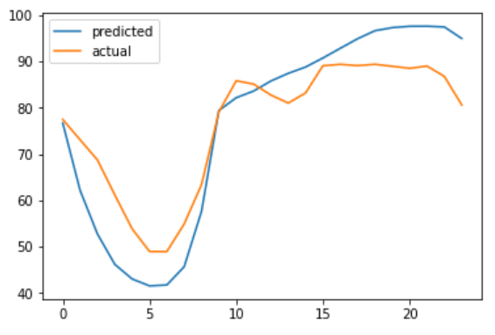
Good Predictions

Slide 11
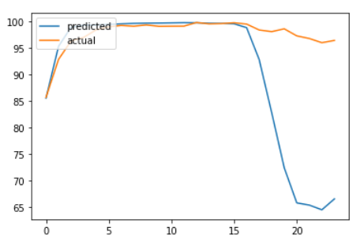
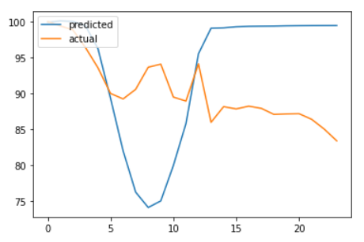
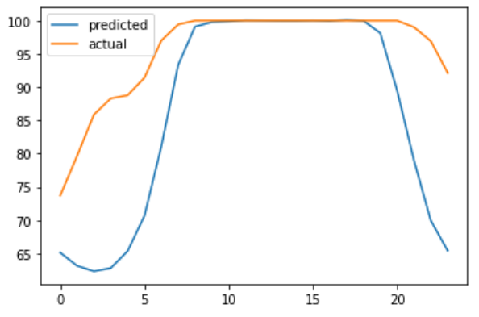
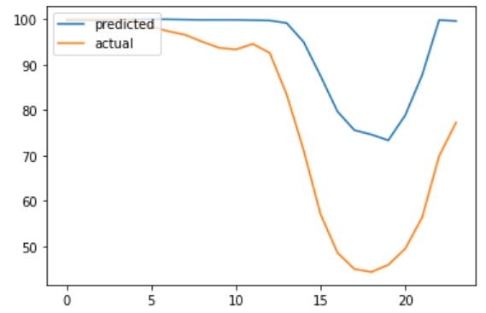
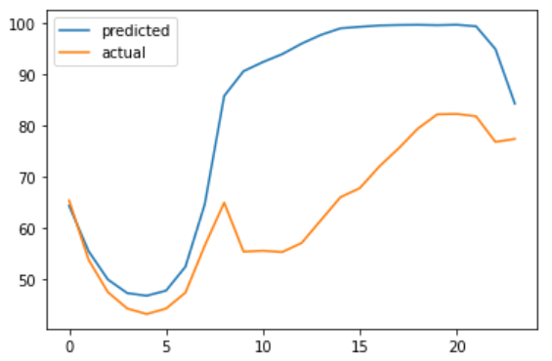
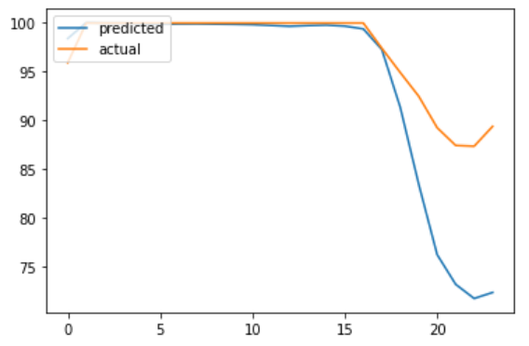
Bad Predictions

Slide 12
HYPER-PARAMETER TUNING
30,000 to 80,000 parameters best for learning without too much overfitting.
Batch sizes below 50 and above 150 increase training time with no noticeable effect on validation performance
Window shift sizes above 1 does not improve validation performance and causes unstable training. There is less training data too.
Window sizes above 168 does not improve performance and increase training time. Popular LSTM discussions recommend 100-500 steps.

Slide 13
OPTIMIZATION
AdamW and Nesterov Adam outperforms SGD and SGD Momentum.
1.0 Clipnorm more effective than step size decay when training loss increases after some epochs
1e-2 is a good rate for the first 2 epochs followed by 1e-3
After 100 epochs, lr is reduced every 15 epochs by a factor a 0.7
Beta 1, Beta 2, not tuned

Slide 14
REGULARIZATION
Batch Normalization
Normalization
Decoupled weight decay (1e-5) using AdamW more effective than L2/L1 layer regularisation
Dropout introduces a lot of noise unless noise shape is specified
Recurrent dropout seem to help, but takes too long to train (no CuDNN)
Reducing network width and increasing depth
Reducing number of parameters and depth is most effective

Slide 15
BASELINE
Performing baseline tests using the test set of 10,000 samples batched into rolling windows of [168,24].
MAE/MSE/MAPE is averaged over all batches.
 | Test MAE | Test MSE | Test MAPE
Encoder Decoder | 5.68 | 79.55 | 8.33
Naive | 18.57 | 633.61 | 28.51
Naive with Trend | 29.52 | 1480.2 | 44.02
Average | 16.38 | 379.42 | 25.89
ARIMA()* | 12.48 | 249.72 | 18.63
*p,q,d found with a zeroth order exploratory optimization algorithm

Slide 16
OTHER WORKS
A Feature Based Neural Network Model for Weather Forecasting [2008]
Multivariate/Univariate %RH prediction
Uses perceptrons with sigmoidal
Best test results: 0.874 r^2
No description of test, problem statement or neural network parameters
Real-Time Weather Monitoring and Prediction Using City Buses and Machine Learning [2020] **
%RH, Temp, Pressure for next 24 hours
Using LSTMs and Dense layers
Best/Worst MAE on test: 2.2 / 5.9
Their work implements a huge and complicated system of sensors using buses to collect local information and compares it to the local Weather station. My work only needs previous data from the weather station. Their test cases are generally linear series’ while my test cases are highly non-linear.

Slide 17
OTHER WORKS
An Improvement Of Backpropagation Performance By Using Conjugate Gradients On Forecasting Of Air Temperature And Humidity in Indonesia [2013]
Standard neural nets
Modified gradient descent using the conjugate gradient method to reduce oscillations in search space
Best test result: 6% MAPE
Only does one step prediction and takes in daily values instead of hourly values which are more prone to noise
Sequence to Sequence Weather Forecasting with Long Short-Term Memory Recurrent Neural Networks [2016]
Deep LSTMs
24 hour and 72 hour multi output predictions of temp, %RH, wind speed
Results uncomparable because they combined all error terms of %RH, wind speed and temp and they did not un-normalize results as well.
Uses Spatial data (9 cities).

Slide 18
OTHER WORKS
An alternative method for predicting relative humidity for climate change studies [2017]
Downscaled GCM minimum temperature
Average RMSE over the year: 2
Only provides predictions of the average of the month per month.
Prediction of Indoor Temperature and Relative Humidity Based on Cloud Database by Using an Improved BP Neural Network in Chongqing
Indoor Temp and %RH prediction
Using standard neural nets
Only provides one step predictions every 10 mins or every 6 hours or every 24 hours based on numerous sensors around the indoor environment. Their work is tested in an environment where %RH only fluctuates around 70%-80%
Prediction of Relative Humidity with Machine Learning by Manouchehr Shokri

Slide 19
OTHER WORKS
Prediction of Relative Humidity with Machine Learning by Manouchehr Shokri [2017]
%RH (one step only)
ANFIS, LSSVM, Standard Neural Networks
Results incomparable as they are not unnormalized

Slide 20
OTHER WORKS
Time Series Forecasting of Univariate Agrometeorological Data: A Comparative Performance Evaluation via One-Step and Multi-Step Ahead Forecasting Strategies. [2021]
Univariate relative humidity SVR
1 day 96 steps best they got was SVR 127.91 mse
My unormalized eval
Mae = 0.0653
Mse = 0.0109

Slide 21
FURTHER IMPROVEMENTS
Recurrent Dropout
Peephole Connection
Relu / Leaky Relu (Gating still remains as Sigmoid)
Multivariate Models (Best Val Result: 75.9 / 5.54 / 8.47%)
Best univariate (Best Val Result: 90.9 / 5.96 / 9.19%)
Multivariate Models with Spatial information

