Slide 1


Database Programming
(Programme : BSCS2:2 )
Mr. Kubanja Martin
Tel: 0782845409
Email : mkubanja@gmail.com
Department of Computing & Technology

Slide 2


This course teaches concepts of development and administration in database systems, building on design concepts taught in a prerequite course (Database design and application. Database development and administration theories, techniques and technologies are explained and implemented to give students the necessary skillset in databases.
Course Description

Slide 3
The Objectives of the Course are to : i.Explain and develop data models using various data modelling techniques. ii.Explain and Implement SQL database programming concepts;DDL,DML,DCL. iii.Implement administrative functions; User management, Transaction Management. iv. Implement various concepts in a database project.
Course Objectives

Slide 4
Upon completion of this course, students should be able to: 1. Apply various data modelling techniques to realise relevant data for real life scenarios. 2. Apply DDL, DML, DCL database programming concepts to a real life project. 3.Apply administrative functions like;Transaction Management, User Management to a real life project. 4. Develop a database project to solve a real life problem.
Learning Outcomes

Slide 5
1. Connolly & Begg. Database Systems: A practical approach to design, implementation and management, 6th Edition, Pearson, 2015 2. Database Systems : Design , Implementation and Management , 12th Edition , Carlos Coronel & Steven Morris. 3.Elmasri & Navathe. Fundamentals of database systems, 7th Edition, Pearson, 2016 3.
Course Outline (Align to major Textbook)

Slide 6
Course Outline
1.Module 1 : Data modelling techniques Week1: ERD, Normalization Week 2: Enhanced ERD Week 3: SQL Concept: DDL( Database Creation, Table creation, Table structure manipulation, Data Insertion, Drop)
2. Module 2: SQL Concepts Week 4: DDL ( Relational Integrity, Table Constraints and Data Validation) Week 5: DML(Data Retrieval, Data Manipulation) Week 6: Multi- Table Queries ( With or without join key word).

Slide 7
Course Outline
3. Module 3:Transaction Management Week 7: Stored Procedures. Week 8: Triggers Week 9: Introduction to User Account.
4. Module 4: User Management Week 10: Security( Priviledges & Roles) Week 11: NoSQL Database Technologies Week 12: Ethical Issues & Project

Slide 8
Data Modeling – ERD Model Technique
In this Chapter , We describe the main techniques for gathering and capturing information about what the users require of a database system.
One of the most difficult aspects of database design is the fact that database designers and end-users tend to view data and its use in different ways.
Unfortunately unless we get a common understanding that reflects how the enterprise operates the design we produce will fail to meet the user requirements.

Slide 9
Designing Systems
Models provide a simplified representation of reality.
Someone should be able to read your design (model) and describe the features of the actual system.
You build models by interacting with the users
Collect user documents . >>Identify objects>> Combining the different datasets and represent them as a data model .
Data Models Notations ( Chens and Crows Foot notation)

Slide 10
Entity-relationship model (ER model)
ER model:
Used to depict graphically a database design before it is actually implemented. ie relationships among system entities
It includes detailed descriptions of
Entity, ( xters of an entity??)
Attributes , Attribute domain , unique identifier , types of key attributes.
Relationships.
Multiplicity Constraints. Refers to the number of times instances in one entity can be related to instances in another entity. ( Denoted by min: max value)

Slide 11
ERD Development Process
Talk with the users to identify the basic forms and reports
Identify the data items to be stored and characteristics associated to the data items.
Select the primary key for each entity
Establish relationships between the entities
Identify any business constraint
.Draw an Entity model

Slide 12
Entity
Is a real-world object distinguishable from other objects. A person, event, or thing about which data is collected
Eg. student, employee, Project etc.
Must be multiple occurrences to be an entity
If available, check the process models for data stores, external entities.
Notes:
12

Slide 13
2. Determine the Attributes
Information captured about an entity
.
Attributes are characteristics that allow users to classify / describe an entity.
Attribute Domain
Set of allowable values for an attribute.
GPA of a student. The domain for an attribute Gender consists of only 2 possibilities M or F.

Slide 14
Add Appropriate Attributes
Identify attributes of the entity that are relevant to the system under development
Check the data requirements of the requirements definition
Interview knowledgeable users
Perform document analysis on existing forms and reports
Check the process model repository entries for details on data flows and data stores
Select the entity’s identifier

Slide 15
Keys
Certain attributes identify particular facts with an entity , these are known as KEY attributes.
Candidate Key
Minimal set of attributes that uniquely identifies each occurrence of an entity type.
Primary Key
Field that is selected to uniquely identify each occurrence of an entity type.
Alternate Key
Candidate keys that are not selected as the primary key
A superkey is a set of attributes within a table whose values can be used to uniquely identify a tuple

Slide 16
Concepts (you should understand)
Key :
Candidate Key,
Primary Key
Foreign Key ,
Alternate Key .
Null values: not applicable, unknown, missing.
Attribute classification
Simple attribute
Composite Attribute
Single Valued Attribute
Multi valued attribute
Derived Attribute

Slide 17
Attributes
Simple Attribute
Attribute composed of a single component with an independent existence. Simple attributes cannot be further subdivided into smaller components. Eg ???
Composite Attribute
-Some attributes can be further divided to yield smaller components with independent existence.
Attribute composed of multiple components, each with an independent existence.
Eg,??

Slide 18
Attributes
Single-valued Attribute
Attribute that holds a single value for each occurrence of an entity type. Eg ? ?
Multi-valued Attribute
Attribute that holds multiple values for each occurrence of an entity type. Eg??
Derived Attribute
Attribute whose value is calculated from other attributes. The derived attribute need not be physically stored within the database.
Eg Employee age can be found by computing an integer value difference of
Current Date- DOB=

Slide 19
Naming and Defining Relationships
An association between entities .Relationship name is a verb phrase.
The first entity in the relationship is the parent entity; the second entity in the relationship is the child entity
Definition explains what action is being taken and why it is important.
eg Supervises or manages

Slide 20
Draw the Relationships
Start with an entity and identify all entities with which it shares relationships
Describe the relationship with the appropriate verb phrase
Determine the multiplicity by discussing the business rules with knowledgeable users

Slide 21
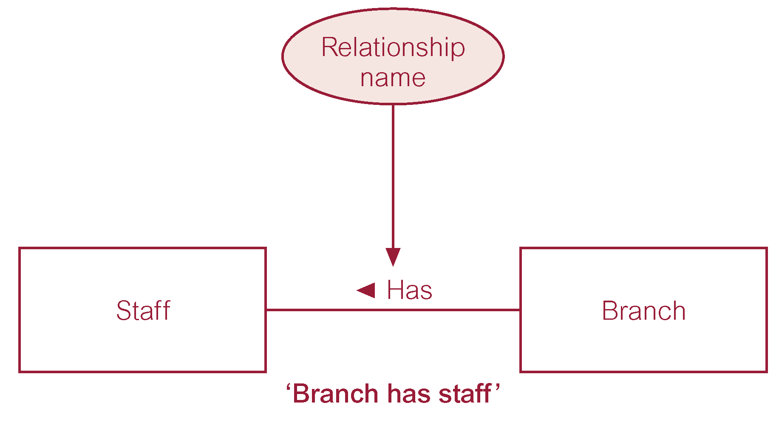
Definition explains what action is being taken and why it is important.
eg Supervises or manages

Slide 22
Relationship Types
Degree of a Relationship
Number of participating entities in relationship.
Relationship of degree :
two is binary
three is ternary
four is
quaternary.

Slide 23
Relationship Types
Degree of a Relationship
Number of participating entities in relationship.
Relationship of degree :
two is binary
three is ternary
four is quaternary.

Slide 24
Binary relationship called Has

Slide 25
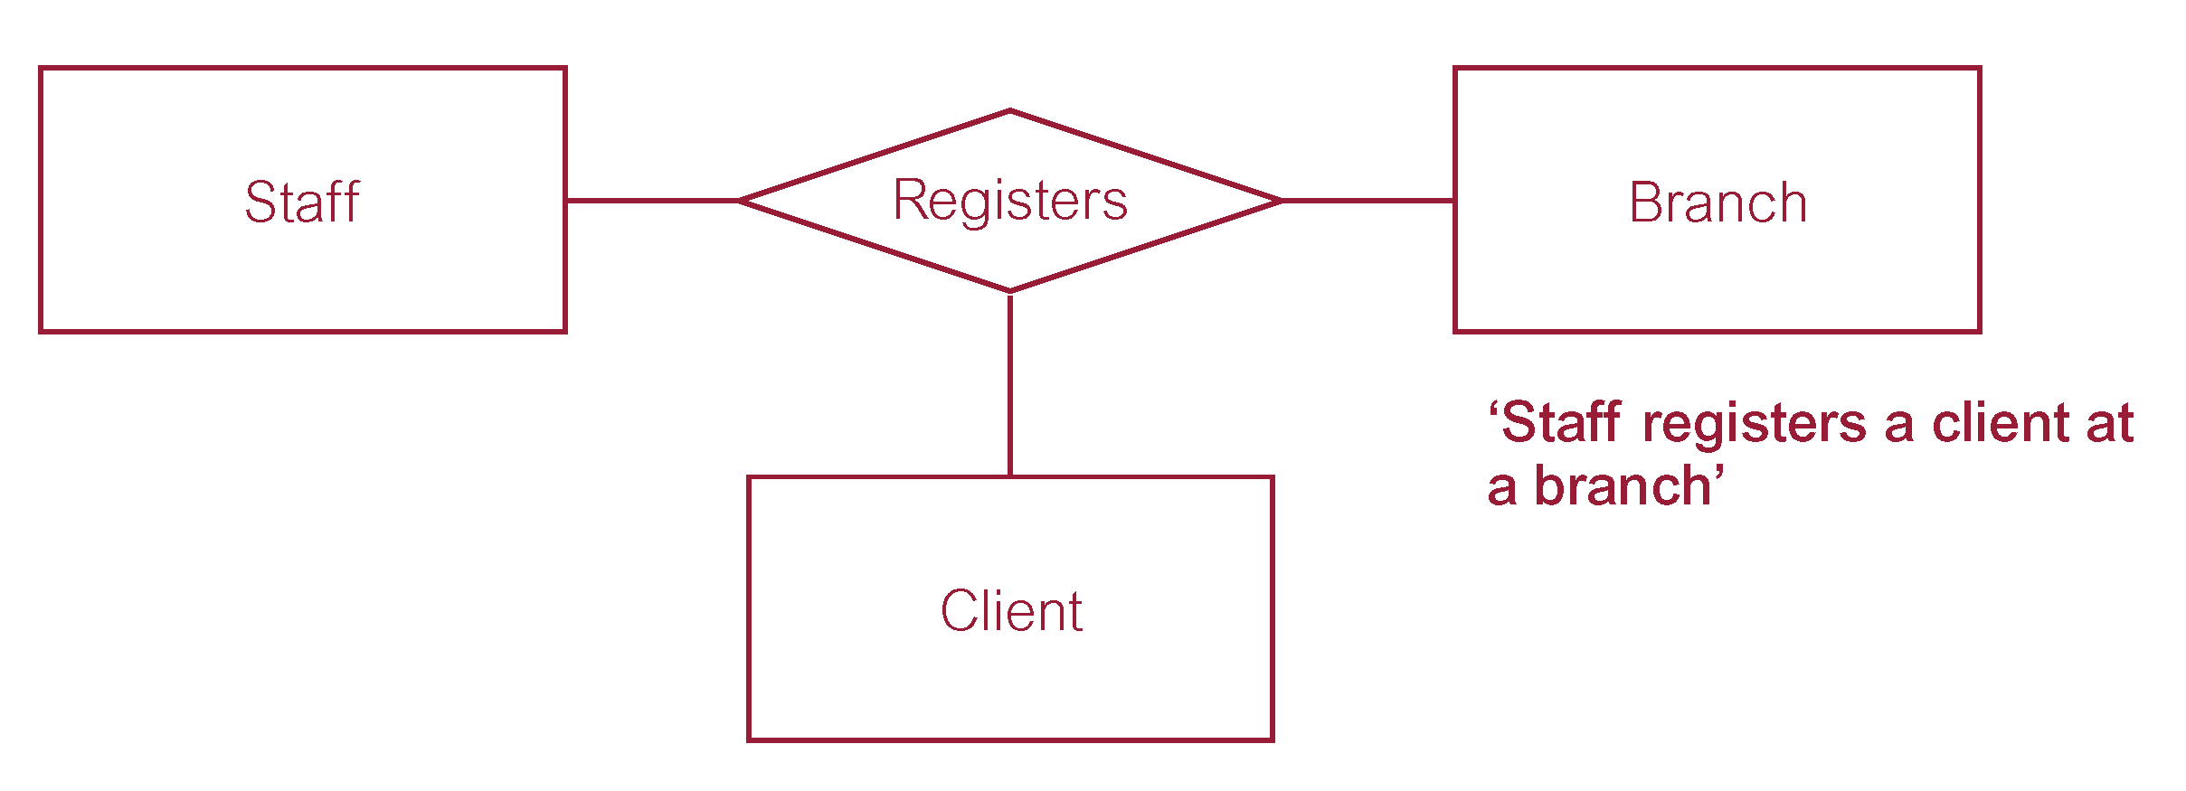
Ternary relationship called Registers

Slide 26
Multiplicity
Refers to the number of times instances in one entity can be related to instances in another entity
One instance in an entity refers to one and only one instance in the related entity (1:1)
One instance in an entity refers to one or more instances in the related entity (1:M)
One or more instances in an entity refer to one or more instances in the related entity (N: M)
. In ERD multiplicity is indicated by placing the appropriate numbers beside the entities using the format ( x,y).
x – minimum value, y – Maximum Value

Slide 27
Multiplicity.
. In ERD multiplicity is indicated by placing the appropriate numbers beside the entities using the format ( x,y).
x – minimum value, y – Maximum Value
An example of a one to many relationship is when an employee can work for only one department, and a department can have many employees

Slide 28
Multiplicity of a Relationship.
. In ERD cardinality is indicated by placing the appropriate numbers beside the entities using the format ( x,y).
x – minimum value, y – Maximum Value
An example of a one to many relationship is when an employee can work for only one department, and a department can have many employees

Slide 29
MULTIPLICITY
A department employs many persons. A person is employed by, at most, one department.
A team consists of many players the atmost number being 18. A player plays for only one team.
An teacher may teach many course units but the at most number of course units taught are 4 . A course unit is taught by a teacher or many teachers

Slide 30
Question 1
What is the multiplicity of each of the following relationships in just the direction given? State any assumptions you have to make.
Player to team
Student to course

Slide 31
CONCLUSION
The whole point about this chapter is “Given a dataset, how does one comeup with (i.e Design and formulate) entities and relationships and cardinalities between the different entities based on the business processes and needs of the organisation for which they are designing the database.

