Slide 1
ANL488 Project Presentation Prediction of Corporate Bankruptcy with Decision Trees
Ho Zhong Ta Benjamin
W1711125
January 2021

Slide 2
Scope
Problem Statement
Overview
Data Understanding
Data Preparation/Transformation
Data Modeling
Results/Evaluation
Discussion
Conclusion
Notes:
Overview (what)
Business logic why
how

Slide 3
Problem Statement
To review and address issues with existing corporate bankruptcy prediction methods and to propose the use of decision tree models to predict corporate bankruptcy
Notes:
Summary slide
Elaborate on issues *spend first 3 minutes on this

Slide 4
Overview – Defining Corporate Bankruptcy
What is Corporate Bankruptcy?
Company unable to repay debt as it falls due
Usually in default or financially insolvent
Legal way of resolving company financial problems
Who does it affect?
Shareholders
Economy
Creditors
How does it affect?
Shareholders: Loses investment
Creditors: Unable to recover bond/loan
Economy: Bank interest rate increase, rising unemployment rates
Notes:
Thus, it is imperative to predict corporate bankruptcy prior to its occurrence

Slide 5
Overview – Current Predictive Methods
Statistical models
E.g., Discriminant Analysis / Altman Z-score
Machine Learning (ML) models
E.g., Support Vector Machines (SVM) / Neural Network (NN)
Data frequently used:
Financial ratios of bankrupt/non-bankrupt firms

Slide 6
Overview – Issues with Current Methods
Issues with statistical models
Generally lower predictive capability than ML models
Several statistical assumptions required
E.g., assumption of normality
Issues with ML models
Considered as “Black Box” models
Refers to models which provides approximation without any further insights to the formula or function used to derive the approximation
More advanced models such as NN require deep understanding of model prior to deployment

Slide 7
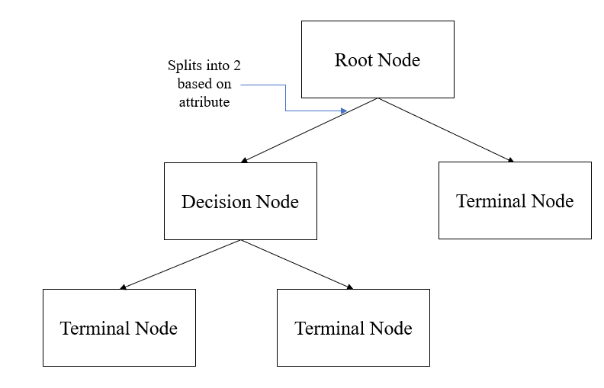
Overview – Proposed Model
Proposed Model: Decision Tree (DT) model
Advantages:
Better predictive capabilities than conventional statistical models
In several studies, able to produces better results than NN/SVM models
More explainable than SVM/NN models
Able to adapt to non-linear data
No statistical assumptions required

Slide 8
Data Understanding
Source of Data Collection:
FactSet Research Systems
Type of data collected:
Financial ratios of companies in energy sector
Current status of said companies (bankrupt/non-bankrupt)
Duration of data:
2011 to 2018

Slide 9
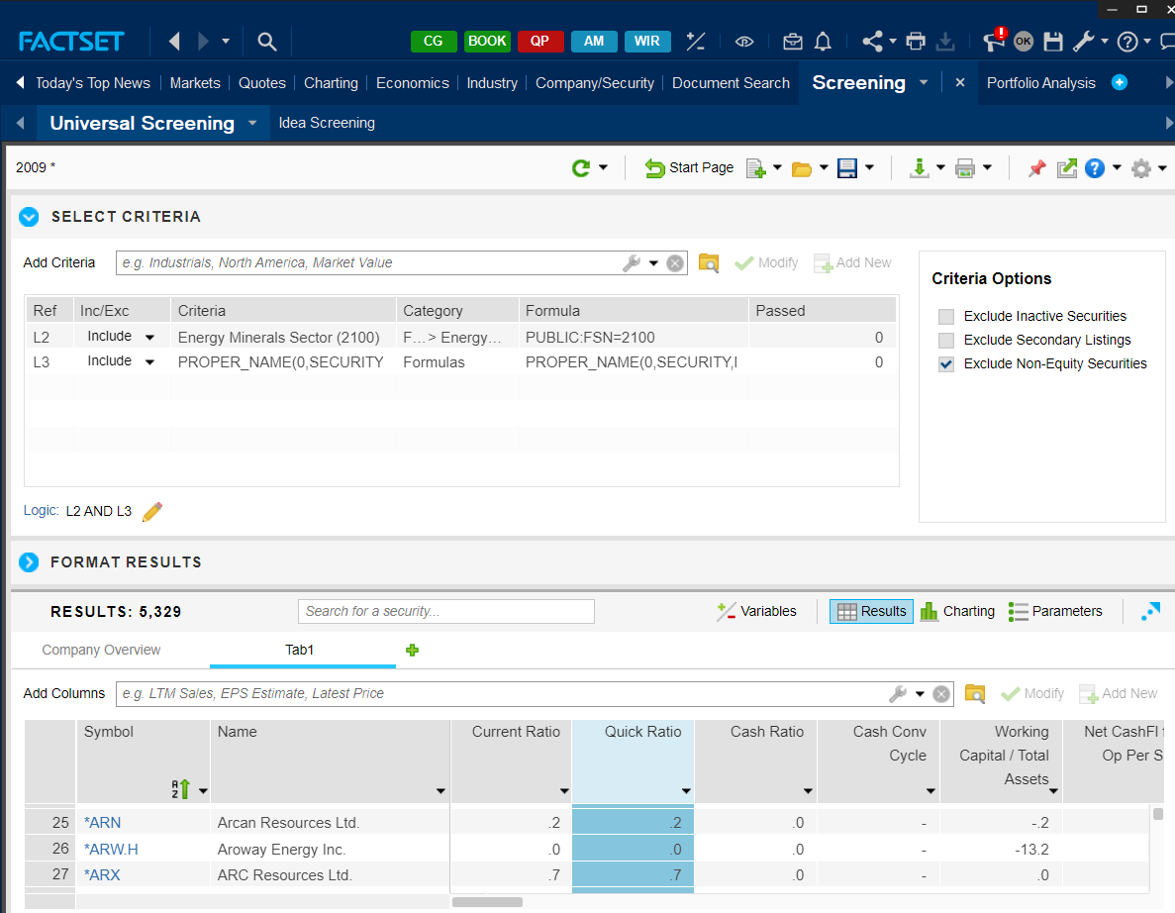
Data Understanding

Slide 10
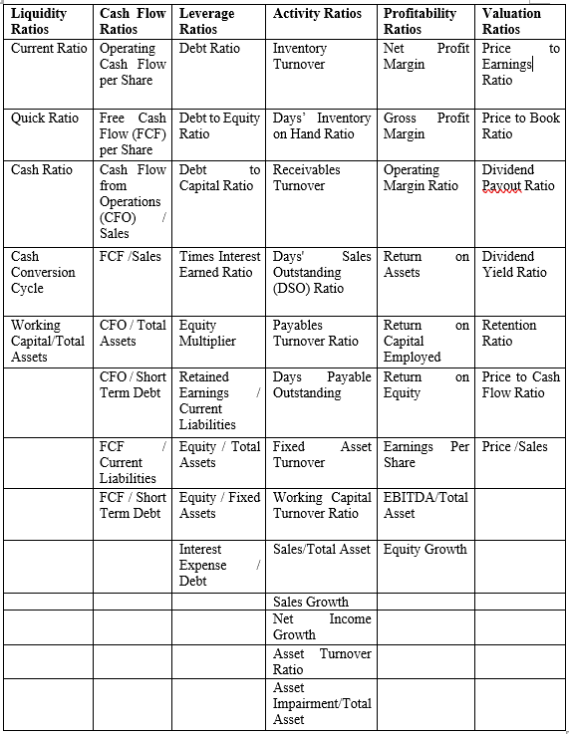
Data Understanding

Slide 11
Data Understanding
Sector in Focus: Energy (Oil/Gas) Sector
3 main types of companies
Upstream (Exploration)
Midstream (Transportation/Storage)
Downstream (Refining/Processing)
Rationale for choice:
Alarming high rates of corporate bankruptcy
Highest global default rates since 2014 (source: S&P Global Ratings)

Slide 12
Data Understanding – Issues
Data Quality
Incomplete data due to lack of information available
All 51 fields have presence of missing value throughout the dataset
13 columns had more than 70% incompleteness
Data Formatting
Target variable not recoded to 0 and 1
Presence of columns not required for analysis (Year/Name)
Imbalanced Data
Only approximately 7.42% bankrupt cases

Slide 13
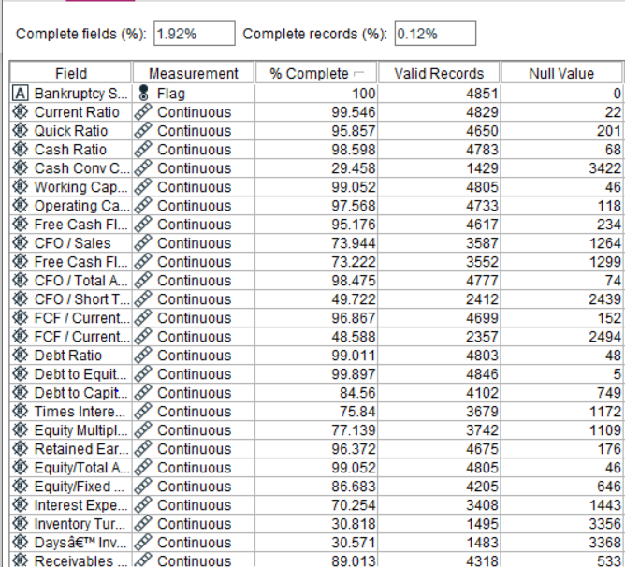
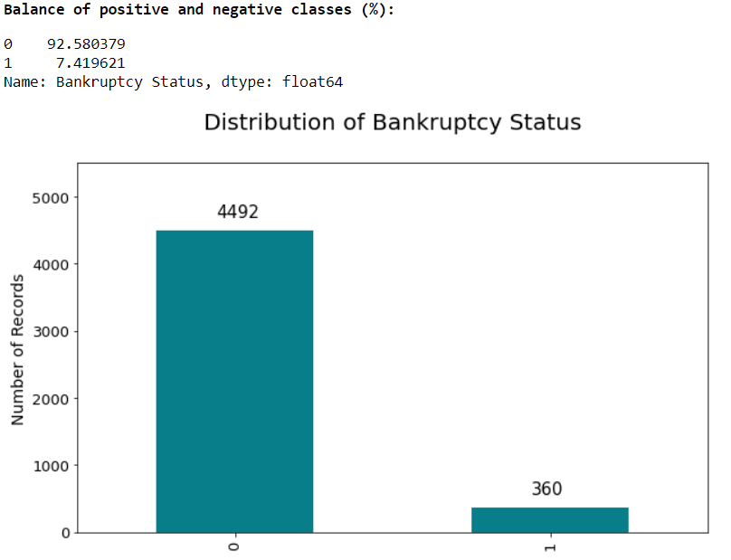
Data Understanding – Issues

Slide 14
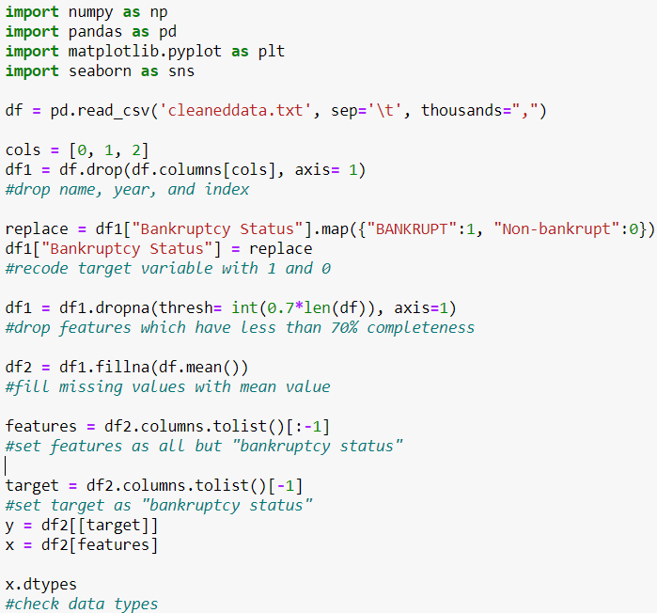
Data Preparation/Transformation
Dropping of columns not used for analysis (year, name, symbol)
Recoding of Bankruptcy Status to 0/1
Dropping of columns with less than 70% completeness
Filling null values with column’s mean value
Split into Training/Test set
Testing Set (20%)
Training Set (80%)
Export to .csv
Export to .csv
Sampling using ADASYN
Data Modelling
(in IBM SPSS Modeler)

Slide 15
Data Preparation/Transformation
Issues with conventional sampling approaches
Oversampling
Replicates minority class data points
Learns very specific regions of minority classes as the points get more prominent
Thus, leading to possible overfitting of model
Undersampling
Randomly selects and reduces the amount of majority class data points
Allowing minority classes to be more prominent, thus reducing bias
Causes loss of data due to the disposal of majority class data
Lesser amount of data might lead to deprivation of model learning performance

Slide 16
Data Preparation/Transformation –Adaptive Synthetic (ADASYN) Sampling
Type of synthetic sampling approach
Overcomes imbalanced data by artificially generating minority class samples
Inspired by Synthetic Minority Oversampling Technique (SMOTE) technique
Uses weighted distribution of minority class samples based on their difficulty to learn
Generates more minority class samples which are harder to learn
Benefits
Reduces bias created by class imbalance
Shifts the classification decision boundary adaptively towards difficult to learn samples
Thus, predictive models will be able to classify minority classes better
Undersamples majority class data to allow better predictive model performance

Slide 17
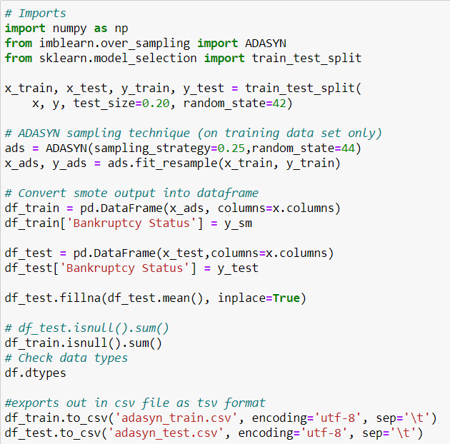
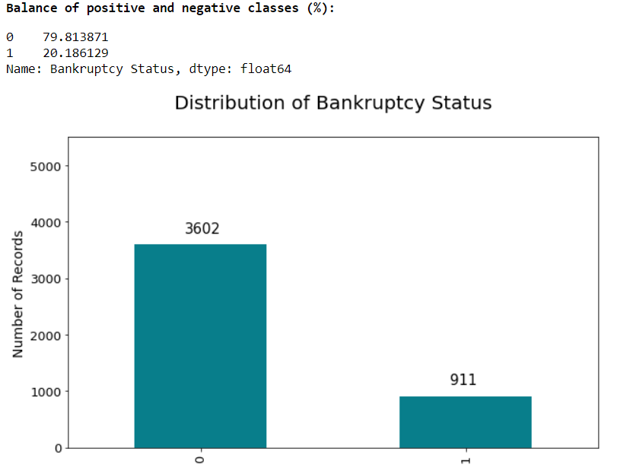
Data Preparation/Transformation

Slide 18
Data Preparation/Transformation
 | Initial Dataset | Training Dataset | Testing Dataset
Non-bankrupt | 4,492 | 3,602 | 890
Bankrupt | 360 | 911 | 81
Total | 4,852 | 4,513 | 971

Slide 19
Modelling
Proposed model: Decision Trees
Algorithm to be used: CART, CHAID, C5.0, Quest
Comparison models: Logistic Regression/Neural Network
Software used: IBM SPSS Modeler

Slide 20
Modelling – Model Settings
For DT:
Pruning settings activated (for algorithms with pruning settings)
Misclassification costs set at 5.0 for False Negatives
For Logistic Regression:
Binomial Procedure
Method: Forwards Stepwise
Removal Criterion: Likelihood Ratio
For Neural Network:
Model: Multilayer Perceptron (MLP)
Number of hidden layers: 1
For DT:
Pruning settings activated (for algorithms with pruning settings)
Misclassification costs set at 5.0 for False Negatives
For Logistic Regression:
Binomial Procedure
Method: Forwards Stepwise
Removal Criterion: Likelihood Ratio
For Neural Network:
Model: Multilayer Perceptron (MLP)
Number of hidden layers: 1

Slide 21
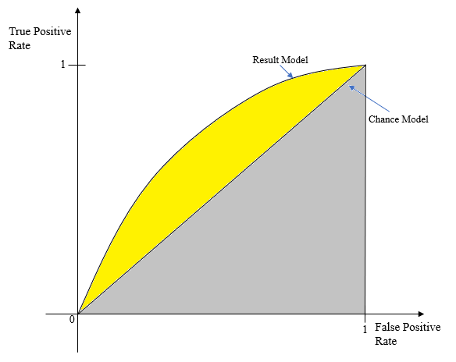
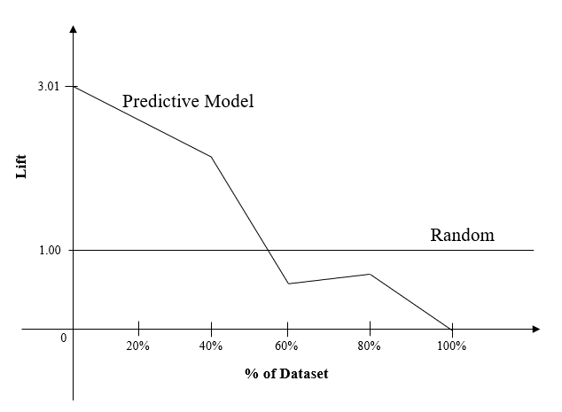
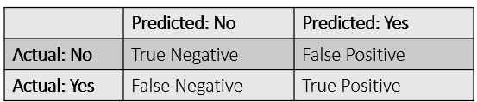

Results/Evaluation – Evaluation Methods
Recall (Sensitivity)
AUC
Lift Charts
Sensitivity (Recall)
AUC
Lift Charts

Slide 22
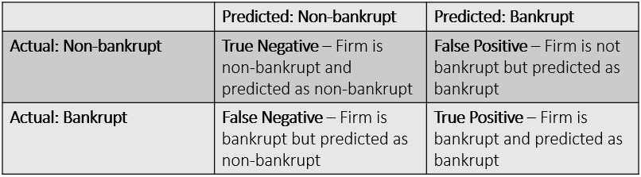
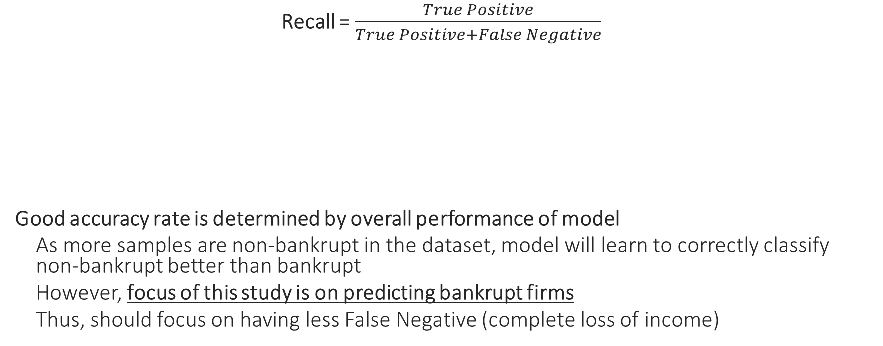
Results/Evaluation – Evaluation Methods
Recall = $\frac{True Positive}{True Positive+False Negative}$
Good accuracy rate is determined by overall performance of model
As more samples are non-bankrupt in the dataset, model will learn to correctly classify non-bankrupt better than bankrupt
However, focus of this study is on predicting bankrupt firms
Thus, should focus on having less False Negative (complete loss of income)

Slide 23
Results/Evaluation – Evaluation Methods
Area under the ROC curve (AUC)
Summary statistics of ROC curve
Used to compare performance of
predictive models
Ranges from 0 to 1
Determines if resulting model is able to
produce a model better than a chance
model
Notes:
1 = True positive 100% of the time
0 = False positive 100% of the time

Slide 24
Results/Evaluation – Evaluation Methods
Lift Chart
Used to compare performance of
models predicting the same variables
Random model will have the same lift
throughout the dataset
Notes:
1 = True positive 100% of the time
0 = False positive 100% of the time

Slide 25
Results/Evaluation – DT
Comparison of DT algorithms
 |  | Recall | AUC | Accuracy (for reference)
CART | Training | 93.74% | 0.887 | 84.89%
 | Testing | 82.72% | 0.837 | 82.80%
C5.0 | Training | 99% | 0.944 | 90.41%
 | Testing | 93.83% | 0.933 | 89.29%
CHAID | Training | 87.49% | 0.945 | 86.55%
 | Testing | 76.54% | 0.918 | 84.65%
QUEST | Training | 75.02% | 0.761 | 68.14%
 | Testing | 70.37% | 0.699 | 65.71%

Slide 26
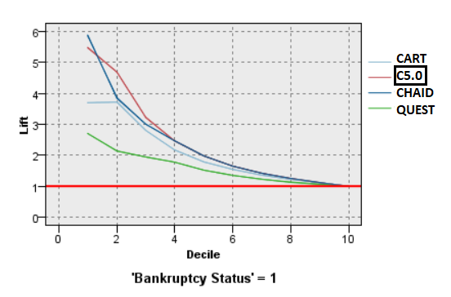
Results/Evaluation – DT
Comparison of DT algorithms

Slide 27
Results/Evaluation – Comparison
Comparing C5.0 DT with NN and Logistic Regression
 |  | Recall | AUC | Accuracy (for reference)
Logistic Regression | Training | 7.24% | 0.685 | 80.12%
 | Testing | 3.70% | 0.575 | 91.25%
NN | Training | 67.95% | 0.934 | 89.79%
 | Testing | 53.09% | 0.882 | 91.14%
C5.0 | Training | 99% | 0.944 | 90.41%
 | Testing | 93.83% | 0.933 | 89.29%

Slide 28
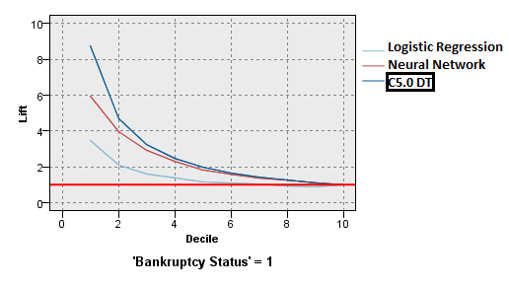
Results/Evaluation – Comparison
Comparing C5.0 DT with NN and Logistic Regression

Slide 29
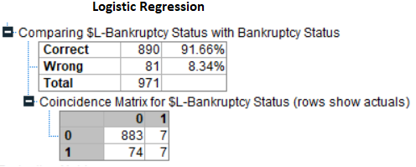
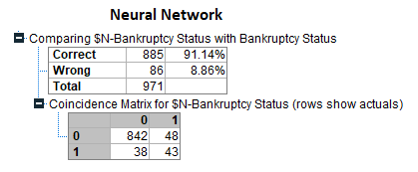
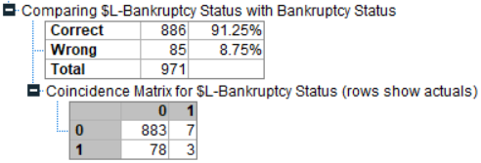
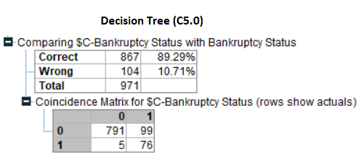
Results/Evaluation

Slide 30
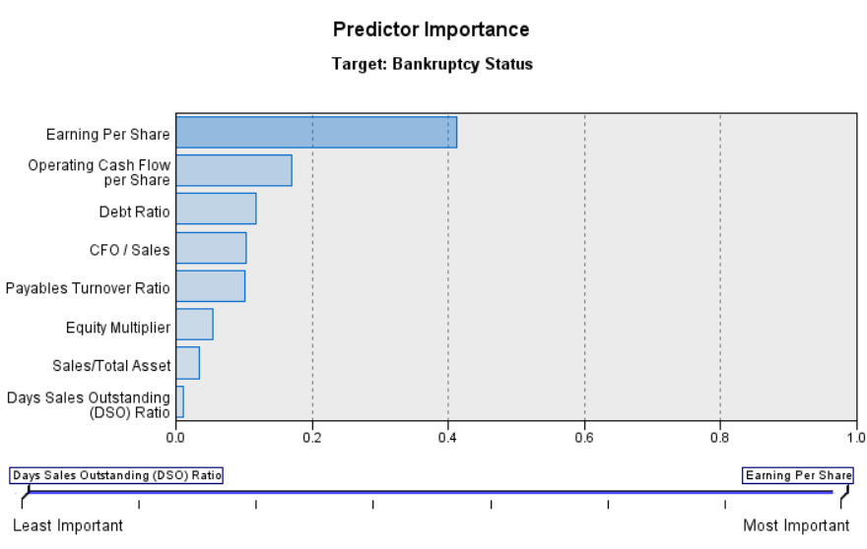
Discussion

Slide 31
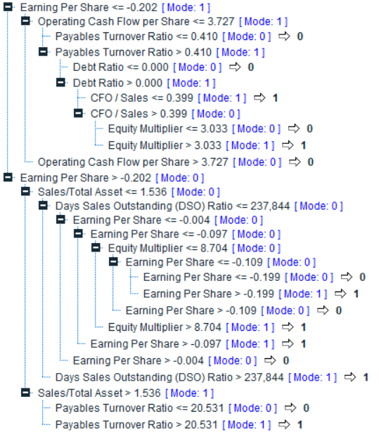
Discussion – Observations
More likely to be bankrupt
Lower Earning per Share
Lower Operating Cash Flow per Share
Lower Cash Flow from Operations over Sales
Higher Debt Ratio
In some rare cases, firm that have good financial ratios still ended up being bankrupt
More important predictors is able to better determine if the firm will be bankrupt

Slide 32
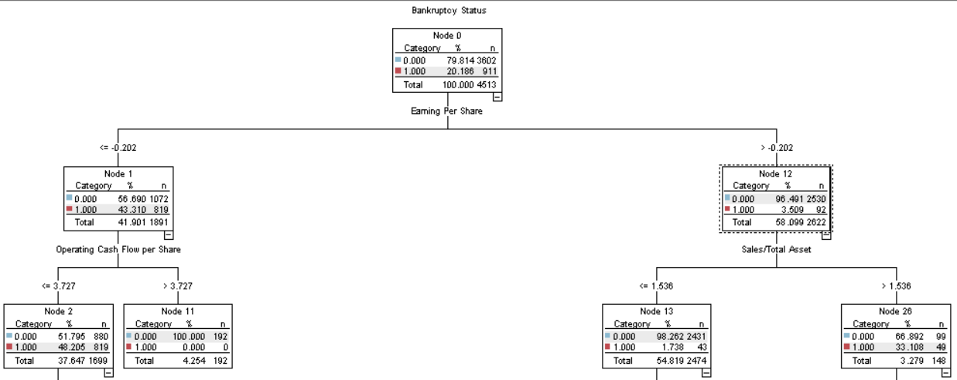
Discussion – Observations

Slide 33
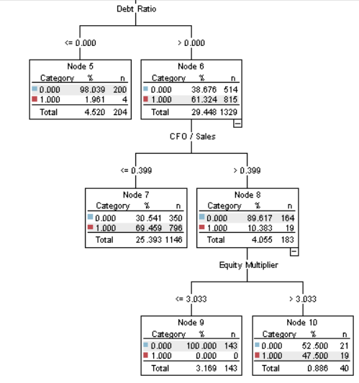
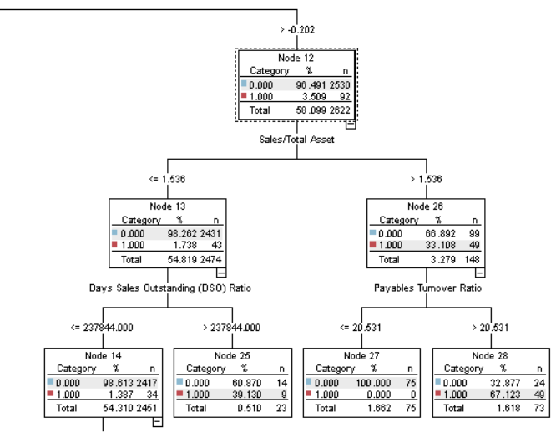
Discussion – Observations

Slide 34
Discussion
DT is most optimal for this use case
Least frequent occurrence of False Negative cases
Top 3 factors that are important in predicting corporate bankruptcy
Earnings per Share
Debt Ratio
Neural Network has higher accuracy but significantly lower recall
DT able to assign misclassification cost
NN unable to assign misclassification cost
Operating Cash Flow per Share
DT is most optimal for this use case
Less frequent occurrence of False Negative cases
Neural Network has higher accuracy but significantly lower recall
DT able to assign misclassification cost
NN unable to assign misclassification cost
Top 3 factors that are important in predicting corporate bankruptcy
Earnings per Share
Debt Ratio
Operating Cash Flow per Share

Slide 35
Conclusion
DT model is able to better predict corporate bankruptcy than Logistic Regression models or NN models
Limitations:
Unable to determine current state of economy during the bankruptcy years
Further studies:
Consider using random forest, bagging or boosting techniques to further improve model performance
Consider using features which are external to companies
E.g. economic factors of country of origin, tax rates etc.

Slide 36
Thank you! Q&A

