Slide 1
FROG OS
BY APAS.AI
The operating system for the people accountable for water.
Fats, rags, oils, and grease cost the County every month. FROG OS sees FOG before it costs, on data Miami-Dade already owns.
01 / 14

Slide 2
01 · THE PROBLEM
02 / 14
Grease costs Miami-Dade millions every year.
→
→
STAGE 1
STAGE 2
STAGE 3
$1.6B
FOG
FROG
FATBERG
Fats, oils, and grease harden inside the pipe.
Picks up rags and wipes. Strains and jams the pumps.
Blocks the main. Overflows into Biscayne Bay.
The federal consent decree Miami-Dade signed to stop sanitary sewer overflows.
Every blockage is paid for twice: the crew that clears it, and the overflow it causes when the crew is late.
CLEANUP · PAID EVERY MONTH
OVERFLOWS · INTO THE BAY
PENALTIES · FEDERAL OVERSIGHT
APAS.AI · FROG OS

Slide 3
02 · THE REAL PROBLEM
03 / 14
Grease is a symptom. The County's data cannot see it.
The answer sits in systems that do not talk.
Permits
×
Manifests
×
Inspections
×
SCADA
×
GIS
DERM
560 HAULERS
PAPER TRAIL
PUMP STATIONS
WASD
DIFFERENT DEPARTMENTS · DIFFERENT VENDORS · DIFFERENT FORMATS · NO SHARED RECORD
INFOBESITY
THE CONSEQUENCE
More data every year. Less sight.
You cannot be proactive while chasing symptoms.
APAS.AI · FROG OS

Slide 4
03 · WHY NOW
04 / 14
AI amplifies whatever it stands on.
The answer already sits in the County's own Open Data Portal. The gap is ungoverned data.
Govern it first, and AI becomes something a utility can trust.
DATA BEFORE AI
SOURCE · MIAMI-DADE OPEN DATA PORTAL

Slide 5
04 · THE SOLUTION
05 / 14
FROG OS follows the substance.
KITCHEN
INTERCEPTOR
HAULER
MANIFEST
PUMP STATION
PLANT
DIGITIZE THE SOURCE
ATTRIBUTE THE RISK
RANK BY RECOVERABLE COST
Every permitted food-service facility, hauler manifest, and inspection, in one place.
Grease risk lands on its real source, restaurant or residence, not on a guess.
Chronic stations ranked by what enforcement can actually recover, on a record that holds up.
NO NEW INFRASTRUCTURE · RUNS ON DATA THE COUNTY ALREADY OWNS
APAS.AI · FROG OS

Slide 6
05 · HOW IT WORKS
06 / 14
Any data in. Deterministic answers out.
01
Normalize
Any vendor, any format, structured or unstructured. The patent-pending method makes it one language.
HIGH CONFIDENCE
Read the permit
Matched the manifest
02
Govern
Flagged the anomaly
Cleansed and anomaly-flagged, then joined into one connected model: restaurants and homes through pipes and manholes to pump stations and the plant.
Ranked the station
EVERY ANSWER TRACES TO ITS SOURCE
03
Decide
Predictive risk, ranked by recoverable cost. Every inference computes the same way each time.
APAS.AI · FROG OS

Slide 7
06 · PROOF
07 / 14
Live today on real Miami-Dade data.
FACILITY CORPUS
RECONCILIATION
LIVE · PUMP NETWORK
9,000+
~213K
19
Permitted food-service facilities, the full County corpus, ingested from the Open Data Portal.
Manifest line-items resolved by the deterministic reconciliation engine.
Opa-locka pump stations streaming SCADA and manhole smart-cover data.
PILOT PARTNER
METHOD
EVIDENCE-GRADE BUILD
Letter of support
Patent-pending
Audit-ready
Airia Austin, Director, Opa-locka Public Works and Utilities. June 1, 2026.
The One Water intelligence module: normalize, cleanse, attribute, and trace any data.
Role-based access, step-up sign-off, immutable hashed notices, append-only audit log. W3C and ISO grounded.
APAS.AI · FROG OS

Slide 8
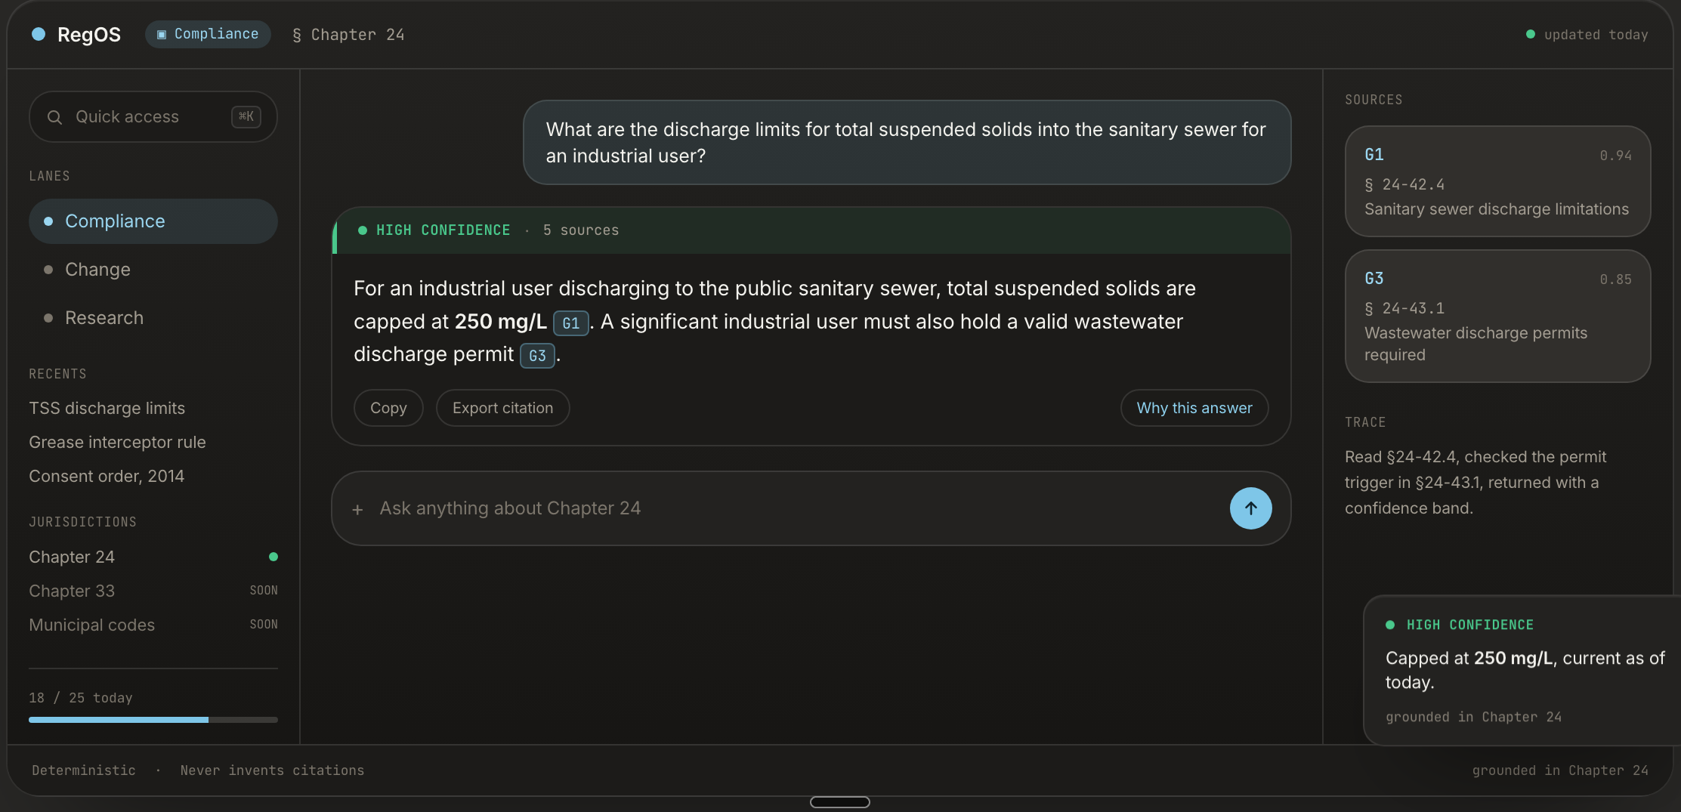
07 · THE PLATFORM
08 / 14
Fund the wedge. Inherit the platform.
THE WEDGE
THE NETWORK
THE CODE
THE PIPES
FROG OS
PUMP OS
REGOS
PIPE OS
The source side. Permits, manifests, inspections.
The network side. Live SCADA and smart covers.
Regulation as code. Chapter 24, DERM. Chapter 32, WASD.
The pipe layer, prototyped in the pilot.
● LIVE
● LIVE · 19 STATIONS
○ NEXT
● LIVE · REGOS.AI
One data thread. Every OS reads the same governed model, so a grease source and the pump downstream of it are one signal.
The $100K funds the wedge. The County inherits the platform that makes any utility AI-ready.
REGOS · LIVE PRODUCT · REGOS.AI
APAS.AI · FROG OS

Slide 9
08 · MARKET
09 / 14
Every large county runs this same program.
Restaurants, haulers, and inspectors on paper. A utility paying to clear blockages. Miami-Dade is the beachhead, not the market.
NOW
Miami-Dade
9,000 LOCATIONS · 560 HAULERS
NEXT
US wastewater utilities
EVERY MAJOR FOG PROGRAM
THEN
The full One Water stack
DRINKING WATER · WASTEWATER · STORMWATER
BUYERS · PUBLIC UTILITIES · GOVERNMENT AGENCIES · THEIR ENGINEERING + CONSULTING FIRMS
APAS.AI · FROG OS

Slide 10
09 · BUSINESS MODEL
10 / 14
Priced against the cost it removes.
01 · SUBSCRIPTION
02 · INCENTIVE LAYER
Platform, sold to agencies
Self-funding option
Green-restaurant recognition businesses opt into, funded by permit revenue the County already collects. No new County money.
DERM and WASD subscribe. Priced against the operating cost the platform removes.
Runs on existing cloud and County data, so marginal cost stays low. Restaurants can opt into verified-waste monetization later.
CAPITAL-EFFICIENT
APAS.AI · FROG OS

Slide 11
10 · TEAM
11 / 14
The founders ran the very agencies this serves.
HA
RO
SA
Hardeep Anand
Rudy Ortiz
Simi Anand
FOUNDER & CEO
CO-FOUNDER
PRODUCT & GO-TO-MARKET
30+ years. Permitting, compliance, and the $8.5B capital program at Miami-Dade DERM and WASD. County One Water Director. Fort Lauderdale Public Works Director.
Founder and CEO of CES Consultants. 40+ years across construction, water, wastewater, stormwater, and engineering.
Technology entrepreneur. Leads marketing and go-to-market across the OS family.
REGULATOR · OPERATOR · PRIVATE SECTOR · ENGINEERING · TECH
APAS.AI · FROG OS

Slide 12
11 · IMPACT & VISION
12 / 14
From reactive cleanup to predictive utilities.
A single avoided sewer overflow can pay for the year.
WE TRACK
Overflows prevented
Everything else is upside, reported as ranges against WASD's own baseline, never false precision: staff-hours returned, pump energy down, pump life extended, education targeted by basin.
Grease kept out of Biscayne Bay
The aspiration is AI-ready cities, governments, and utilities. Education is a cornerstone, carried by the One Water Foundation: government, vendors, consultants, academia, and nonprofits at one table.
Cost avoided
APAS.AI · FROG OS

Slide 13
12 · THE ASK
13 / 14
$100K and 6 months.
$100K
PHASE 1 · MO 1-2
Normalize the basin
Permits, manifests, inspections, and pump data into one model. Record the County's cost baseline.
MDIA equity investment
+ 4 TO 6 MONTH WASD / DERM PILOT
PHASE 2 · MO 3-4
Attribute and rank
PICK A BASIN · WE CONNECT IT END TO END
FOG risk lands on its real source. Chronic stations ranked by recoverable cost.
ALMOST NO STAFF TIME
PHASE 3 · MO 5-6
Close the loop
One build item: the production host service for notice, validation, and audit tools. Plus certification of one sensor vendor, SmartCover.
Full path from kitchen to plant. Pipe OS prototyped. Weekly dashboard and ROI readout.
APAS.AI · FROG OS

Slide 14
FROG OS
BY APAS.AI
The County already owns the data.
FROG OS sees FOG before it costs.
APAS.AI
·

