Slide 1
CNN Model & API to Classify CIFAR10 Images
Hong Pan
Notes:
Please enter project details and your details here.

Slide 2
Outline
Problem and Data Set
CNN Model Building
Hyper-Parameter Tuning
Plot & Interpretation
Model Comments
API

Slide 3
Problem and Data Set
Problem: Multinomial classification
Using CNN to classify images
Data Set: CIFAR10
Training set: 40,000 (0.8)
Validation set: 10,000 (0.2)
Test set: 10,000
Image vector shape: (d, height=32, width=32, rbg=3)
Output Labels: 10 classes ['airplane','automobile','bird','cat','deer','dog','frog','horse','ship','truck']
Notes:
User Experience

Slide 4
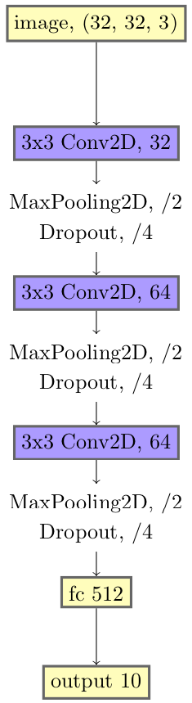
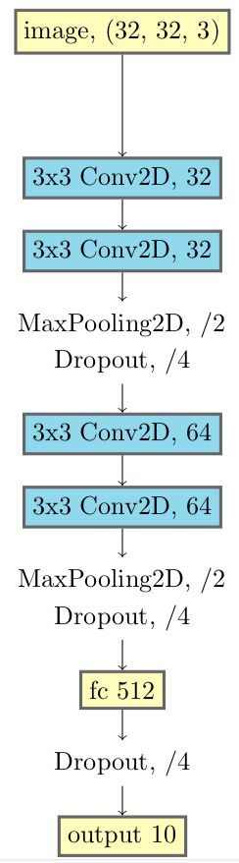
CNN Model Building
Model 1: LeNet5^{[1]}
3 Conv2D layers
Score=0.77
Optimizer:
adam (lr=0.001)
Metrics:
accuracy
Loss:
categorical_crossentropy
Model 2: Stacked^{[2]}
4 Conv2D layers
Score=0.78
Data Augment
Score=0.84
[1]. Y. LeCun, L. Bottou, Y. Bengio, P. Haffner, et al. Gradient-based learning applied to document recognition. Proceedings of the IEEE, 86(11):2278–2324, 1998.
[2]. Keras. Train a simple deep cnn on the cifar10 small images dataset, Online, 2019
Notes:
Talk about your database, what schema you used and what data you used

Slide 5
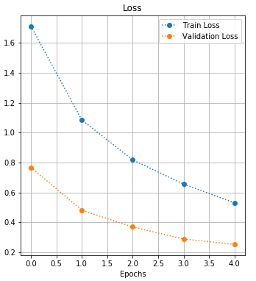
Pre-trained Models
Train CIFAR10 on ResNet50^{[5][6]} from Scratch
5 epochs
train_acc=0.869
val_acc=0.928
test_acc (score)= 0.933
25 mins per epoch (one GPU on Colab)
Transfer Learning on VGG16^{[7]}
10 epochs
Train_acc=0.87, val_acc=0.8, score=0.55
Data augmentation
[5]. K. He, X. Zhang, S. Ren, and J. Sun. Deep residual learning for image recognition. In Proceedings of the IEEE conference on computer vision and pattern recognition, pages 770–778, 2016.
[6]. A. Dabydeen. Transfer learning using resnet50 and cifar-10, 2019.
[7]. D. Sarkar. A comprehensive hands-on guide to transfer learning with real-world applicationsin deep learning, 2018.

Slide 6
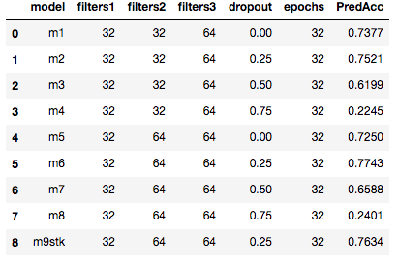
Hyper-Parameter Tuning
Grid search
Epoch:
(5, 32, 64),
key factor, 32 chosen
Dropout rate:
(0, 0.25, 0.5, 0.75)
key factor, 0.25 the optimal
Number of filters:
(32, 64)
Stacked or not
Best: 32, 0.25, (32,64,64)
Notes:
Explain your Azure features here

Slide 7
Training & Validation Accuracy/Loss

Slide 8
Plot: Confusion Matrix & F1 Score
Notes:
Advanced features…

Slide 9
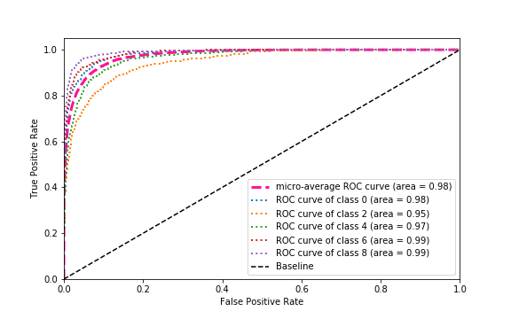
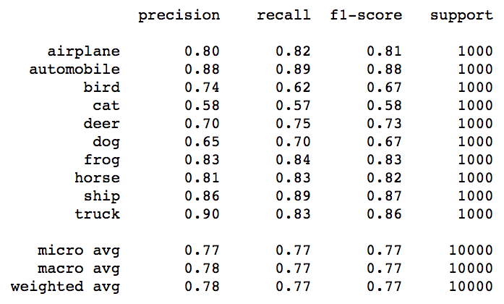
Plot: ROC & Scores for each class

Slide 10
Comments
Moderate good accuracy
Possible reason: Only 3 Conv2D layers
Improvement 1: Data augment and stacked Conv2D layers^{[1]-[4]}
Improvement 2: Transfer Learning on pre-trained^{[5]-[7]}
Different scores in classes
Description: Automobile and Ship classes have highest mean accuracy (89%),but Cat class is the lowest at 57%.
Reason: Background color helps to do classification, such as ship-sea-blue.
[3]. D. Lu and Y. Zhang. A comparison of classifiers on the cifar-10 dataset. 2017.
[4]. Y. Wang. Image classification on cifar-10 dataset, 2018.
Notes:
Any final things you want to tell us

Slide 11
API
Deploy as Rest API on Azure Machine Learning Service.
2 ways of queries
Batch query:
request: json format {"data": image_matrix}
response: matrix of softmax probability
Single online image query:
request: post(apiUri, data=imageUrl)
response: e.g. "Top 1: cat Top 2: dog”
Demo
Notes:
Advanced features…

Slide 12
Thank You!

