Slide 1
Prediction of Body Fat Percentage
STAT 628 Module 2
Group 1
Yuchen Zeng
Ruixuan Zhao
Jiantong Wang
Hao Pan

Slide 2
Step 1: Raw Data Analysing and Cleaning

Slide 3
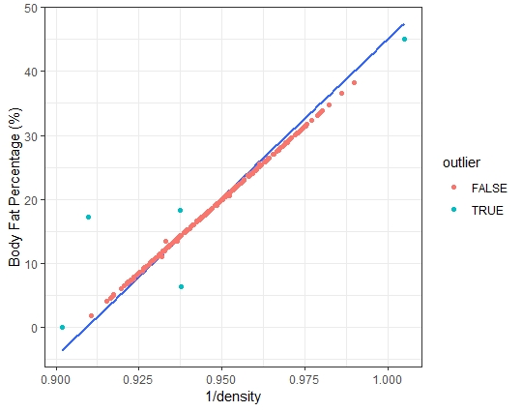
Method 1: The relationship between Body fat and density
Percentage of Body Fat (%) = 495/DENSITY - 450
IDNO | BODYFAT from raw data | BODYFAT from formula
96 | 17.3 | 0.4
48 | 6.4 | 14.1
76 | 18.3 | 14.1
182 | 0.0 | -3.6
216 | 45.1 | 47.5

Slide 4
Dealing with the outliers:
We compare the predicted percentage of body fat and the input percentage of body fat and check which one is more reasonable.
IDNO-96: We keep the original percentage of body fat, because the percentage of body fat from raw data is more reasonable;
IDNO-48,76: We delete these observations because we don’t know which part of the data is wrong;
IDNO-182: We delete it because the percentage of body fat is too low;
IDNO-216: We delete it because the percentage of body fat is too large.

Slide 5
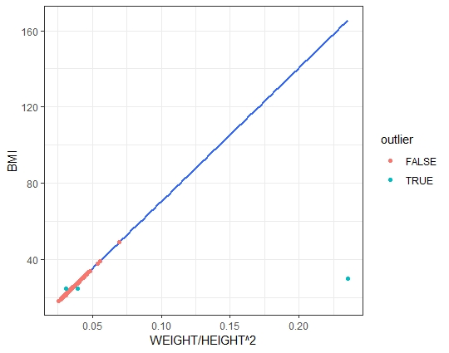
Method 2: The formula of adiposity
BMI(Adiposity) = WEIGHT / HEIGHT^2 (kg/m^2)
IDNO | ADIPOSITY from raw data | ADIPOSITY from formula | WEIGHT | HEIGHT
42 | 29.9 | 165.6 | 205.00 | 29.50
163 | 24.4 | 27.4 | 184.25 | 68.75
221 | 24.5 | 21.7 | 153.25 | 70.50

Slide 6
Dealing with the outliers:
We compare the predicted adiposity and the input adiposity and check whether weights and heights from raw data are correct.
IDNO-42: The height in raw data is 29.50 inches, which seems incorrect. We use the BMI formula to change it as 69.45 inches (It seems that it is a writing mistake);
IDNO-163,221: We delete these observations because we think they are outliers which may influence the result of following statistical model.

Slide 7
Step 2: Visualizing Data

Slide 8
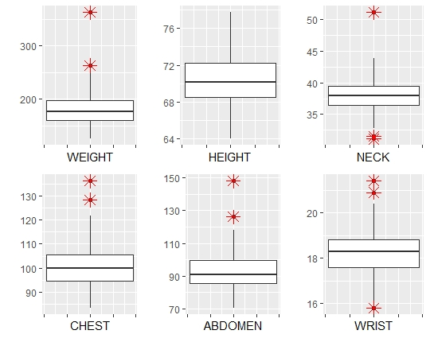
Making Boxplot to find potential outliers

Slide 9
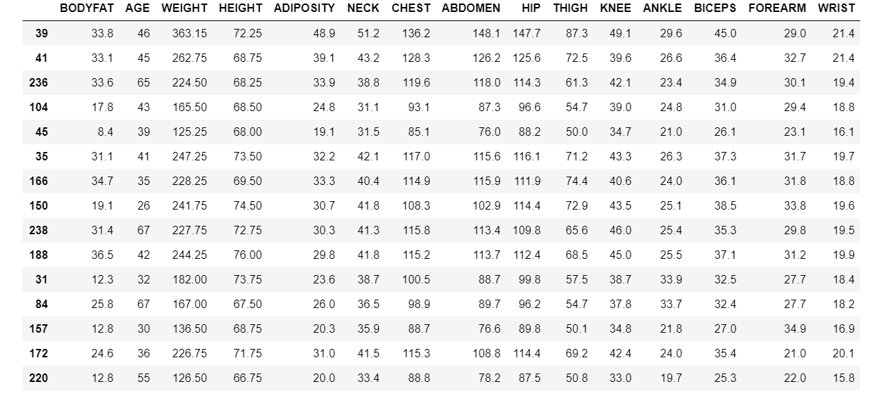
Potential Outliers: (IDNO-39: Extreme Case)

Slide 10
Step 3: Statistical Modeling

Slide 11
Model 1
The formula below is how US army compute bodyfat for men:
Given that data of waist are not provided and to simplify the model,
Waist - Neck is replaced by Abdomen
The final model is:
𝐵𝑜𝑑𝑦𝐹𝑎𝑡 ∼ log(𝑊𝑎𝑖𝑠𝑡−𝑁𝑒𝑐𝑘) + log(𝐻𝑒𝑖𝑔ℎ𝑡)
𝐵𝑜𝑑𝑦𝐹𝑎𝑡 ∼ log(Abdomen) + log(𝐻𝑒𝑖𝑔ℎ𝑡)

Slide 12
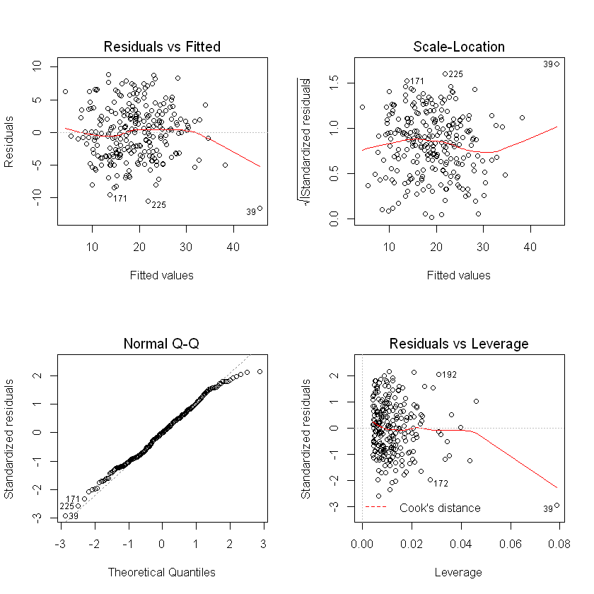

Slide 13
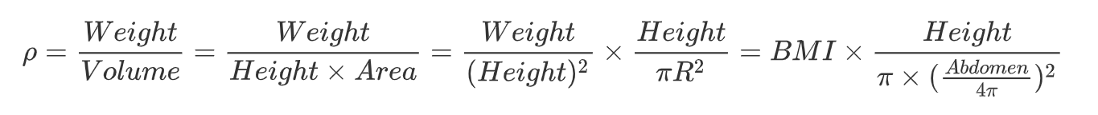
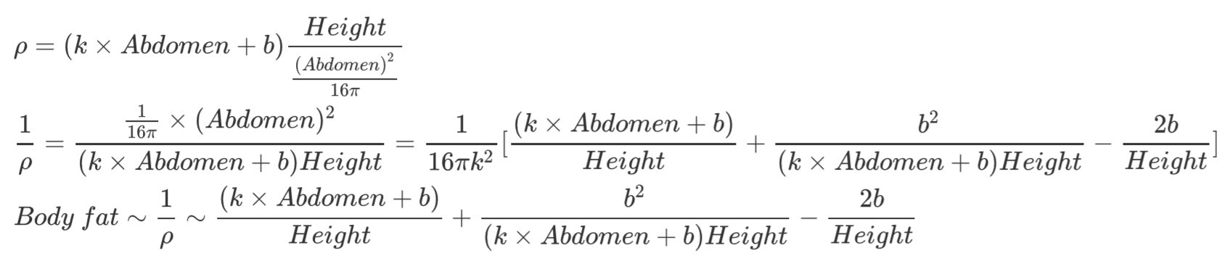
Model 2
It's known that there’s a strong linear relationship between body fat and reciprocal of body density. Thus, It’s a good idea to estimate reciprocal of body density.
From the definition of density, it can be derived that:
Volume of each person must equals to a certain cylinder with equal height and a certain radius r. Both radius r and BMI can be considered a linear function of abdomen. To simplify our model, we replace r with abdomen. In addition, some terms are ignored to further simplify the model, the final model is:

Slide 14
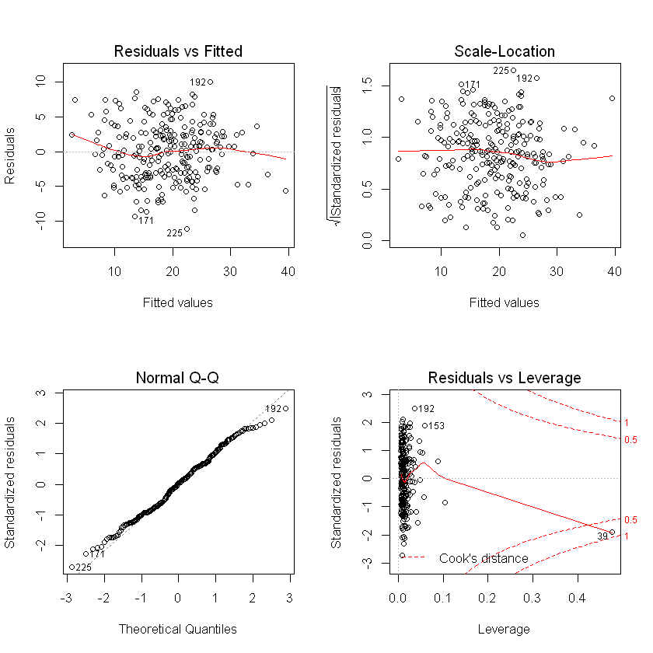

Slide 15
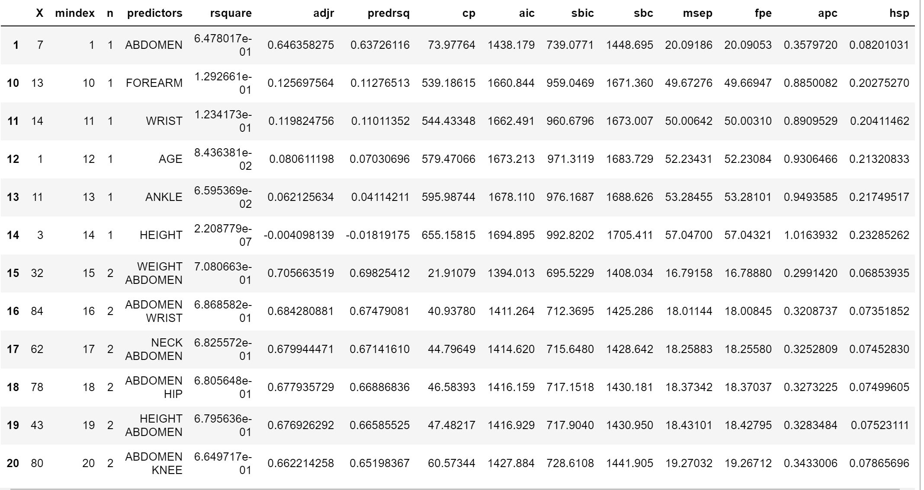
Model 3
Exhaustive method is the easiest but most time-consuming way to built a good model. The result of exhaustive model is shown below.
The combination with highest rsquare is Weight and abdomen.
The simple model from exhaustive method is :
𝐵𝑜𝑑𝑦𝐹𝑎𝑡∼ Abdomen + Weight

Slide 16
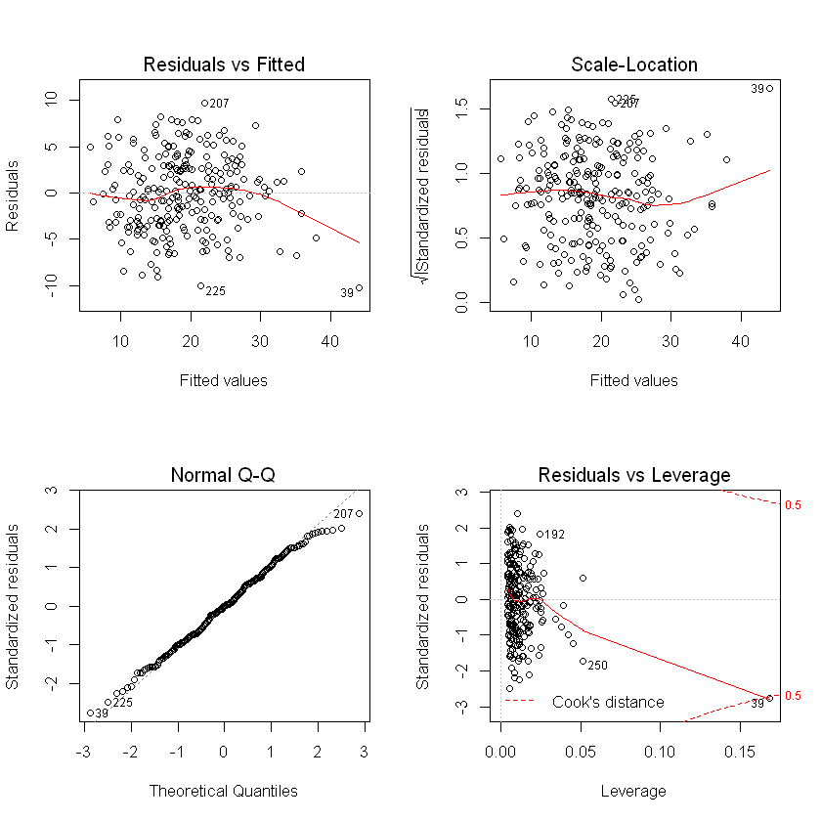

Slide 17
Model Performance
The adjusted R square of the three models are listed below:
It’s hard to tell which model is better from this table.
 | Model 1 | Model 2 | Model 3
Adjusted R square | 0.6971 | 0.703 | 0.7057
Residual standard error | 4.132 | 4.091 | 4.073
F - statistics | 282.9 | 194.3 | 294.7

Slide 18
Step 4: Model Selection and Diagnose

Slide 19
Model Selection
Cross validation methods are taken to do model selection.
The results are listed below:
The three models are almost equally good, but model 2 and model 3 is a bit better than model 1 due to low standard error of MSE.
 | Model 1 | Model 2 | Model 3
mean of MSE | 4.072 | 4.044 | 4.111
standard error of MSE | 0.510 | 0.406 | 0.392

Slide 20
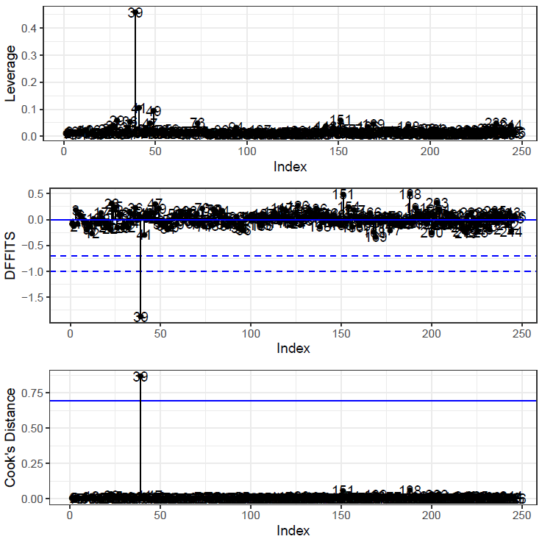
Model Diagnose
Model 2

Slide 21
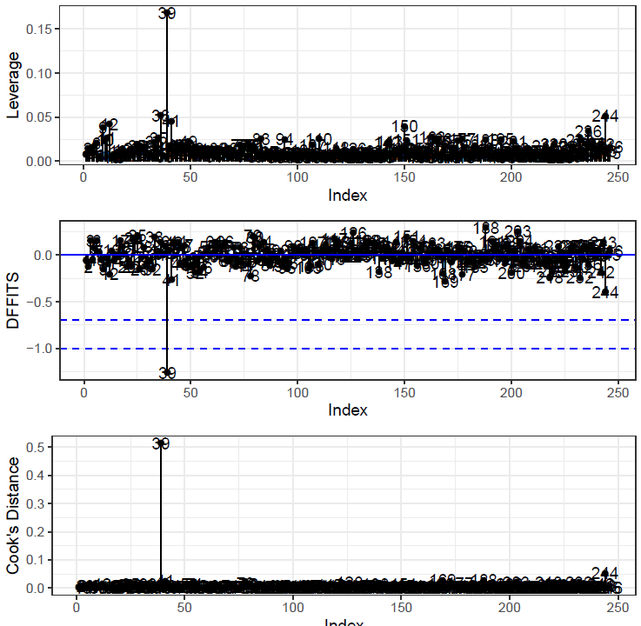
Model Diagnose
Model 3

Slide 22
Additional Deletetion of Data
For each of the three models, IDNO-39 seems to be a leverage point and if you take a glance on data of 39, you would also consider 39 as an outlier.
Because this is an extreme case with max WEIGHT, max NECK, max ADIPOSITY, max CHEST, ...,max HIP, max THIGH,..., we delete it and fit our final models: Model 2 and Model 3.

Slide 23
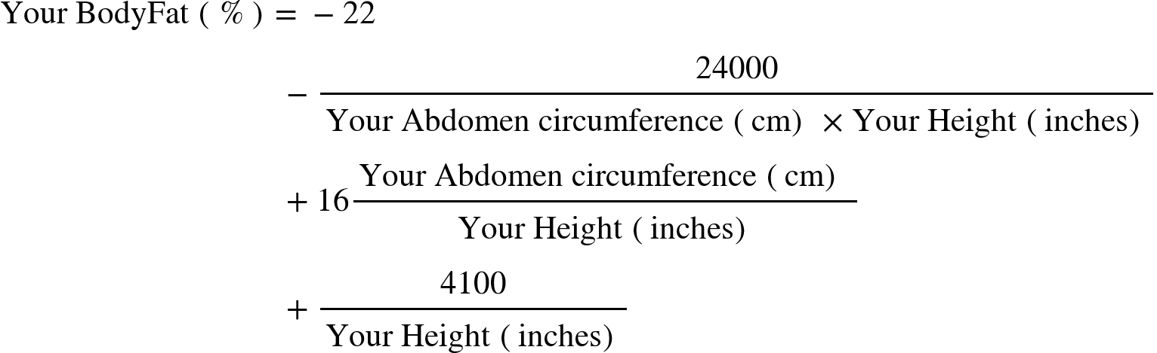
Model 2
The final model 2 is:
Rule of thumb:

Slide 24
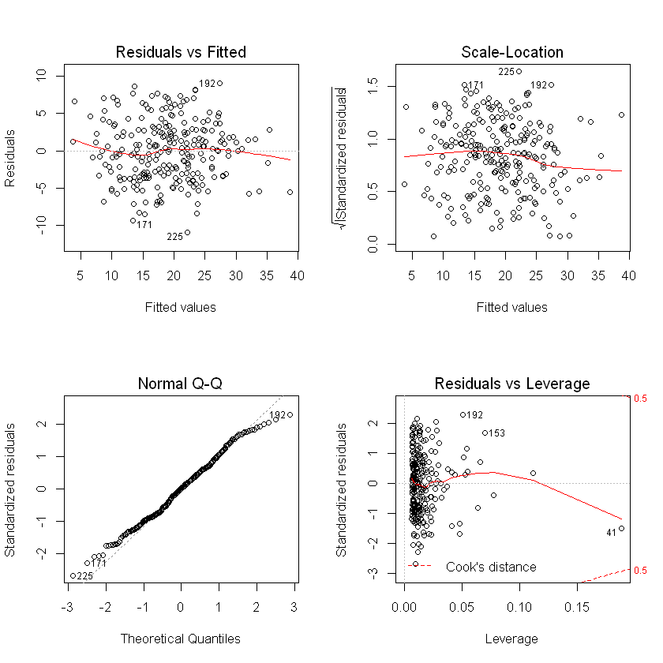

Slide 25
Model 3
The final model 3 is:
Body Fat = - 41.96048 + 0.89851Abdomen - 0.12384Weight
Rule of thumb:
Your Body Fat(%) = Your Abdomen circumference (cm) × 0.9
minus Your Weight (lbs) × 0.1
minus 42

Slide 26
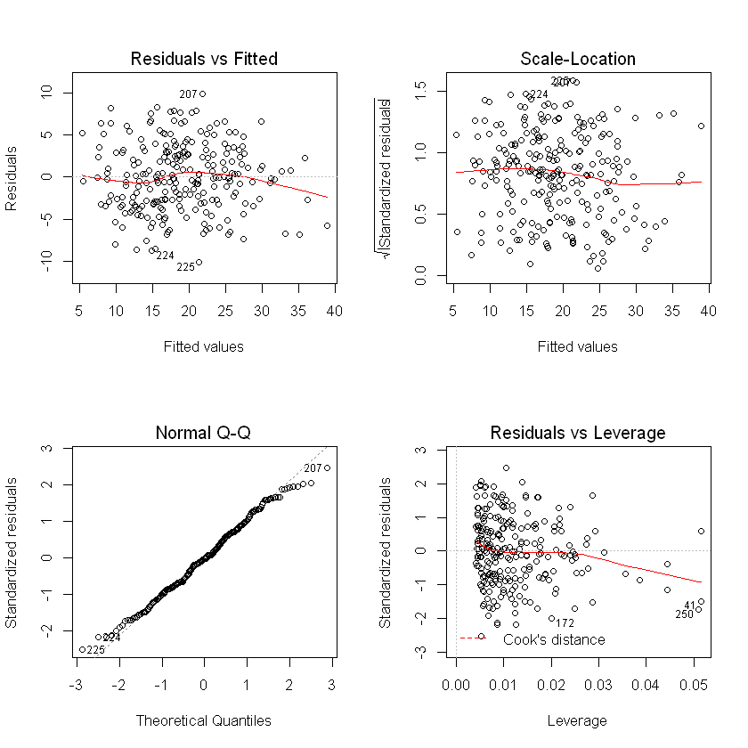

Slide 27
Step 5: Shiny APP

Slide 28
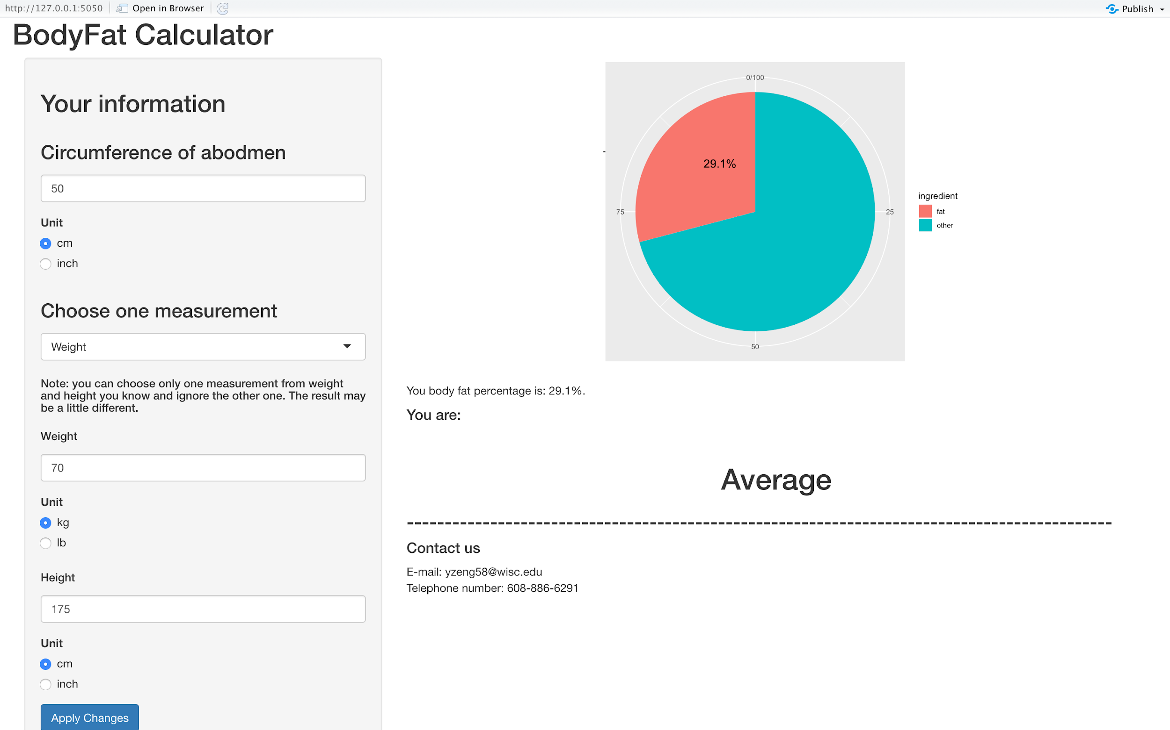
Here is the interface of our Shiny APP

Slide 29
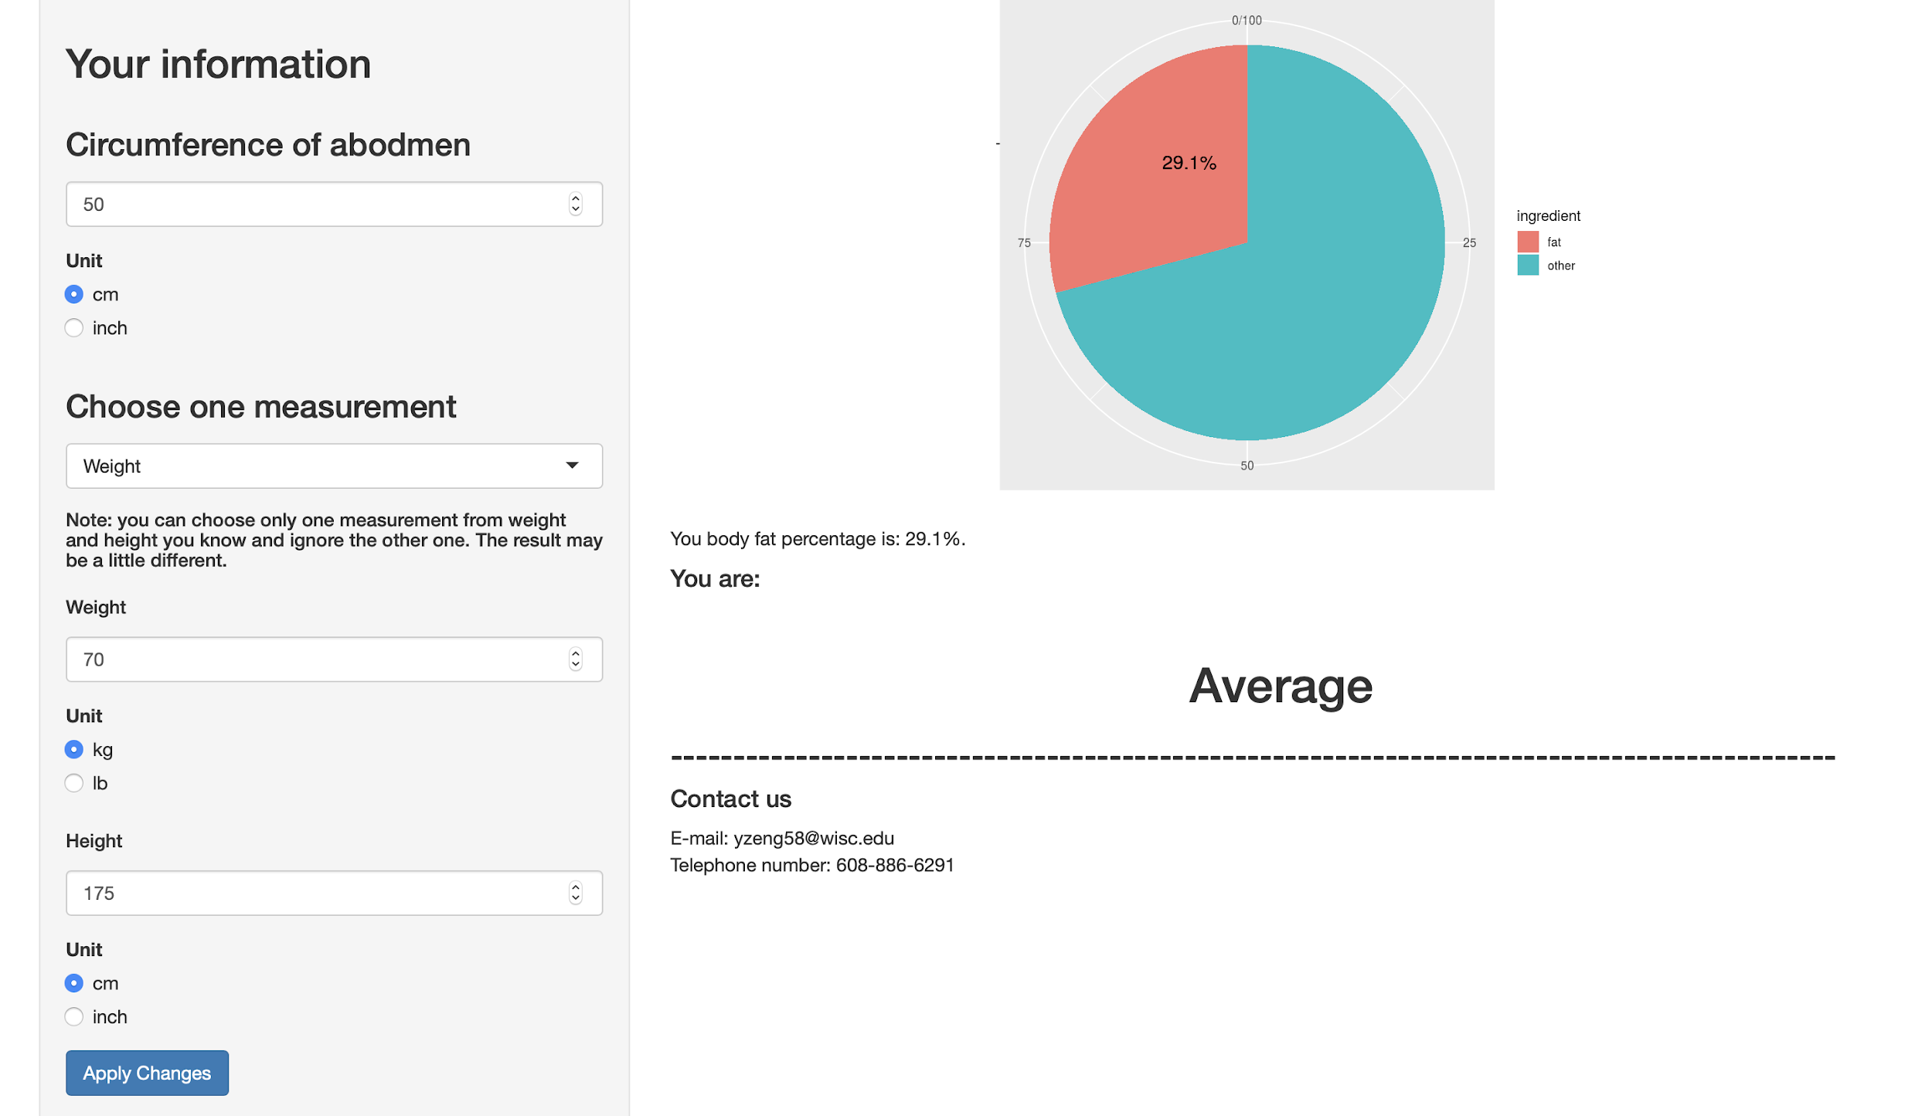

Slide 30
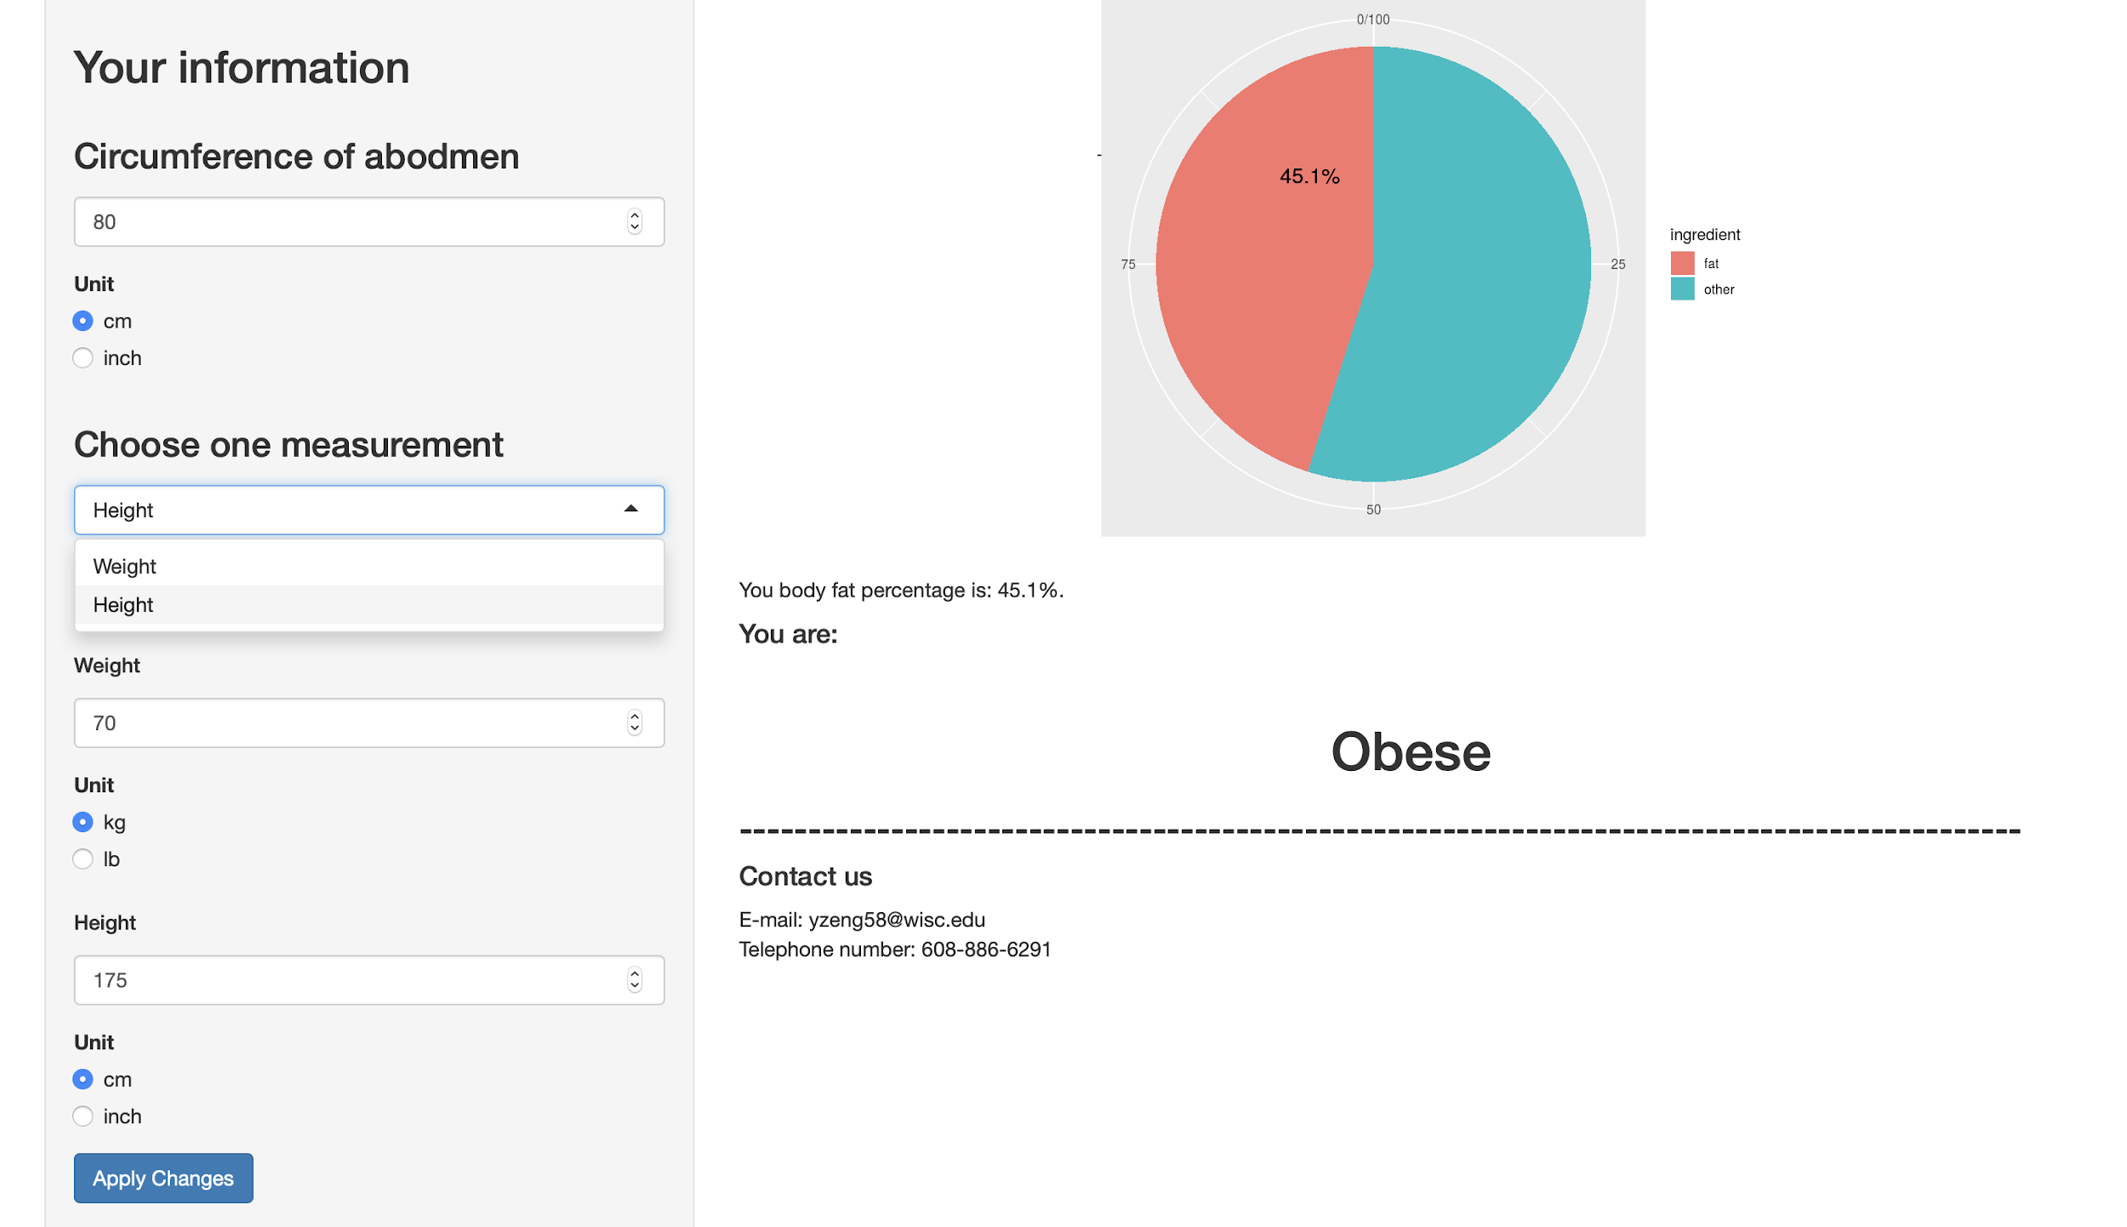

Slide 31
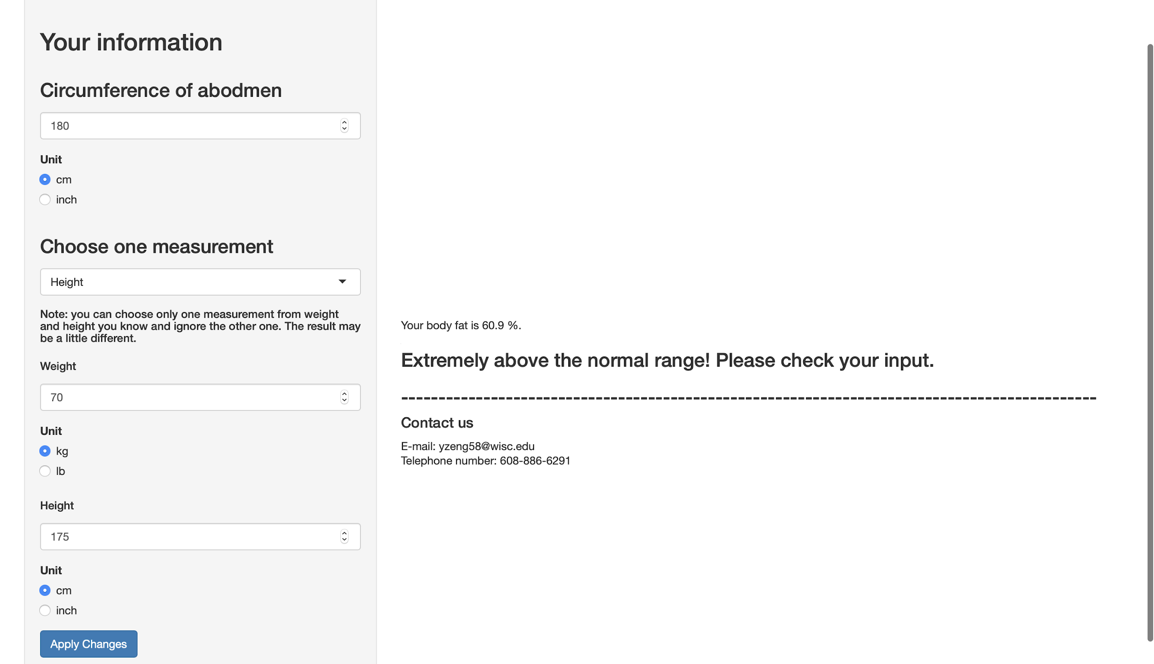

Slide 32
Strength and Weakness
Strength:
The model we use is quite simple, which only requires two variables as input but gives a fairly good R square.
It also provides us some flexibility that you can either input abdomen and height or abdomen and weight.
Weakness:
The confidence interval is kind of wide.

Slide 33
Thank you!

