Slide 1
Telco Customer Churn Prediction

Slide 2
Basics
here are two types.
Voluntary churn
Involuntary churn
Voluntary churn -
A decision by the customer to switch to another company or service provider
Involuntary churn -
Customer's relocation to a long-term care facility, death, or the relocation to a distant location
Analytics are based on Voluntary churn

Slide 3
Logistic Regression
Logistic Regression is a classification algorithm. It is used to predict a binary outcome (1 / 0, Yes / No, True / False) given a set of independent variables
it predicts the probability of occurrence of an event by fitting data to a logit function
I have used this algorithm to predict customer churn

Slide 4
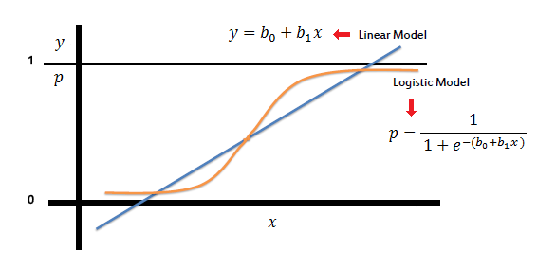
Logistic vs Linear Regression
Notes:
According to this graph, logistic model mainly has two classes as 0 and 1. Here model uses one independent variable (x). From this x value it can give p value according to above equation. This equation can be have multiple independent variables as x1, x2, x3, ………

Slide 5

Logistic with Multiple independent variables
As mentioned before, logistic regression can handle any number of numerical and/or categorical variables.

Slide 6
Obtaining the Co-efficients
Just as ordinary least square regression is the method used to estimate coefficients for the best fit line in linear regression, logistic regression uses maximum likelihood estimation (MLE) to obtain the model coefficients that relate predictors to the target

Slide 7
According to our application
Independent variables –
'customerID', 'gender', 'SeniorCitizen', 'Partner', 'Dependents', 'tenure', 'PhoneService', 'MultipleLines', 'InternetService', 'OnlineSecurity', 'OnlineBackup', 'DeviceProtection', 'TechSupport', 'StreamingTV', 'StreamingMovies', 'Contract', 'PaperlessBilling', 'PaymentMethod', 'MonthlyCharges', 'TotalCharges'
Dependant variable –
'Churn'
Notes:
Here there two type of columns as numerical and categorical. Categorical columns are numbered by using LabelEncoder class. Numercial columns are standardized with StandardScaler class.

Slide 8
Data Preparation
All the column values are converted to numerical values
Dataset contains 7032 number of user records
Dataset is divided into train data and test data with 0.25 proportion

Slide 9
Training
Here sklearn LogisticRegression class is used as algorithm in the model
For Optimization, liblinear algorithm is used. Because size of data set is small
Whereas ‘sag’ and ‘saga’ are faster for large ones

Slide 10
Training
Here Recursive Feature Elimination method is used to find suitable features to predict customer churn
Recursive Feature Elimination is feature selection method that fits a model and removes the weakest feature (or features) until the specified number of features is reached.

Slide 11
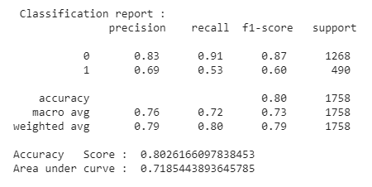
Results
Notes:
Here 0 is used as non-churned and 1 for churned customer
Precision -
For each class it is defined as as the ratio of true positives to the sum of true and false positives.
Recall -
For each class it is defined as the ratio of true positives to the sum of true positives and false negatives.
F1 Score -
The best score is 1.0 and the worst is 0.0
Support -
The number of actual occurrences of the class in the specified dataset.

Slide 12
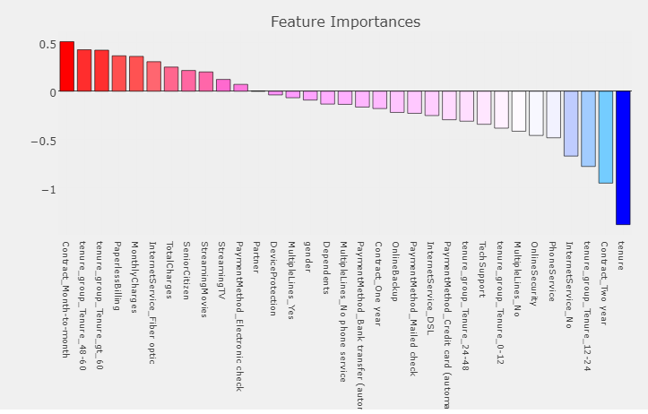
Results
Notes:
Note :- This logistic regression method can be used with any number of independent variables according to our use case

