Slide 1

[Loan Eligibility Process]
[BOT Masters]

Slide 2
Team Detail
Insight
Key
Harshavardhan KP
Harshavardhan KP
Drive
Testing
Harshavardhan KP
Harshavardhan KP
Develop
Performance Tune
Harshavardhan KP
Harshavardhan KP

Slide 3
A.Objective of this excercise is to analyse existng loan data and build a predictive model which will predict applicatns who could be
eligible for Loans.
B. This prediction will be used by XYZ bank to target customers based on their eligibility
Objective

Slide 4
1. Identify dependent and independet variables
2. Perform the goodness of fit (Chi square , LDA , correlation ) test to decide suitable variables that affect loan approval decision
3. Missing value treatment and outlier treatment
4. Data analysis (univariate and multivariate analysis) to check the distribution of data
5. split training data in to training sample and test sample
6. Build Linear and non linear models ( CART, XGBoost, LDA, LR, NB,KNN,SVM)
7. Compare their performance through cross validation score
8. chose the top 3 models for prediction
9. predict the outcome of test data
10. take mode value of all 3 predictions as final prediction ( This will reduce errors and increase accuracy of prediction)
Approach

Slide 5
Code is in python scripts it has to be executed in environment with following configuration
1.Python2.7 with following modules (sklearn,pandas,Xgboost,math,numpy)
2.Ubuntu (14.4)
Build Tools

Slide 6
Below steps should be followed to generate the result file
1.Downlod the script to a folder
2.Copy the data file to same folder
3. Open command prompt and navigate to above foder
4. Run the script file using following command “python LEP.py”
5. Result file “submission.csv” will be generated with results
Source/Build/Execution Guidelines

Slide 7
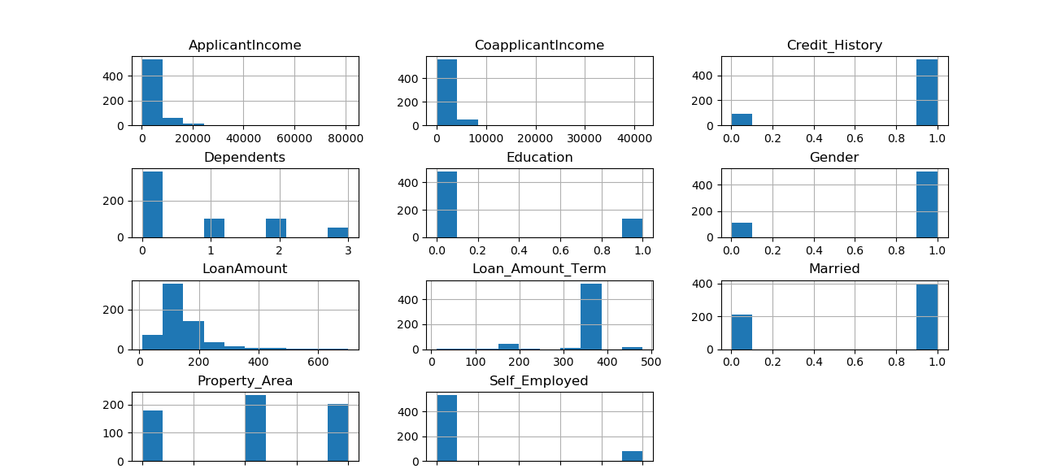
A. Null values and outliers are imputed with following rule:: Median value for numeric data and mode value for non numeric
B. New feature NetIncome is created ,which consolidates income of applicants and fecilitate in better predictions
Univariate plots :Histogram
Data Exploration and Data Cleaning

Slide 8
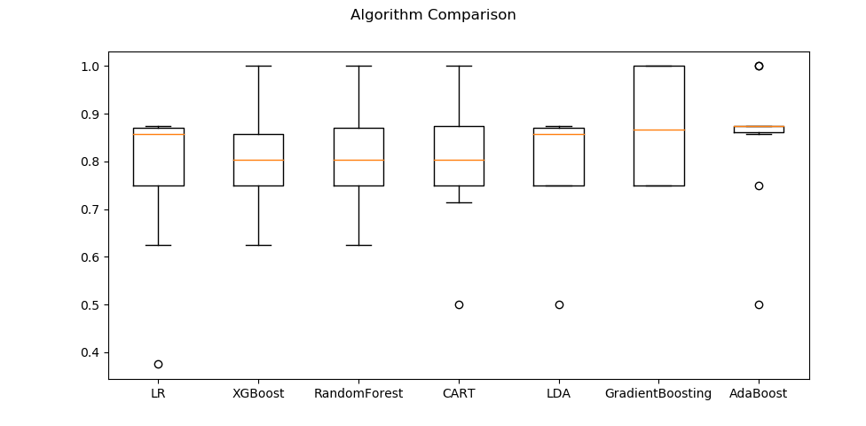
Modelling and Validation

Slide 9
A. Collaction of Linear and non linear classification models were chosen for modelbuilding. (Logistic regression, LDA,Decision tree ,Xgboost,SVM ,GaussianNB,
B. After Crossvalidation test with 10 splits of input data we observed that Decision tree, LDA and XGBoost had more accurate and consistent predictions , hence those three were chosen for final model
C. Final model precitions = mode (CART Prediction, XGBoost Prediction, LDA Prediction.)
Modelling and Validation

Slide 10
Score and Evaluate Model
 | Predicted
Actual | T | F
T | 7 | 2
F | 1 | 13
 | precision | recall | f1-score | support
N | 0.88 | 0.78 | 0.82 | 9
Y | 0.87 | 0.93 | 0.9 | 14
avg / total | 0.87 | 0.87 | 0.87 | 23

Slide 11
Possible Improvement
01
Decision Tree classification model can be furher tuned to get more accurate Predictions
02
Current modeluses random sampling to train . If stratified sampling is used more accurate predictions can be made for example : Single urban female, Single urban male, Single earning female in rural , Single earning male in semi urban

Slide 12
Final Predictions will be provided in a seperate file
Final Results / Summary

Slide 13
Thank You
[Loan Eligibility Process]
[BOT Masters]
um

