Slide 1

Super Stocks
By Team Super Stocker
Keith Morel
Hetvi Patel

Slide 2
Agenda
Project Scope
Product Functions
Design and Implementation Constraints
Security Measures
BackEnd
FrontEnd
User Stories
Proposed Features

Slide 3
Project Scope
The Super Stocks application is a program for effective and efficient tracking and management of stocks for Users.
The SCOPE of the project is to design, build and implement a new program for tracking stocks with the capability of adding future functionality as needed.

Slide 4
Product Functions
User should be able to LogIn/Register to the Application.
User can add and updates stock in their Portfolio.
Users can view detailed information about stocks they follow.
Users can view historical data about each stock in graph format.
Users can delete their stocks from the Portfolio.
Users can update their own Profile.
Admin user will be able to view/update all users’ information.

Slide 5
Design and Implementation Constraints
This is a lightweight application for tracking stocks. Each user will have a dashboard that will provide brief overview of their chosen stocks. Users will also be able to access more detailed information about individual stocks.
Constraints:
Stock API only allows limited requests per minute.

Slide 6

Security Measures
Access to the database controlled by code (Injection OWASP-1)
Passwords are hashed by the application (Broken Authentication OWASP-2)
Application uses frameworks with a proven record of security (OWIN, Identity, EF) (Using Components with Known Vulnerabilities OWASP-9)
Notes:
The following technologies, techniques and practices were incorporated into the project:
Hibernate

Slide 7







Back-End Technologies
Notes:
Spring(Framework, MVC, Data, Test, ORM)
Hibernate
JDBC/MariaDB
Mockito
LogBack
Junit
Junit 5/Jupiter
SonarLint/Jacoco

Slide 8







Front-End Technologies
@angular-material
@ng2-charts

Slide 9





CloudServices

Slide 10
User stories

Slide 11
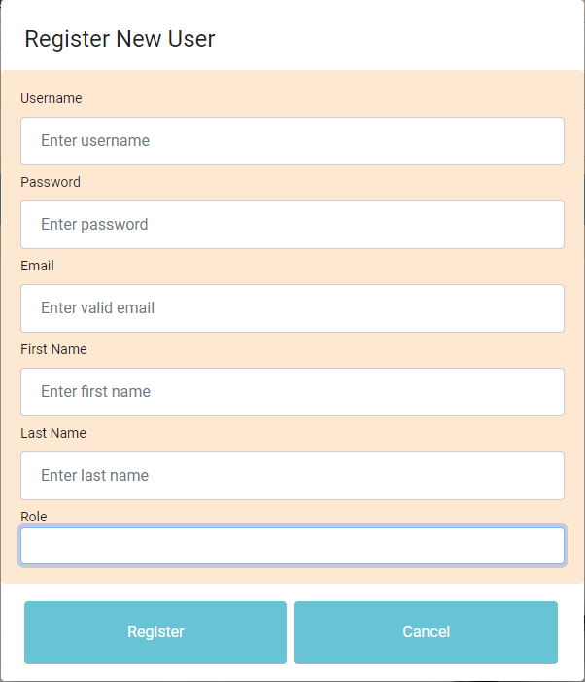
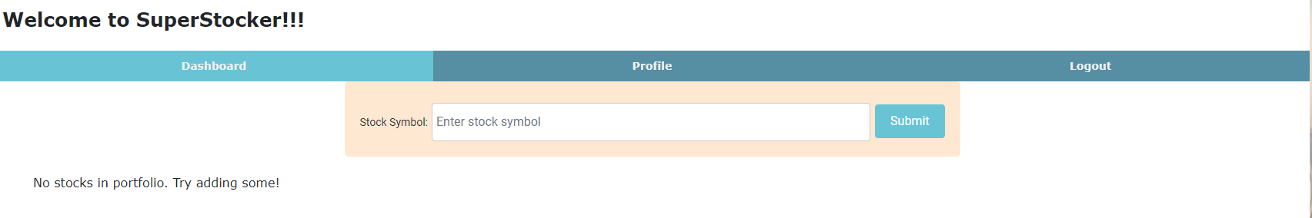
User Story - 1
As a regular user
I want to be able to register for an account,
So that I can log in and view my own stocks.
**Acceptance Criteria**
1. Should be able to enter their first name, last name, email, password.
2. When they click submit, they should be registered and redirected to Landing page.

Slide 12
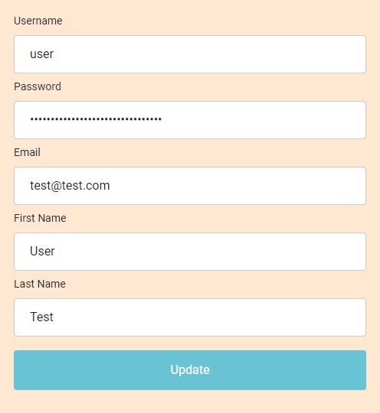
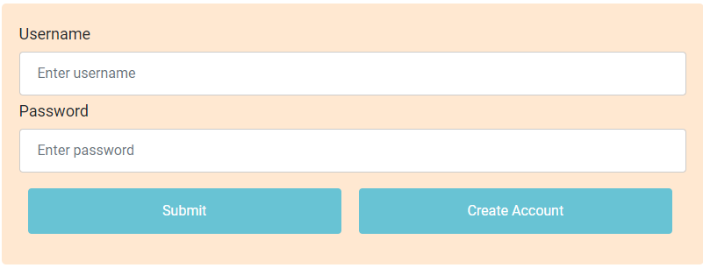
User Story - 2
As a regular user
I want to be able to log in,
So that I can view my and update profile.
Acceptance Criteria
Able to log in with username and password.
Should be able to display their first name, last name, email, password(******).
Should be able to update their information.

Slide 13
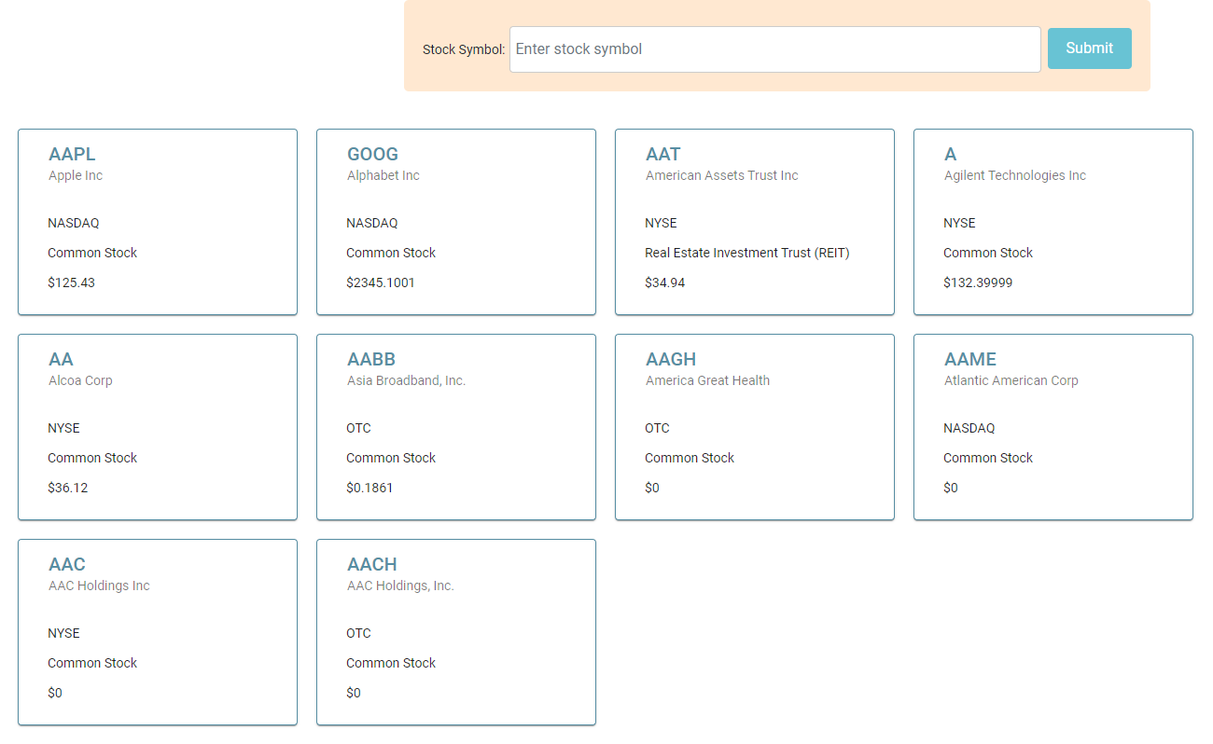
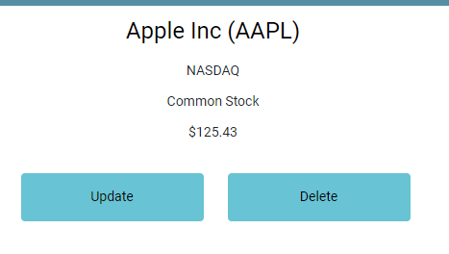
User Story - 3
As a regular user
I want to be able to log in,
So that I can add/view/delete stocks to dashboard.
Acceptance Criteria
Able to log in with username and password.
Receive invalid login error on webpage if not providing correct credentials.
Display all my stocks on the Dashboard.
Add, View and Delete Stock to the Dashboard.

Slide 14
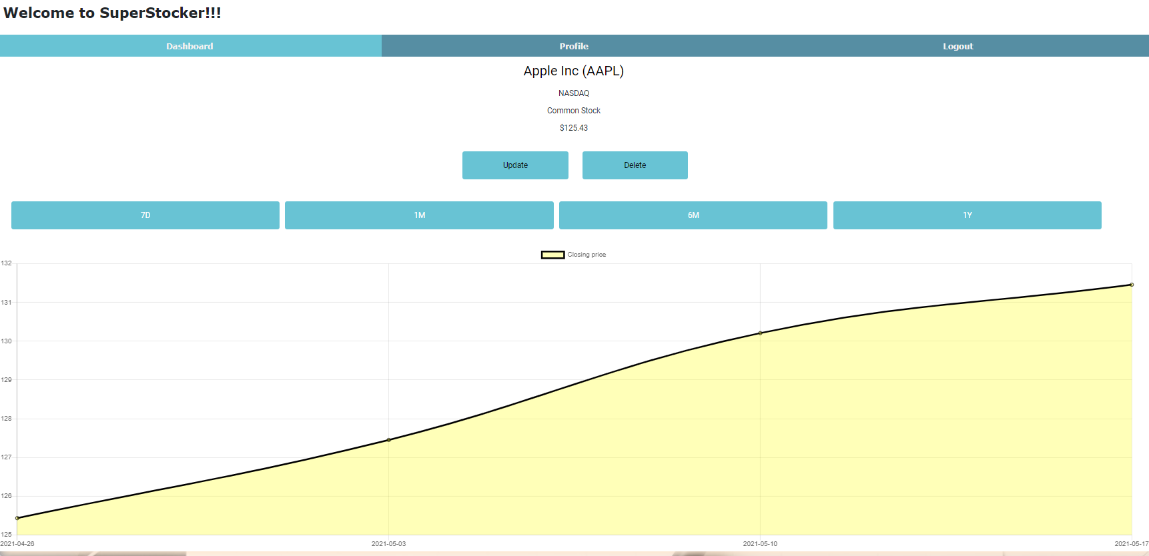
User Story – 4
As a regular user
I want to be able to click on my stock displayed on Dashboard,
So that I can view detailed stock information.
Acceptance Criteria
Able to click on stock displayed on Dashboard.
Should redirect to new page.
New page will have detailed stock information.

Slide 15
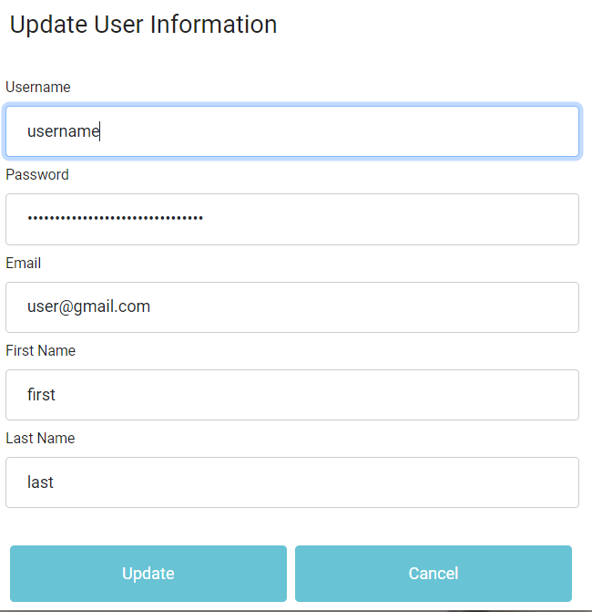
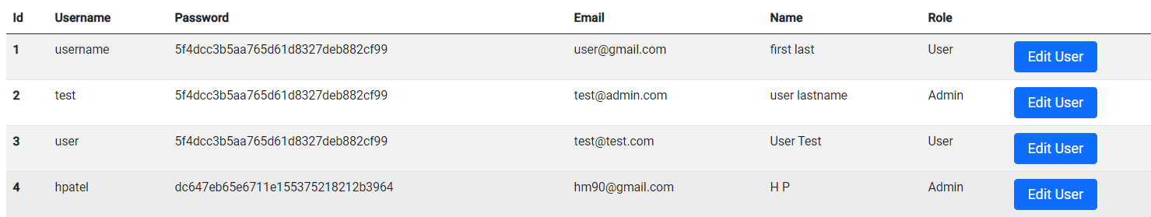
User Story – 5
As a Administrator
I want to be able to log in.
So that I can view/update/delete user accounts
Acceptance Criteria
Able to log in with username and password.
Receive invalid login error on webpage if not providing correct credentials.
Redirect to Admin landing page if logged in successfully.
Able to update regular user information.

Slide 16
Demo

Slide 17

Software Testing

Slide 18
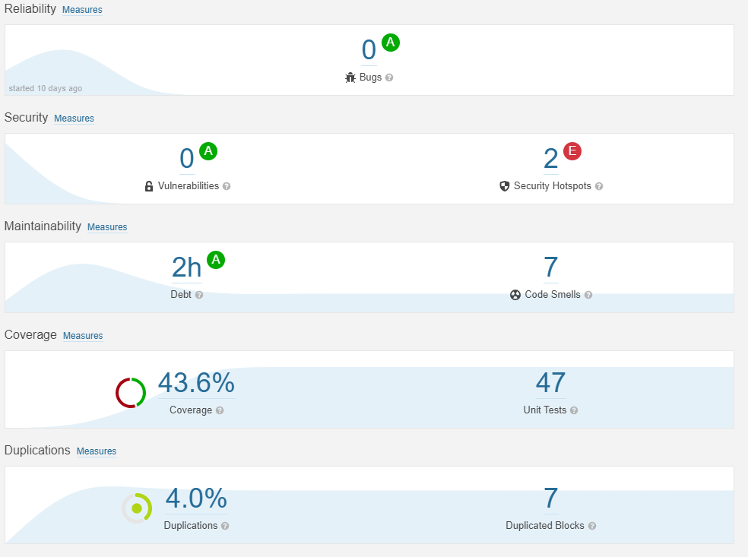
Unit Testing (Overall Coverage)

Slide 19
Proposed Features
Utilize another stock API for more detailed information for Stock detail page.
Implement advanced security via JWT/cookies, Spring Security.
Implement additional features for Admin Users(Banning Users, Restrict Sign up).
Display errors in a less intrusive manner.

