Slide 1
Determine What is most influence factor on Customer satisfaction survey from booking to arriving at destination

Slide 2
Hypothesis
Bag rating is dependent on flight delay
Over all satisfaction is strongly correlated to Origin Airport, Customer frequent flyer level, Cabin, Ticket price and delay time
Note: Weather and irregular operation identifier is missing in todays data.

Slide 3
Technical Detail
Extract Data from Teradata: out to put to 3 file
Combine file 1 and 2 using common number
Combine 2 and 3 file using booking number to get ticket price
Then analyze data
Impute 8 rating parameters otherwise it will drop 50% of data
Classify Delay minutes into 3 different category
Wish list: Classify Airport into Region and Sub category which is Hub and Spoke and use as a predictor along with weather of the day
Created one variable called SAT using 8 rating variable
Use Random Forest model: created training model
Created Decision tree verify

Slide 4
Data Set
Document Index: Artificial key used to join three different file: Survey, Ticket and Flight Detail: DOCUMENT_ID"
Booking Number: PNR
"DOCUMENT_ID",
Frequent Flyer level: MPLVL
Cabin: CABIN
Flight Delay Minutes, (-_) represent delay DELAY_MINS
Origin Airport: O_AIRPORT
Equipment Coed: EQUIP,
Departure Airport : "D_AIRPORT",
Seat Number : "SEATNUM",
Baggage rating: EXP_BAG",
Check-in rating: "EXP_CHKIN",
Gate Raring: "EXP_GATE",
Lounge Rating: "EXP_LOUNGE",
TSA rating "EXP_TSA",
Pilot rating "PILOT_SAT",
Clean product rating: "CCE_SEAT_AREA" , "OBE_FA",
Ticket Price: 'FARE'

Slide 5
NULL Data
Count of missing data:
MC_BAG: 122 MC_CHKIN: 164 MC_GATE: 46 MC_TSA: 162 MC_PILOT: 46 MC_CCE 46 MC_LOUNGE: MC_FA: 46
Since count is more than 10% I used median function to impute data.

Slide 6
Combining variable
There are total 8 Satisfaction surgery rating collected from customers and all of them are closely related and dependent on same variable which is Origin Airport, Delay minute etc.
So combine them into one variable called SAT.

Slide 7
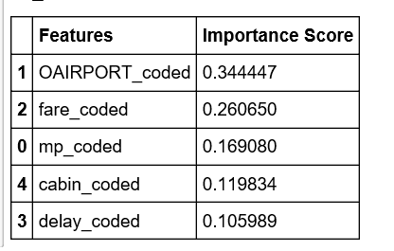
I applied random forest model
As Random forest uses many different decision tree to classify data I used random Forest.
We will simply create a RandomForestClassifier object and indicate how many different decision trees we want to include.
I also have created decision tree.
predictors = [ 'mp_coded', 'OAIRPORT_coded', 'fare_coded', 'delay_coded' , 'cabin_coded' ]
X = Cov_complete[predictors]
y = Cov_complete['SAT']
Result:

Slide 8
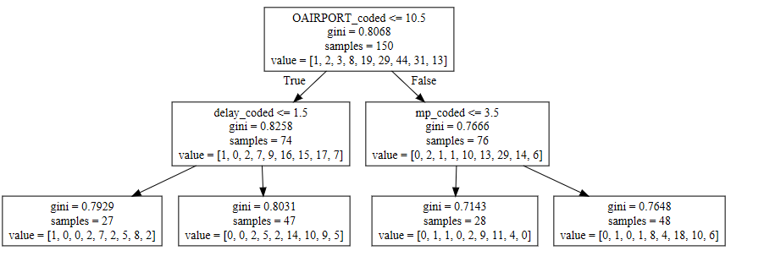
Decision Tree: Parameter are:

Slide 9
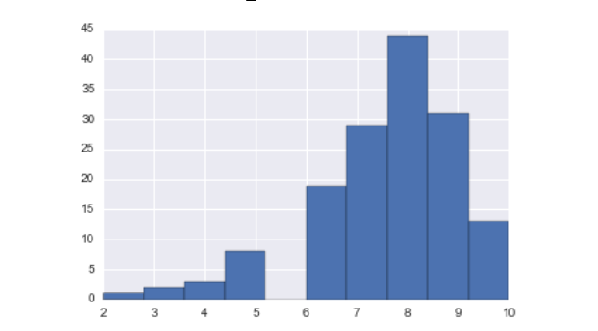
Hysterogram of Overall Satisfaction

Slide 10
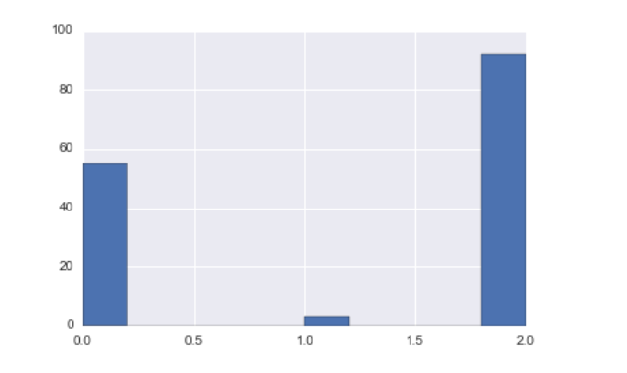
Distribution of Flight Delay

Slide 11
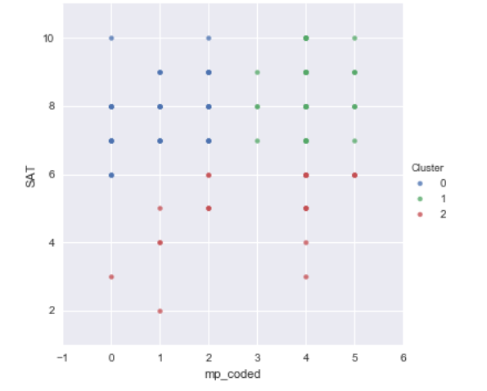
Plotting Cluster : Delay, Satisfaction and
clusters = pd.DataFrame(k_means_labels,index=df.index,columns=["Cluster"])
survey_with_cluster = pd.concat([df, clusters], axis=1)
g = sns.lmplot(x="delay_coded", y="SAT", hue=" Cluster",
fit_reg=False,
data=survey_with_cluster)

