Slide 1
Image classification for self driving cars
By hiten patel

Slide 2
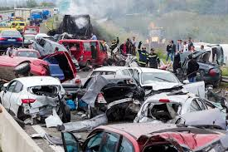
Business value
6 million car accidents per year
3 million people are injured
37,000 deaths
96% due to human error
Image classification system to help identify objects
Self driving cars will allow for accurate and safer transportation
Reduce accidents, deaths, traffic, and financial hardship
Notes:
100 people die per year
Human/driver error
Goal here is to reduce those numbers and removing humans from driving and create a multi-label image classification system
Which can be used for self driving cars
Financial hardship for victims

Slide 3
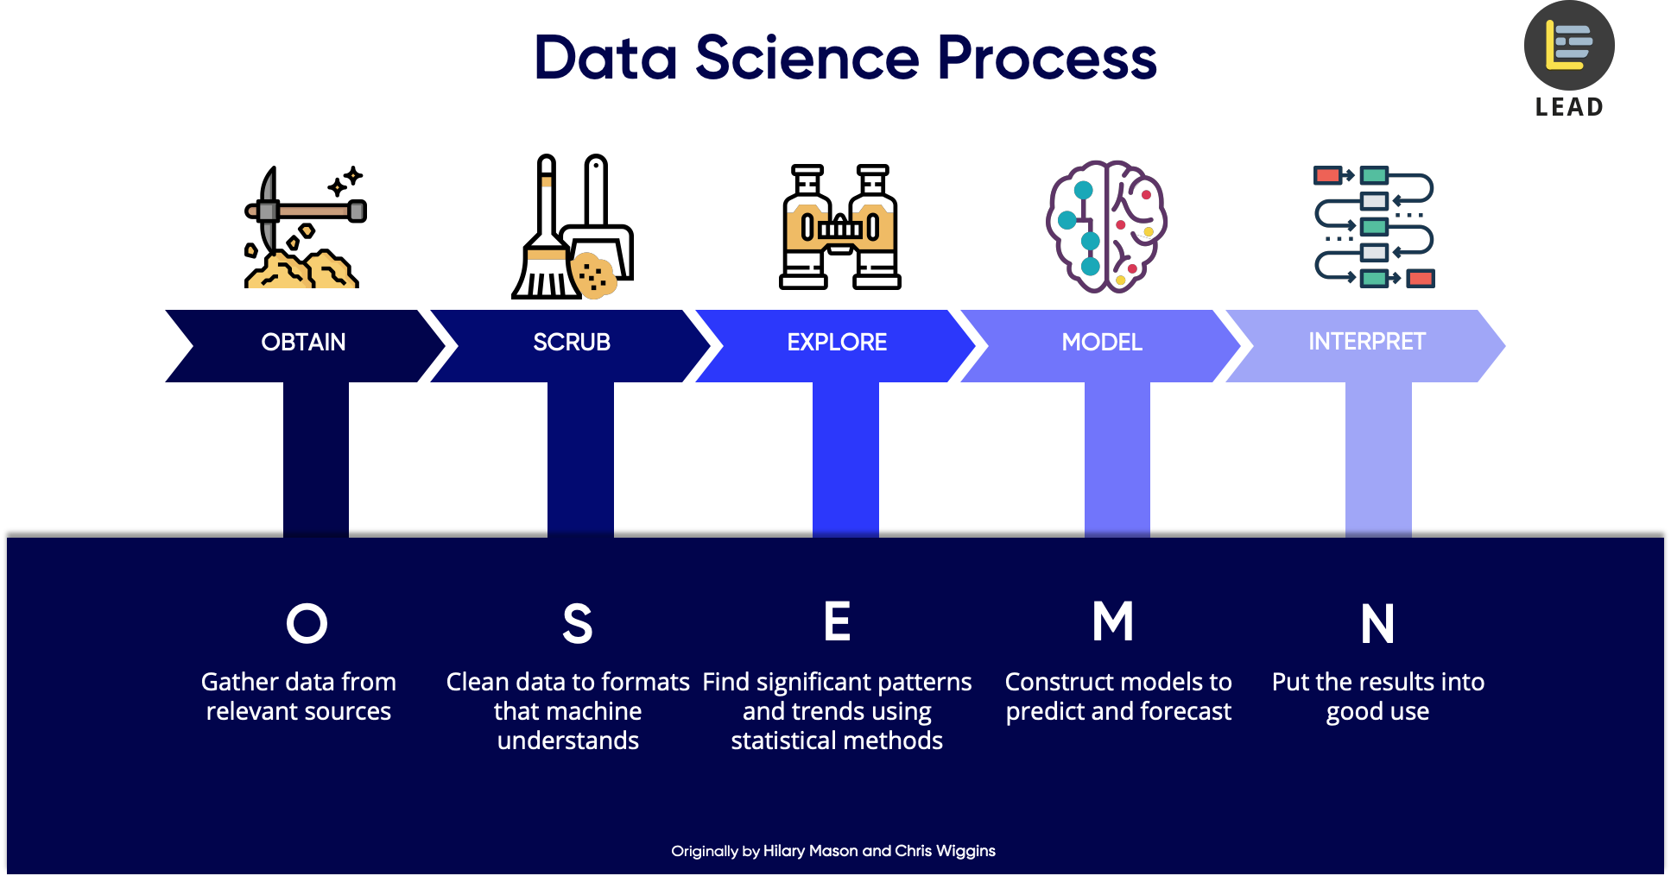
Osemn process

Slide 4

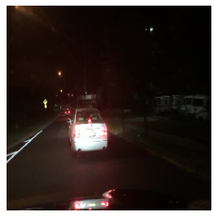
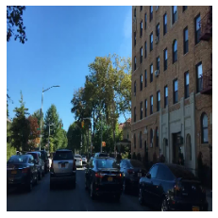
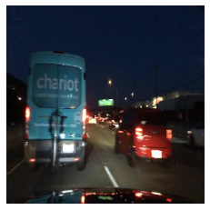
Obtain & Scrub
The data set was obtained by
Contained over 100,000 images
Resize images and extract important labels
Notes:
Contained 100k images and 100k videos
For the purpose of this project, we used the images only
The dataset possesses geographic, environmental, and weather diversity, which was useful for training models that are less likely to be surprised by new conditions.
Rescale, resize the images to 86 x 86 image size –largest I could go with out the computer crashing
- we also had to scrub the labels file and extract the important labels each object was being classified as

Slide 5
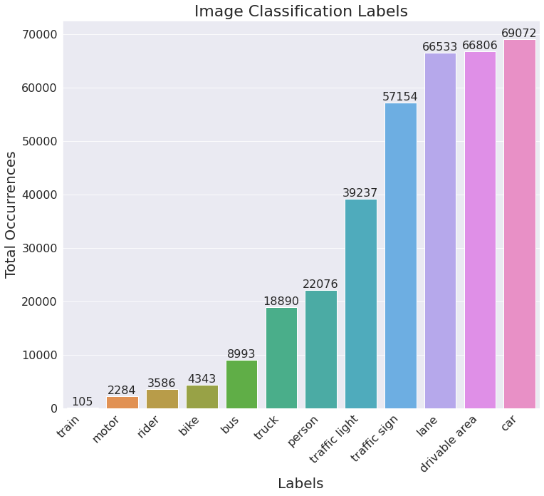
Explore
Notes:
Multilabel classification system so you will see more than one label per image,
66k of the 70k in the training set

Slide 6
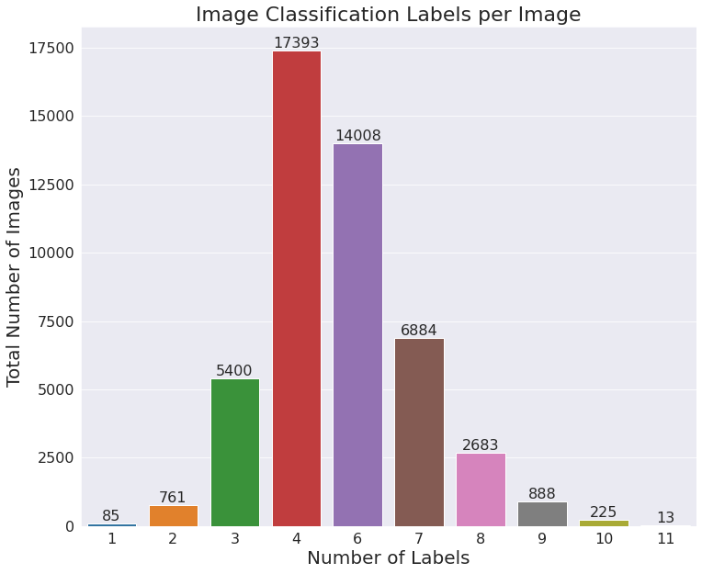
Explore more
Notes:
No images contained all 12 labels

Slide 7
Convolutional neural network
Image is scanned by a deep neural network
Networks are made of input and an output layer, as well as multiple hidden layers
Convolutional (Conv2d) layers analyze the picture and push it through to the next layer
Each layer helps determine the ”weight” of a feature in the picture.
Notes:
Analyzing the strong features and pushing them to the next layer
A feature can be certain shapes, color, things of that nature
Pooling layer takes the features and intensivies them over the network while discarding the information that doesn’t make sense

Slide 8
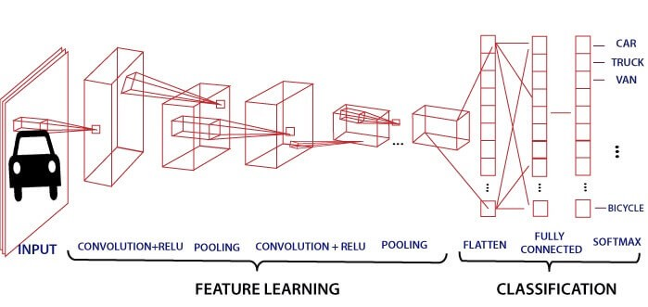
Model comparison
FINAL CNN MODEL
Hamming Loss Score: 11%
Accuracy: 89%
Followed a Conv2D-Conv2D-Pool pattern
Faster training time than pretrained model
PRETRAINED MODEL
Hamming Loss Score: 13%
Accuracy: 87%
InceptionResNetV2 model
Notes:
Hamming score: predicted wrong labels / total number of labels

Slide 9
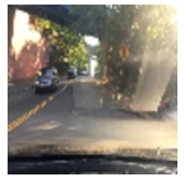
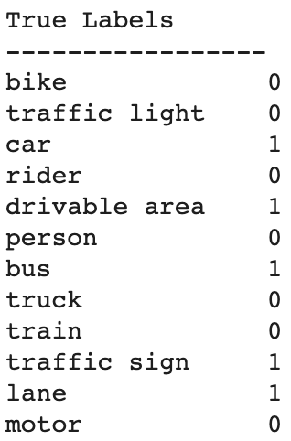
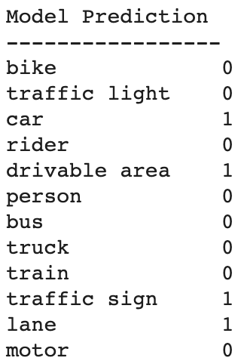
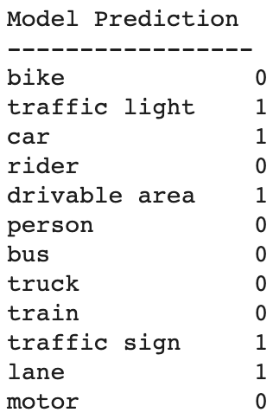
MODEL COMPARISON
True Labels CNN Model Pretrained Model
CNN model predicted 11 of the 12 labels correct. Did not predict ‘bus’.
Pretrained model predicted 10/12 labels correct. Incorrectly predicted ‘traffic light’ and did not predict ‘bus’.
Notes:
Pretrained – inceptionResNetV2
Incorrectly predicted…
Did not predict
Interestingly…if we recall on our label occurrence graph, bus had a very low frequency of only appearing in less than 9k images
Looks like the pretrained model saw the sign and predicted both traffic light and traffic sign

Slide 10
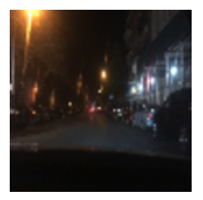
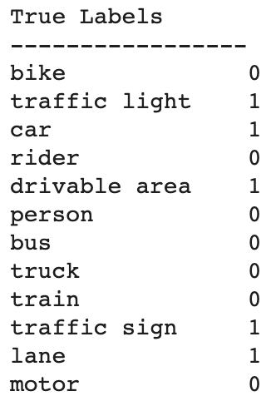
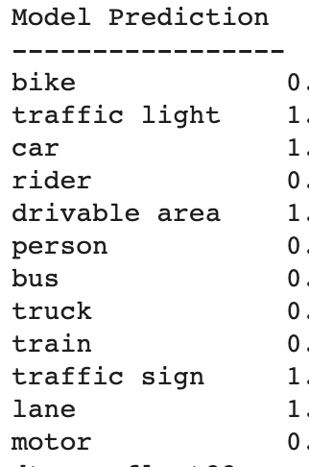
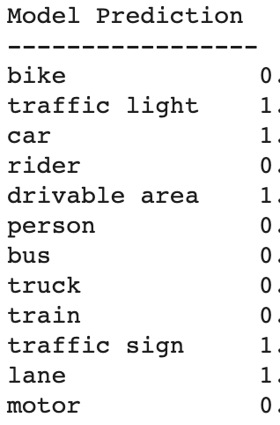
MODEL COMPARISON
True Labels CNN Model Pretrained Model
Both CNN model and the Pretrained model predicted 12 of the 12 labels correct.

Slide 11
rESULTS
CNN Model: 89% accuracy
Pretrained Model: 87% accuracy
Pretrained model incorrectly predicted a ‘traffic light’ in the image
Both models failed to predict a ‘bus’ in the image

Slide 12
recommendations
Car companies can use the CNN image classification model as a driver assistant
Starting point to create a self driving electric vehicle
Building your own? CNN and a diverse dataset
Notes:
- Model is not 100 percent and missing labels
Essentially be used as a second pair of eyes to highlight objects. And could be greatly beneficial in the dark and rush hour. This will help mitigate car accidents
Diverse data set with no surprises

Slide 13
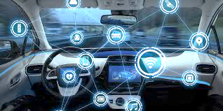
Future work
Data Augmentation
Increase Image Size
Explore Other Frameworks
Object Localization
Notes:
Data augmentation for labels that occurred the least. As we saw, ‘bus’ was not predicted by either model
- Increase image size, There was an improvement in the model going from 64 X 64 image size to 86 X 86. That’s all that my computer could handle without crashing
Adding object localization. In this project, we completed object detection (image classification) which is to classify and detect all objects in a image. The next step is object localization which is locating where that object is and drawing a bounding box. This is what bring self driving cars to a reality.
LSTM (long short term memory) and YOLO (you only look once) that can be used for multi-label classification problems

Slide 14
Thank you for your time questions?
Contact: Hiten Patel
Email:
h.patel.ms@gmail.com
Linkedin: https://www.linkedin.com/in/hitenpatel3/

