Slide 1
Image classification for self driving cars
By hiten patel

Slide 2
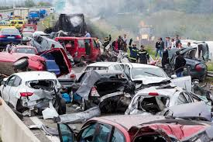
Project motivation
Car Accident stats per year:
6 million car accidents
3 million people suffer injuries
37,000 deaths
96% due to human error
Self driving vehicles will allow for more accurate and safer transportation. This will mitigate accidents, injuries, and deaths.
The goal is to build a multi-label image classification model to help identify objects which then can be used in self driving vehicles.
Notes:
driver/passenger/ped/bike
100 people die per day
Human/driver error = 5.7 million
Goal here is to reduce those numbers and removing humans from driving and create a multi-label image classification system
Which can be used for self driving cars
Financial hardship for victims

Slide 3
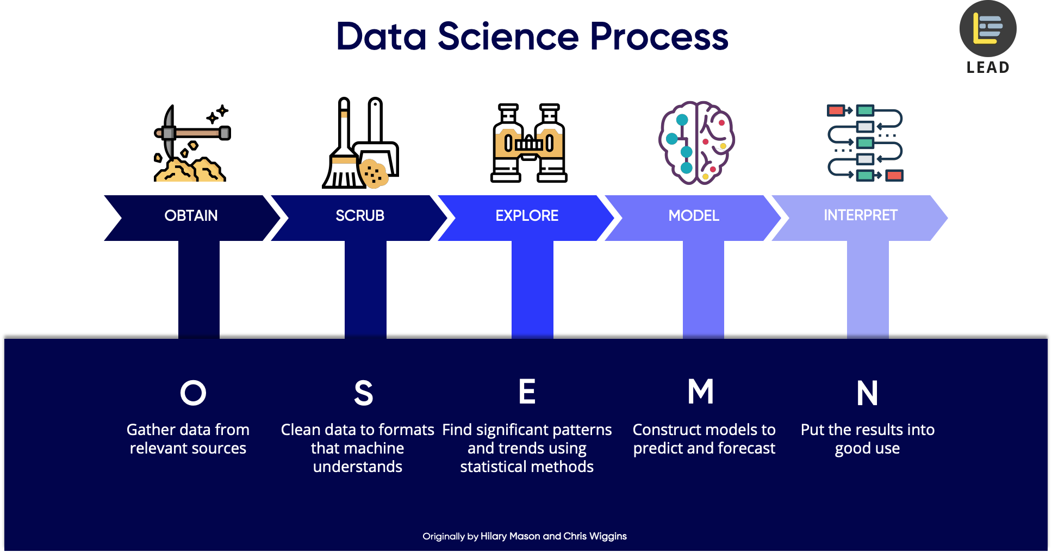
Osemn process

Slide 4
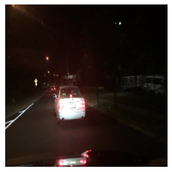
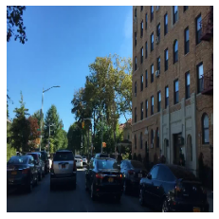
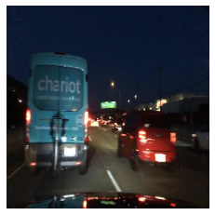
Obtain & Scrub
The data set was obtained by Berkeley Deep Drive
Contained over 100,000 images
Resize images to 86x86 and converted to array
Extract important labels and convert to one-hot-encoding
Notes:
Contained 100k images and 100k videos
For the purpose of this project, we used the images only
The dataset possesses geographic, environmental, and weather diversity, which was useful for training models that are less likely to be surprised by new conditions.
Rescale, resize the images to 86 x 86 image size –largest I could go with out the computer crashing
- we also had to scrub the labels file and extract the important labels each object was being classified as and converted to one-hot-encoding

Slide 5
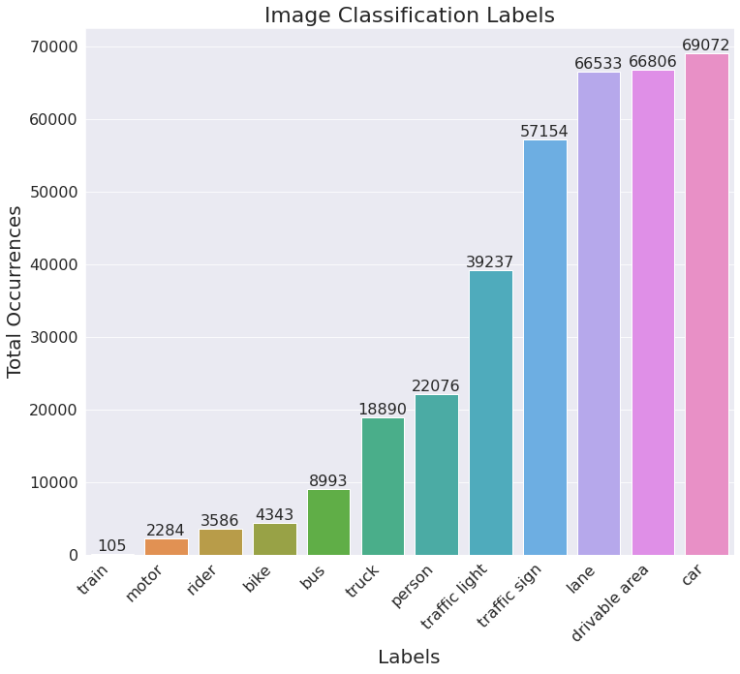
Explore
Notes:
Multilabel classification system so you will see more than one label per image,
66k of the 70k in the training set

Slide 6
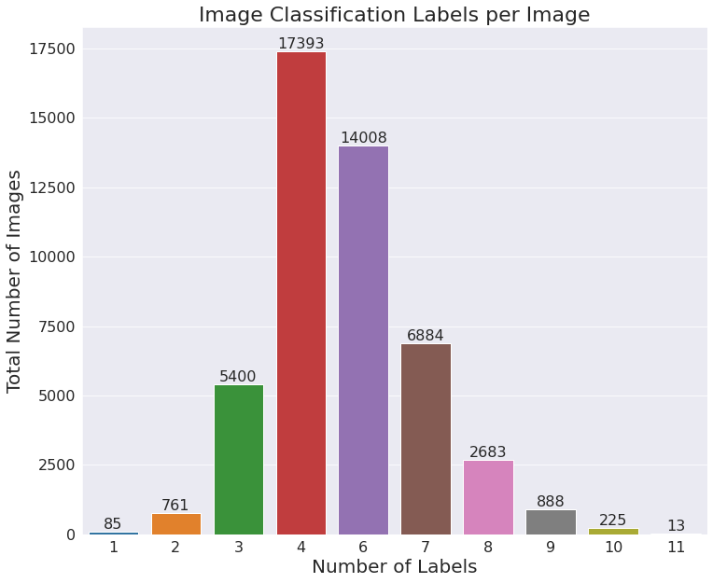
Explore more
Notes:
No images contained all 12 labels

Slide 7
Convolutional neural network
Image is scanned by a deep neural network
Networks are made of input and an output layer, as well as multiple hidden layers
Convolutional (Conv2d) layers analyze the picture and push it through to the next layer
Each layer helps determine the ”weight” of a feature in the picture.
Notes:
Analyzing the strong features and pushing them to the next layer
A feature can be certain shapes, color, things of that nature
Pooling layer takes the features and intensivies them over the network while discarding the information that doesn’t make sense

Slide 8
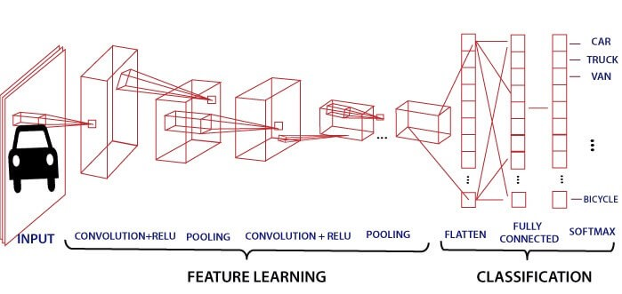
Model comparison
FINAL CNN MODEL
Hamming Loss Score: 11%
(predicted wrong labels/total labels)
Accuracy: 89% (1 – Hamming Loss Score)
Followed a Conv2D-Conv2D-Pool pattern
Faster training time than pretrained model
PRETRAINED MODEL
Hamming Loss Score: 13%
(predicted wrong labels/total labels)
Accuracy: 87% (1 – Hamming Loss Score)
InceptionResNetV2 model
Notes:
Hamming score: predicted wrong labels / total number of labels

Slide 9
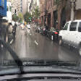
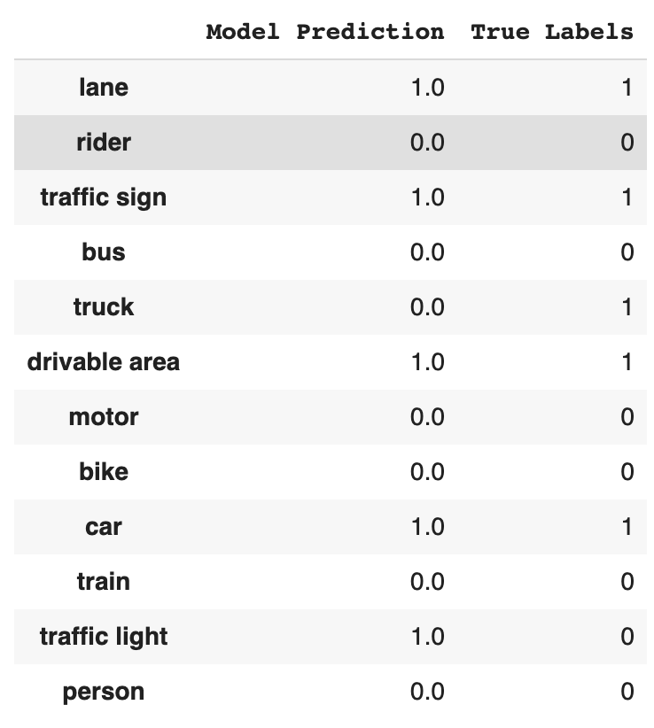
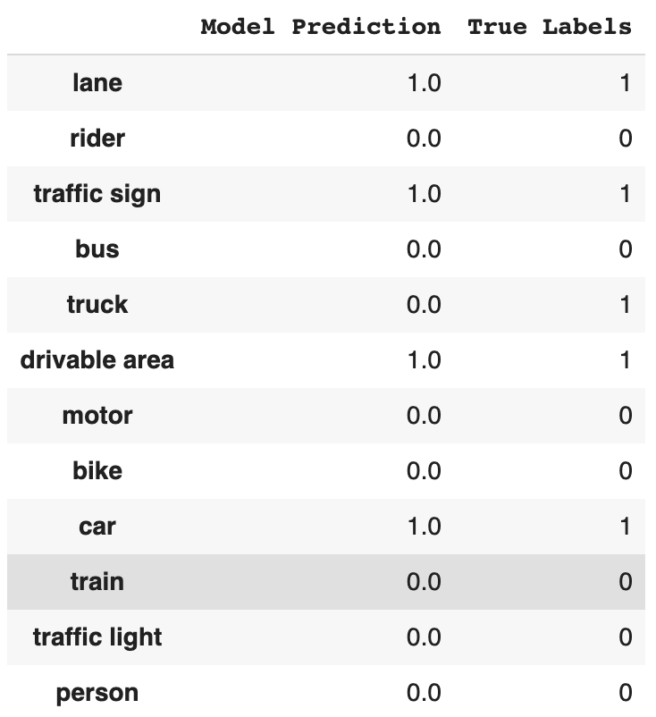
MODEL COMPARISON
CNN Model Pretrained Model
The final model did not predict 'truck' and incorrectly predicted 'traffic light'. The model got 10/12 labels correct.
The inception model did not predict 'truck'. The model got 11/12 labels correct.
Notes:
Pretrained – inceptionResNetV2
Incorrectly predicted…
Did not predict
Interestingly…if we recall on our label occurrence graph, bus had a very low frequency of only appearing in less than 9k images
Looks like the pretrained model saw the sign and predicted both traffic light and traffic sign

Slide 10
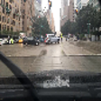
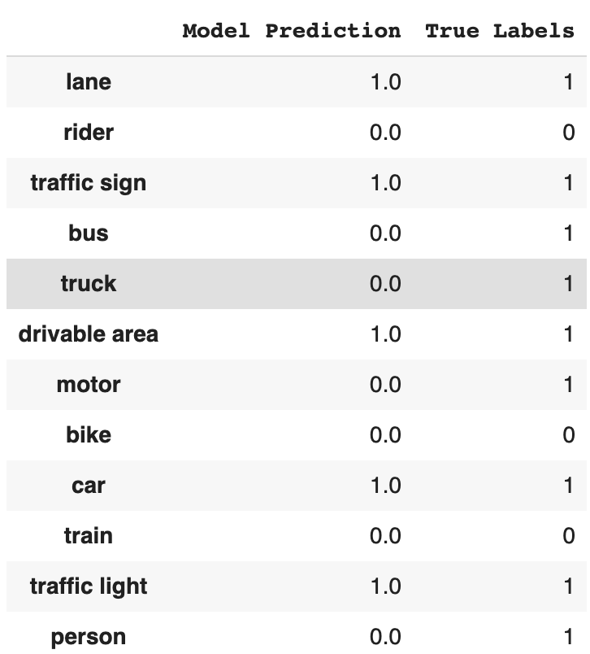
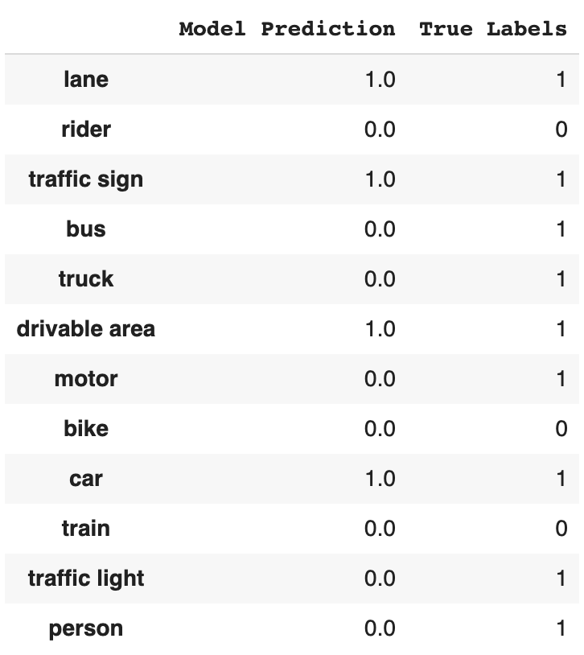
MODEL COMPARISON
CNN Model Pretrained Model
The final model did not predict 'bus', 'truck', 'motor' or 'person'. 8 of 12 labels predicted correctly.
The inception model did not predict 'bus', 'truck', 'motor', 'traffic light' or 'person' leaving the model being correct on 7/12 labels.
Both models did not predict the same labels except 'traffic light'. This could be because those same labels are on the lower side of occurrences in the training set. The pretrained model could be confusing 'traffic light' and 'traffic sign'.
Notes:
Pretrained – inceptionResNetV2
Incorrectly predicted…
Did not predict
Interestingly…if we recall on our label occurrence graph, bus had a very low frequency of only appearing in less than 9k images
Looks like the pretrained model saw the sign and predicted both traffic light and traffic sign

Slide 11
rESULTS
CNN Model: 89% accuracy
Pretrained Model: 86% accuracy
The CNN model incorrectly predicted a ‘traffic light’ and the pretrained model did not predict a ‘traffic light’.
Both models failed to predict a ‘bus’, ’truck’, ‘person’ or ‘motor’ in a image
Notes:
The models may be confusing traffic light with traffic sign or vice versa
The models did not predict bus, truck, person, or motor. Which makes sense to a degree because in the training set, the images contained these items the least.

Slide 12
recommendations
Car companies can use the CNN image classification model as a driver assistant
Starting point to create a self driving electric vehicle
Building your own? Use a CNN and a diverse dataset
Notes:
- Model is not 100 percent and missing labels
Essentially be used as a second pair of eyes to highlight objects. And could be greatly beneficial in the dark and rush hour. This will help mitigate car accidents
Diverse data set with no surprises

Slide 13
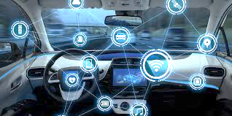
Future work
Data Augmentation
Increase Image Size
Explore Other Frameworks
LSTM
YOLO
Object Localization
Notes:
Data augmentation for labels that occurred the least. As we saw, ‘bus’ was not predicted by either model
- Increase image size, There was an improvement in the model going from 64 X 64 image size to 86 X 86. That’s all that my computer could handle without crashing
LSTM (long short term memory) and YOLO (you only look once) that can be used for multi-label classification problem
Adding object localization. In this project, we completed object detection (image classification) which is to classify and detect all objects in a image. The next step is object localization which is locating where that object is and drawing a bounding box. This is what bring self driving cars to a reality.

Slide 14
Thank you for your time questions?
Contact: Hiten Patel
Email:
h.patel.ms@gmail.com
Linkedin: https://www.linkedin.com/in/hitenpatel3/

