Slide 1
Strategies for Dynamic Load Balancing on Highly Parallel Computers
Amy Le
M. Willebeek and A. Reeves. Strategies for Dynamic Load Balancing on Highly Parallel Computers. IEEE Trans. On parallel and distributed systems, 4(9), September, 1993

Slide 2
Dynamic Load Balancing
Motivation
5 Strategies
Comparison
Result
Amy Le

Slide 3
Motivation
Uniform
Even computation
Non-Uniform
Unpredictable load
Even communication
Uneven communication
Amy Le

Slide 4
5 Strategies
SID
RID
HBM
GM
DEM
Sender initiates diffusing heavy loads to neighbors
Overloaded processors send heavy loads to neighbors
Under loaded processors ask for heavy loads from neighbors
Hierarchy of processors balance loads by level
Map all processors and their loads
Synchronize, then iteratively balance
Amy Le
Notes:
Processor load evaluation – how to know if I am under or over loaded?
Load balancing profitability – is it worth the overhead to load balance
Task migration – who gets the extra work?
Task selection – which part of the problem gets split off?
Trade off between accuracy and increased time for communication

Slide 5
5 Criteria
Initiation
Balancing Domain
Knowledge
Aging Period
Overhead
Sender initiates diffusing heavy loads to neighbors
Who decides which processor gets more work?
Which processors are allowed to take on more work?
How much information should each processor know?
How long before processor load size is invalid?
How does this strategy scale?
Amy Le
Notes:
Initiation: sending proc, receiving proc, or pre-designated proc
Balancing domain: nearest neighbor diffusion (consistently) or variable domain that can grow/shrink. Main goal is to decentralize balancing process and reduce complexity.
Knowledge: RID/SID only know K neighbors but GM, DEM, HBM use hierarchical structure. More info = more accurate & more time
Aging Period: Update information. Delay between load determination and load balancing.
Overhead: RID/SID increases with number of neighbors, independent of problem size. HBM is a binary tree, scales with O(logn). GM requires N proximity updates (linear). DEM requires full synchronization.

Slide 6
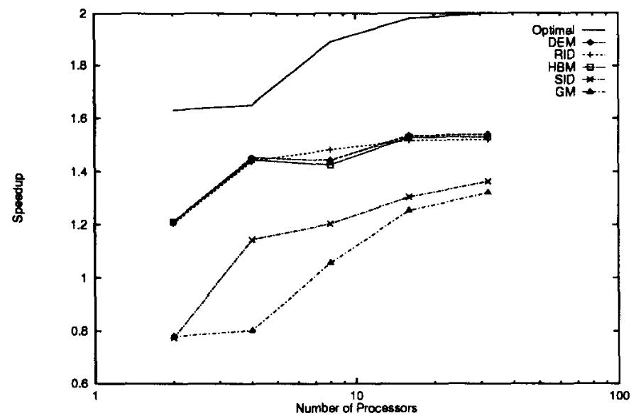

Slide 7
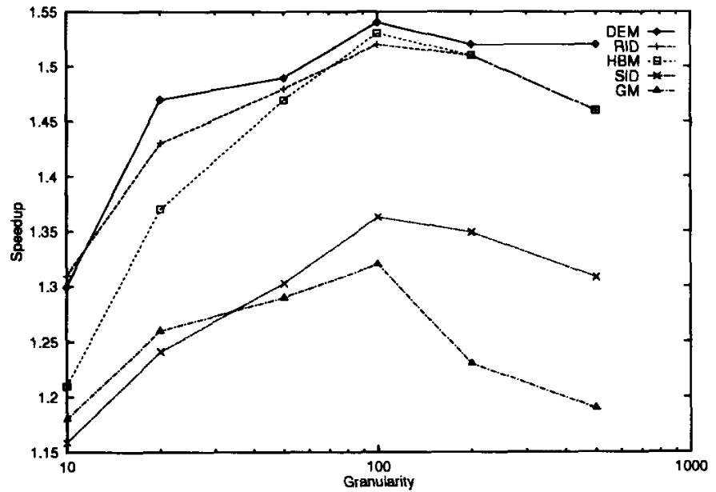

Slide 8
Results
Granularity
Overhead
Task Locality
Sender initiates diffusing heavy loads to neighbors
DEM
RID
HBM
RID
DEM & HBM
RID
Amy Le
Notes:
DEM & HBM depend heavily on system connection topology (hypercube)
DEM synchronization cost and HBM nonuniform overhead distribution results in poor scalability
SID may send an excessive amount of tasks but RID will never receive more than half of its neighbors tasks
SID task granularity poor compared to RID so there is less overhead with RID

