Slide 1
Iterative development
Not just for software!
What did you think of this boot camp?

Slide 2
Feedback and follow-up
http://www.archer.ac.uk/training/feedback/
You can ask questions at all virtual tutorials
http://www.archer.ac.uk/training/virtual/

Slide 3
Getting access to ARCHER
Standard research grant
Request Technical Assessment using form on ARCHER website
Submit completed TA with notional cost in Je-S
Apply for time for maximum of 2 years
ARCHER Resource Allocation Panel (RAP)
Request Technical Assessment using form on ARCHER website
Submit completed TA with RAP form
Every 4 months
Application for computer time only
Instant Access – Pump-Priming Time
Request Technical Assessment using form on ARCHER website
Submit completed TA with 2 page description of work

Slide 4
Support and Documentation
Helpdesk
Email support@archer.ac.uk
via ARCHER SAFE http://www.archer.ac.uk/safe
phone: +44 (0)131 650 5000
By post, to: Liz Sim EPCC, University of Edinburgh JCMB, The King's Buildings Mayfield Road, EDINBURGH, EH9 3JZ
http://www.archer.ac.uk/community/techforum/
http://www.archer.ac.uk/documentation/

Slide 5
Training opportunities
ARCHER Training (free to academics)
http://www.archer.ac.uk/training/
Online sessions (using Blackboard Collaborate)
Technical Forum meetings (normally15:00 last Wednesday of month)
technical presentations of interest to ARCHER users
http://www.archer.ac.uk/community/techforum/
Virtual tutorials (normally 15:00 second Wednesday of month)
opportunity for discussion with ARCHER staff on any topic
usually starts with a presentation of general interest
http://www.archer.ac.uk/training/virtual/
EPCC MSc in HPC (scholarships available)
http://www.epcc.ed.ac.uk/msc/

Slide 6
Funding calls
Embedded CSE support
Through a series of regular calls, Embedded CSE (eCSE) support provides funding to the ARCHER user community to develop software in a sustainable manner for running on ARCHER. Funding will enable the employment of a researcher or code developer to work specifically on the relevant software to enable new features or improve the performance of the code
Apply for funding for development effort
Planned every 4 months
Second call closes 4pm on Tuesday 13th May
See http://www.archer.ac.uk/community/eCSE/ for details

Slide 7
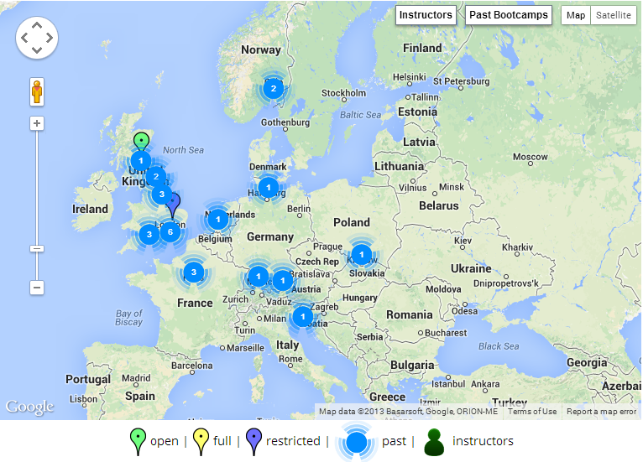




Getting involved in Software Carpentry
admin-uk@software-carpentry.org
http://software-carpentry.org/bootcamps
http://software-carpentry.org/lessons.html

Slide 8

Software Sustainability Institute
We want the research community to
Recognise software as a fundamental research output
Recognise the value of research software engineers
Receive better software training
Recognise the role of software in reproducibility
What we do
Fellowship: we find and nurture researchers with combined talents in research and software
Software Carpentry: teaching basic software skills to researchers from all disciplines
Consultancy: providing software expertise to advance research software
Campaigning: raising the profile of software in research and highlighting the issues it faces
We are supported by EPSRC under grant EP/H043160/1

Slide 9












Some of our partners

