Slide 1
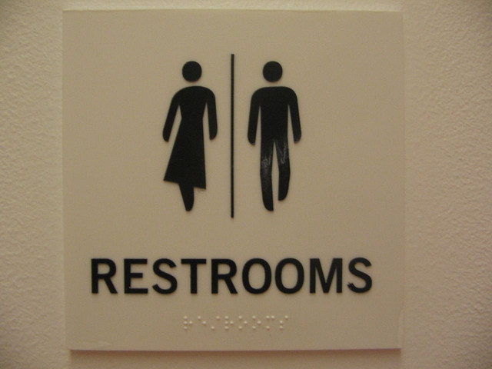
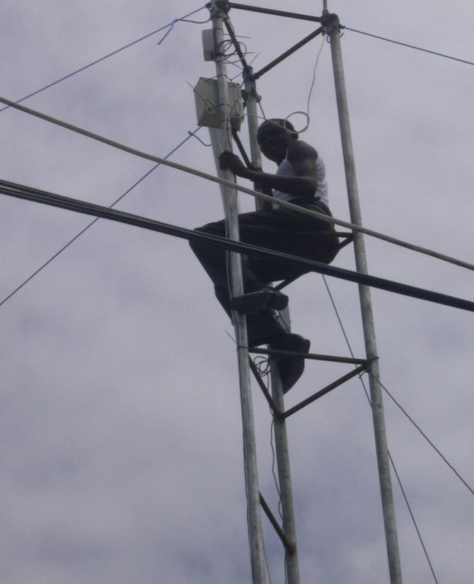
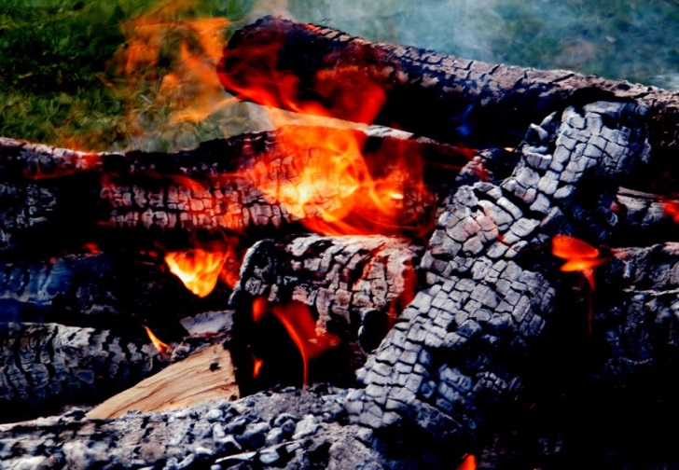
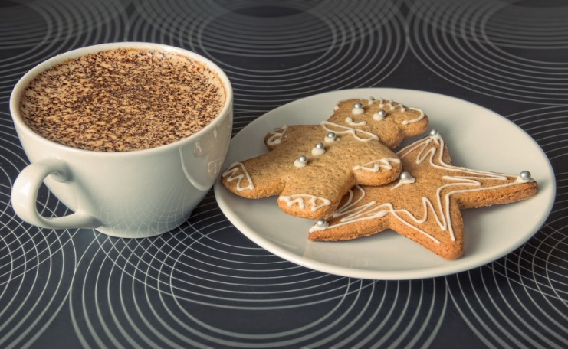
Important stuff
Images courtesy of (clockwise from top-left) oneVillage initiative, Bobbymond, Dajanda, Anton Novojilov

Slide 2
How to ask for help
Flag down a helper
Stick up your sticky note
Red – I’m stuck, help!
Green – I’m fine

