Slide 1
Pulling everything together
Mike Jackson, ARCHER CSE Team
michaelj@epcc.ed.ac.uk

Slide 2

Reusing this material
This work is licensed under a Creative Commons Attribution-NonCommercial-ShareAlike 4.0 International License.
http://creativecommons.org/licenses/by-nc-sa/4.0/deed.en_US
This means you are free to copy and redistribute the material and adapt and build on the material under the following terms: You must give appropriate credit, provide a link to the license and indicate if changes were made. If you adapt or build on the material you must distribute your work under the same license as the original.
Note that this presentation contains images owned by others. Please seek their permission before reusing these images.

Slide 3





http://www.archer.ac.uk
support@archer.ac.uk

Slide 4
Best practices for scientific computing
Write programs for people, not computers
Let the computer do the work
Make incremental changes
Don’t repeat yourself (or others)
Plan for mistakes
Optimize software only after it works correctly
Document design and purpose, not mechanics
Collaborate
Wilson G, Aruliah DA, Brown CT, Chue Hong NP, Davis M, et al. (2014) Best Practices for Scientific Computing. PLoS Biol 12(1): e1001745. doi:10.1371/journal.pbio.1001745. http://dx.doi.org/10.1371/journal.pbio.1001745.
Notes:
“Scientists spend an increasing amount of time building and using software. However, most scientists are never taught how to do this efficiently. As a result, many are unaware of tools and practices that would allow them to write more reliable and maintainable code with less effort. We describe a set of best practices for scientific software development that have solid foundations in research and experience, and that improve scientists' productivity and the reliability of their software.”
1. Write programs for people, not computers
(a) A program should not require its readers to hold more than a handful of facts in memory at once
(b) Make names consistent, distinctive, and meaningful
(c) Make code style and formatting consistent
2. Let the computer do the work.
(a) Make the computer repeat tasks.
(b) Save recent commands in a ﬁle for re-use.
(c) Use a build tool to automate workﬂows.
3. Make incremental changes.
(a) Work in small steps with frequent feedback and course correction.
(b) Use a version control system.
(c) Put everything that has been created manually in version control.
4. Don’t repeat yourself (or others).
(a) Every piece of data must have a single authoritative representation in the system.
(b) Modularize code rather than copying and pasting.
(c) Re-use code instead of rewriting it.
5. Plan for mistakes.
(a) Add assertions to programs to check their operation.
(b) Use an oﬀ-the-shelf unit testing library.
(c) Turn bugs into test cases.
(d) Use a symbolic debugger.
6. Optimize software only after it works correctly.
(a) Use a proﬁler to identify bottlenecks.
(b) Write code in the highest-level language possible.
7. Document design and purpose, not mechanics.
(a) Document interfaces and reasons, not implementations.
(b) Refactor code in preference to explaining how it works.
(c) Embed the documentation for a piece of software in that software.
8. Collaborate.
(a) Use pre-merge code reviews.
(b) Use pair programming when bringing someone new up to speed and when tackling
particularly tricky problems.
(c) Use an issue tracking tool

Slide 5
Ten simple rules for reproducible computational research
For every result, keep track of how it was produced
Avoid manual data manipulation steps
Archive the exact versions of all external programs used
Version control all custom scripts
Record all intermediate results, when possible in standardized formats
For analyses that include randomness, note underlying random seeds
Always store raw data behind plots
Generate hierarchical analysis output, allowing layers of increasing detail to be inspected
Connect textual statements to underlying results
Provide public access to scripts, runs, and results
Sandve GK, Nekrutenko A, Taylor J, Hovig E (2013) Ten Simple Rules for Reproducible Computational Research. PLoS Comput Biol 9(10): e1003285. doi:10.1371/journal.pcbi.1003285. http://dx.doi.org/10.1371/journal.pcbi.1003285.
Notes:
Track how results were produced. This includes: data files, parameters, command-line parameters, configuration files, URLs of online data sources, software versions etc.
Automate manual data manipulation steps – shell scripts, Python scripts, pipelines e.g. e.g. sed, awk, grep, head, tail, sort,
If a file format supports meta-data then use it to record – who, when, what version of software produced it etc.
If you are defining your own file format, then add this meta-data.

Slide 6
Why bother?
Poor organizational choices can lead to significantly slower research progress
Help someone unfamiliar with your project look at your files and understand in detail what you did and why
Researchers, collaborators, students, research supervisors, PIs
You!
Help yourself do things over and over again
Correct flaws in the initial preparation of the data being analysed
Update when you get access to new data
Broaden parameterizations of a particular model
Noble WS (2009) A Quick Guide to Organizing Computational Biology Projects. PLoS Comput Biol 5(7): e1000424. doi:10.1371/journal.pcbi.1000424. http://dx.doi.org/10.1371/journal.pcbi.1000424.
Notes:
“A few months from now, you may not remember what you were up to when you created a particular set of files, or you may not remember what conclusions you drew. You will either have to then spend time reconstructing your previous experiments or lose whatever insights you gained from those experiments.”

Slide 7
Iterative development
Not just for software!
What did you think of this boot camp?

Slide 8
Feedback and follow-up
http://www.archer.ac.uk/training/feedback/
You can ask questions at all virtual tutorials
http://www.archer.ac.uk/training/virtual/

Slide 9
Getting access to ARCHER
Standard research grant
Request Technical Assessment using form on ARCHER website
Submit completed TA with notional cost in Je-S
Apply for time for maximum of 2 years
ARCHER Resource Allocation Panel (RAP)
Request Technical Assessment using form on ARCHER website
Submit completed TA with RAP form
Every 4 months
Application for computer time only
Instant Access – Pump-Priming Time
Request Technical Assessment using form on ARCHER website
Submit completed TA with 2 page description of work

Slide 10
Support and Documentation
Helpdesk
Email support@archer.ac.uk
via ARCHER SAFE http://www.archer.ac.uk/safe
phone: +44 (0)131 650 5000
By post, to: Liz Sim EPCC, University of Edinburgh JCMB, The King's Buildings Mayfield Road, EDINBURGH, EH9 3JZ
http://www.archer.ac.uk/community/techforum/
http://www.archer.ac.uk/documentation/

Slide 11
Training opportunities
ARCHER Training (free to academics)
http://www.archer.ac.uk/training/
Online sessions (using Blackboard Collaborate)
Technical Forum meetings (normally15:00 last Wednesday of month)
technical presentations of interest to ARCHER users
http://www.archer.ac.uk/community/techforum/
Virtual tutorials (normally 15:00 second Wednesday of month)
opportunity for discussion with ARCHER staff on any topic
usually starts with a presentation of general interest
http://www.archer.ac.uk/training/virtual/
EPCC MSc in HPC (scholarships available)
http://www.epcc.ed.ac.uk/msc/

Slide 12
Funding calls
Embedded CSE support
Through a series of regular calls, Embedded CSE (eCSE) support provides funding to the ARCHER user community to develop software in a sustainable manner for running on ARCHER. Funding will enable the employment of a researcher or code developer to work specifically on the relevant software to enable new features or improve the performance of the code
Apply for funding for development effort
Planned every 4 months
Third call opens Tuesday 5th August, 2014 and closes at 4pm on Tuesday 16th September, 2014 (to be confirmed)
See http://www.archer.ac.uk/community/eCSE/ for details

Slide 13
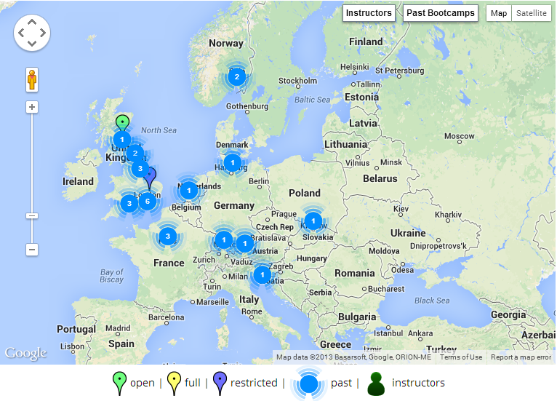



Getting involved in Software Carpentry
admin-uk@software-carpentry.org
http://software-carpentry.org/bootcamps
http://software-carpentry.org/lessons.html

Slide 14

Software Sustainability Institute
We want the research community to
Recognise software as a fundamental research output
Recognise the value of research software engineers
Receive better software training
Recognise the role of software in reproducibility
What we do
Fellowship: we find and nurture researchers with combined talents in research and software
Software Carpentry: teaching basic software skills to researchers from all disciplines
Consultancy: providing software expertise to advance research software
Campaigning: raising the profile of software in research and highlighting the issues it faces
We are supported by EPSRC under grant EP/H043160/1

Slide 15












Some of our partners

Slide 16
Thank you!

