Slide 1
ARCHER Software Carpentry workshop
Mario Antonioletti, Alistair Grant, Mike Jackson, Arno Proeme
ARCHER CSE Team
mario@epcc.ed.ac.uk
agrant3@epcc.ed.ac.uk
michaelj@epcc.ed.ac.uk
aproeme@epcc.ed.ac.uk

Slide 2

Reusing this material
This work is licensed under a Creative Commons Attribution-NonCommercial-ShareAlike 4.0 International License.
http://creativecommons.org/licenses/by-nc-sa/4.0/deed.en_US
This means you are free to copy and redistribute the material and adapt and build on the material under the following terms: You must give appropriate credit, provide a link to the license and indicate if changes were made. If you adapt or build on the material you must distribute your work under the same license as the original.
Note that this presentation contains images owned by others. Please seek their permission before reusing these images.

Slide 3





http://www.archer.ac.uk
support@archer.ac.uk

Slide 4

http://www.training.prace-ri.eu
Notes:
Hubs for world-class HPC training for researchers in Europe.
Barcelona Supercomputing Center (Spain).
CINECA – Consorzio Interuniversitario (Italy).
CSC – IT Center for Science Ltd (Finland).
EPCC at the University of Edinburgh (UK).
Gauss Centre for Supercomputing (Germany).
Maison de la Simulation (France).
PRACE also funds catering and other expenses for PATC courses.
Please fill in the course feedback form linked in from the registration page - opens on last day of course.

Slide 5
ARCHER in a nutshell
UK National Supercomputing Service
Replacement for HECToR (they overlapped by ~4 months)
Cray XC30 Hardware
Nodes based on 2×Intel Ivy Bridge 12-core processors
64GB (or 128GB) memory per node
3008 nodes in total (72162 cores)
Linked by Cray Aries interconnect (dragonfly topology)
Cray Application Development Environment
Cray, Intel, GNU Compilers
Cray Parallel Libraries (MPI, SHMEM, PGAS)
DDT Debugger, Cray Performance Analysis Tools

Slide 6
Performance
HECToR #50 in top 500 with 830 TFlop/s
ARCHER
Designed to provide 3-4 times scientific throughput of HECToR
#19 in November 2013 top 500 list with 1.65 PFlop/s
Fastest (known) computer in the UK
Extract the best performance possible from the hardware

Slide 7
Optimization is perlious
“More computing sins are committed in the name of efficiency (without necessarily achieving it) than for any other single reason ..
…Including blind stupidity” (Wulf)
"We should forget about small efficiencies, say about 97% of the time:
…Premature optimization is the root of all evil.“ (Knuth 1974)
Notes:
http://en.wikipedia.org/wiki/Program_optimization

Slide 8
Optimization
What is preferable?
An optimised code that produces incorrect results?
A non-optimised code that produces correct results?
Which is the most efficient use of resources?
How do we prevent ourselves introducing bugs when we’re optimizing and parallelizing?
Isn’t our time more valuable than a computer’s time?
Hardware life < software life < our life

Slide 9
Three rules of optimization
Don't – optimised code is not readable or maintainable code
Don't....yet – designing code is not the same as optimising code
Profile first – anything else is just a guess!
Notes:
http://en.wikipedia.org/wiki/Program_optimization
Don't, negative effect on readability and maintainability, hardware is cheap, developer time is expensive.
Don't yet, designing =/= optimizing. Don't optimize until the design is correct.
Profile first, an educated guess is still a guess.
Dissuade novice programmers from cluttering up their programs with vain attempts at writing optimal code.
http://c2.com/cgi/wiki?RulesOfOptimization
http://blogs.msdn.com/b/audiofool/archive/2007/06/14/the-rules-of-code-optimization.aspx?Redirected=true
Software developers have the skills, tools and techniques to help us.
Many compilers are more efficient than people.

Slide 10
Optimize ourselves
Technical debt
1-10-100 rule
50%-80% of errors
in
15%-20% of modules
(Davis 1995 quoting Endres 1975, Weinberg 1992)
number / cost
50% of modules are error free
(Boehm and Basili 2001)
# design errors >> # coding errors
(Boehm et al. 1975)
time
Notes:
Empirical research into software development.
Note how long some of these have been known.
“Some experience with automated aids to the design of large-scale reliable software”, Software Engineering, IEEE Transactions on, March 1975, Boehm, B.W. McClean, R.K., Urfrig, D.B. Volume: SE-1, Issue: 1, Page(s): 125 – 133.
“large preponderance of design errors over coding errors on large-scale projects, not only with respect to numbers of errors, but also with respect to the relative time and effort required to detect them and correct them”
"Half the errors are found in 15% of the modules" (Davis 1995, quoting Endres 1975)
“80% of all errors are found in just 2% (sic) of the modules" (Davis 1995, quoting Weinberg 1992)
"About 80% of the defects come from 20% of the modules, and about half the modules are error free" (Boehm and Basili 2001)
1-10-100 rule – “if it takes one unit of costs or effort to complete a job correctly, it will take 10 times that effort to correct an error before it reaches the customer. Once it has reached the customer, it will take 100 times the cost and effort to correct the situation, not to mention the loss of customer goodwill.”

Slide 11
Programming language or programmer?
“The number of lines of code a programmer can write in a fixed period of time is the same independent of the language used” – Corbato’s Law
“Regardless of whether one is dealing with assembly language or compiler language, the number of debugged lines of source code per day is about the same!” (Corbato 1969)
“performance variability that derives from differences among programmers of the same language … is on average as large or larger than the variability found among the different languages.” (Prechelt 2000)
Notes:
Prechelt, L. An empirical comparison of C, C++, Java, Perl, Python, Rexx, and Tcl for a search/string-processing program, Technical report, Fakultat fur Informatik Universitat Karlsruhe, March 10, 2000.
Prechelt, L. An Empirical Comparison of Seven Programming Languages, IEEE Computer, October 2000, pp23-29.
http://citeseerx.ist.psu.edu/viewdoc/download?doi=10.1.1.113.1831&rep=rep1&type=pdf
C, C++, Java, Perl, Python, Rexx, and Tcl.
Corbató, F. J. (6 May 1969). "PL/I as a Tool for System Programming". Datamation 15 (5): 68–76.

Slide 12

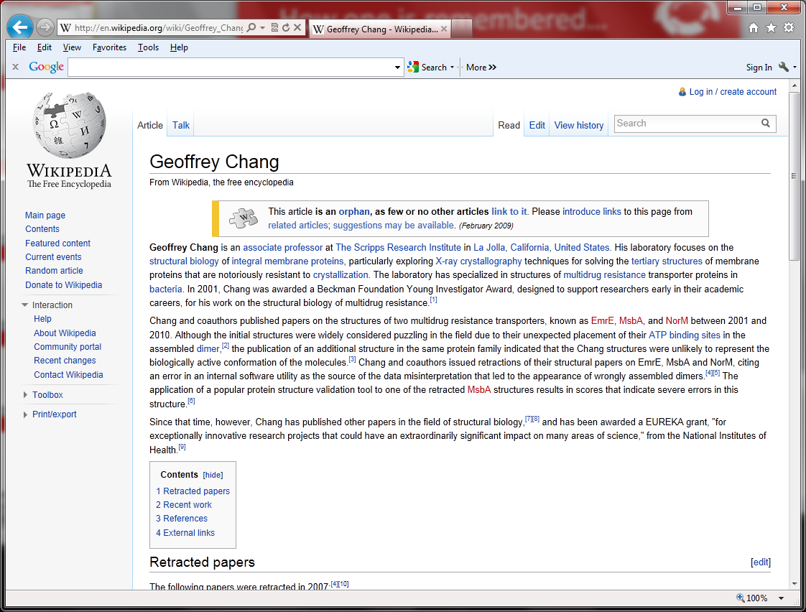
What about correctness?
We wish to retract our research article … and both of our Reports...
An in-house data reduction program introduced a change in sign for anomalous differences…
Unfortunately, the use of the multicopy refinement procedure still allowed us to obtain reasonable refinement values for the wrong structures.
Notes:
Consequences for missed bugs can be dramatic.
Geoffrey Chang, Scripps scholar, flipped sign bit, retracted papers from Science, December 2006.
Wikipedia entry notes this unfortunate occurrence!
McKitrick and Michaels, 2004, climate research, data in degrees, used component that expected data in radians, they didn’t do any conversion, this was spotted, they had to retract
How optimal is this? ;-)

Slide 13
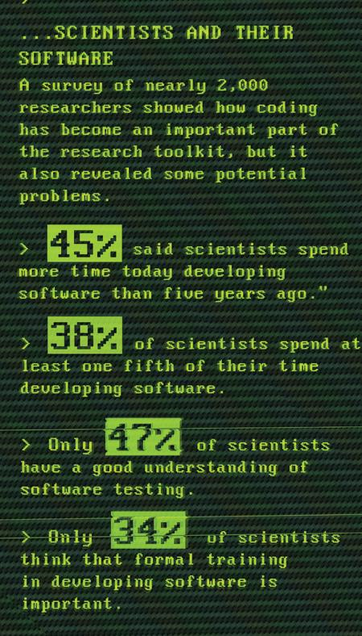
A skills gap
Hannay et al, “How Do Scientists Develop and Use Scientific Software?
SECSE '09 Proceedings of the 2009 ICSE Workshop on Software Engineering for Computational Science and Engineering, IEEE Computer Society, 2009. DOI: 10.1109/SECSE.2009.5069155
Images courtesy of Greg Wilson and Neil Chue Hong
Notes:
Software developers have the skills, tools and techniques to help us but why aren’t they used?

Slide 14

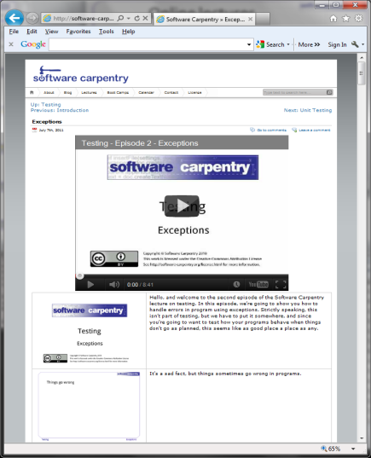
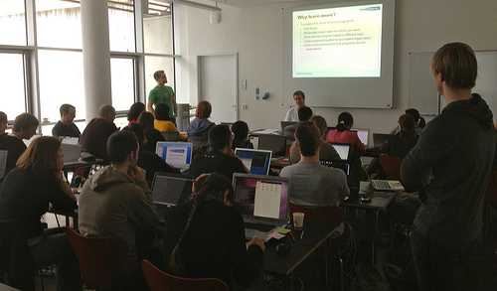





Filling the gap
Notes:
Software Carpentry workshops, online lectures and book.
SSI, led from EPCC, are coordinators of SWC in the UK.
RCUK are promoting SWC to CDTs and DTCs.
DiRAC supercomputing consortium are also exploiting SWC.

Slide 15
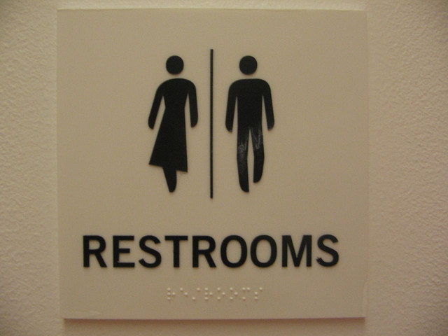
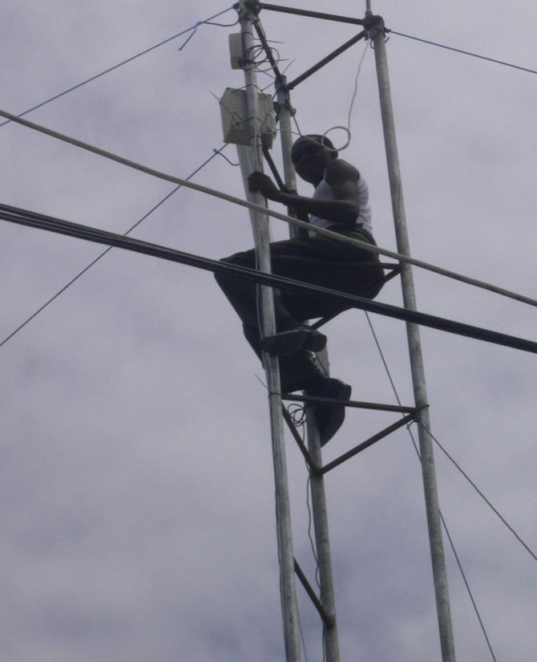


Important stuff
Images courtesy of (clockwise from top-left) oneVillage initiative, Bobbymond, Dajanda, Anton Novojilov

Slide 16
How to ask for help
Flag down a helper
Stick up your sticky note
Red – I’m stuck, help!
Green – I’m fine

