Slide 1

New York City Taxi Trips

Slide 2

Had known, I would book a cab earlier

Slide 3

Prediction
NYC Taxi Data
48 GB
241M RECORDS
JAN 2015 – JUN 2016
16 MONTH
W/ WEATHER INFO
NOTE: The slides introduce you to a sample of the original dataset to keep the instructions simple and precise. The instructions to use the complete dataset is listed in the Appendix.

Slide 4
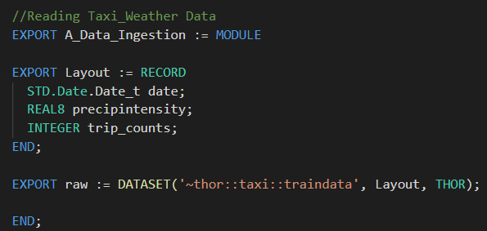
Read Data
date | precipintensity | trip_counts
20150106 | 0.001289982 | 374040
20150118 | 0.057181148 | 416962
20150126 | 0.008881908 | 224097
20150130 | 0.001424809 | 471812
20150202 | 0.015235616 | 329387
Sample Dataset

Slide 5
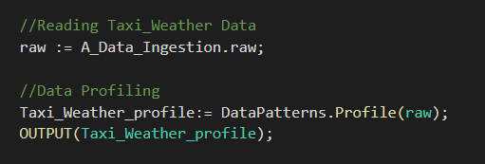
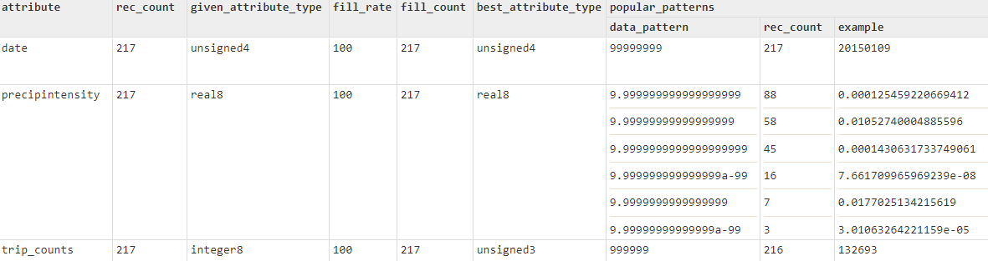
Profile
Profile Result Example

Slide 6
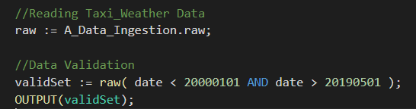
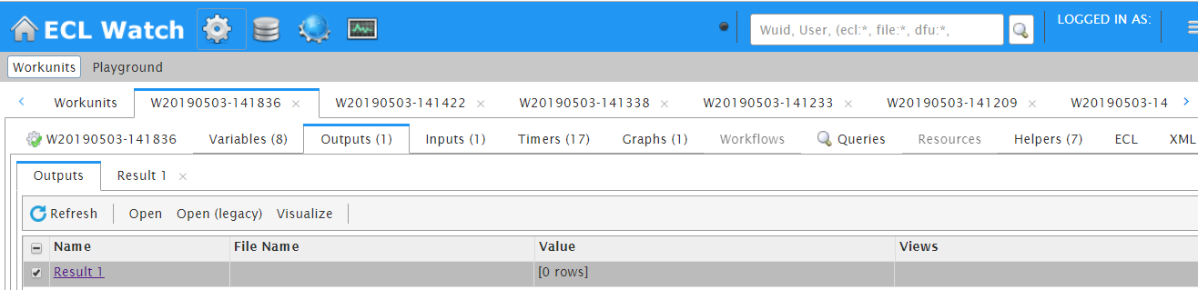
Validation
Validation Result Example

Slide 7
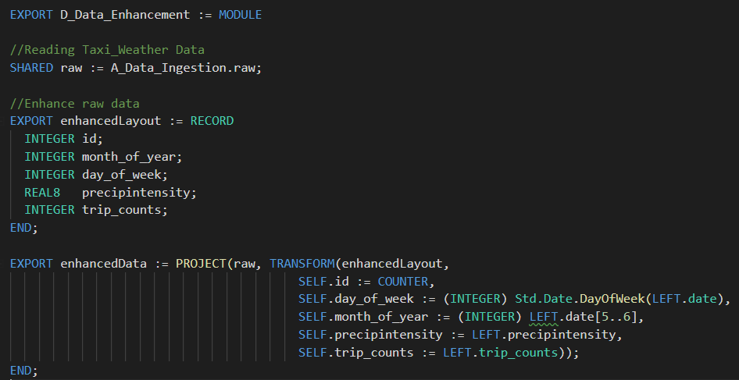
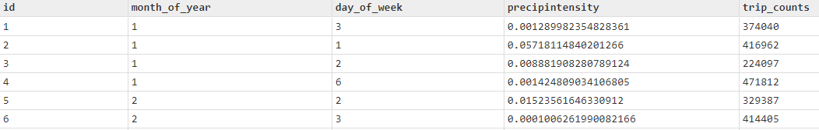
Enhance
Enhancement Result Example

Slide 8
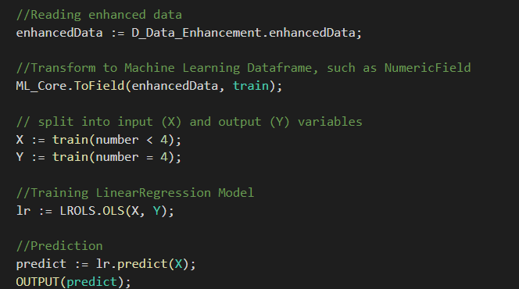
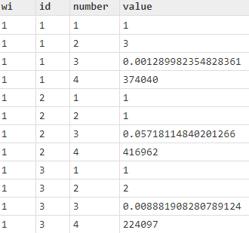
Linear Regression
ML Dataframe: NumericField
Linear Regression Result Example

Slide 9
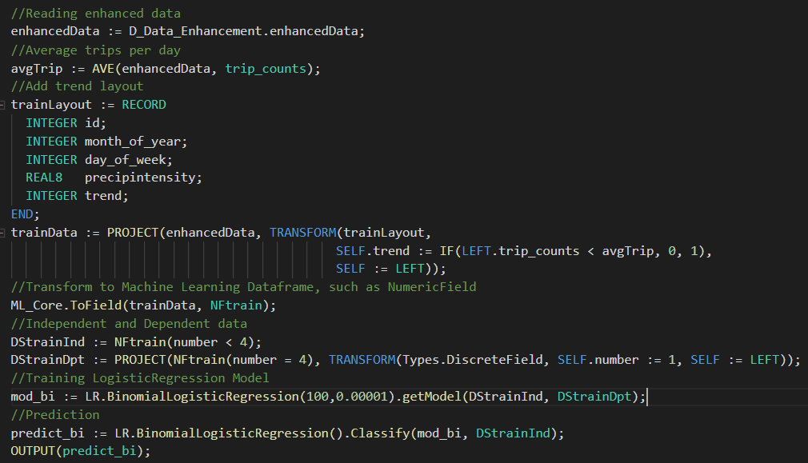
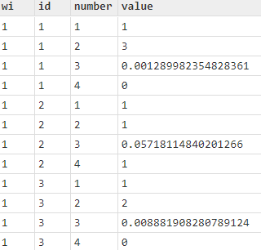
Logistic Regression
ML Dataframe: DiscreteField
Logistic Regression Result Example

Slide 10
Appendix
This tutorial is based on a sample set of the original data.
For the complete information about the original tutorial, please see details in below Github Repository
https://github.com/lilyclemson/Solutions-ECL-Training/tree/master/Taxi_Tutorial

