Slide 1

Stock Price Prediction

Slide 2
Stock Data
3 U.S. stock exchanges
NYSE
NASDAQ
AMEX
16 years of data
1GB of data in tab-delimited format
~21M rows of data
NOTE: The slides introduce you to a sample of the original dataset to keep the instructions simple and precise. The instructions to use the complete dataset is listed in the Appendix.

Slide 3
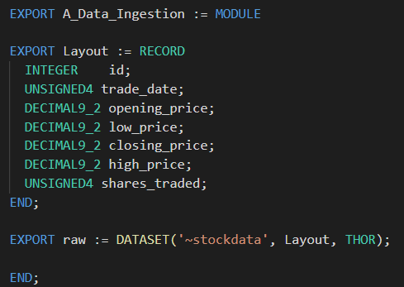
Read Data
trade_date | trade_date | opening_price | high_price | low_price | closing_price | shares_traded
20020102 | 20020103 | 1.64 | 1.7 | 1.63 | 1.68 | 152705000
20020103 | 20020104 | 1.67 | 1.71 | 1.64 | 1.69 | 102481400
20020104 | 20020107 | 1.69 | 1.71 | 1.63 | 1.64 | 111115200
20020107 | 20020108 | 1.63 | 1.65 | 1.6 | 1.62 | 112501200
Sample Dataset

Slide 4
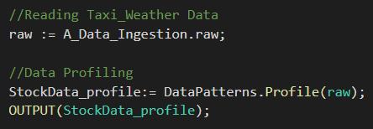
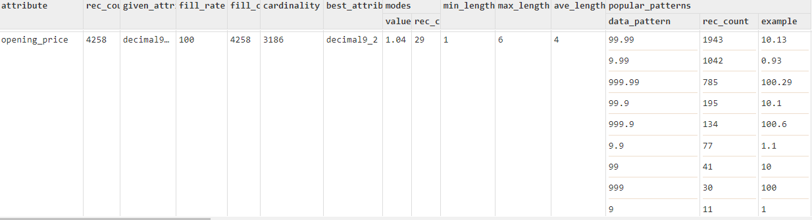
Profile
Profile Result Example

Slide 5
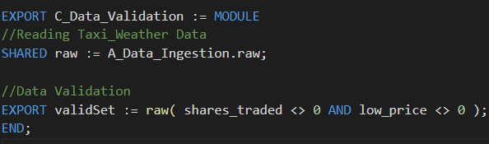
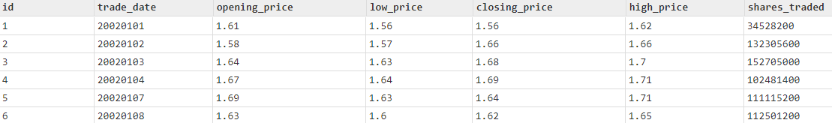
Validation
Validation Result Example

Slide 6
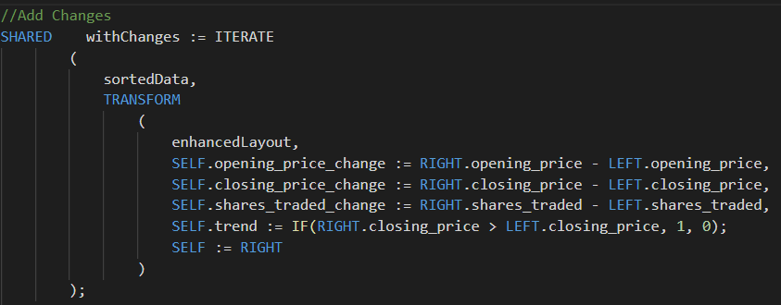
Enhance
Enhancement Result Example

Slide 7
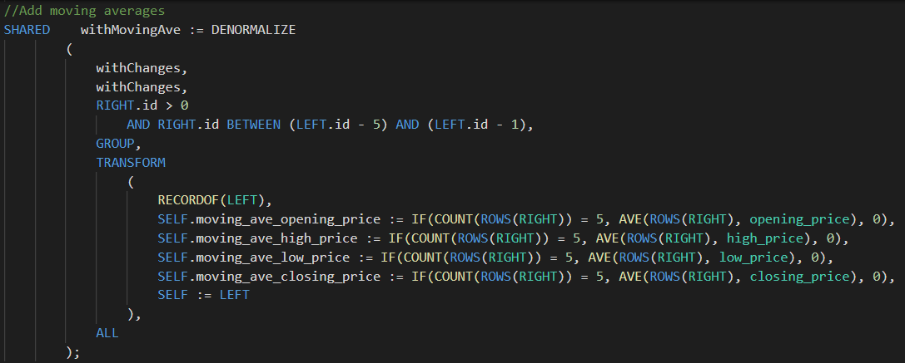
Enhance
Enhancement Result Example

Slide 8
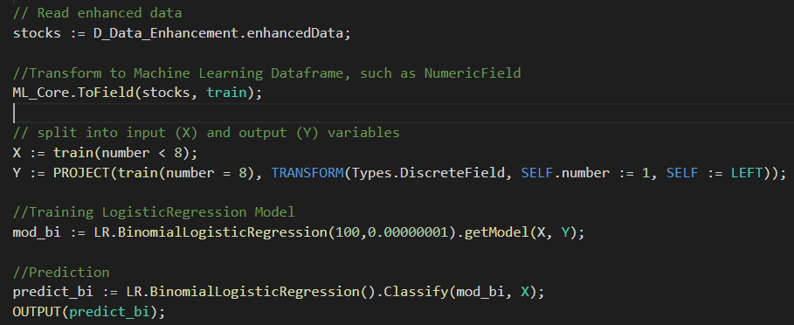
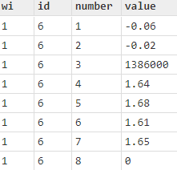
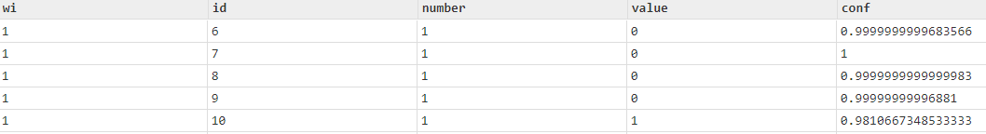
Logistic Regression
ML Dataframe: DiscreteField
Logistic Regression Result Example

Slide 9
Appendix
This tutorial is based on a sample set of the original data.
For the complete information about the original tutorial, please see details in below Github Repository
https://github.com/dcamper/StockTrade

