Slide 1
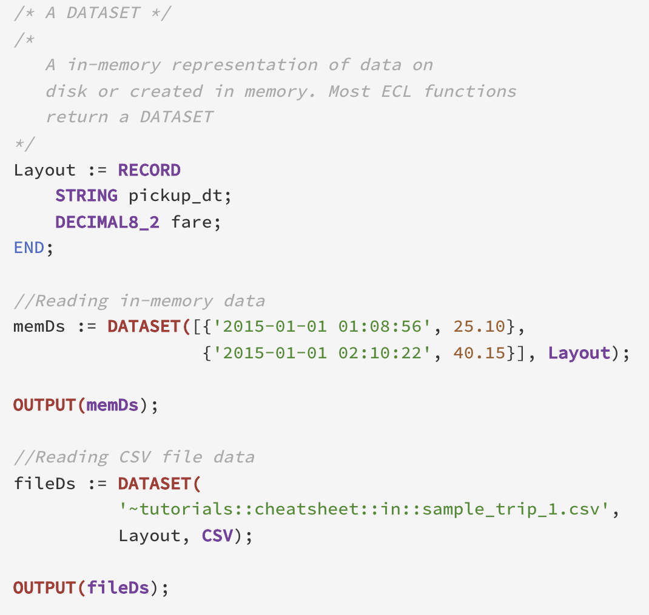
Dataset
2015-01-01 01:08:56 | 25.10
2015-01-01 02:10:22 | 40.15

Slide 2
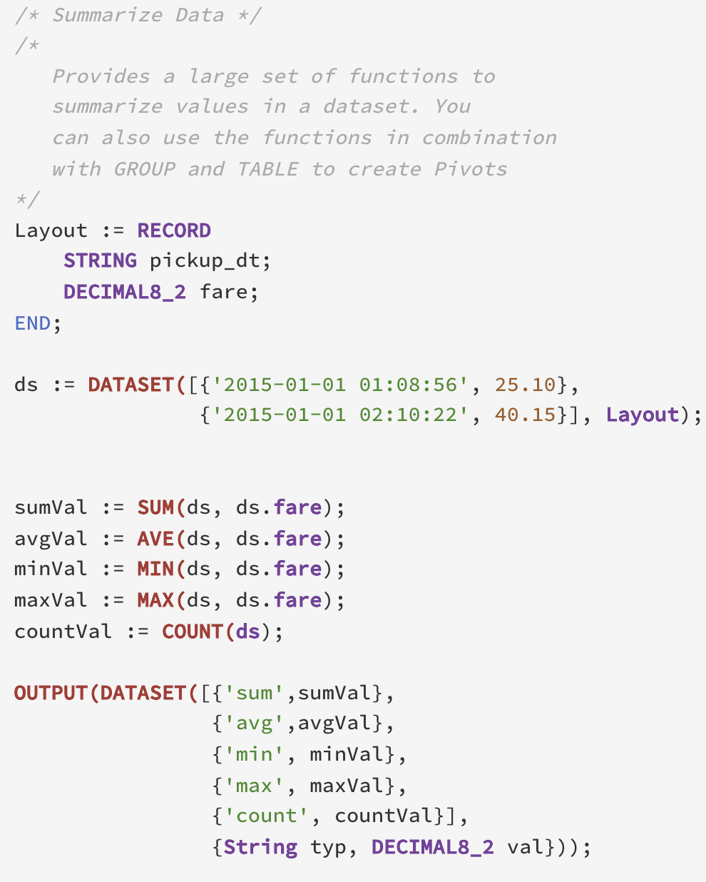
Summarize
2015-01-01 01:08:56 | 25.10
2015-01-01 02:10:22 | 40.15
typ | val
sum | 65.25
avg | 32.63
min | 25.1
max | 40.15
count | 2

