Slide 1

Benchmarking Message Brokers for IoT Edge
Computing: A Comprehensive Performance Study
The 26th IEEE International Symposium on Cluster, Cloud, and Internet Computing (CCGRID) (Journal Extension Plan)
Tapajit Chandra Paul
High Performance Cloud Computing Lab (HPCC)
School of Computing and Informatics
University of North Texas
Apr 06, 2026

Slide 2

Benchmarking Message Brokers for IoT-Edge
Computing: A Comprehensive Performance Study (Journal Extension Plan)
Tapajit Chandra Paul¹, Pawissanutt Lertpongrujikorn¹, Hai Duc Nguyen², and Mohsen Amini Salehi¹
¹High Performance Cloud Computing (HPCC) Lab, University of North Texas, USA
²Argonne National Laboratory and University of Chicago, USA
Notes:
-

Slide 3
Proposed Extension: Beyond 1-to-1 Steady Load
Goal
Extend the benchmark from isolated pairwise communication to shared-topic, various topology and dynamic workloads
Why this matters
Real IoT systems are rarely pure 1-to-1
Many applications use aggregation or broadcast
Steady-rate benchmarks miss behavior under traffic spikes
We want to study both topology effect and traffic dynamics
Four new experiments
Exp 1: Fan-out under steady load → replication efficiency
Exp 2: Fan-in under steady load → aggregation efficiency
Exp 3: Bursty fan-out (under dynamic traffic) → overload and recovery behavior
Exp 4: Bursty fan-in (under dynamic traffic)

Slide 4
Why extension? (hidden)
Why?
Current paper studies isolated 1-to-1 steady load
Extension studies shared-topic workloads
Extension also studies dynamic traffic

Slide 5
Experiment 1: Fan-Out Under Steady Load
Research question
How efficiently can each broker replicate shared-topic messages to many subscribers?
Topology
P publishers → broker → S subscribers
All publishers publish to the same topic
All subscribers subscribe to the same topic
Publisher scaling rule
P = max(1, ceil(S / 100))
use 1 publisher per 100 subscribers
Suggested subscriber scales
S = 500, 1000, … , 5000
then publishers become: 5, 10, 20, … , 50
Notes:
Feedback needed: Is 1:100 the right primary ratio, or should we also test 1:10 and 1:20?

Slide 6
Use cases of Fan-Out Topology
Industrial control-state dissemination
one supervisory controller distributes setpoints, schedules, or control parameters to many machines on the shop floor
Plant-wide configuration updates
one management service pushes configuration or policy changes to many gateways and devices
Operational dashboard distribution
one analytics service publishes processed plant status to many operator consoles and local applications

Slide 7
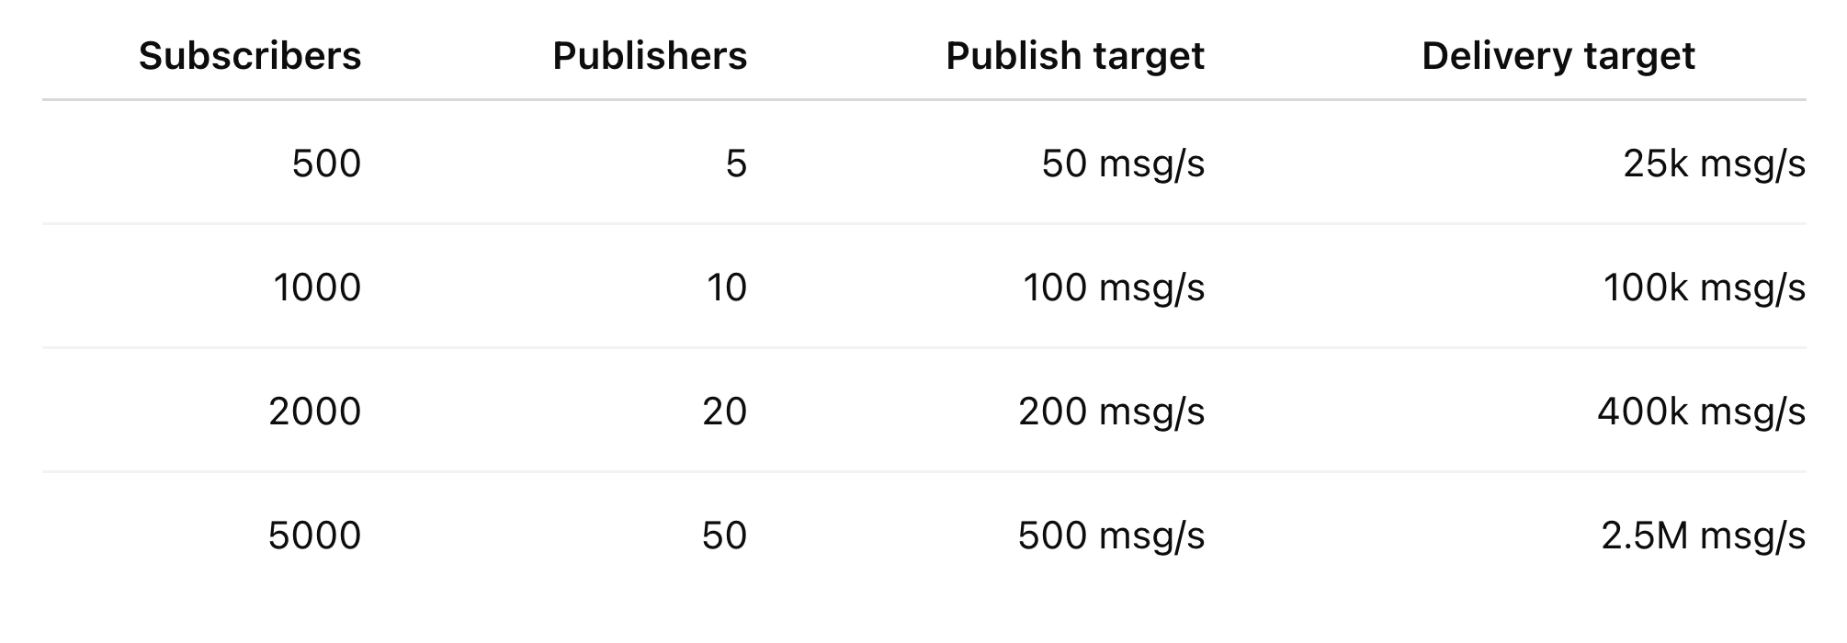
Experiment 1: Fan-Out Under Steady Load
Offered load
Publish throughput target = P × 10
Delivery throughput target = P × 10 × S
Metrics
Delivery Throughput
Latency
CPU Utilization
Memory footprint
Network overhead / bandwidth usage
Use Cases
Industrial controller sends setpoints to many machines
Management service pushes configuration to many gateways
Analytics service distributes plant status to dashboards

Slide 8
Fan-Out: What We Expect
Expect to see
Delivery overhead rises with subscriber count
CPU rises quickly
Latency rises at high fan-out
Multi-threaded brokers scale better
Single-threaded brokers saturate earlier
We learn
Which brokers are best for broadcast
Cost of message replication
Whether 1-to-1 strength also helps in fan-out

Slide 9
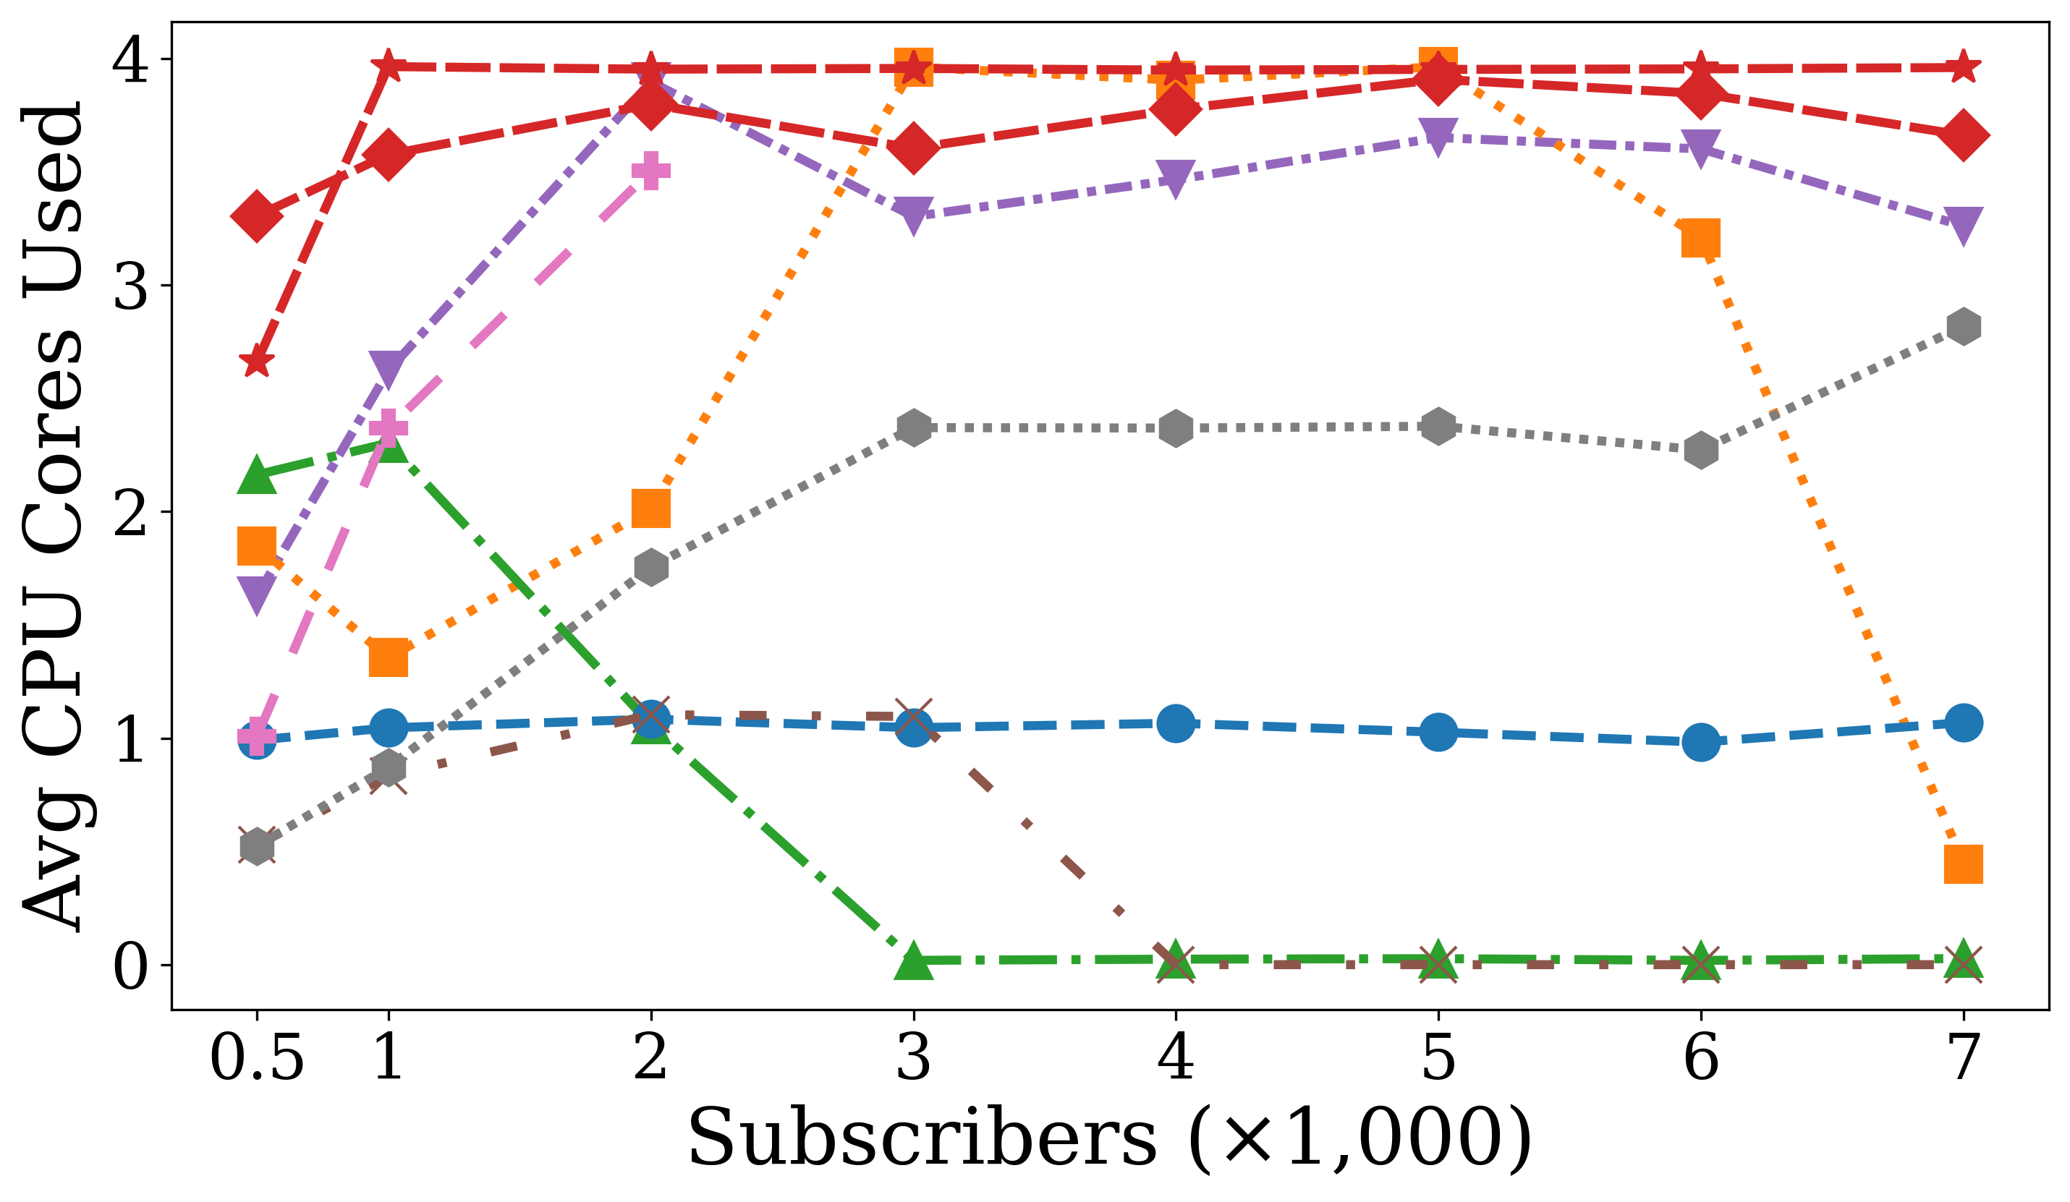
Initial Result (CPU) (4 vCPU, 8 GB RAM) (hidden)

Slide 10
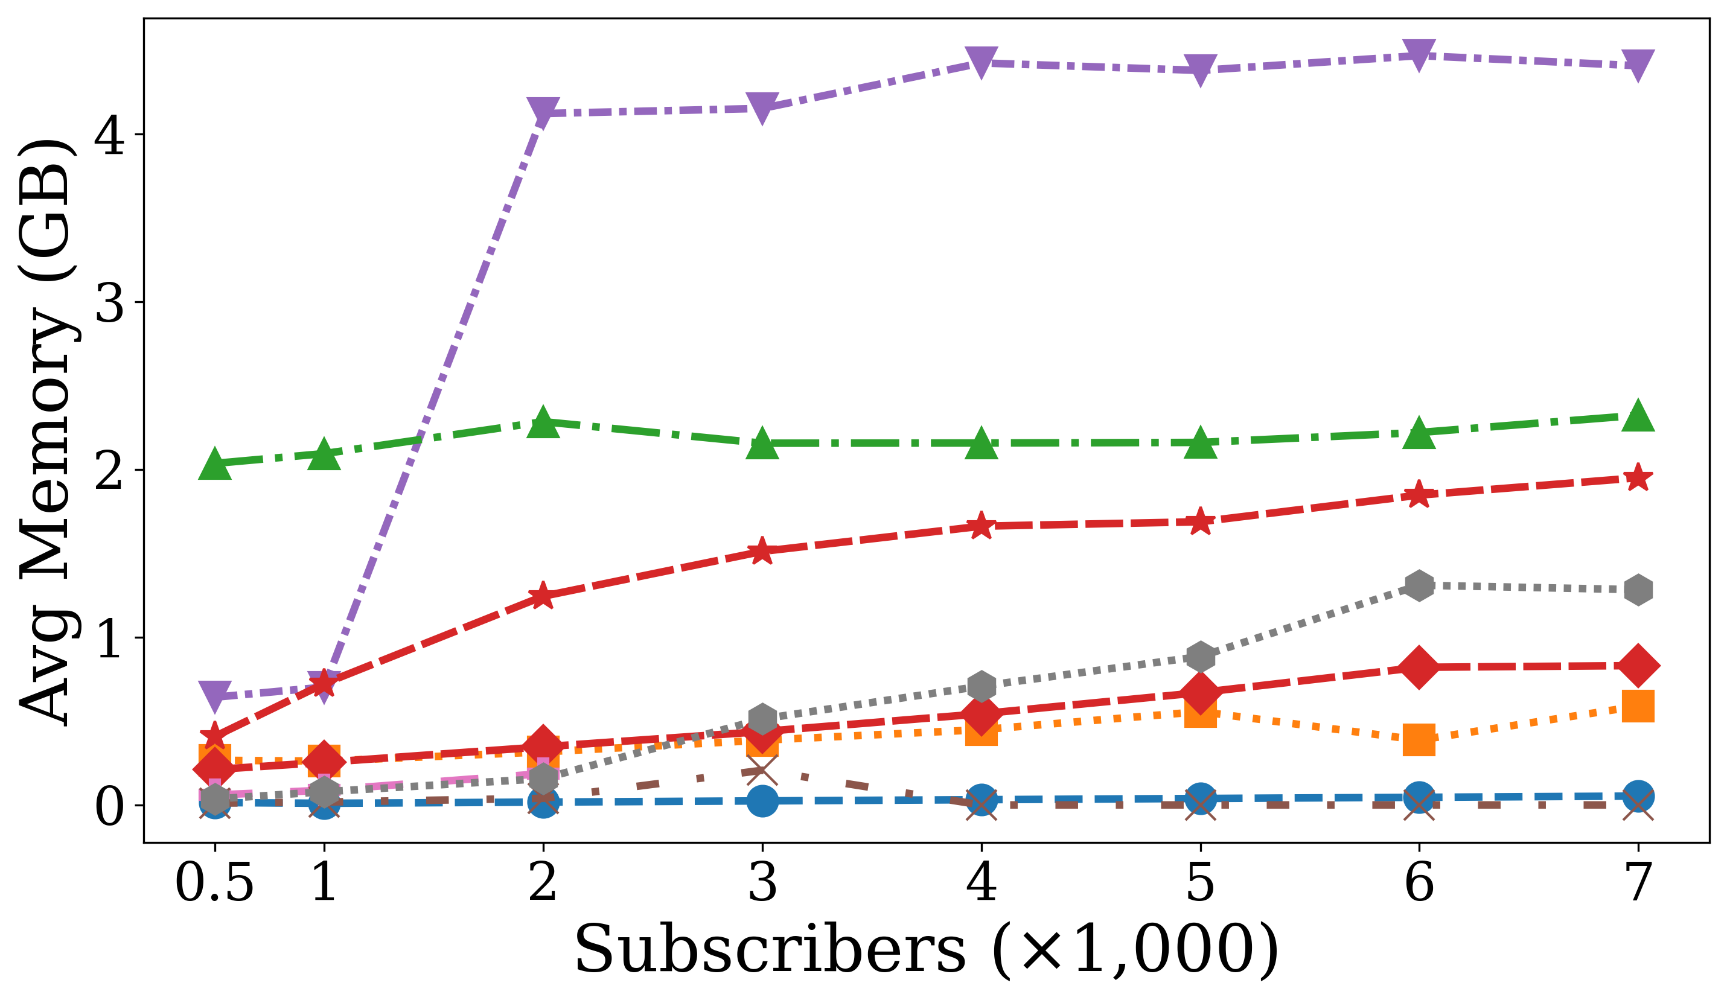
Initial Result (Memory) (4 vCPU, 8 GB RAM) (hidden)

Slide 11
Why Network Bandwidth for fan-out (hidden)
Fan-out replicates messages to many subscribers
Network cost naturally grows in Fan-out
This is where “bytes on wire” is most meaningful

Slide 12
Why 1 Publisher per 100 Subscribers? (hidden)
Why not only 1 publisher?
less realistic for practical deployments
may under-stress ingress
may overemphasize one client’s limits
Why 1:100 makes sense, because:
keeps the experiment primarily fan-out
introduces just enough ingress diversity
aligns nicely with the original study’s scale
easy to explain and reproduce

Slide 13
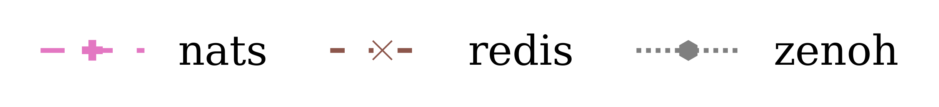
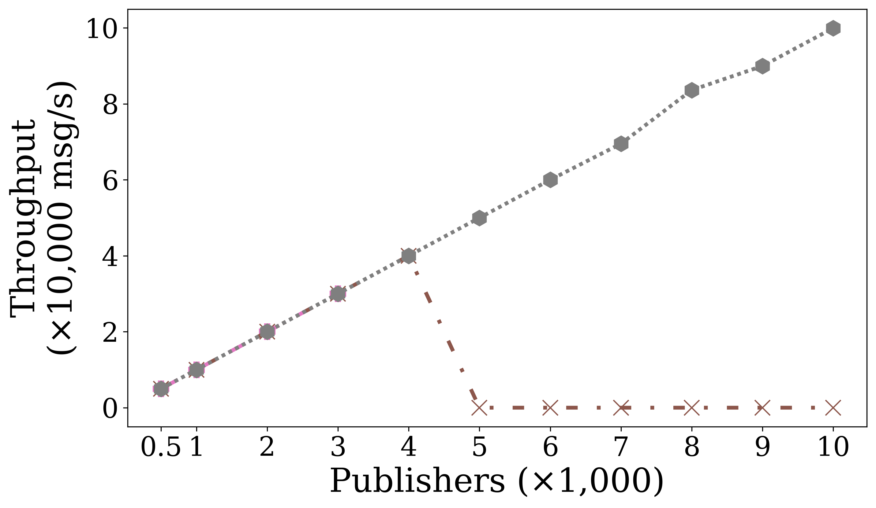
Fan-In Initial Results (hidden)

Slide 14
Experiment 2: Fan-In Under Steady Load
Research question
How does performance change when many publishers send to one shared topic instead of isolated 1-to-1 pairs?
Topology
N publishers → broker → 1 subscriber
All publishers publish to the same topic
Why this experiment
isolates the effect of shared-topic aggregation
keeps traffic steady
directly comparable to the current throughput experiment
Notes:
The problem is not correctness; the problem is that it mixes aggregation with replication, so the results become harder to explain. For the main paper, 1 subscriber gives the cleanest fan-in result. A few subscribers are better as a secondary sensitivity study.
Topology
N publishers → 1 subscriber
All publishers publish to the same topic

Slide 15
Use cases of Fan-In Topology
Sensor aggregation at an edge gateway
many IoT devices continuously send telemetry to one collector for monitoring and analytics
Fleet or robot status collection
many distributed agents report health, position, or state updates to a central controller
Industrial data ingest
multiple machines publish measurements to a shared stream for local processing

Slide 16
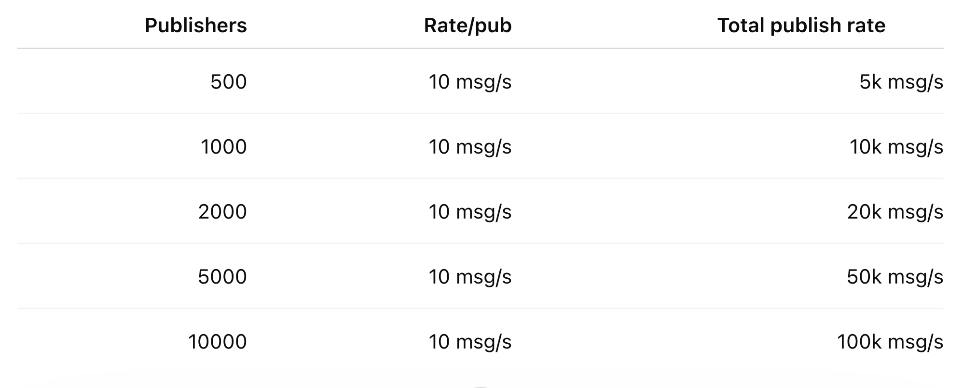
Experiment 2: Fan-In Under Steady Load
Parameters
Publishers: 500, 1000, 2000, 5000, 10000
Subscriber: 1
Rate per publisher: 10 msg/s
Payload: 1 KB
Duration: 120 s
Warmup: 60 s
QoS: 0
Metrics
Delivery Throughput
CPU Utilization
Memory footprint
Latency
Network Bandwidth
Use Cases
Sensor aggregation: Many devices send telemetry to one edge gateway.
Fleet status collection: Robots or distributed agents report state to one controller.
Industrial data ingest: Machines publish measurements to one local processing stream.

Slide 17
Fan-In: What We Expect
Expect to see
Fan-in is cheaper than fan-out
Throughput still drops vs 1-to-1
Shared-topic contention increases
CPU rises with publisher count
Latency rises gradually
We learn
Which brokers are best for aggregation
Cost of hot shared-topic ingest
Whether ingress or topic handling is the bottleneck

Slide 18
Experiment 3: Bursty Controlled Fan-Out
Research question
How do brokers behave when one-to-many dissemination is combined with bursty traffic and recovery periods?
Topology
20 publishers → broker → 2000 subscribers
Why this experiment
Exp 1 shows steady-state fan-out behavior
Exp 3 adds transient overload
this is closer to alarms, event bursts, and sudden telemetry spikes

Slide 19
Experiment 3: Bursty Controlled Fan-Out
Research question
How do brokers behave when one-to-many dissemination is combined with bursty traffic and recovery periods?
Topology
Same as Exp 1
P publishers → S subscribers
shared topic
P = max(1, ceil(S / 100))
S = 1000
Why this experiment
Exp 1 shows steady-state fan-out behavior
Exp 3 adds transient overload
this is closer to alarms, event bursts, and sudden telemetry spikes

Slide 20
Use cases of Bursty Fan-Out Topology
Emergency alert dissemination
one event suddenly triggers notifications to many receivers at once
Intrusion or alarm broadcast
a monitoring system pushes urgent alerts to multiple downstream systems simultaneously
Traffic / airspace advisory push
a sudden event causes one publisher to send time-sensitive updates to many consumers

Slide 21
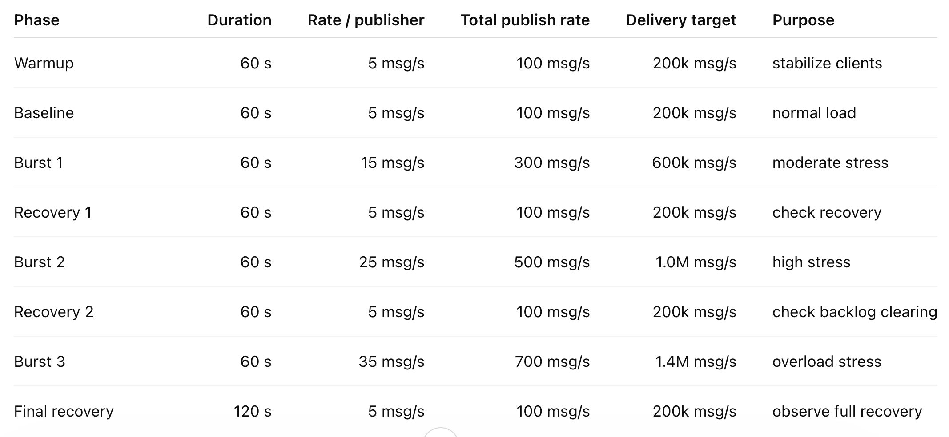
Experiment 3: Bursty Traffic Profile
Traffic phases
Warmup: 60 s @ 10 msg/s per publisher
Loll: 60 s @ 10 msg/s per publisher
Burst: 120 s @ 30 msg/s per publisher
Recovery: 60 s @ 10 msg/s per publisher
Metrices:
Delivery Throughput
CPU Utilization
Memory Usage
Latency
Network Bandwidth
Notes:
For experiment 3: Bursty Traffic Profile, we want to have multiple burst or multiple of each phases,
warmpu-> Loll -> Burst -> Recovery -> Burst -> Recovery -> Burst

Slide 22
Exp 4: Payload Sensitivity in Shared-Topic Workloads
Research question
How does message payload size affect broker performance in shared-topic communication patterns such as fan-in and fan-out?
Why this experiment?
Previous paper studied payload size only in small-scale latency tests
This experiment checks whether broker rankings change when payload size and shared-topic topology interact
Topologies
Fan-Out: 10 publishers → 1000 subscribers, shared topic
Fan-In: 1000 publishers → 1 subscriber, shared topic

Slide 23
Payload Sensitivity in Shared-Topic Workloads
Common parameters
Rate per publisher: 10 msg/s
Duration: 120 s
Warmup: 60 s
QoS: 0
Metrics: p95 Latency
Example Use Cases
Small telemetry Temperature, humidity, status flags.
Rich industrial messages Diagnostics, metadata, alarms, state snapshots.

Slide 24
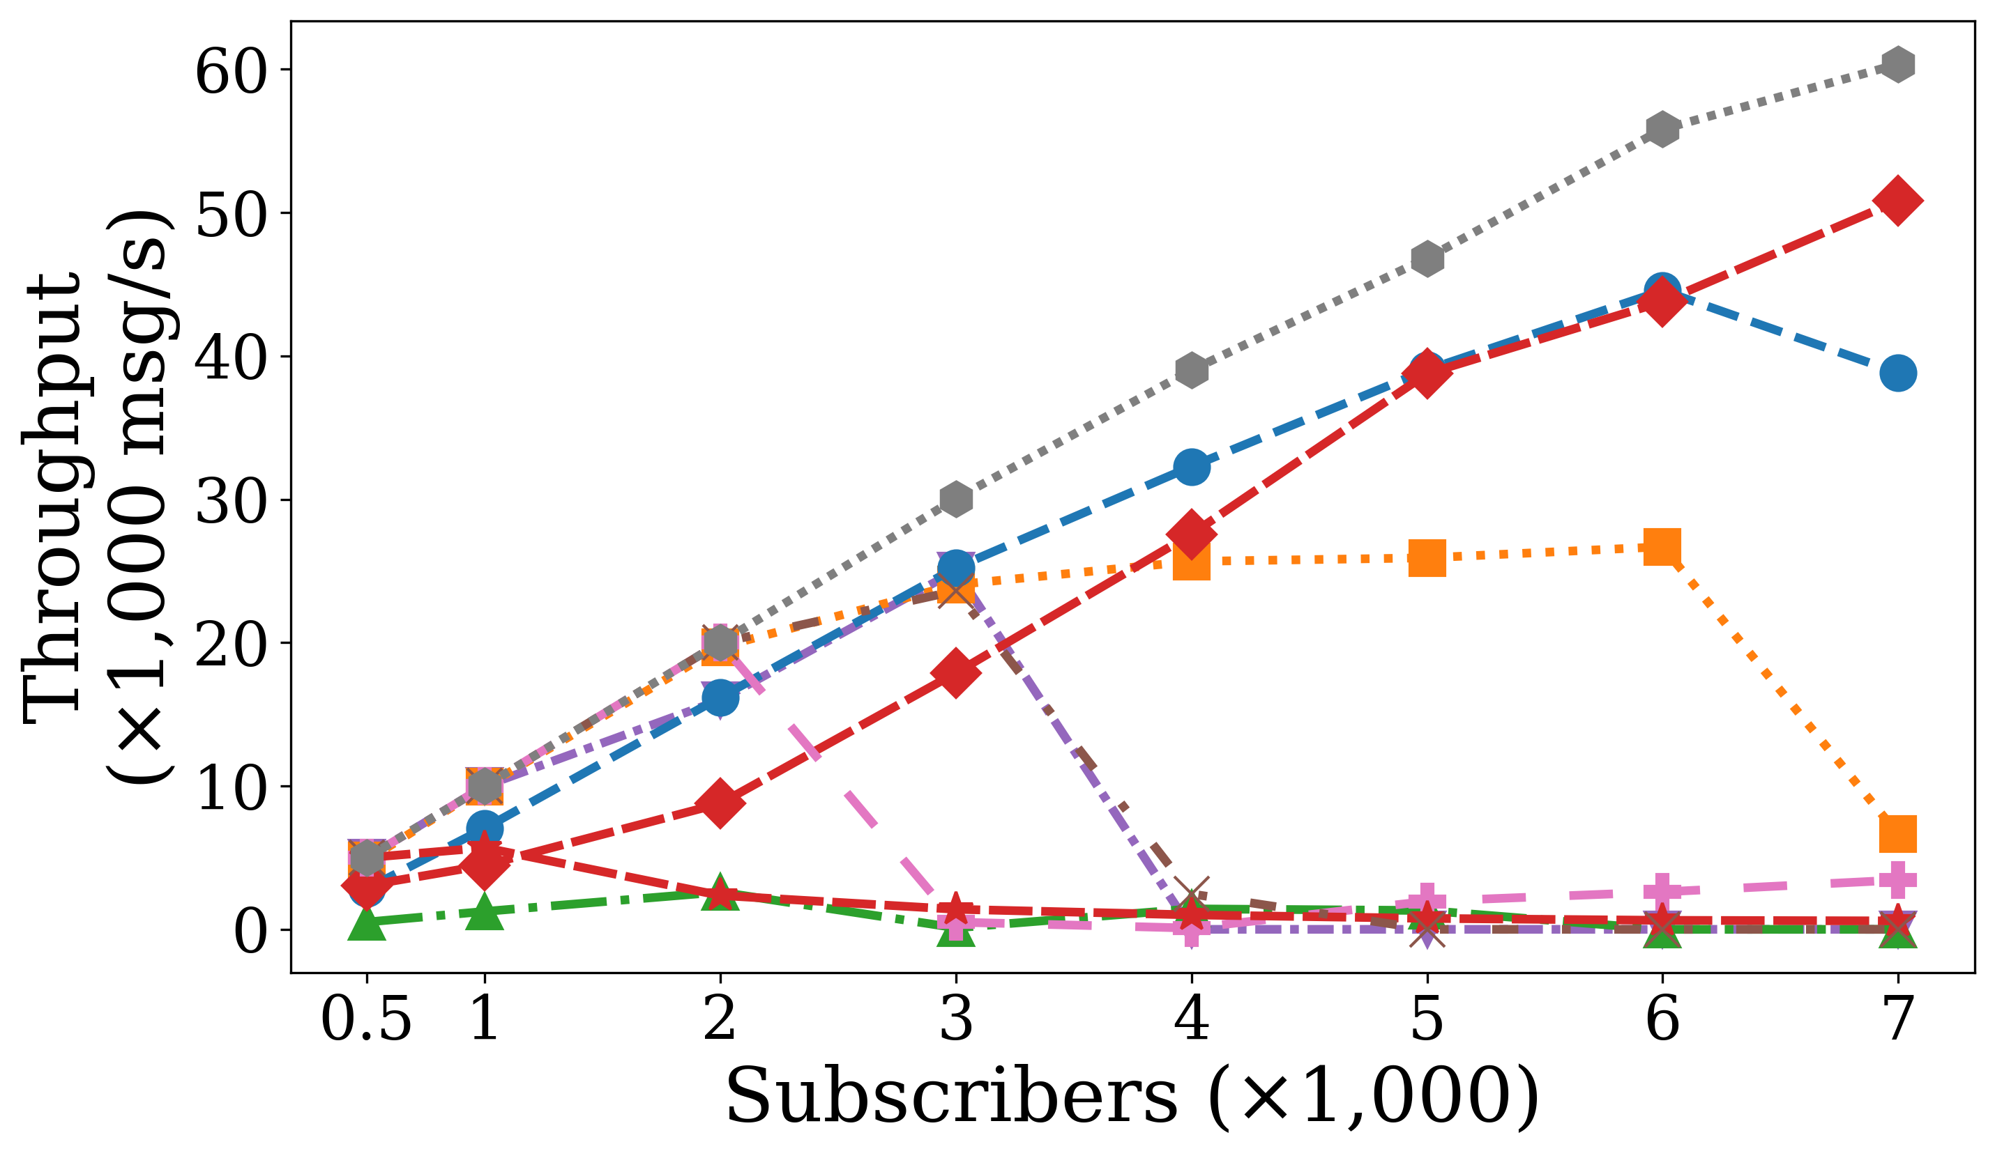
Fan Out Initial Result (Throughput) (4 vCPU, 8 GB RAM)
Notes:
Make length a little bigger
Instead of time, ignore messages (first 100)
Make Message based
First 10 message for every pub
Don’t stop the subscribers -> to make stop the message loss
Try various/different ratio: 1:10, 1:20
Why RabbitMQ is consuming
Connect the hypothesis to number/evidence

Slide 25
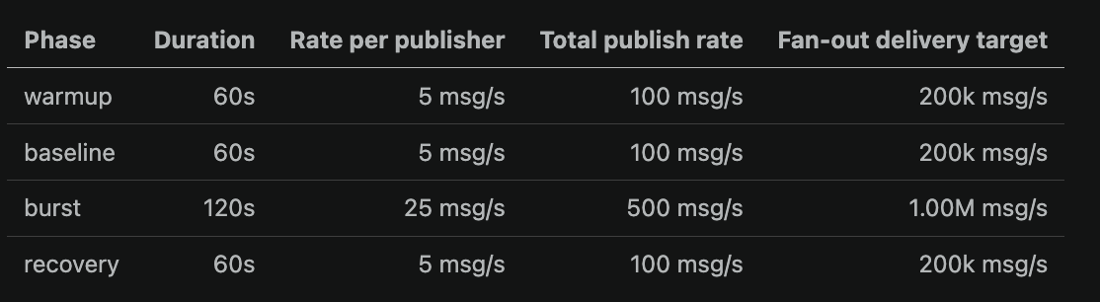
Bursty Fan Out Experimental Setup
4 vCPU, 8 GB RAM
Subscriber: 2000, Publisher: 20

Slide 26
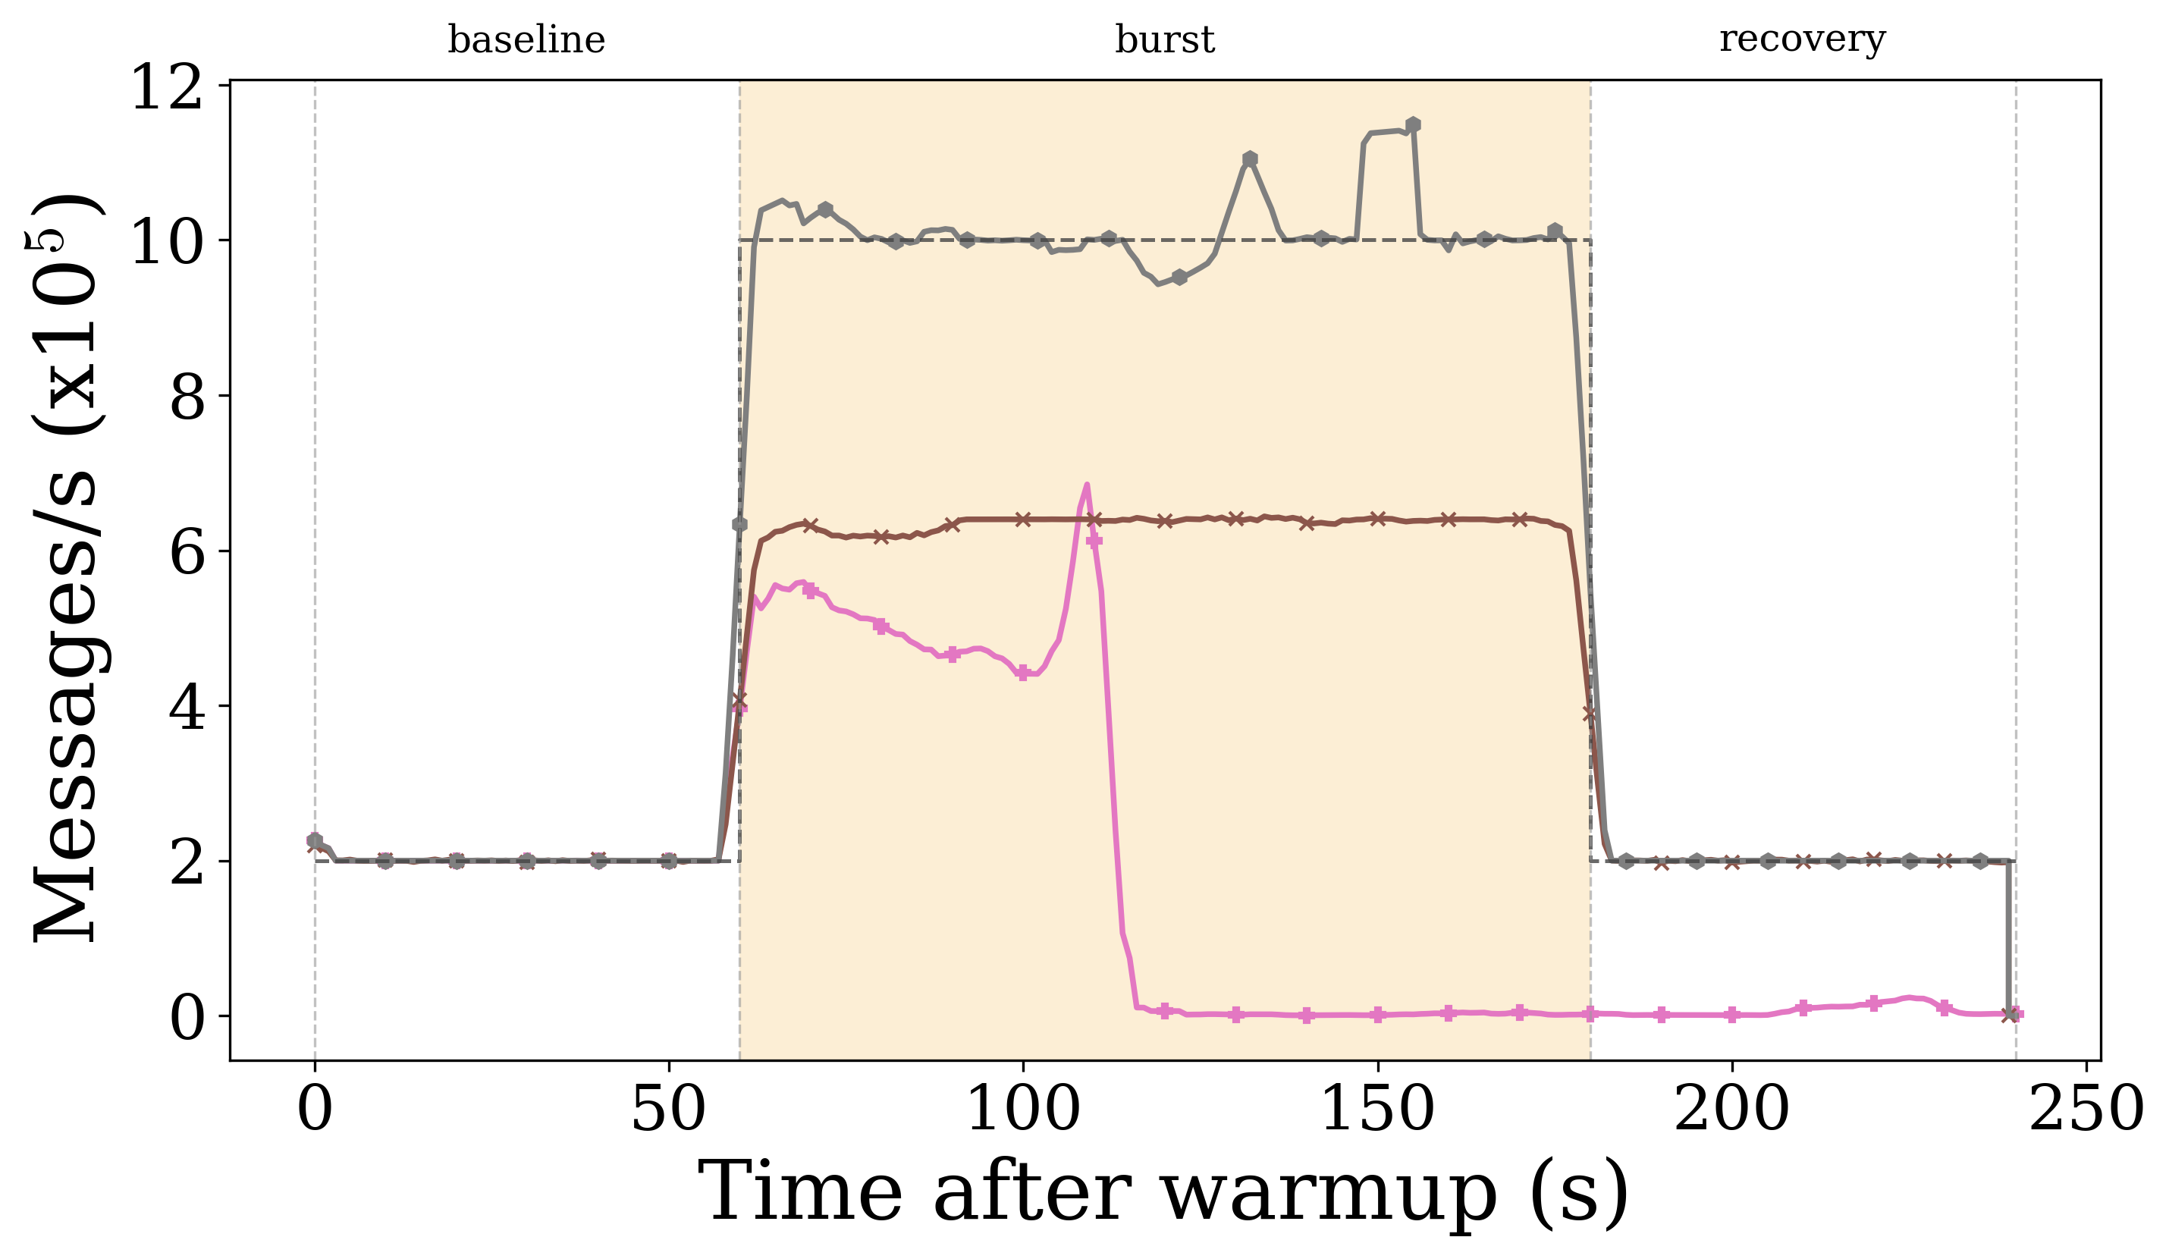
Delivery Throughput
Notes:
If we plot all the brokers in the same graph, is it going to be convulated?
--rate-profile "warmup:60:5,baseline:60:5,burst:120:25,recovery:60:5, ,burst:60:25"

Slide 27
Average Latency

Slide 28
CPU Usage

Slide 29
Network Bandwidth

Slide 30
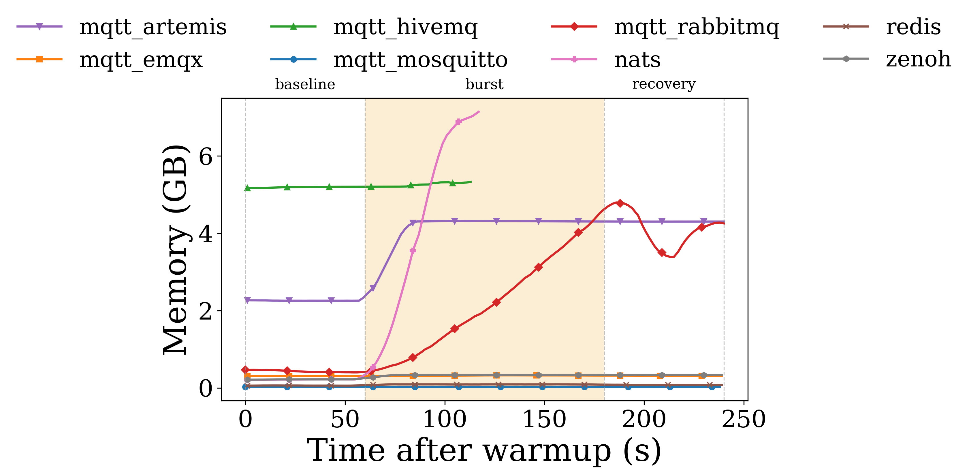
Memory Footprint
NATS and Artemis consume GiBs, suggesting queued work or pressure rather than clean burst handling.

Slide 31
Use cases of Payload Sensitivity Experiment
Small telemetry vs rich industrial messages
a simple temperature reading may be only a few bytes, while a machine-health update may include timestamps, metadata, alarms, and structured diagnostics
Control command vs state snapshot
a short command like “stop” or “set speed” is tiny, but a full equipment state or route update is much larger

Slide 32
Expected Hypotheses
H1: Fan-in
Shared-topic aggregation will reduce throughput relative to isolated 1-to-1
H2: Controlled fan-out
Fan-out will stress brokers more than fan-in because each message must be replicated
Multi-threaded brokers should handle replication better
H3: Bursty controlled fan-out
Tail latency will rise sharply during bursts
Some brokers may sustain throughput but recover slowly
Recovery time will become a key differentiator

