Slide 1

HPCC Systems
An introduction
Presented by
HPCC-Systems Solution Labs

Slide 2

HPCC
High Performance Computing Cluster
Open-source
Data-intensive supercomputing platform
Solve enterprise level big data problems
ECL
Enterprise Control Language
Uses HPCC platform
Scalable
Works with huge datasets

Slide 3
Dipping into a Data Lake
Data Cleansing and Organization (ETL)
Machine Learning
Advanced Analytics
A central (logical) repository of data
Unlimited storage
Schema on read
Low cost of storage and compute
File metadata tracking
High performance processing
HPCC Systems DATA LAKE
On-premises Data Movement
Real-time Data Movement
Batch Data
Notes:
HPCC Systems is data lake technology that allows you to store all your structured and unstructured data at any scale. You can store your data as-is, without having to first structure the data, and run different types of analytics—from dashboards and visualizations to big data processing, real-time analytics, and machine learning to guide better decisions. Data can be ingested in real-time via streams or API and batch.

Slide 4
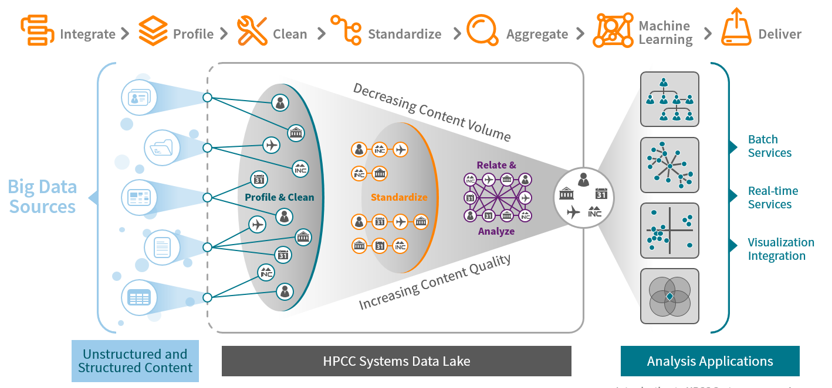
HPCC Systems (Small to Big Data) ETL
Notes:
At LexisNexis we use HPCC Systems to collect data from 1000s of sources like public records (property, court records) and private (Driver Motor Vehicle, telematics). We ingest the data, clean it, link it and then analyze it. The goal of the LN services is to identify risky individuals or businesses for insurance (driving and life), financial services (loans, credit cards etc.) and government (track fraudsters, criminals like sex offenders, drug traffickers and money launderers).
HPCC System is capable of handling and processing batch data (processing data in massive amount). Real time services refers to ability real time data and processing it that same time. Driving information is great example, data is sent in real time and gets processed immediately. Visualization Integration refers to the ability of adding graphs, tables and visualization to big data processing.

Slide 5
Anatomy of a Big Data Processing System
Big Data
Smaller Data
Compute
Divide
Notes:
Big Data processing in traditional computing like relational systems is hard. HPCC Systems data lake technology uses a divide and conquer approach to solving Big Data problems by dividing data into smaller chunks and running compute on these chunks in parallel. This means faster processing and hence results.

Slide 6

The Challenge
Use Case: Smart Hat
4,000 workers die and millions are injured annually while working on the industrial floor
$
Very high cost for maintaining safety in industrial businesses
Notes:
Workers in industries such as oil rigs and manufacturing factories are always at a risk of injuries from accidents. Over 4000 workers die on the industrial floor every year. The time to react to an accident is very slow and expensive.

Slide 7

The Solution + Result
Use Case: Smart Hat
Sensor-Equipped Wi-Fi Hardhats Pushing floor information to a monitoring station, which uses a prediction engine to forecast emergency situations
Factory readings and real-time alerts
Prediction Engine sends back emergency updates
Monitoring station updates
Produced an industrial wearable that uses IoT and wireless communications systems to protect and empower industrial workers
Notes:
With the help of IoT and HPCC Systems, Guardhat was able to create a solution that, one, enabled proactive actions to potentially avoid accidents and, two, react quickly if there was an accident. The solution involved creating protective smart hats that are equipped with IoT sensors to detect atmospheric parameters like pressure, CO levels, O2 levels etc. In addition to enabling video and audio detection of events.
HPCC Systems provides the platform that is used to collect the sensor data and process it for analysis. HPCC Systems AI algorithms are used to predict potential events (like fires) before they can occur.

Slide 8
Mobile Strategy Games
The mobile games industry is worth billions of dollars, with companies spending vast amounts of money on the development and marketing of these games to an equally large market. This dataset includes fields such as Name, Release Date, Description, avg rating, etc.
Spotify Playlists Dataset
This dataset is based on the subset of users in the #nowplaying dataset who publish their #nowplaying tweets via Spotify. In principle, the dataset holds users, their playlists and the tracks contained in these playlists.

Slide 9

Cloud IDE
Register for ECL Cloud IDE
https://ide.hpccsystems.com/auth/login​​​​​​​

Slide 10
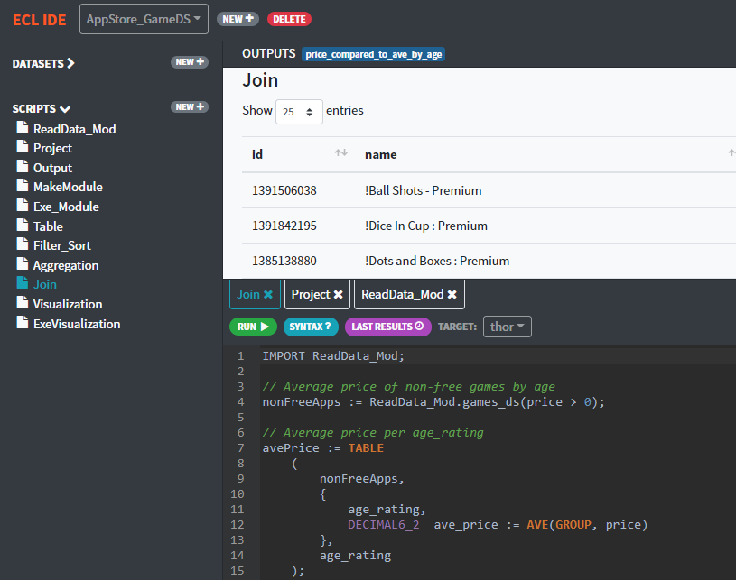

Cloud IDE
Please see following for how to register and tutorial
https://github.com/hpccsystems-solutions-lab/CodeDay_May2020/blob/master/CloudIDE-Setup.pdf

Slide 11
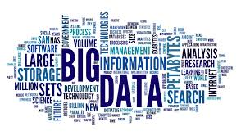
Big Data
Handling massive volume of both structured and unstructured.
Structured Data
Data that can be processed, stored, and retrieved in a fixed format.
Ex: dates, salary table
Unstructured Data
Data that lacks any specific form or structure whatsoever. This makes it very difficult and time-consuming to process and analyze unstructured data.
Ex: emails, videos.

Slide 12
ECL
Source
ECL is a language design to query/manipulate massive data and is used for ETL (Extract, Transform, Load) and data visualization.
Extract
Reading data from different type of datasets
Transform
Formatting/converting data to needed shape, so it can be used
Load
Writing dataset to it’s target location
Extract
Transfer
Load
Destination

Slide 13
ECL SYNTAX

Slide 14
House Keeping
Not case-sensitive
White space is ignored
Formatting is recommended
// This is a single line comment
/* A block comment */
Object.Property syntax is used to qualify definition scope and disambiguate field references within datasets:
ModuleName.Definition //reference a definition from another module/folder
Dataset.Field //reference a field in a dataset or record set

Slide 15
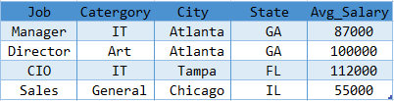
Record Structure
Defines the layout of fields in the dataset, order of the fields should be the same as the dataset.
File Dataset
A physical data file on disk. It can be defined directly, or can be brought in.

Slide 16
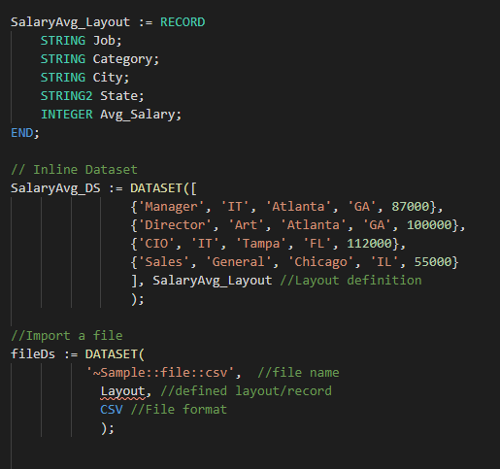
Datasets Record Structure

Slide 17
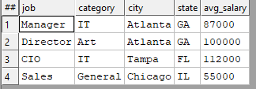
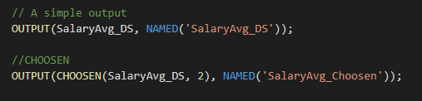

OUTPUT
Lets you display result.
CHOOSEN
Returns the first n number of records.

Slide 18
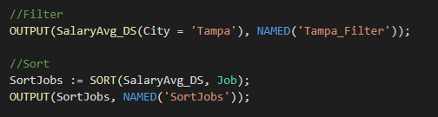

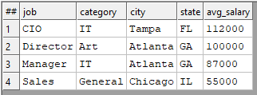
SORT
Ascending or descending sort
FILTER
Choosing a smaller part of dataset

Slide 19
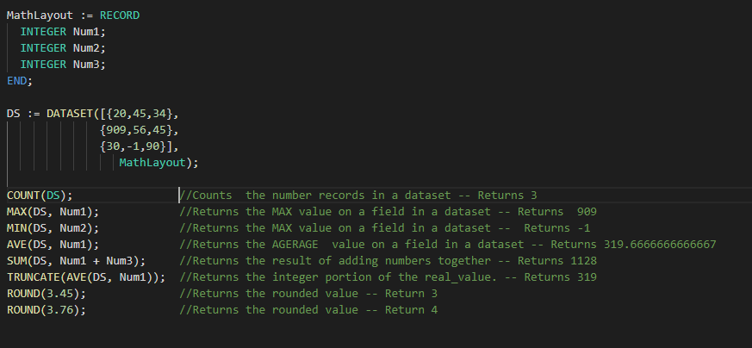

Math Functions

Slide 20
Correlation
When two sets of data are strongly linked together we say they have a High Correlation.
Correlation can have a value:
1 is a perfect positive correlation
0 is no correlation , no relationship between values
-1 is a perfect negative correlation

Slide 21
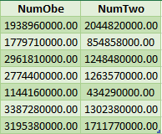
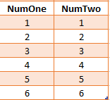


Correlation
Returns 1.0
Returns 0.4978702535543908

Slide 22
MODULE
Is a container that allows you to group related definitions. The parameters passed to the module are shared by all the related members definitions.
Variable Scope
Local definitions are visible only up to an EXPORT or SHARED
SHARED definitions are visible through module.
EXPORT definitions are visible within and outside of a module .

Slide 23
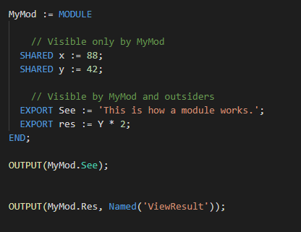



Slide 24
TRANSFORM
Specifies exactly how each field in the output record set is to receive its value.
It should include the result type.
Should contain name
Contains parameter list
SELF: refers to fields in result type.
PROJECT
Processes through all the records in the dataset performing TRANSFORM.
LEFT: refers to dataset getting passed to PROJECT.

Slide 25
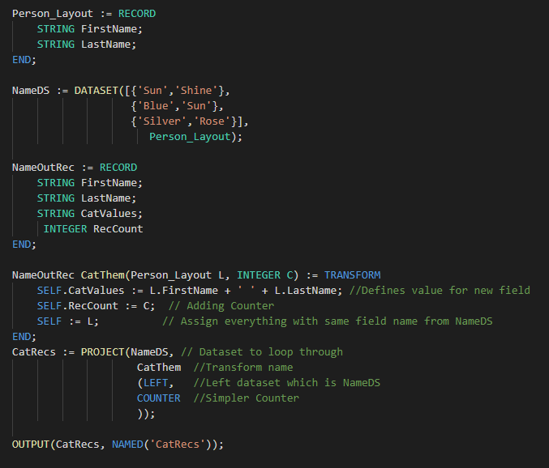


Standalone TRANSFORM
NameOutRec: Result Layout
CatThem: Transform Name
Person_Layout: Input Dataset Layout
L : Reference to Person_Layout fields
SELF: Refers to fields in result dataset
C: Will do the Counting

Slide 26
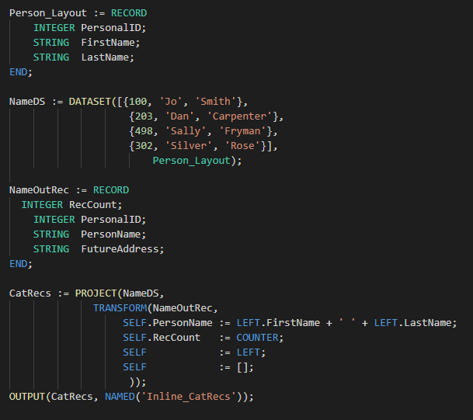
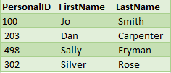
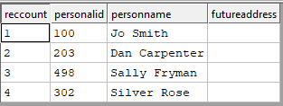
Inline TRANSFORM
CatRecs: Project Name
NameDS: Input Dataset to loop through
NameOutRec: Result layout
SELF: Refers to fields in result dataset
SELF := LEFT: Assign everything with same field name from NameDS
SELF := []: All un-assigned fields will be set to default values

Slide 27
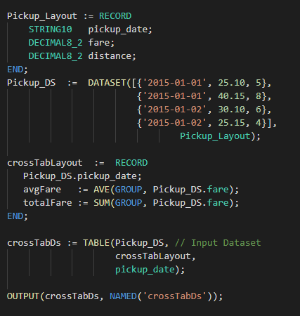
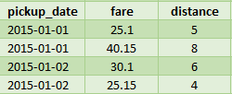

TABLE
Creates a temporary dataset in memory, GROUP option can be used.

Slide 28
JOIN
The JOIN function produces a result set based on the intersection of two or more datasets or indexes.
INNER: Only those records that exist in both datasets.
LEFT OUTER: At least one record for every record in the left.
RIGHT OUTER: At least one record for every record in the right.
LEFT ONLY: One record for each left record with no match in the left.
RIGHT ONLY: One record for each left record with no match in the right.
FULL ONLY: One record for each left and right record with no match in the opposite.

Slide 29
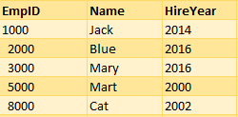
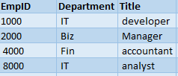
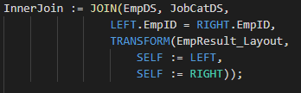
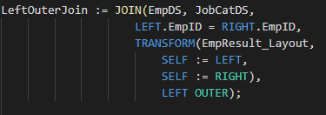
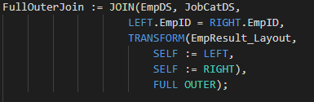
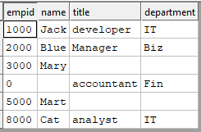


EmpDS
JobCatDS

Slide 30
VISUALIZATION
Methods include
Two-Dimensional
Multi-Dimensional Methods
Geospatial
General
A basic visualization typically requires the following steps:
1. Creation of a suitable dataset.
2. Output the dataset with a suitable name, so that visualization can locate the data.
3. Create (and output) the visualization, referencing the named output from step

Slide 31
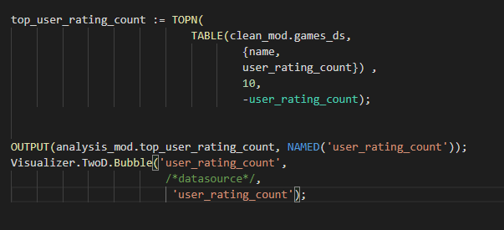
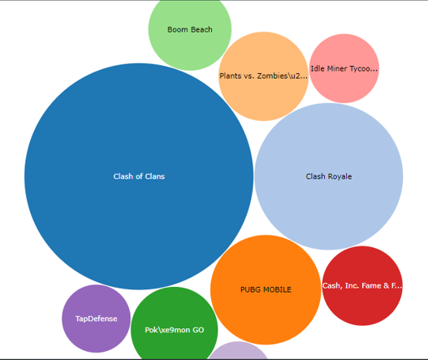

Slide 32
REFRENCES
Github CodeDay:
https://github.com/hpccsystems-solutions-lab/CodeDay_May2020
ECL cheat sheet
https://github.com/hpccsystems-solutions-lab/CodeDay_May2020/blob/master/ECL_Cheat_Sheet.pdf
Cloud IDE setup
https://github.com/hpccsystems-solutions-lab/CodeDay_May2020/blob/master/CloudIDE-Setup.pdf
ECL training containing six short videos
https://www.youtube.com/watch?time_continue=192&v=Lk78BCCtM-0
ECL document
http://cdn.hpccsystems.com/releases/CE-Candidate-7.0.24/docs/EN_US/ECLLanguageReference_EN_US-7.0.24-1.pdf
Visualization document
https://d2wulyp08c6njk.cloudfront.net/releases/CE-Candidate-7.6.2/docs/EN_US/VisualizingECL_EN_US-7.6.2-1.pdf

Slide 33


